Slide 1
Database Systems
Lecture 3 & 4: Modeling Data in the Organization
By
Rimsha Khan

Slide 2
Today’s Lecture: Agenda
Business Rules
ER Modeling

Slide 3
Business Rules
Statements that define or constrain some aspect of the business
Assert business structure
Control/influence business behavior
Expressed in terms familiar to end users
Automated through DBMS software

Slide 4
Scope of Business Rules
We see business rules in Information system context. What all fall inside and what all is outside the scope.

Slide 5
E-R Model Constructs
Entities:
Entity instance–person, place, object, event, concept (often corresponds to a row in a table)
Entity Type–collection of entities (often corresponds to a table)
Relationships:
Relationship instance–link between entity instances
Relationship type–category of relationship…link between entity type
Attribute–property or characteristic of an entity or relationship type (often corresponds to a field in a table)
Notes:
2

Slide 6
Entity……concepts….courses , students
Attributes….. Properties of entity. For example Course…course id, course name, course prerequisites.
Relationship….association…eg take, teaches.

Slide 7
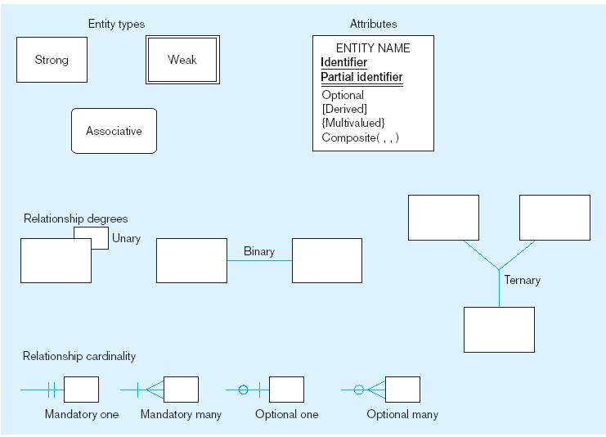
Basic E-R notation (Figure 3-2)
Entity symbols
Attribute symbols
A special entity that is also a relationship
Relationship symbols
Relationship degrees specify number of entity types involved
Relationship cardinalities specify how many of each entity type is allowed
Notes:
8

Slide 8
What Should an Entity Be?
SHOULD BE:
An object that will have many instances in the database
An object that will be composed of multiple attributes
An object that we are trying to model
SHOULD NOT BE:
A user of the database system
An output of the database system (e.g., a report)

Slide 9
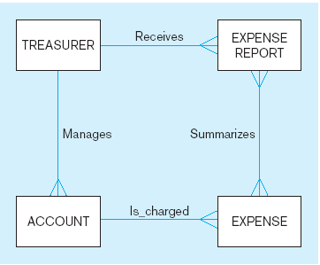
Figure 3-4 Example of inappropriate entities
System
user
System output
Inappropriate entities
Appropriate entities

Slide 10
Attributes
Attribute–property or characteristic of an entity or relationship type
Classifications of attributes:
Required versus Optional Attributes
Simple versus Composite Attribute
Single-Valued versus Multivalued Attribute
Stored versus Derived Attributes
Identifier Attributes
Notes:
5

Slide 11
Identifiers (Keys)
Identifier (Key)–An attribute (or combination of attributes) that uniquely identifies individual instances of an entity type
Simple versus Composite Identifier
Candidate Identifier–an attribute that could be a key…satisfies the requirements for being an identifier
Notes:
6

Slide 12
Characteristics of Identifiers
Will not change in value
Will not be null
No intelligent identifiers (e.g., containing locations or people that might change)
Substitute new, simple keys for long, composite keys
Notes:
7

Slide 13
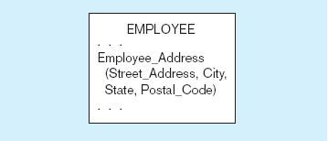
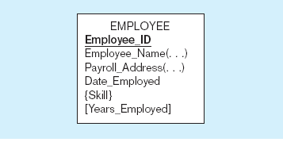
Figure 3-7 A composite attribute
An attribute broken into component parts
Figure 3-8 Entity with multivalued attribute (Skill)
and derived attribute (Years_Employed)
Multivalued
an employee can have
more than one skill
Derived
from date employed and current date
Notes:
12

Slide 14
Figure 3-9 Simple and composite identifier attributes
The identifier is boldfaced and underlined
Notes:
14

Slide 15
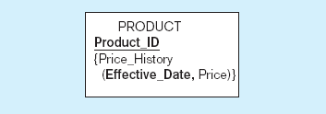
Figure 3-19 Simple example of time-stamping
This attribute that is both multivalued and composite
Notes:
37

Slide 16
More on Relationships
Relationship Types vs. Relationship Instances
The relationship type is modeled as lines between entity types…the instance is between specific entity instances
Relationships can have attributes
These describe features pertaining to the association between the entities in the relationship

Slide 17
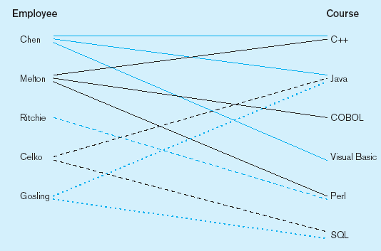
Figure 3-10 Relationship types and instances
a) Relationship type
b) Relationship instances
Notes:
17

Slide 18
Degree of Relationships
Degree of a relationship is the number of entity types that participate in it
Unary Relationship
Binary Relationship
Ternary Relationship
Notes:
16

Slide 19
Degree of relationships – from Figure 3-2
Entities of two different types related to each other
One entity related to another of the same entity type
Entities of three different types related to each other
Notes:
8

Slide 20
Cardinality of Relationships
One-to-One
Each entity in the relationship will have exactly one related entity
One-to-Many
An entity on one side of the relationship can have many related entities, but an entity on the other side will have a maximum of one related entity
Many-to-Many
Entities on both sides of the relationship can have many related entities on the other side

Slide 21
Cardinality Constraints
Cardinality Constraints - the number of instances of one entity that can or must be associated with each instance of another entity
Minimum Cardinality
If zero, then optional
If one or more, then mandatory
Maximum Cardinality
The maximum number
Notes:
29

Slide 22
Figure 3-12 Examples of relationships of different degrees
a) Unary relationships
Notes:
22

Slide 23
Figure 3-12 Examples of relationships of different degrees (cont.)
b) Binary relationships
Notes:
22

Slide 24
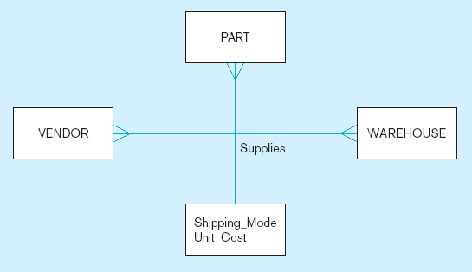
Figure 3-12 Examples of relationships of different degrees (cont.)
c) Ternary relationship
Note: a relationship can have attributes of its own
Notes:
22

Slide 25
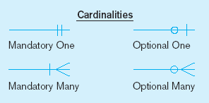
Figure 3-17 Examples of cardinality constraints
a) Mandatory cardinalities
A patient history is recorded for one and only one patient
A patient must have recorded at least one history, and can have many
Notes:
1

Slide 26
Figure 3-17 Examples of cardinality constraints (cont.)
b) One optional, one mandatory
A project must be assigned to at least one employee, and may be assigned to many
An employee can be assigned to any number of projects, or may not be assigned to any at all
Notes:
1

Slide 27
Figure 3-17 Examples of cardinality constraints (cont.)
a) Optional cardinalities
A person is is married to at most one other person, or may not be married at all
Notes:
1

Slide 28
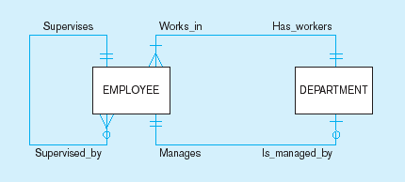
Figure 3-21 Examples of multiple relationships
a) Employees and departments
Entities can be related to one another in more than one way
Notes:
40

Slide 29
Strong vs. Weak Entities, and Identifying Relationships
Strong entities
exist independently of other types of entities
has its own unique identifier
identifier underlined with single-line
Weak entity
dependent on a strong entity (identifying owner)…cannot exist on its own
does not have a unique identifier (only a partial identifier)
Partial identifier underlined with double-line
Entity box has double line
Identifying relationship
links strong entities to weak entities

Slide 30
SUMMARY OF ER-DIAGRAM NOTATION FOR ER SCHEMAS
Symbol
Meaning
ENTITY TYPE
WEAK ENTITY TYPE
RELATIONSHIP TYPE
IDENTIFYING RELATIONSHIP TYPE
ATTRIBUTE
KEY ATTRIBUTE
MULTIVALUED ATTRIBUTE
COMPOSITE ATTRIBUTE
DERIVED ATTRIBUTE

Slide 31
Identifying relationship
Strong entity
Weak entity

Slide 32
Associative Entities
An entity–has attributes
A relationship–links entities together
When should a relationship with attributes instead be an associative entity?
All relationships for the associative entity should be many
The associative entity could have meaning independent of the other entities
The associative entity may participate in other relationships other than the entities of the associated relationship
Ternary relationships should be converted to associative entities

Slide 33
Figure 3-11a A binary relationship with an attribute
Here, the date completed attribute pertains specifically to the employee’s completion of a course…it is an attribute of the relationship
Notes:
20

Slide 34
Figure 3-11b An associative entity (CERTIFICATE)
Associative entity is like a relationship with an attribute, but it is also considered to be an entity in its own right.
Note that the many-to-many cardinality between entities in Figure 3-11a has been replaced by two one-to-many relationships with the associative entity.
Notes:
21

Slide 35
Creating an ERD from the Investigated Facts
Identify all the entities.
Identify all the relationships.
Identify cardinality and multiplicities (min max).

