Slide 1
Data Communication & Networks Chapter 2: Network Models

Slide 2
Topology
“The Topology is the geometric representation of the relationship of the links and the linking devices (Nodes) in a Network”
“Topology defines the physical or the Logical Agreement of Links in a Network”
Topology of a Network is suggestive of how a network is laid out.
Two or more devices connect to a Link and two or more Links form a Topology

Slide 3
Categories of topology

Slide 4
Mesh Topology

Slide 5
Mesh Topology
Every device has a dedicated link to every other device .
Dedicated means that the link carries traffic only between these two devices.
Example Mesh Topology
In figure above, we have 5 Nodes, therefore:
No. of Links= 5(5-1)/2 = 10

Slide 6
Advantages of Mesh Topology
Use of Dedicated links guarantees that each connection can carry its own load.
This eliminates Traffic Problems as in case of shared Link.
Mesh Topology is robust. If one link fails, it does not effect other links.
Security & Privacy due to dedicated links.
Point – to –Point links make Fault Identification easy.

Slide 7
Disadvantages of Mesh Topology
Large amount of Cabling:
Makes Installation & Reconfiguration difficult
Sheer bulk of wiring can be greater than the available space.
Large number of I/O Ports required
Hardware required to connect each link can be prohibitively expensive.

Slide 8
Star topology

Slide 9
Star topology
Each device has a dedicated point-to-point link to a central controller ( Hub).
Devices are not directly connected to each other.
Controller (Hub) acts as an exchange.
If one device wants to send data to the other, it sends the data to the controller , which then relays it to the other connected device

Slide 10
Advantages of star topology
Less cabling required.
Less expensive than Mesh as each device needs only one link and one I/O Port.
Easy to Install and reconfigure.
Robust, if a link fails , only that link fails.
Easy Fault Detection.

Slide 11
Tree topology

Slide 12
Tree topology
Nodes in a Tree are linked to a central hub that controls the traffic to and from network.
Difference b/w star and tree is not all the devices plug directly into the central HUB.
Majority connects to secondary hub that is connected to central hub.
Central Hub in a Tree is an ACTIVE HUB

Slide 13
Tree topology
ACTIVE HUB contains a repeater, that regenerates the received bit pattern before sending them out.
Repeater strengthens the signal and increases the distance a signal can travel.
Secondary Hub in a Tree may be Active or Passive HUB .
Passive Hub simply provides physical connection between attached devices.

Slide 14
Advantages of tree topology
Because of Secondary Hub, More devices can be attached to a Central Hub and therefore increase the distance a signal can travel.
Allows to prioritize communication, e.g. computers attached to one secondary hub can be given priority over others.
Therefore, TIME SENSITIVE data will not have to wait for access to the network
Example Tree Topology: Cable TV
–Main cable from main office is divided into many branches and each branch is divided into smaller branches and so on
–Hubs are used when cable is divided

Slide 15
Bus Topology

Slide 16
Bus Topology
Drop Lines and Taps
Drop Line is the connection between device and the main cable (Backbone)
Tap is a connector that; Splices into the main cable.
Signal degrades as it travels, therefore there is a limit on:
The number of Taps a Bus can support and
The distance between those Taps

Slide 17
Advantages of bus topology
Easy to install.
Backbone can be laid on the most efficient path and then rest of the nodes can be connected using Drop Lines.
Less cabling than Mesh , Star or Tree.

Slide 18
Ring topology

Slide 19
Ring topology
Each device has point-to-point dedicated link with only two devices on either side.
A signal is passed in the ring in one direction from device to device until it reaches its destination.
Each device has a repeater incorporated.
When a device receives a signal destined for another device, it regenerates the bits and pass them along.

Slide 20
Advantages of ring topology
Easy to Install and Reconfigure.
Only two connections to be moved to add or delete a device.
SIMPLE Fault Isolation.
Generally a signal is circulating at all times in a ring.
If one device does not receive a signal within a specified period, it can issue an alarm to tell network operator about the problem and its location

Slide 21
Hybrid topology

Slide 22
Protocol Architecture

Slide 23
Importance of Rules
To destroy communication completely, there must be no rules in common between transmitter and receiver—neither of alphabet nor of syntax —On Human Communication, Colin Cherry

Slide 24
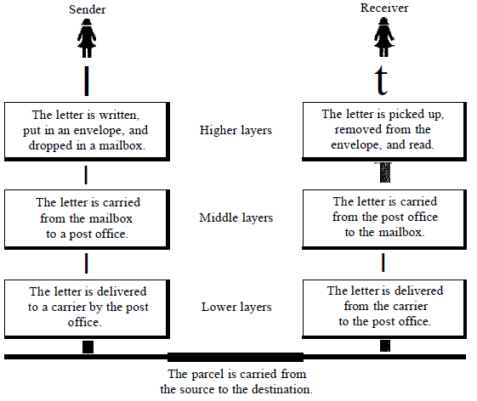
Need for Protocols

Slide 25
Need for Protocols
The procedures involved in a communication can be quite complex.
There must be a data path between the two computers, but also need:
Source to activate communications path or inform network of destination.
Source must check destination is prepared to receive.
File transfer application on source must check destination file management system will accept and store file for his user.
May need file format translation.

Slide 26
Need for Protocols
This complex logic is broken up into subtasks instead of implementing as a single task.
In a protocol architecture, the modules are arranged in a vertical stack of layers.
Each layer in the stack performs a related subset of the functions.
The peer layers communicate using a set of rules or conventions known as a protocol.

Slide 27
Key elements of a protocol
Communication is achieved by having the corresponding, or peer layers in two systems communicate.
The peer layers communicate by means of formatted blocks of data that obey a set of rules known as a protocol.
The key features of a protocol are:
• Syntax: Concerns the format of the data blocks.
• Semantics: Includes control information for coordination and error handling.
• Timing: Includes speed matching and sequencing.

Slide 28
The OSI Model
Open Systems Interconnection (OSI).
Developed by the International Organization for Standardization (ISO).
Model for understanding and developing computer-to-computer communication architecture that is flexible, robust and interoperable.
It is not a protocol.
Developed in the 1980s.
Divides network architecture into seven layers.

Slide 29
OSI cont.
Each layer performs a subset of the required communication functions
Each layer relies on the next lower layer to perform more primitive functions
Each layer provides services to the next higher layer
Changes in one layer should not require changes in other layers
Layer 1,2,3 are the network support layer, deals with the physical aspects of moving data from one device to another.
Layer 5,6,7 are the user support layer, allow the interoperability among unrelated software.
Layer 4 ensures that what the lower layer have transmitted is in a form that the upper layers can use.

Slide 30
OSI layer
Application layer
Presentation layer
Session layer
Transport layer
Network layer
Data Link layer
Physical layer

Slide 31
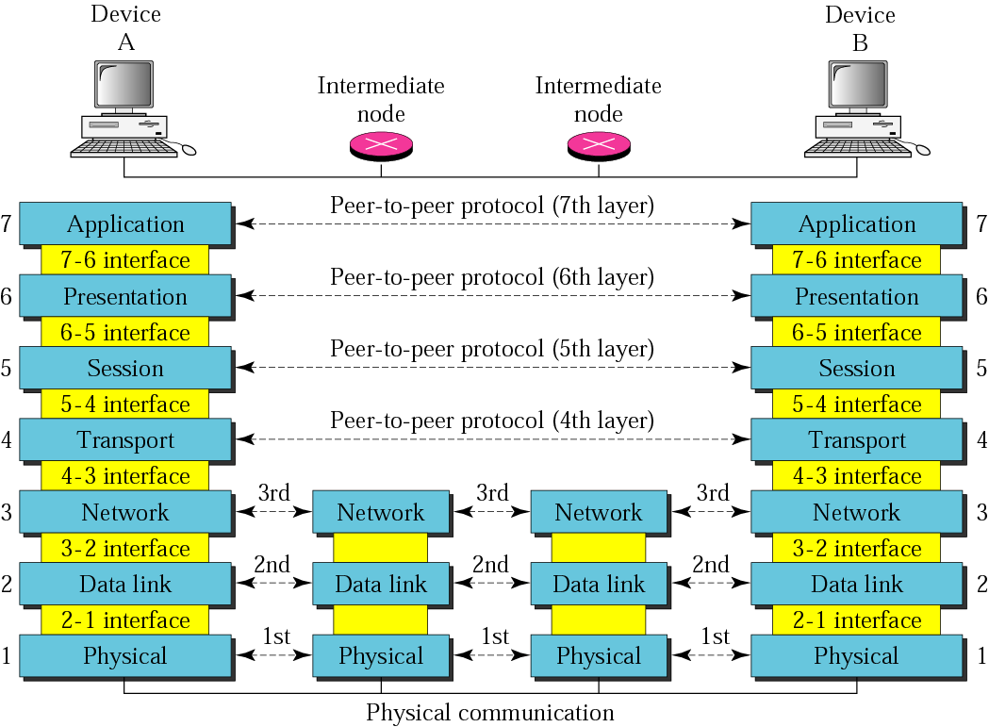
OSI layer

Slide 32
Protocol Data Units (PDU)
At each layer, protocols are used to communicate.
Control information is added to user data at each layer.
For example, the transport layer may fragment user data.
Each fragment has a transport header added
Destination Address
Sequence number
Error detection code
This creates a transport protocol data unit (TPDU).

Slide 33
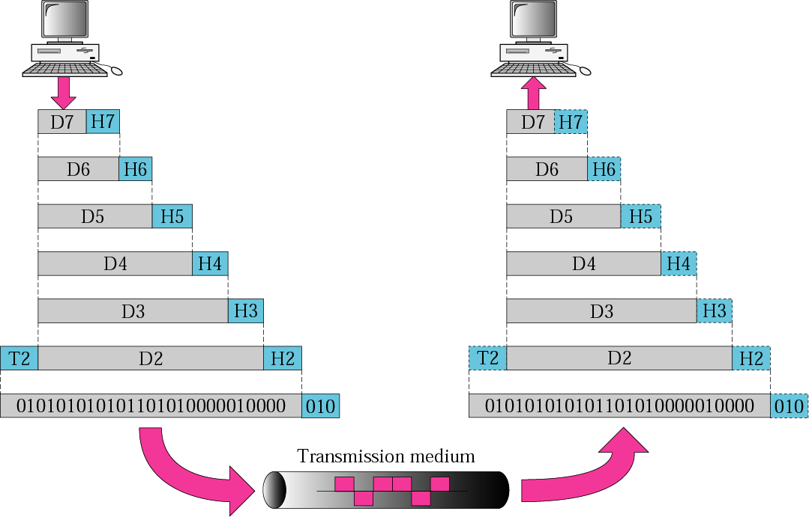
An exchange using the OSI model

Slide 34
Layer 1,2,3
Application
Application
Presentation
Presentation
Session
Session
Transport
Transport
Network
Layer-3
Device
Layer-3
Device
Network
Data Link
Data Link
Physical
Physical
Layer 2 and 3 addressing schemes needed and
layer 1 addressing scheme is not needed

Slide 35
Layer 1: Physical Layer
Responsible of:
Transmitting individual bits from one to the next.
Physical characteristics of interface and media.
Representation of bits: a stream of bit(0s,1s),
Data rate.
Synchronization of bits
Line configuration
Physical topology
Transmission mode

Slide 36
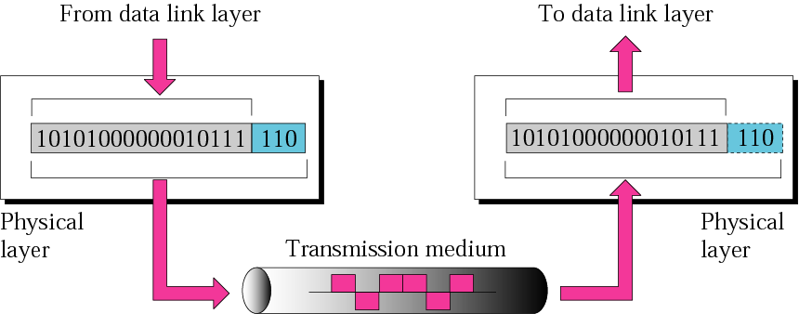
Physical Layer cont.

Slide 37
Layer 2: Data Link layer
Responsible of:
Moving frames from one hop (node) to the next.
Framing: Dividing the stream of bits received from the network layer into manageable data units called frames.
Physical address (MAC address).
Flow control.
Error control: added trailer to the end of frame.
Access control.
Hop to hop delivery

Slide 38
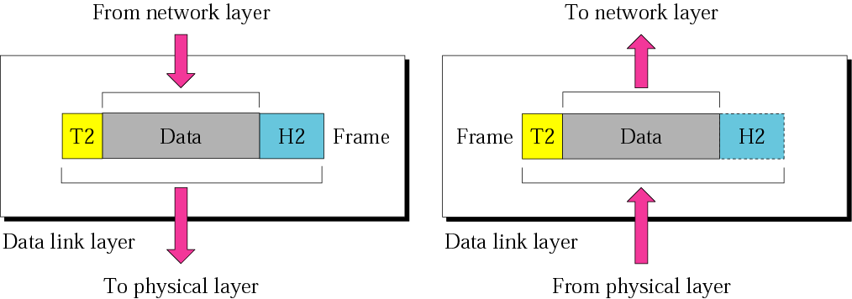
Data Link layer cont.
10110110101
01100010011
10110000001

Slide 39
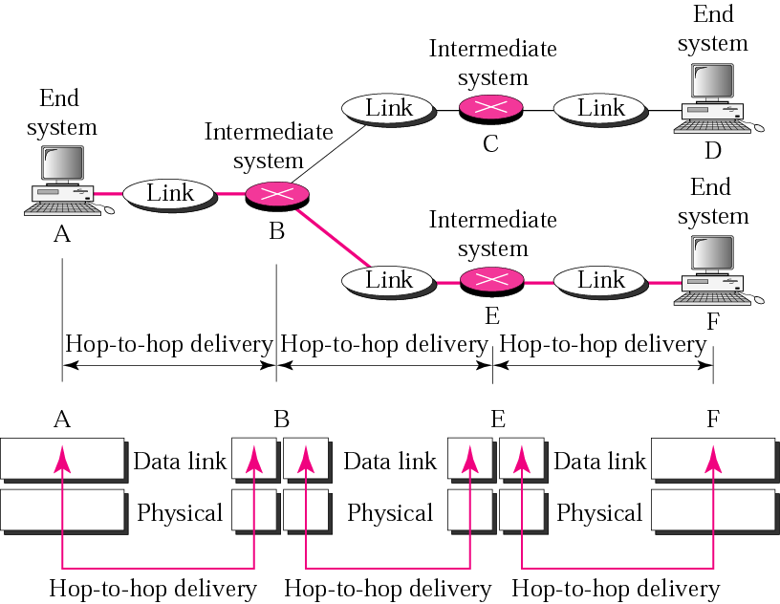
Hop-to-Hop delivery

Slide 40
Layer 3: Network Layer
The network layer is responsible for:
The delivery of individual packets from the original source to the final destination .
Logical addressing: if the packet passes the network boundary we need another addressing system to help (source to destination) connection.
Routing : route or switch the packet to final destination.
Source-to-destination delivery (End-to-End).

Slide 41
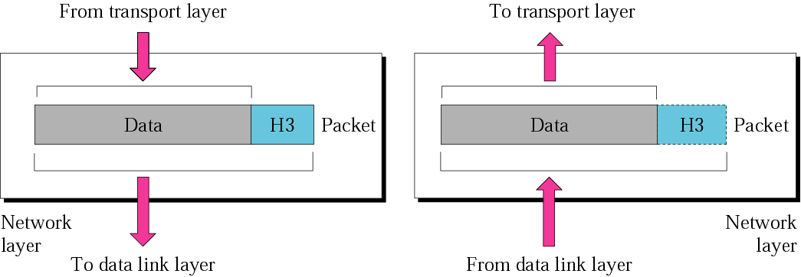
Network Layer cont.

Slide 42
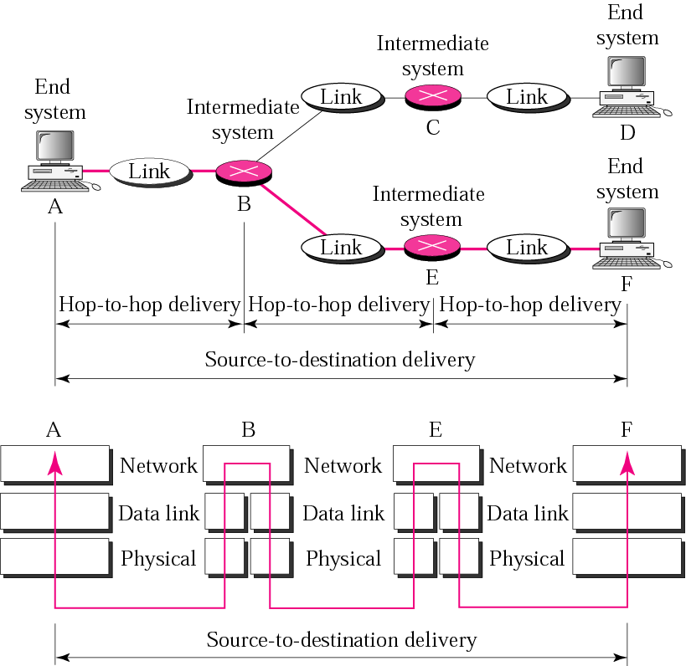
Source-to-Destination delivery

Slide 43
Layer 4: Transport Layer
The transport layer is responsible for:
Service point or Port addressing
Segmentation and reassembly : a message is divided into transmittable segments each segment containing a sequence no.
Connection Control: connection oriented or connectionless.
Flow control
Error control

Slide 44
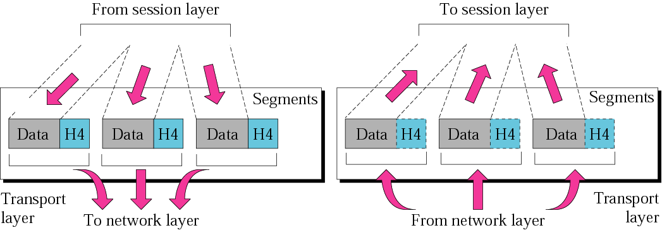
Transport Layer cont.

Slide 45
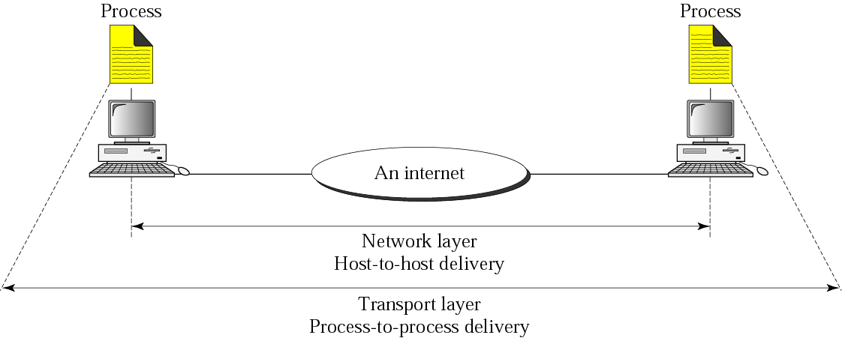
Reliable process-to-process delivery of a message

Slide 46
Layer 5: Session Layer
Dialog control: design to establish, maintain, and synchronize the interaction between communicating systems.
Synchronization: it allows a process to add checkpoints or synchronization points to a data stream.

Slide 47
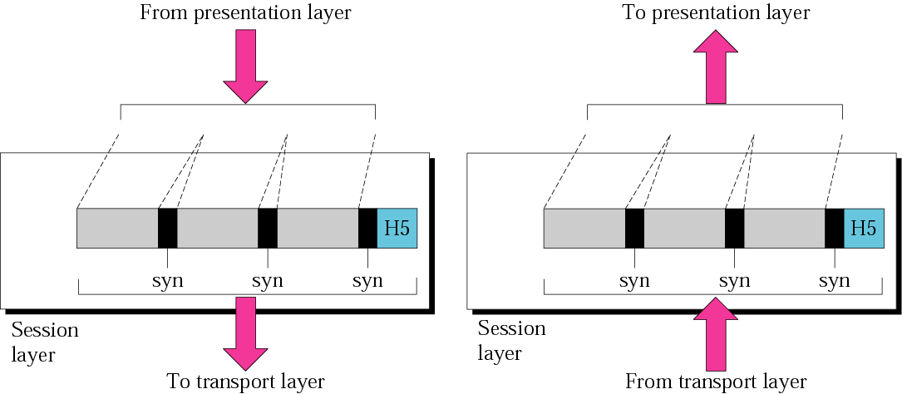
Session Layer cont.

Slide 48
Layer 6 :Presentation Layer
Design to the handle the syntax and semantic of the information exchanged between 2 systems.
And design for data translation, encryption, decryption, and compression.

Slide 49
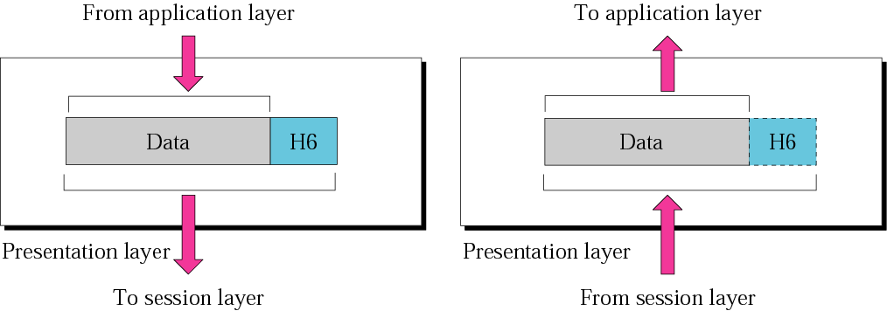
Presentation Layer cont.

Slide 50
Layer 7: Application Layer
The application layer is responsible for providing services to the user.
Mail services
File transfer, access and management
Remote log-in or network virtual terminal
Accessing the World Wide Web
Directory service

Slide 51
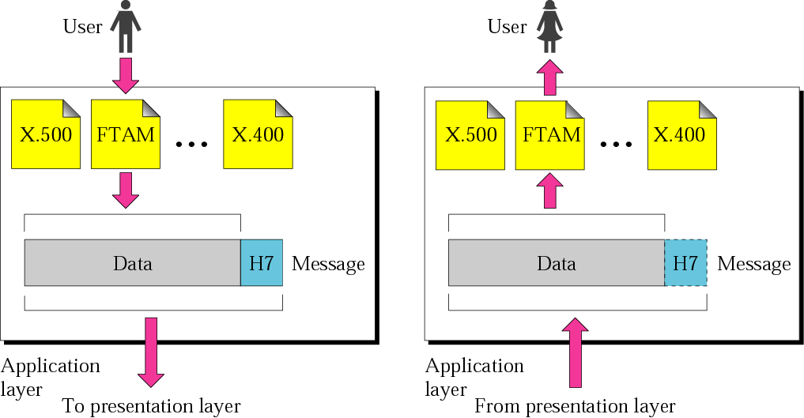
Application Layer cont.
SMTP
Telnet
HTTP
SMTP
Telnet
HTTP

Slide 52
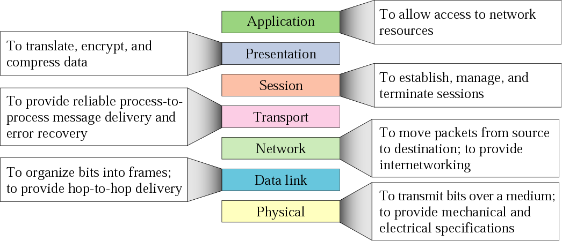
Summary

Slide 53
Application
Presentation
Session
Transport
Network
Data link
Physical
Application
Presentation
Session
Transport
Network
Data link
Physical
data stream
data stream
data stream
data stream
data stream
data stream
data
data
Segments
data
Segments
data
data
data
data
data
Network header
Network header
data
data
packets
packets
From trailer
From trailer
Frames
Frame H
Frames
Frame H
Network H
Network H
data
data
1110111 0111 011111101
1110111 0111 011111101
Bits
Bits

Slide 54
TCP/IP Protocol Suite
The TCP/IP protocol suite is a hierarchical protocol , made of five layers:
Physical layer
Data link layer
Network layer
Transport layer
Application layer.

Slide 55
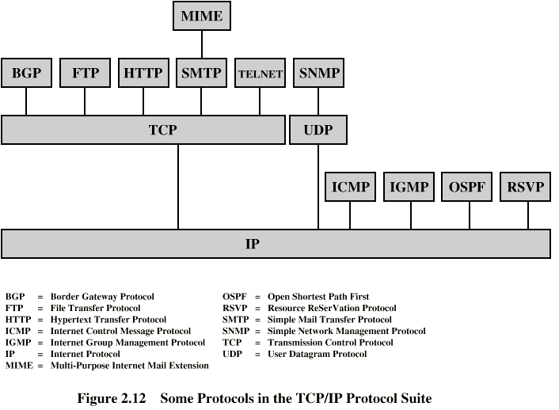
Some Protocols in TCP/IP Suite

Slide 56
TCP/IP PROTOCOL SUITE
The layers in the TCP/IP protocol suite do not exactly match those in the OSI model.
The original TCP/IP protocol suite was defined as having four layers: host-to-network, internet, transport, and application.
However, when TCP/IP is compared to OSI, we can say that the TCP/IP protocol suite is made of five layers: physical, data link, network, transport, and application.

Slide 57
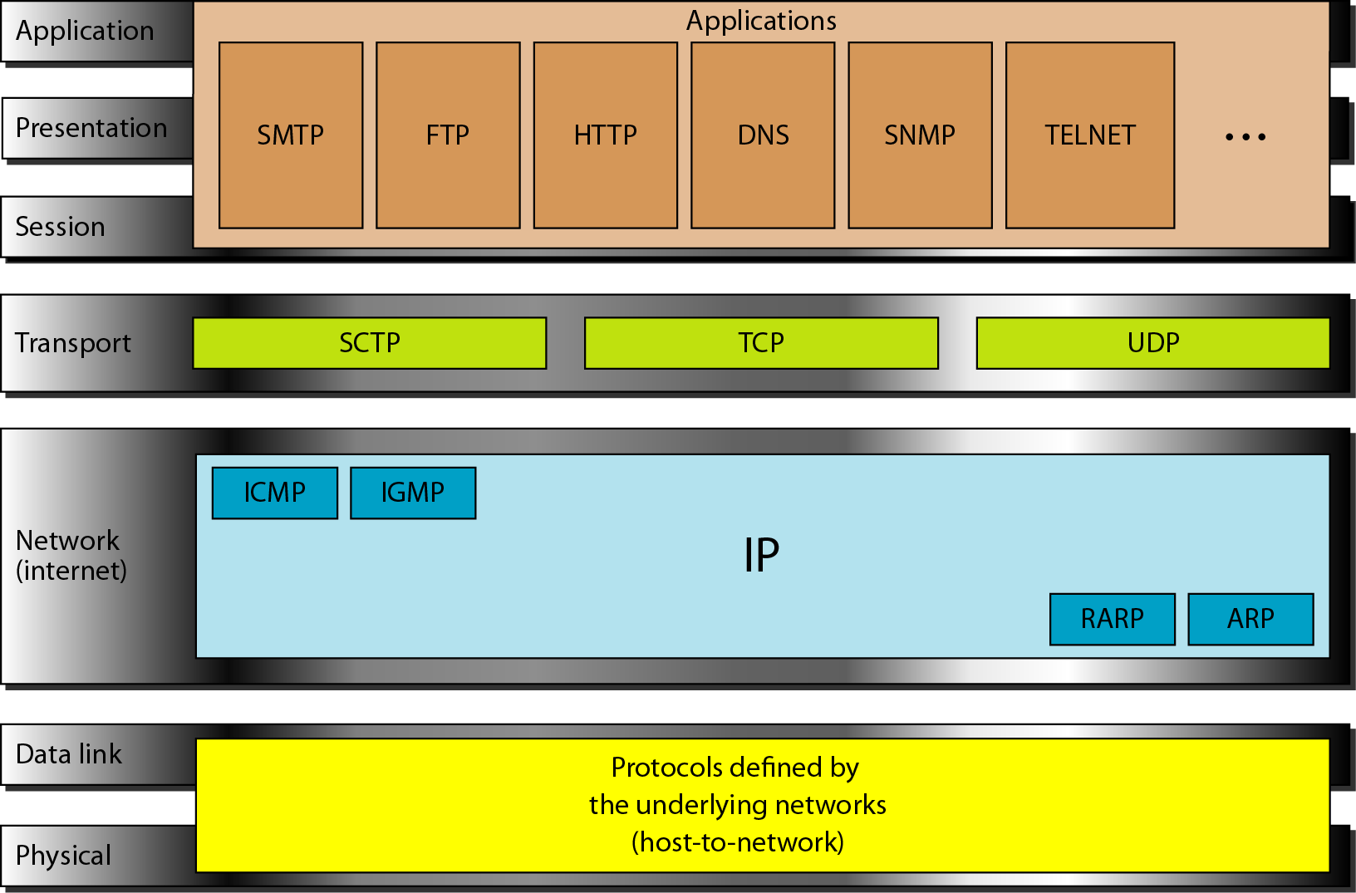
TCP/IP and OSI model

Slide 58
ADDRESSING
Four levels of addresses are used in an internet employing the TCP/IP protocols: physical address, logical address, port address and specific address.

Slide 59
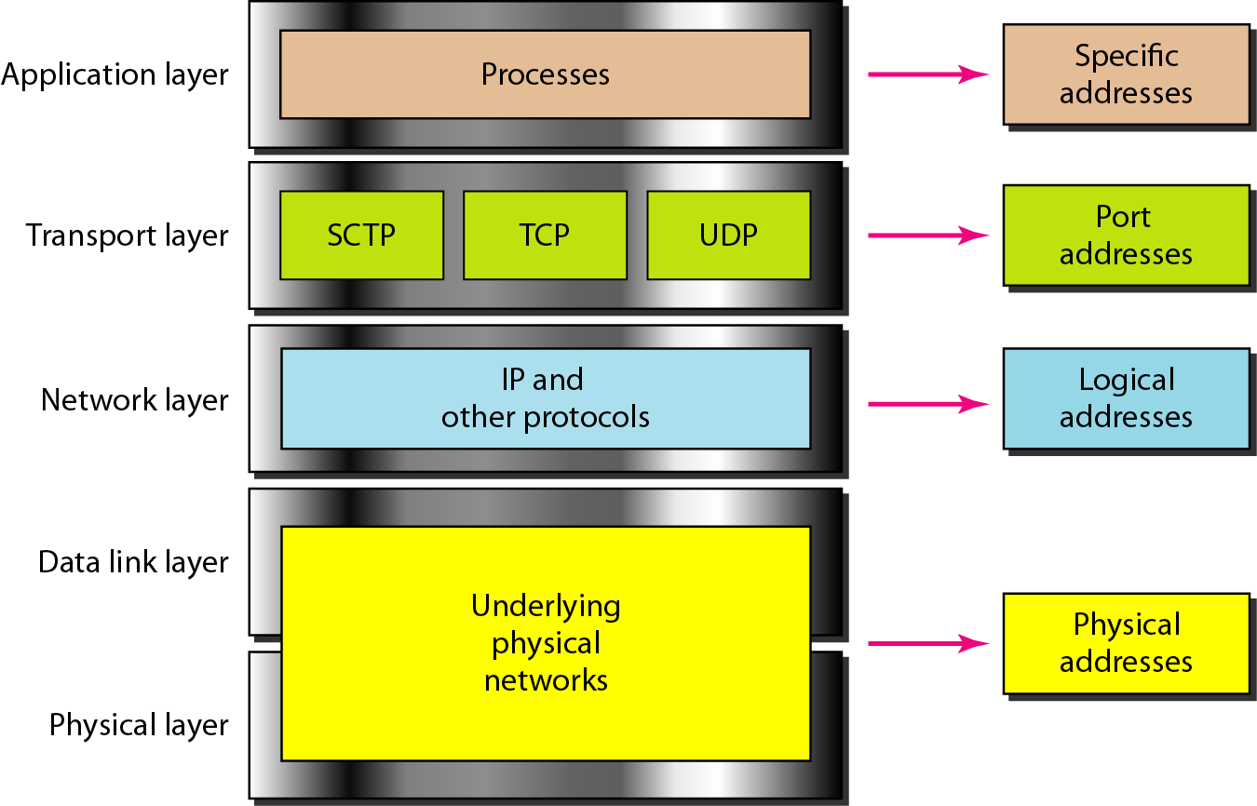
Relationship of layers and addresses in TCP/IP
SCTP: Stream Control Transmission Protocol
TCP: Transmission Control Protocol
UDP: User Datagram Protocol

Slide 60
Example 2.1
In Figure, a node with physical address 10 sends a frame to a node with physical address 87. The two nodes are connected by a link (bus topology LAN). As the figure shows, the computer with physical address 10 is the sender, and the computer with physical address 87 is the receiver.

Slide 61
Example 2.2
Figure below shows a part of an internet with two routers connecting three LANs. Each device (computer or router) has a pair of addresses (logical and physical) for each connection. In this case, each computer is connected to only one link and therefore has only one pair of addresses. Each router, however, is connected to three networks (only two are shown in the figure). So each router has three pairs of addresses, one for each connection.

Slide 62
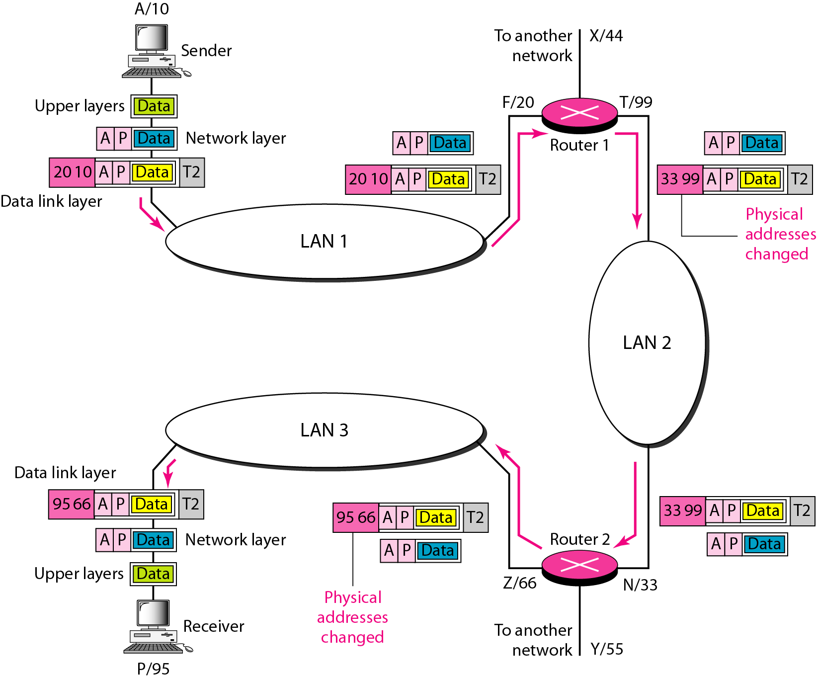
IP addresses

Slide 63
Example 2.3
Figure below shows two computers communicating via the Internet. The sending computer is running three processes at this time with port addresses a, b, and c. The receiving computer is running two processes at this time with port addresses j and k. Process a in the sending computer needs to communicate with process j in the receiving computer. Note that although physical addresses change from hop to hop, logical and port addresses remain the same from the source to destination.

Slide 64
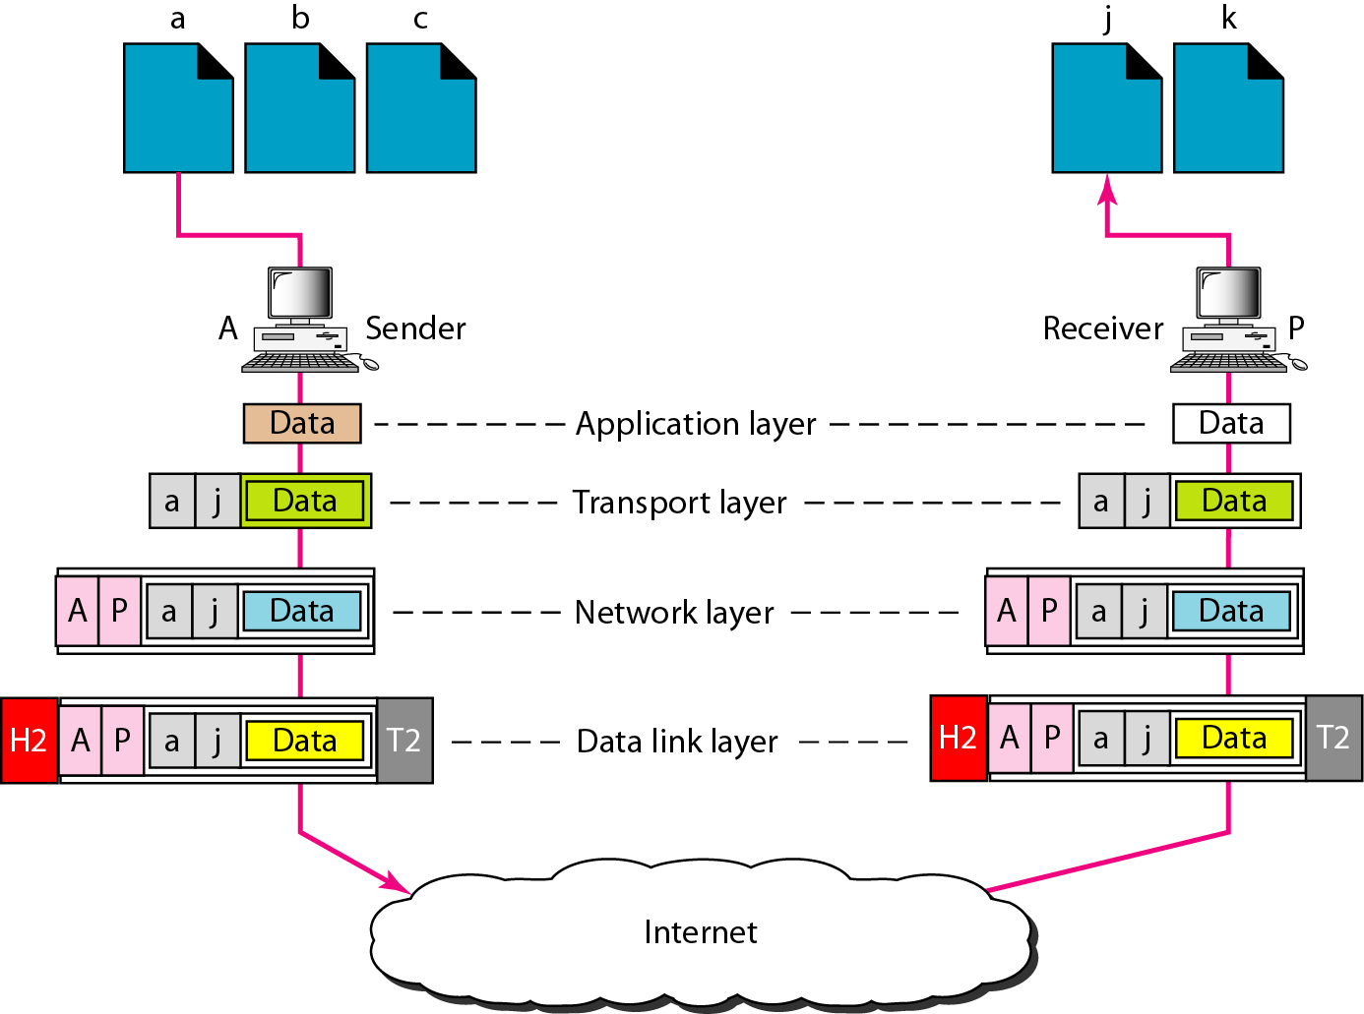
Port addresses

Slide 65
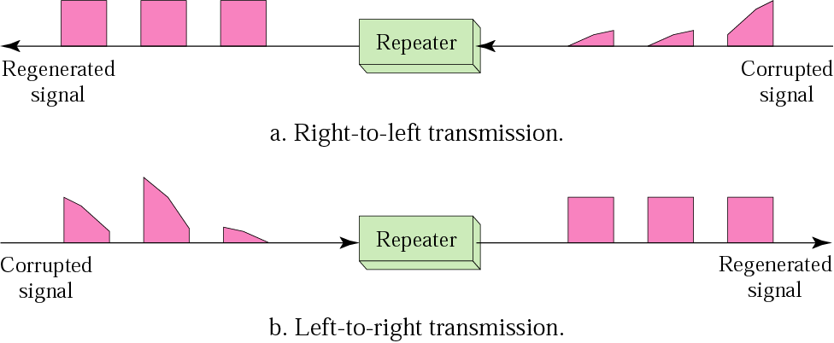
Network Devices
Modem: a device that modulates a digital signal onto analog signal for transmission over telephone lines.
Repeater: Re-generates the signal again.

Slide 66
DEVICES :
Hub, a distributor that has a lot of ports which connected to computers.
Switches, like a hub but it transmit packets to it destination
Bridge, it is used to connect two similar LANs.
Routers, choose the best path to transmit the packet.
Gateway, it is used to connect two different LANs and connect different application protocols.
Repeaters, repeats signals that travels via long distance

Slide 67
Network devices With Layer
Layers | Network Devices
Application Layer | Application gateway
Transport Layer | Transport gateway
Network Layer | Router and gateway
Data link layer | Bridge and Switch
Physical Layer | Repeater, Hub and Modem.

Slide 68
Thank you

