Slide 1
WHY STUDY BUSINESS ETHICS?

Slide 2
WHY STUDY BUSINESS ETHICS?
Studying business ethics is valuable for several reasons.
Business ethics is not merely an extension of an individual’s own personal ethics.
Many people believe that if a company hires good people with strong ethical values, then it will be a “good citizen” organization.
Just being a good person and, in your own view, having sound personal ethics may not be sufficient to enable you to handle the ethical issues that arise in a business organization.
It is important to recognize the relationship between legal and ethical decisions.

Slide 3
Although abstract virtues linked to the high moral ground of truthfulness, honesty, fairness, and openness are often assumed to be self-evident and accepted by all employees, business strategy decisions involve complex and detailed discussions.
For example, there is considerable debate over what constitutes antitrust, deceptive advertising,

Slide 4
A high level of personal moral development may not prevent an individual from violating the law in a complicated organizational context where even experienced lawyers debate the exact meaning of the law.
Some approaches to business ethics assume that ethics training is for people whose personal moral development is unacceptable, but that is not the case.
Because organizations are culturally diverse and personal values must be respected, ensuring collective agreement on organizational ethics (that is, codes reasonably capable of preventing misconduct) is as vital as any other effort an organization’s management may undertake.

Slide 5
Many people who have limited business experience suddenly find themselves making decisions about product quality, advertising, pricing, sales techniques, hiring practices, and pollution control. The values they learned from family, religion, and school may not provide specific guidelines for these complex business decisions.
In other words, a person’s experiences and decisions at home, in school, and in the community may be quite different from his or her experiences and decisions at work.
Managerial responsibility for the conduct of others requires knowledge of ethics and compliance processes and systems. Years of experience in a particular industry may be required to know what is acceptable.

Slide 6
DEVELOPING AN ORGANIZATIONAL AND GLOBAL ETHICAL CULTURE
To develop more ethical corporate cultures, many businesses are communicating core values to their employees by creating ethics programs and appointing ethics officers to oversee them.
The ethical component of a corporate culture relates to the values, beliefs, and established and enforced patterns of conduct that employees use to identify and respond to ethical issues.
The term ethical culture can be viewed as the character or decision making process that employees use to determine whether their responses to ethical issues are right or wrong.

Slide 7
Ethical culture is used to describe the component of corporate culture that captures the values and norms that an organization defines as appropriate conduct.
The goal of an ethical culture is to minimize the need for enforced compliance of rules and maximize the use of principles that contribute to ethical reasoning in difficult or new situations.
An ethical culture creates shared values and support for ethical decisions and is driven by top management.

Slide 8
Global Ethical Culture
Globally, businesses have started working more closely together to establish standards of acceptable behavior.

Slide 9
THE BENEFITS OF BUSINESS ETHICS
The field of business ethics continues to change rapidly as more firms recognize the benefits of improving ethical conduct and the link between business ethics and financial performance.
Both research and examples from the business world demonstrate that building an ethical reputation among employees, customers, and the general public pays off.
Among the rewards for being more ethical and socially responsible in business are increased efficiency in daily operations, greater employee commitment, increased investor willingness to entrust funds, improved customer trust and satisfaction, and better financial performance.
The reputation of a company has a major effect on its relationships with employees, investors, customers, and many other parties.

Slide 10
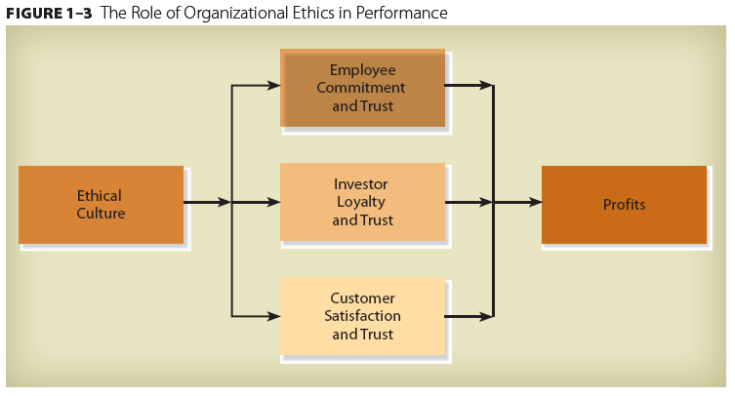

Slide 11
Ethics Contribute to Investor Loyalty
Ethical conduct results in shareholder loyalty and can contribute to success that supports even broader social causes and concerns.
Former Wal-Mart CEO Lee Scott has stated that “As businesses, we have a responsibility to society. We also have an extraordinary opportunity. Let me be clear about this point, there is no conflict between delivering value to shareholders and helping solve bigger societal problems. In fact, they can build upon each other when developed, aligned, and executed right”
Investors today are increasingly concerned about the ethics, social responsibility, and reputation of companies in which they invest.

Slide 12
Ethics Contribute to Customer Satisfaction
Customer satisfaction is one of the most important factors in successful business strategy.
When an organization has a strong ethical environment, it usually focuses on the core value of placing customers’ interests first.
Putting customers first does not mean that the interests of employees, investors, and local communities should be ignored, however;
An ethical culture that focuses on customers incorporates the interests of all employees, suppliers, and other interested parties in decisions and actions.
Employees working in an ethical environment support and contribute to the process of understanding customers’ demands and concerns.
Ethical conduct toward customers builds a strong competitive position that has been shown to affect business performance and product innovation positively.

Slide 13
Ethics Contribute to Profits
A company cannot nurture and develop an ethical culture unless it has achieved adequate financial performance in terms of profits.
Businesses with greater resources—regardless of their staff size—have the means to practice social responsibility while serving their customers, valuing their employees, and establishing trust with the public.
Ethical conduct toward customers builds a strong competitive position that has been shown to affect business performance and product innovation positively.

