Slide 1
Introduction to Change Management

Slide 2
Definition
Minimizing resistance to organizational change through involvement of key players and stakeholders.

Slide 3
Stakeholders
Anyone who has an interest in the process or outcome
Anyone who may need to support the change
May be an individual, group, organization, etc.

Slide 4
Change Management
Change management is an approach to transitioning individuals, teams and organizations to a desired future state.

Slide 5
Rogers: Adopter Categories
innovators - the first 2.5% to adopt the innovation
early adopters - the next 13.5% to adopt the new idea
early majority - next 34% of the adopters
late majority - the next 34% to embrace the change
laggards - the last 16% to adopt the innovation

Slide 6
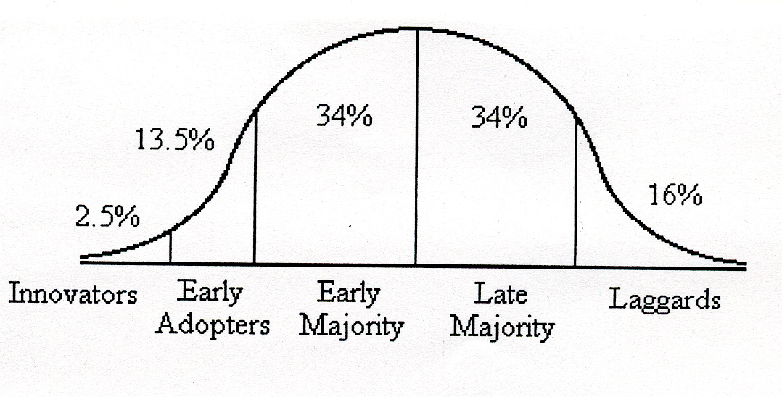
Adopters vs Time

Slide 7
Adopter Categories Definitions
Innovators
have a great interest in new ideas and a desire to be daring and risky
can cope with uncertainty regarding change
may not be respected by other members of the organization
Early Adopters
are the critical group for change/opinion leaders
contain role models for others that respect them for judicious ‘innovation decisions’
are not too far ahead of the organization as compared to innovators
decrease uncertainty when they adopt new ideas

Slide 8
Adopter Categories Definitions
Early Majority
adopts new ideas before the average members of the organization
not opinion leaders/make decisions slowly and carefully
follow with deliberate willingness in adopting change but rarely lead
Late Majority
adopts innovations after the majority of the organization
generally are skeptical and cautious
respond to pressure from their peers and new organizational norms

Slide 9
Adopter Categories Definitions
Laggards
are isolated and interact with others with traditional values
usually make decisions on what has been done in the past
possess almost no opinion leaders
often are suspicious of change and change agents

Slide 10
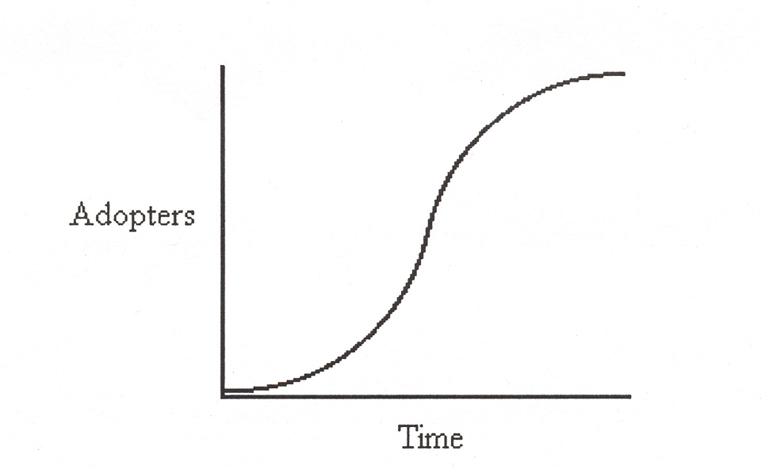
Rogers: S-shaped Curve
a period of slow adoption before experiencing a sudden period of rapid adoption and then a gradual leveling off

Slide 11
Change Management Strategies

Slide 12
1. Empirical-Rational strategy
Assumptions:
People are rational beings and will follow their self-interest – once it is revealed to them. Successful change is based on the communication of information and incentives.

Slide 13
Selection Factors:
Change strategy here centers on the balance of incentives and risk management.
This strategy is difficult to deploy when the incentives available are modest, when people currently have it pretty good.

Slide 14
2. Normative-Reeducative strategy
Assumptions:
People are social beings and will adhere to cultural norms and values. Successful change is based on redefining and reinterpreting existing norms and values, and developing commitments to new ones.

Slide 15
Selection Factors:
Change strategy here focuses on culture.
Ordinarily, culture doesn’t change quickly and certainly not overnight. This, then, is not the strategy of choice in a turnaround situation on short dead- lines.
Moreover, an organization’s culture is as much in the grip of the informal organization as it is the formal organization. For this reason, this strategy works only when the relationships between the formal and informal organizations are at least cordial and hopefully harmonious. If they are at odds with one another, this change strategy is denied to management.
Still, there is an avenue or two open here. Almost all change efforts have long-term as well as short-term goals. To some ex- tent, the long-term change strategy will have to incorporate some normative-reeducative actions.

Slide 16
3. Power-Coercive Strategy
Assumptions:
People are basically compliant and will generally do what they are told or can be made to do. Successful change is based on the exercise of authority and the imposition of sanctions.

Slide 17
Selection Factors:
Two major factors influencing the choice of this strategy are time and the seriousness of the threat faced.
If the threat is grave and the time for action is limited, this strategy is useful.
That idea might have merit in extreme situations but it also entails considerable risk – to the organization, to its people, and to the leader who attempts it.

Slide 18
4. Environmental- Adaptive Strategy
Assumptions:
People oppose loss and disruption but they adapt readily to new circumstances. Change is based on building a new organization and gradually transferring people from the old one to the new one.

Slide 19
Selection Factors:
The major consideration here is the extent of the change. This strategy is best suited for situations where radical, transformative change is called for. For gradual or incremental change, this is not the strategy of choice.
Time frames are not a factor. However, under short time frames, a key issue will be that of managing what could be explosive growth in the new organization and, the rapid influx of people from the old culture can infuse the new organization with the old culture.
Another factor to consider is the availability of suitable people to “seed” the new organization and jump-start its culture.

Slide 20
Strategy Selection Considerations
Degree of Change. Radical change or transformation argues for an environmental- adaptive strategy (build a new one instead of trying to transform the old one). Less radical changes argue against this strategy.
Degree of Resistance. Strong resistance argues for a coupling of power-coercive and environmental-adaptive strategies. Weak resistance or concurrence argues for a combination of rational-empirical and normative-reeducative strategies.

Slide 21
Population. Large populations argue for a mix of all four strategies, something for everyone so to speak. Diverse populations also call for a mix of strategies. This implies careful segmentation.
Stakes. High stakes argue for a mix of all four strategies. When the stakes are high, nothing can be left to chance. Moderate stakes argue against a power-coercive strategy. There are no low-stakes change problems. If the stakes are low, no one cares, and resistance levels will be low. Avoid Power-Coercive strategies in low stakes situations.
Time Frame. Short time frames argue for a power-coercive strategy. Longer time frames argue for a mix of rational-empirical, normative-reeducative, and environmental-adaptive strategies.

Slide 22
Cont’
Expertise. Having available adequate expertise at making change argues for some mix of the strategies outlined above. Not having it available argues for reliance on the power- coercive strategy.
Dependency. This is a classic double-edged sword. If the organization is dependent on its people, its ability to command and demand is limited. On the other hand, if the people are dependent on the organization, their ability to oppose is limited. (Mutual dependency almost always signals a requirement to negotiate.)

