Slide 1
Database Systems
Lecture 1: Basics of Database
By
Rimsha Khan

Slide 2
Today’s Lecture: Agenda
Introduction
Course outlines
Basic concepts
Comparison of file processing systems with the database systems
Database development approaches

Slide 3
Course Outline
Text Book:
Modern Database Management, by Hoffer, Prescott, MsFadden, Latest Edition
References:
Fundamentals of Database Systems by Elmasri, Navathi
Some other material may be added on runtime

Slide 4
Course Outline
Theoretical Background
Importance of Database System
Database design and development
Conceptual design,
Relational design,
Physical design,
ERD,
EERD
SQL for database querying
Normalization
Web/Windows/Mobile based applications development

Slide 5
Marks Distribution (Tentative)
Quizzes 10
Project/ Assignments 10
Sessional Exams 30
Final 50

Slide 6
Some basic concepts
Data
Structured
Un-Structured
Information
Metadata
Information Systems
Data layer
App layer

Slide 7
Database (Definition)
In the broadest sense, a database is anything that stores data. A phone book, for instance, could be considered a database as it stores related pieces of information such as name and phone number. However, in the world of computers, a database usually refers to a collection of related pieces of information stored electronically. Aside from the ability to store data, a database also provides a way for other computer programs to quickly retrieve and update desired pieces of data.
Reference:
http://www.mariosalexandrou.com/definition/database.asp

Slide 8
Database (Definition)
A database is an application that manages data and allows fast storage and retrieval of that data.
Reference
http://cplus.about.com/od/glossar1/g/databasedefn.htm

Slide 9
Database (Definition)
A database is a collection of information that is organized so that it can easily be accessed, managed, and updated.
Reference:
http://searchsqlserver.techtarget.com/sDefinition/0,,sid87_gci211895,00.html

Slide 10
Definitions (By Hoffer)
Database (Concluded): organized collection of logically related data

Slide 11
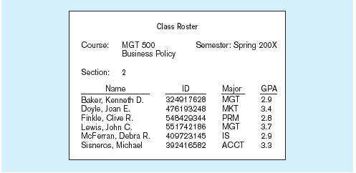
Figure 1-1a Data in context
Context helps users understand data

Slide 12
Figure 1-1b Summarized data
Graphical displays turn data into useful information that managers can use for decision making and interpretation

Slide 13
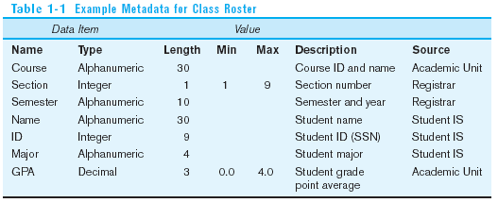
Descriptions of the properties or characteristics of the data, including data types, field sizes, allowable values, and data context

Slide 14
Disadvantages of File Processing
Program-Data Dependence
All programs maintain metadata for each file they use
Duplication of Data
Different systems/programs have separate copies of the same data
Limited Data Sharing
No centralized control of data

Slide 15
Problems with Data Dependency
Lengthy Development Times
Programmers must design their own file formats
Excessive Program Maintenance
80% of information systems budget

Slide 16
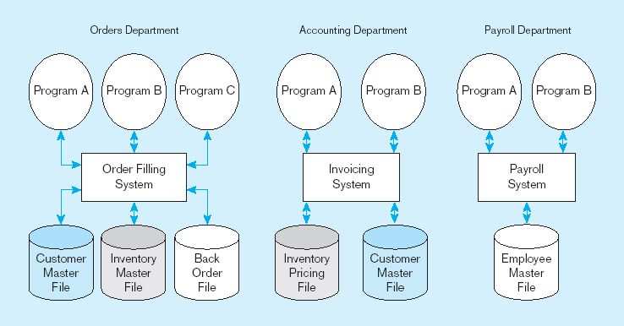
Figure 1-3 Old file processing systems at Pine Valley Furniture Company
Duplicate Data

Slide 17
Problems with Data Redundancy
Waste of space to have duplicate data
Causes more maintenance headaches
The biggest problem:
Data changes in one file could cause inconsistencies
Compromises in data integrity

Slide 18
SOLUTION: The DATABASE Approach
Central repository of shared data
Data is managed by a controlling agent
Stored in a standardized, convenient form
Requires a Database Management System (DBMS)

Slide 19
Database Management System
A software system that is used to create, maintain, and provide controlled access to user databases
Order Filing
System
Central database
Contains employee,
order, inventory,
pricing, and
customer data
Invoicing
System
DBMS
Payroll
System
DBMS manages data resources like an operating system manages hardware resources

Slide 20
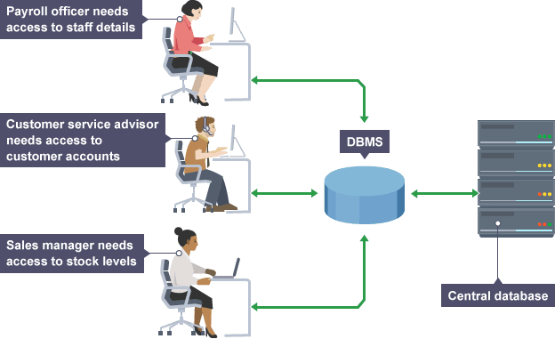
Database Management System

Slide 21
Database Management System

Slide 22
Advantages of the Database Approach
Program-data independence
Planned data redundancy
Improved data consistency
Improved data sharing
Increased application development productivity
Improved data accessibility and responsiveness
Reduced program maintenance

Slide 23
Costs and Risks of the Database Approach
New, specialized personnel
Installation and management cost and complexity
Conversion costs from file management system
Need for explicit backup and recovery
Organizational conflict

Slide 24
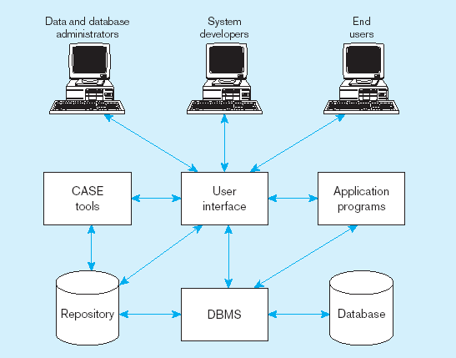
Figure 1-5 Components of the Database Environment

Slide 25
Components of the Database Environment
CASE Tools–computer-aided software engineering. These tools providing automated support for systems development
Repository–centralized storehouse of metadata
Database Management System (DBMS) –software for managing the database
Database–storehouse of the data
Application Programs–software using the data

Slide 26
User Interface–text and graphical displays to users
Data/Database Administrators–personnel responsible for maintaining the database
System Developers–personnel responsible for designing databases and software
End Users–people who use the applications and databases

Slide 27
The Range of Database Applications
Personal databases
Workgroup databases
Departmental/divisional databases
Enterprise database

Slide 28
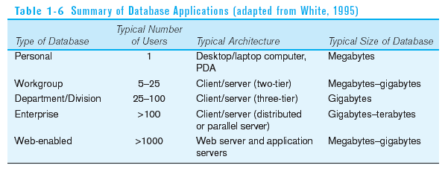

Slide 29
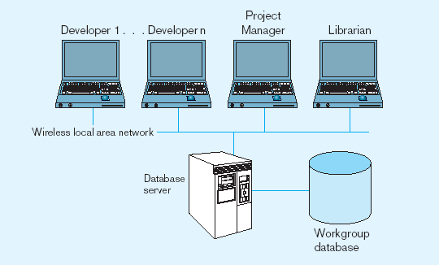
Figure 1-7 Workgroup database with wireless
local area network

Slide 30
Enterprise Database Applications
Enterprise Resource Planning (ERP)
Integrate all enterprise functions (manufacturing, finance, sales, marketing, inventory, accounting, human resources)
Data Warehouse
Integrated decision support system derived from various operational databases

Slide 31
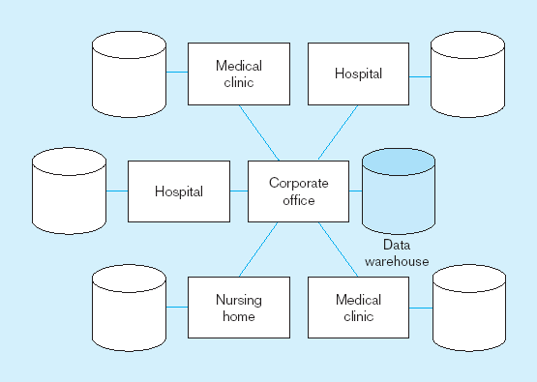
Figure 1-8 An enterprise data warehouse

Slide 32
Systems Development Life Cycle
Planning
Analysis
Logical Design
Physical Design
Implementation
Maintenance

Slide 33
Systems Development Life Cycle
Planning
Purpose–preliminary understanding
Deliverable–request for study
Planning
Analysis
Logical Design
Physical Design
Database activity–
enterprise modeling and early conceptual data modeling
Implementation
Maintenance

Slide 34
Systems Development Life Cycle (see also Figures 2.4, 2.5) (cont.)
Purpose–thorough requirements analysis and structuring
Deliverable–functional system specifications
Planning
Analysis
Analysis
Logical Design
Physical Design
Database activity–Thorough and integrated conceptual data modeling
Implementation
Maintenance

Slide 35
Systems Development Life Cycle
Purpose–information requirements elicitation and structure
Deliverable–detailed design specifications
Planning
Analysis
Logical Design
Logical Design
Physical Design
Database activity–
logical database design (transactions, forms, displays, views, data integrity and security)
Implementation
Maintenance

Slide 36
Systems Development Life Cycle
Purpose–develop technology and organizational specifications
Deliverable–program/data structures, technology purchases, organization redesigns
Planning
Analysis
Logical Design
Physical Design
Physical Design
Database activity–
physical database design (define database to DBMS, physical data organization, database processing programs)
Implementation
Maintenance

Slide 37
Systems Development Life Cycle
Purpose–programming, testing, training, installation, documenting
Deliverable–operational programs, documentation, training materials
Planning
Analysis
Logical Design
Physical Design
Database activity–
database implementation, including coded programs, documentation, installation and conversion
Implementation
Implementation
Maintenance

Slide 38
Systems Development Life Cycle
Planning
Purpose–monitor, repair, enhance
Deliverable–periodic audits
Analysis
Logical Design
Physical Design
Database activity–
database maintenance, performance analysis and tuning, error corrections
Implementation
Maintenance
Maintenance

Slide 39
CASE
Computer-Aided Software Engineering (CASE)–software tools providing automated support for systems development
Three database features:
Data modeling–drawing entity-relationship diagrams
Code generation–SQL code for table creation
Repositories–knowledge base of enterprise information

Slide 40
Schema
The word schema comes from the Greek word "σχήμα" (skhēma), which means shape, or more generally, plan. The plural is "σχήματα" (skhēmata). In English, both schemas and schemata are used as plural forms, although the latter is the standard form for written English.
Schema may refer to:
Model or Diagram
Schematic, a diagram that represents the elements of a system using abstract, graphic symbols
Reference: http://en.wikipedia.org/wiki/Schema

Slide 41
Database Schema
The schema (pronounced skee-ma) of a database system is its structure described in a formal language supported by the database management system (DBMS).
Although a schema is defined in text database language, the term is often used to refer to a graphical depiction of the database structure. In other words, schema is the structure of the database that defines the objects in the database.
Levels of database schema
Conceptual schema, a map of concepts and their relationships.
Logical schema, a map of entities and their attributes and relations
Physical schema, a particular implementation of a logical schema
Reference: http://en.wikipedia.org/wiki/Database_schema

Slide 42
Thank You

