Slide 1
Basics of Energy Conversion

Slide 2


Energy is all around you!
You can hear energy
You can see energy
you can feel it

Slide 3









ENERGY is…
the ability to do WORK or cause change
WORK is…
when a FORCE moves an object
a FORCE ^{is…} a push or a pull

Slide 4
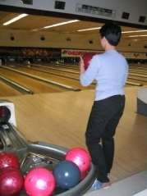
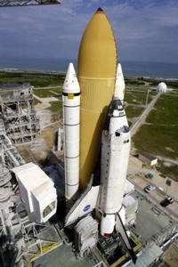
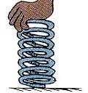

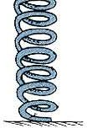
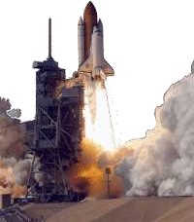
There are two main kinds of energy…
POTENTIAL ENERGY KINETIC ENERGY
STORED energy or
Energy that is NOT being used
Energy that IS being used or
Energy in MOTION
Examples:
Examples:

Slide 5


Mechanical energy
The sum of kinetic and potential energy
in an object that is used to do work.
Chemical Energy
The energy stored in the bonds of
chemical compounds (atoms and molecules).
examples : Batteries, biomass, petroleum, natural gas, and coal.
Radiant energy
The energy of electromagnetic and gravitational radiation. The SI unit of
radiant energy is the joule (J)

Slide 6
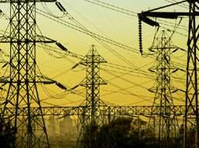





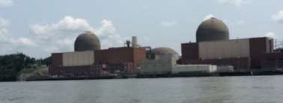
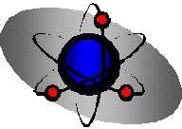
DIFFERENT FORMS OF ENERGY
ELECTRICAL ENERGY
Moving electrical charges
ELECTROMAGNETIC ENERGY
Light energy, X-rays, radio waves
NUCLEAR ENERGY
Stored in the nucleus of an atom & released when atoms are split or joined together, nuclear reactors, atomic bombs, stars, sun

Slide 7
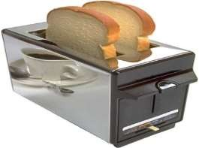
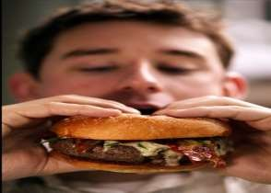
Energy Transformations Conversions Between Forms of Energy
A change from one form of energy to another is called energy conversion. Most forms of energy can be converted into any other form.
Examples :
Toaster converts electrical energy to thermal energy.
Your body converts chemical energy in the food you eat into the mechanical energy you need to move your muscles.
Heat energy is also formed in an energy conversion.
Electrical Energy into Thermal Energy
Chemical Energy into Mechanical Energy

Slide 8
Law of Conservation of Energy
When one form of energy is converted to another, no energy is destroyed in the process.
Energy cannot be created or destroyed, so the total amount of energy
is the same before and after any process. All energy is accounted for.
In 1905, Albert Einstein said that mass and energy can be converted into each other.
He showed that if matter is destroyed, energy is created, and if energy is destroyed mass is created.
E= 𝑚𝑐²
Where, E is Energy, m is unit Mass
& c is Speed of light squared

Slide 9
Energy Balance
source + import = export + variation of stock + use + loss
Consider a primary energy balance.
Sources are the local (or national) primary energy sources, like coal, hydro, biomass, animate, etc.
Imports are energy sources which come from outside the region (or country). Exports go to other regions (or countries).
Variations of stock are reductions of stocks (like of forests, coal, etc.), and storage. Use can be specified sectoral, or by energy form, or by end-use, etc., as required.
Losses are technical losses and administrative losses:
Technical losses are due to conversions and transport or transmission
Administrative losses are due to non-registered consumptions.

Slide 10
Examples of calculations of energy conversions
How much heat is produced by a human body?
A man doing no or very little physical work needs about 2,000 kcal (or less) of energy in his daily food. The body converts this energy almost entirely into heat. 1 day = 24 x 60 x 60 s = 86,400 s 1 cal = 4.2 J
Hence
We see that a human body doing no work is equivalent to a heat source of about 100 W - the
equivalent of a good bulb.

Slide 11
ENERGY SOURCES
Biomass
Biogas (Dung and animate)
Hydro Resource
Wind Energy
Fossil Fuels
Geothermal Energy
Solar Radiation

Slide 12
DIRECT ENERGY CONVERSION

Slide 13
Transformation of one type of energy (such as sunlight) to another (such as electricity) without passing through an intermediate stage (such as steam to spin generator turbines).
The fuel cell, another electrochemical producer of electricity, was developed by William Robert Grove.
Thermoelectric generators are devices that convert heat directly into electricity.
In a solar cell, radiant energy drives electrons across a potential difference at a semiconductor junction in which the concentrations of impurities are different on the two sides of the junction.

Slide 14
NEED FOR DEC
No conversion of energy into mechanical and to electricity.
Less losses in conversion process.
More efficient process
Cost also reduced

Slide 15
TYPES OF DEC
Thermo electric power generation
Thermo ionic power generation
Magneto hydro dynamic systems
Photovoltaic power systems
Fuel cells
Thermo nuclear fusion power generation

Slide 16
CARNOT CYCLE
The Carnot cycle has the greatest efficiency possible of an engine (although other cycles have the same efficiency) based on the assumption of the absence of incidental wasteful processes such as friction, and the assumption of no conduction of heat between different parts of the engine at different temperatures.
In the early 19th century, steam engines came to play an increasingly important role in industry and transportation. However, a systematic set of theories of the conversion of thermal energy to motive power by steam engines had not yet been developed. Nicolas Léonard Sadi Carnot (1796-1832), a French military engineer, published Reflections on the Motive Power of Fire in 1824.
The book proposed a generalized theory of heat engines, as well as an idealized model of a thermodynamic system for a heat engine that is now known as thea Carnot cycle. Carnot developed the foundation of

Slide 17
Video Link CARNOT CYCLE
https://www.youtube.com/watch?v=77EIce2Nu8Y
https://www.youtube.com/watch?v=pRiDJBqVRIw
https://www.youtube.com/watch?v=NasmLQOf30s
https://www.youtube.com/watch?v=6IRXVZKH6WQ

Slide 18
PROCESSESS OF CARNOT CYCLE
A reversible isothermal gas expansion process. In this process, the ideal gas in the system absorbs q_{in} amount heat from a heat source at a high temperature T_{h}, expands and does work on surroundings.
A reversible adiabatic gas expansion process. In this process, the system is thermally insulated. The gas continues to expand and do work on surroundings, which causes the system to cool to a lower temperature, T_{l}.
A reversible isothermal gas compression process. In this process, surroundings do work to the gas at T_{l}, and causes a loss of heat, q_{out}.
A reversible adiabatic gas compression process. In this process, the system is thermally insulated. Surroundings continue to do work to the gas, which causes the temperature to rise back to T_{h}

Slide 19
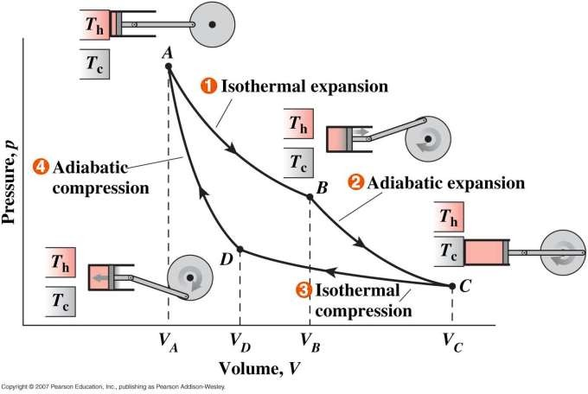
P-V DIAGRM
In isothermal processes I and III, ∆U=0 because
∆T=0. In adiabatic processes II and IV,
q=0. Work, heat, ∆U, and ∆H of each process

Slide 20
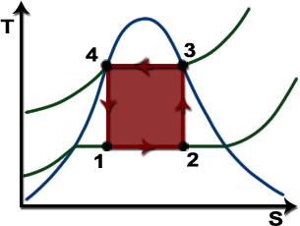
T-S DIAGRAM
In isothermal processes I and III, ∆T=0. In adiabatic processes II and IV, ∆S=0 because dq=0. ∆T and ∆S of each process

Slide 21
LIMITATION OF CARNOT CYCLE
This equation shows that the wider the temperature range, the more efficient is the cycle.(a) T3
In practice T3cannot be reduced below about 300 K (27ºC), corresponding to a condenser pressure of 0.035 bar. This is due to two tractors:
Condensation of steam requires a bulk supply of cooling water and such a continuousnaturalsupply below atmospheric temperature of about 15°C is unavailable.
If condenser is to be of a reasonable size and cost, the temperature difference between thecondensing steam and the cooling water must be at least 10°C.(b) TI
The maximum cycle temperature T1 is also limited to about 900 K (627°C) by the strengthof the materials available for the highly

Slide 22
Critical Point:
In fact the steam Carnot cycle has a maximum cycle temperature of well below this metallurgical limit owing to the properties of steam; it is limited to the critical-pointtemperature of 374°C (647 K). Hence modern materials cannot be used to their best advantagewith this cycle when steam is the working fluid. Furthermore, because the saturated water andsteam curves converge to the critical point, a plant operating on the carnot cycle with itsmaximum temperature near the critical- point temperature would have a very large s.s.c., i.e. itwould be very large in size and very expensive.
Compression Process:
Compressing a very wet steam mixture would require acompressor of size and cost comparable with the turbine. It Would absorb work comparable withthe developed by the turbine. It would have a short life because of blade erosion and cavitations problem. these reasons

Slide 23
Carnot Ideal Heat Engine

Slide 24
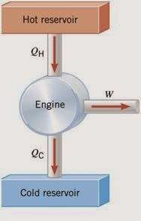

Slide 25
Carnot Cycle
Cyclic stepwise Process
Step1 :- Isothermal Reversible Expansion Step 2 :- Adiabatic Reversible Expansion Step 3 :- Isothermal Reversible Compression Step 4 :- Adiabatic Reversible Compression

Slide 26
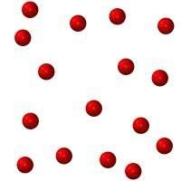
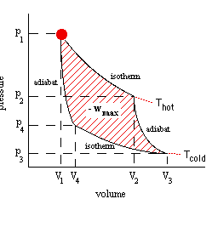


Step I –Isothermal expansion ( T = constant)
w₁ = - R T₁ ln (V₂ / V₁) Q_{H} = R T₁ ln (V₂ / V₁)
∆E = 0
P2 V 2T1 b
Insulated piston
a
P1 V 1 T1
a
+ QH
b
+ Q
d
H
T1 = TH
P :- ↓ V :- ↑ T :- const.
c

Slide 27

Step II –Adiabatic Expansion (Q = 0 )
w₂ = C_{v} (T₂ - T₁)
∆E = C_{v} (T₂ - T₁)
q = 0
P3 V 3T2
c
Insulated piston
a
P2 V 2 T1 b
b
+ QH
d
c
P :- ↓
V :- ↑
T :- ↓

Slide 28
Step III –Isothermal Compression ( T = constant)
w₃ = - R T₂ ln (V₄ / V₃)
Q_{C} = R T₂ ln (V₄ / V₃)
∆E = 0
P3 V 3T2 c
Insulated piston
a
P4 V 4 T2 d
b
- Qc
d
T2 = TC
P :- ↑ V :- ↓ T :- const.
c

Slide 29
Step IV –Adiabatic Compression( Q = 0 )
w₄ = C_{v} (T₁ - T₂)
∆E = C_{v} (T₁ - T₂)
q = 0
Insulated piston
a
b
d
c
P4 V 4T2
d
P1 V 1 T1 a
P :- ↑ V :- ↓ T
:- ↑

Slide 30

Efficiency means the ratio of net work done obtained in a cycle and total heat absorbed .
It is denoted by η
η = Net work done / Input
= W_{net}/ QH
= ( QH – QC ) / QH
= ( T1 – T2 ) / T1
= 1 – T2 / T1
Efficiency(η) < 1

Slide 31

η = 1 – T2 / T1
Heat source constant at T1 temperature
and lowering sink
Sink constant at T2 and increasing source temperature

Slide 32




Slide 33
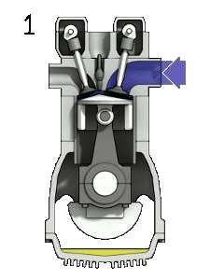
Diesel engine

Slide 34

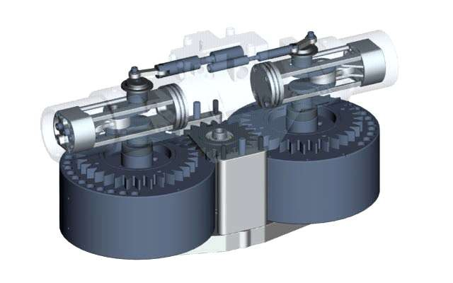
Heat engine

Slide 35

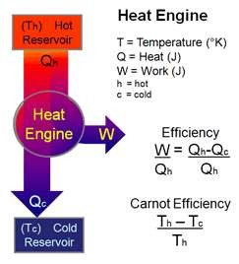
Carnot Cycle is a cyclic Process
It is a ideal cycle
It has Maximum Efficiency (η)
given as :- η = 1 – T2 / T1
It works on temperature difference

