Slide 2
Thermionic emission is the basis for the working of this system.
In 1873, the Britain professor Frederic Guthrie invented the Thermionic phenomenon.
In 1883, Thomas A. Edison observed that the electrons are emitted from a metal surface when it was heated. This effect is called Edison effect.
Later in 1904, a British physicist John Ambrose Fleming developed two-element vacuum tube known as diode.

Slide 3
History
In 1883 Edision discovered release of electrons from a hot body
In 1904 Fleming invented thermionic diode rectifier
In 1915 Schlicter proposed thermionic conversion
After 1950 serious research on this began

Slide 4
Introduction
Thermionic Power Convertor is a static device that converts heat into electricity by boiling electrons from a hot emitter surface(approx 1800 K) across a small inter electrode gap(<
0.5 mm) to a cooler collector surface(approx 1000 K)
A Thermionic Generator consists of one or more of these convertors coupled to give desired power output
Thermionic generators can be operated from any primary heat source.
For low power level(3 kW or less) solar energy can be used
For high power level (50 kW or more) nuclear heat source can
be used

Slide 5
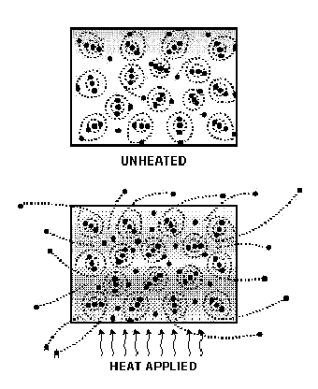
The idea of electrons leaving the surface

Slide 6
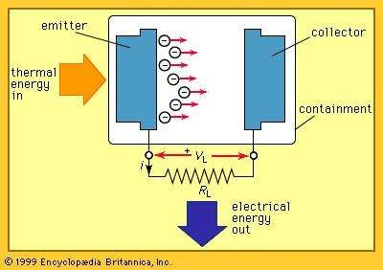

Slide 7
A thermionic energy converter (or) thermionic power generator is a device consisting of two electrodes placed near one another in a vacuum.
One electrode is normally called the cathode, or emitter, and the other is called the anode, or plate.
Ordinarily, electrons in the cathode are prevented from escaping from the surface by a potential-energy barrier.
When an electron starts to move away from the surface, it induces a corresponding positive charge in the material, which tends to pull it back into the surface.
To escape, the electron must somehow acquire enough energy to overcome this energy barrier.
At ordinary temperatures, almost none of the electrons
can acquire enough energy to escape.

Slide 8
However, when the cathode is very hot, the electron
energies are greatly increased by thermal motion.
At sufficiently high temperatures, a considerable number of electrons are able to escape.
The liberation of electrons from a hot surface is called thermionic emission

Slide 9
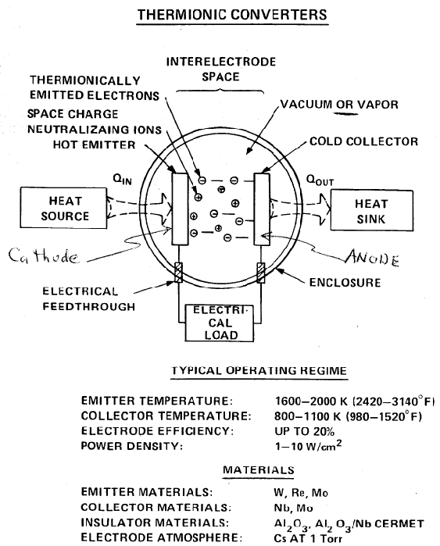
Common components

Slide 10
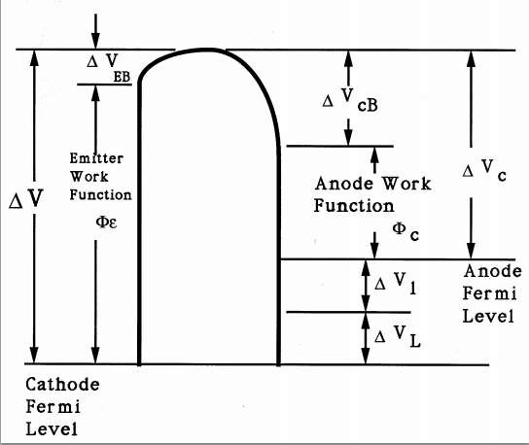

Slide 11
For the electrons to travel, the unit is at vacuum. This
limit the size of the generator.
Electron emission is inhibited by space charge, small quantity of Cesium metal is introduced into the evacuated vessel
Molybdenum, tantalum, tungsten impregnated barium oxide.Uranium carbide, zirconium carbide.
Prototype combustion-heated thermionic systems for domestic heat and electric power cogeneration

Slide 12
Important aspects considered
The cathode must emit an abundant supply of electron
Evaporation of atoms from cathode should be negligible
Electronic space charge build-up in the inter- electrode spacing must be eliminated

Slide 13
Classification
Classification according to methods of neutralization space charge
Vacuum close-spaced
Cesium Gas Filled

Slide 14
Vacuum close-spaced convertor
Has been under extensive research since 1957
Physical spacing of .0005 inch or less is maintained between anode and cathode
Will have engineering difficulty
Lifetime is 40 hours

Slide 15
Cesium Gas Filled
Cesium gas is filled between anode and cathode
Working efficiency is higher than former one
Lifetime is nearly 600 hours
Main problem is efficient sealing and corrosive nature of cesium

Slide 16
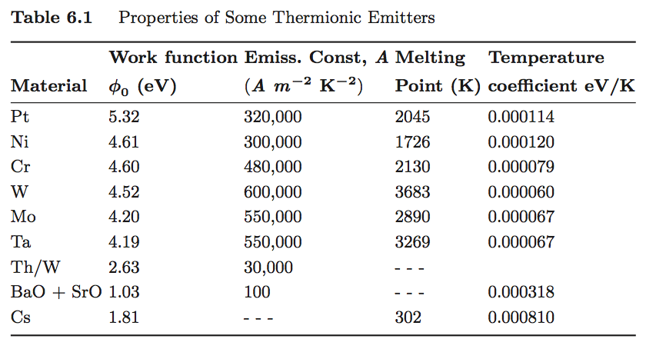

Slide 17
Advantages
Rotating equipment is not employed
Liquid-Vapour phase problems do not exist
Separators for fluids are not required
Frictional losses due to bearings not present

Slide 18
Disadvantage
Individual convertors are low voltage, high current devices
A large number of convertors must be sequentially arranged to obtain useful voltage
Power losses in convertors can seriously cut useful power output

Slide 19
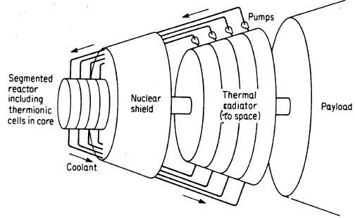
Application

Slide 20
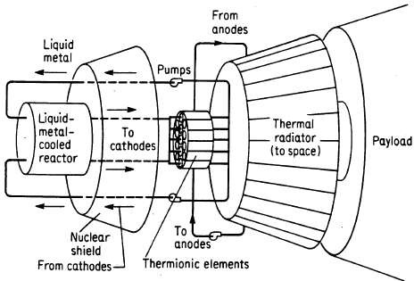

Slide 21
