Slide 1
Lecture11
Global Supply Chain Procurement and Distribution

Slide 2
Procurement
The purchase of goods and services from suppliers
Cross enterprise teams
coordinate processes between a company and its supplier
On-demand (direct-response) delivery
requires the supplier to deliver goods when demanded by the customer
Continuous replenishment
supplying orders in a short period of time according to a predetermined schedule

Slide 3
Outsourcing
Sourcing
selection of suppliers
Outsourcing
purchase of goods and services from an outside supplier
Core competencies
what a company does best
Single sourcing
a company purchases goods and services from only a few (or one) suppliers

Slide 4
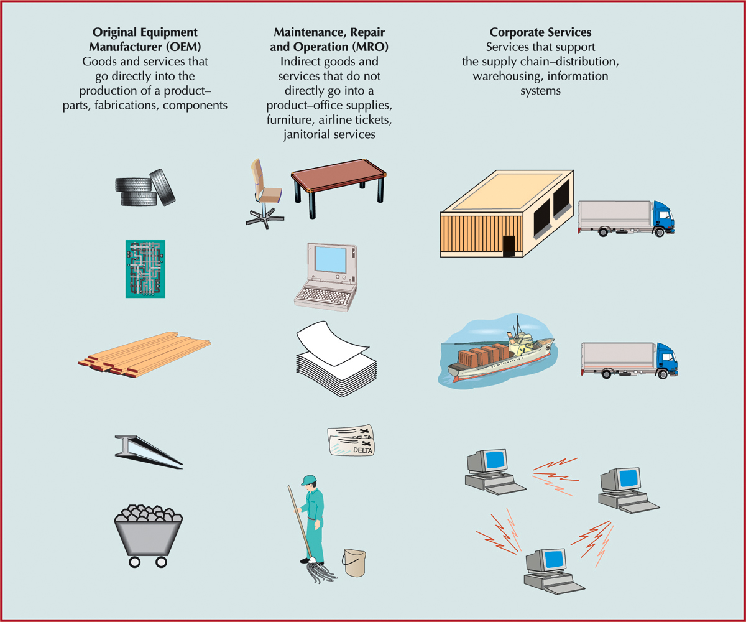
Categories of Goods and Services

Slide 5
E-Procurement
Direct purchase from suppliers over the Internet, by using software packages or through e-marketplaces, e-hubs, and trading exchanges
Can streamline and speed up the purchase order and transaction process

Slide 6
E-Procurement
What can companies buy over the Internet?
Manufacturing inputs
the raw materials and components that go directly into the production process of the product
Operating inputs
maintenance, repair, and operation goods and services

Slide 7
E-Procurement
E-marketplaces (e-hubs)
Websites where companies and suppliers conduct business-to-business activities
Reverse auction
process used by e-marketplaces for buyers to purchase items; company posts orders on the internet for suppliers to bid on

Slide 8
Distribution
Encompasses all channels, processes, and functions, including warehousing and transportation, that a product passes on its way to final customer
Order fulfillment
process of ensuring on-time delivery of an order
Logistics
transportation and distribution of goods and services
Driving force today is speed
Particularly important for Internet dot-coms

Slide 9
Distribution Centers (DC) and Warehousing
DCs are some of the largest business facilities in the United States
Trend is for more frequent orders in smaller quantities
Flow-through facilities and automated material handling
Postponement
final assembly and product configuration may be done at the DC

Slide 10
Warehouse Management Systems
Highly automated system that runs day-to-day operations of a DC
Controls item putaway, picking, packing, and shipping
Features
transportation management
order management
yard management
labor management
warehouse optimization

Slide 11
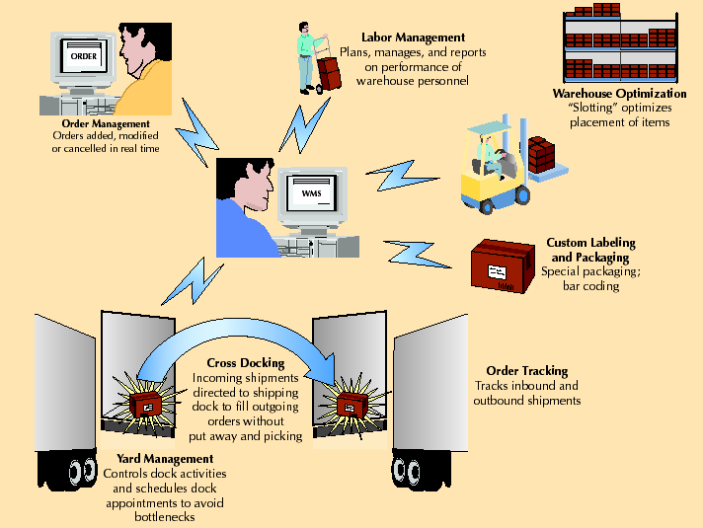
A WMS

Slide 12
Vendor-Managed Inventory
Manufacturers generate orders, not distributors or retailers
Stocking information is accessed using EDI
A first step towards supply chain collaboration
Increased speed, reduced errors, and improved service

Slide 13
Collaborative Logistics and Distribution Outsourcing
Collaborative planning, forecasting, and replenishment create greater economies of scale
Internet-based exchange of data and information
Significant decrease in inventory levels and costs and more efficient logistics
Companies focus on core competencies

Slide 14
Transportation
Rail
low-value, high-density, bulk products, raw materials, intermodal containers
not as economical for small loads, slower, less flexible than trucking
Trucking
main mode of freight transport in U.S.
small loads, point-to-point service, flexible
More reliable, less damage than rails; more expensive than rails for long distance

Slide 15
Transportation
Air
most expensive and fastest, mode of freight transport
lightweight, small packages <500 lbs
high-value, perishable and critical goods
less theft
Package Delivery
small packages
fast and reliable
increased with e-Business
primary shipping mode for Internet companies

Slide 16
Transportation
Water
low-cost shipping mode
primary means of international shipping
U.S. waterways
slowest shipping mode
Intermodal
combines several modes of shipping-truck, water and rail
key component is containers
Pipeline
transport oil and products in liquid form
high capital cost, economical use
long life and low operating cost

Slide 17
Internet Transportation Exchanges
Bring together shippers and carriers
Initial contact, negotiations, auctions
Examples
www.nte.com
www.freightquote.com

Slide 18
Global Supply Chain
International trade barriers have fallen
New trade agreements
To compete globally requires an effective supply chain
Information technology is an “enabler” of global trade

Slide 19
Obstacles to Global Chain Transactions
Increased documentation for invoices, cargo insurance, letters of credit, ocean bills of lading or air waybills, and inspections
Ever-changing regulations that vary from country to country that govern the import and export of goods
Trade groups, tariffs, duties, and landing costs
Limited shipping modes
Differences in communication technology and availability

Slide 20
Obstacles to Global Chain Transactions
Different business practices as well as language barriers
Government codes and reporting requirements that vary from country to country
Numerous players, including forwarding agents, custom house brokers, financial institutions, insurance providers, multiple transportation carriers, and government agencies
Since 9/11, numerous security regulations and requirements

Slide 21
Duties and Tariffs
Proliferation of trade agreements
Nations form trading groups
no tariffs or duties within group
charge uniform tariffs to nonmembers
Member nations have a competitive advantage within the group
Trade specialists
include freight forwarders, customs house brokers, export packers, and export management and trading companies

Slide 22
Web-based International Trade Logistic Systems
International trade logistics web-based software systems reduce obstacles to global trade
convert language and currency
provide information on tariffs, duties, and customs processes
attach appropriate weights, measurements, and unit prices to individual products ordered over the Web
incorporate transportation costs and conversion rates
calculate shipping costs online while a company enters an order
track global shipments

Slide 23
Global Terrorism and Global Chains
Increase security measures
added time to supply chain schedules
Increased supply chain costs
24 hours rules for “risk screening”
extended documentation
extend time by 3-4 days
Inventory levels have increased 5%
Other costs include:
new people, technologies, equipment, surveillance, communication, and security systems, and training necessary for screening at airports and seaports around the world

