Slide 1
B-Cultural diversity within culture

Slide 2
Cultural Diversity is the existence of a variety of cultural groups within a society.
Cultural groups can share many different characteristics. They include:
Culture, religion, ethnicity, language, nationality, sexual orientation, class, gender, age, disability, health differences, geographic location and lots of other things.
Culture is the lens with which we evaluate everything around us; we evaluate what is proper or improper, normal or abnormal, through our culture. If we are immersed in a culture that is unlike our own we may experience culture shock and become disoriented when we come into contact with a fundamentally different culture. People naturally use their own culture as the standard to judge other cultures.
Cultural diversity helps us recognize and respect “ways of being” that are not necessarily our own, so that as we interact with others we can build bridges to trust, respect, and understanding across cultures.

Slide 3
Cultural Perceptions and Values
Cultural perception is how an individual's culture affects the way he or she's see the world. Since culture informs all areas of life (including the arts, thought, religion, language, food, etc.), perception (how they see the world) is significantly impacted by culture.
Cultural values are the core principles and ideals upon which an entire community exists. This is made up of several parts: customs, which are traditions and rituals; values, which are beliefs; and culture, which is all of a group's guiding values.

Slide 4
The nature of perception
Perception is a process by which individuals organize and interpret their sensory impressions in order to give meaning to their environment. People's behavior is based on their perception of what reality is, not on reality itself. The world as it is perceived is the world that is behaviorally important.

Slide 5
Cultural influences on perceptions
Culture plays an important role in molding us into the people we are today. It creates an environment of a shared belief, way of thinking, and method interacting among that group of people. It is dynamic and constantly changing across time. The culture you are born into will shape your eating behavior, such as what you eat, when you eat, and even how you eat. It will influence the clothes you choose to wear and the sports you play. Social norms set forth by your culture will determine how you interact with family members, friends, and strangers.
Culture is all around us, shaping our brain and behavior. Consequently, people from various cultures will process the world differently. Furthermore subcultures exist within cultures. Religions, communities, ad regional accents and customs all work to influence your cognition and perception.

Slide 6
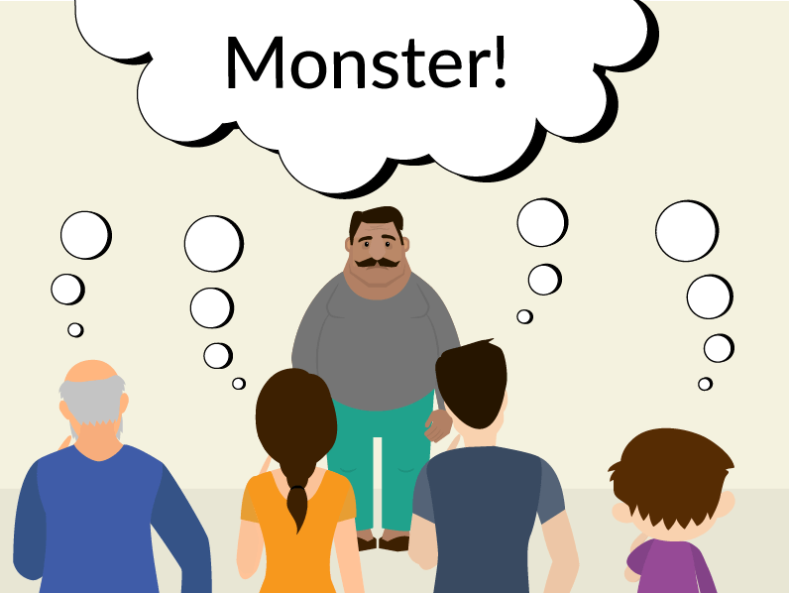
Stereotypes
stereotype is an over-generalized belief about a particular category of people.

Slide 7
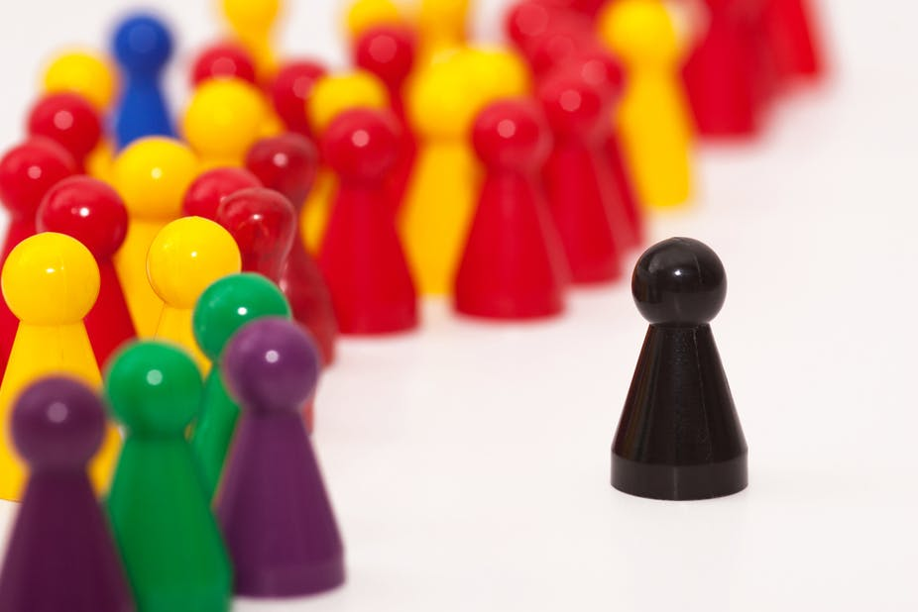
Prejudice
Prejudice is an affective feeling towards a person based on their perceived group membership.
The word is often used to refer to a preconceived, usually unfavorable, evaluation of another person based on that person's political affiliation, sex, gender, beliefs, values, social class, age, disability, religion, sexuality, race, ethnicity, language, nationality, beauty, occupation, education, criminality, sport team affiliation or other personal characteristics.

Slide 8
Ethnocentrism
Evaluation of other cultures according to preconceptions originating in the standards and customs of one's own culture.
Or
Ethnocentrism means to apply one's own culture as a frame of reference in order to judge other cultures, practices, behaviors, beliefs, and people, instead of using the standards of the particular culture involved.

