Slide 1
House Drainage System & Its Objectives
Lecture # 14

Slide 2
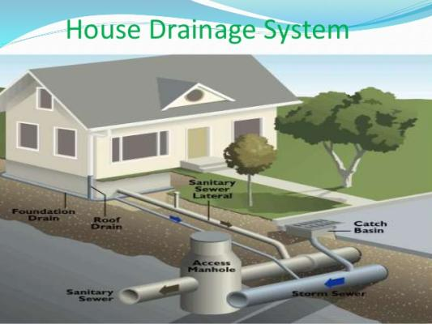
House Drainage: Introduction
House drainage :-
The principles and procedure to be followed while constructing and laying sewer lines in private buildings are referred as ‘house drainage.
Aims :-
To maintain healthy condition in the building .
To dispose off waste water as early and quickly as possible .
To avoid the entry of foul gases from the sewer or the septic tank .
To facilitate quick removal of foul matter.
To collect and remove waste matters systematically.

Slide 3
House Drainage: Principles
House Drainage should be preferable laid by side of the building to facilitate easy repair and better maintenance.
House sewer joints should be leek proof because leakage if any shall create an odor problem and leaked wastewater shall infiltrate in the ground and shall reduce bearing capacity of soil below foundation, which is not desirable.
The sewage or sullage should flow under the force of gravity.
The house sewer should always be straight.

Slide 4
House Drainage: Principles
The entire system should be well ventilated from start to the end.
The house sewer should be connected to the manhole such that the invert level is sufficiently higher to avoid back flow of sewage in house sewer.
Where ever there is change in direction of sewer line in the premises, provide inspection chamber at the junction.
Rain water from roofs or open courtyards should not be allowed to flow through the house sewers.
Adequate ventilation systems should be installed.

Slide 5
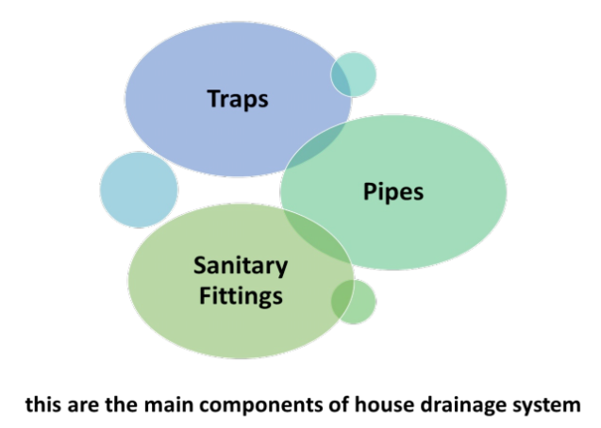
House Drainage: Components

Slide 6
House Drainage: Traps

Slide 7
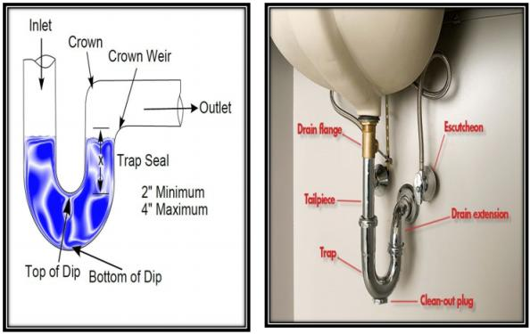
House Drainage: traps

Slide 8
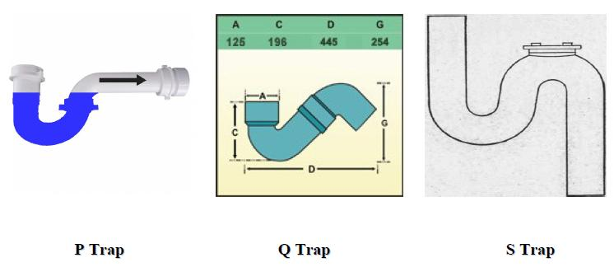
House Drainage: traps (Classification)
Classification according to shape:
a. P – Trap b. Q – Trap c. S - Trap

Slide 9
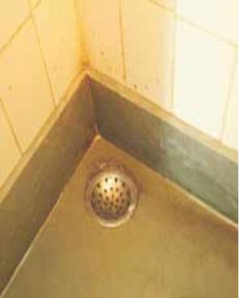
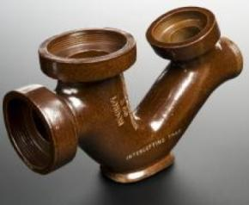
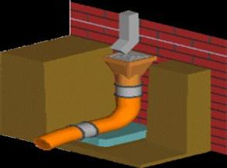
House Drainage: traps (Classification)
2. Classification according to Use:
a. Floor Traps (Nahni Trap) b. Gully Traps c. Intercepting Traps
This trap is generally used to admit sewage from the floors of rooms, bathrooms, kitchen etc.
A Gully trap or gully is provided at a junction of a roof drain and other drain coming from kitchen or bathroom.
Intercepting traps is provided at junction of a house sewer and municipal sewer, mainly at manhole.

Slide 10
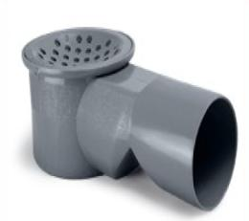
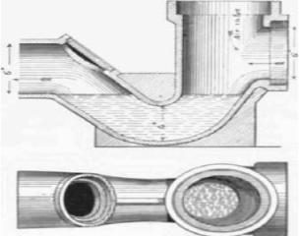
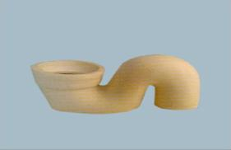
House Drainage: Traps (Requirements)
1.It should possess a adequate water seal at all times .
2.It should be not absorbent material .
3.The internal and external surface should have smooth finish so that dirt , etc. Does not stick to it .
4.It should be free from any inside projection , angles ,
contractions, so that flow is not obstructed.
5.It should be self cleansing .
6.It should be simple in construction , cheap and readily available.

Slide 11
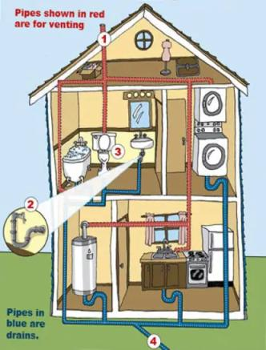
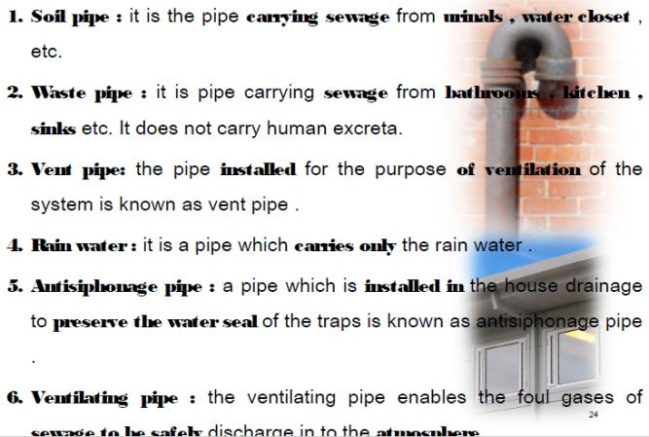
House Drainage: Pipes

Slide 12
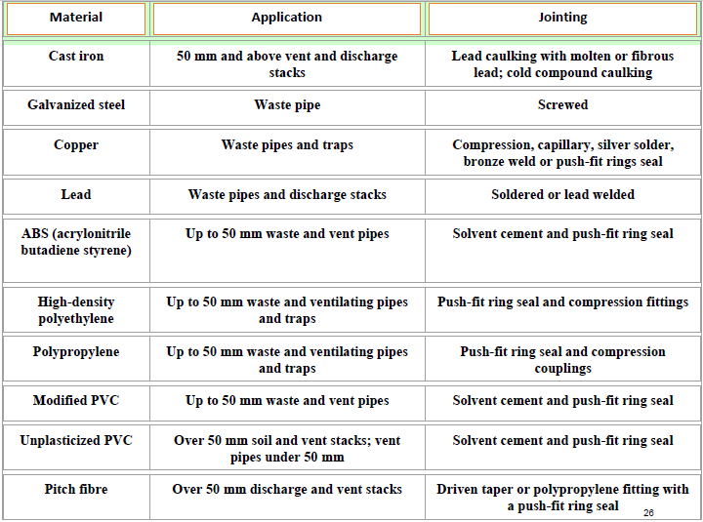
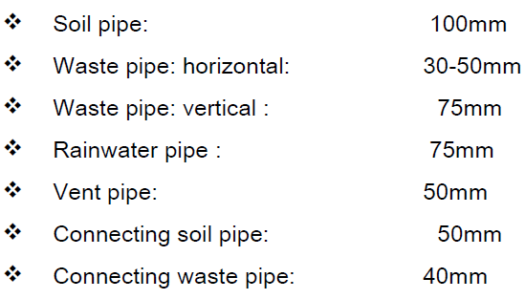
House Drainage: Pipes (Sizes & Materials)
Materials
Sizes

Slide 13
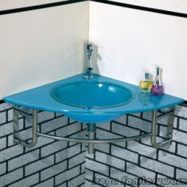
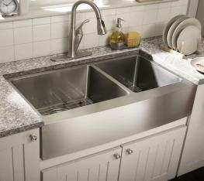
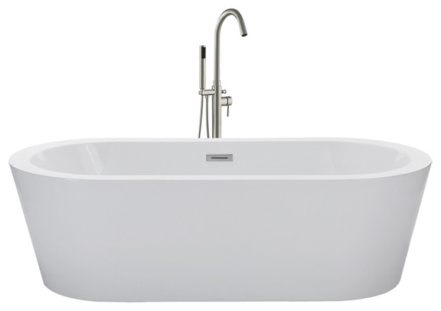
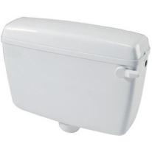
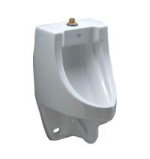
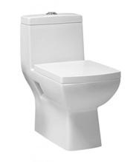
House Drainage: Sanitary Fittings
1. Wash Basin
2. Sink
3. Bathing Tub
5. Urinal
6. Flushing
Cistern
4. Water Closet

Slide 14
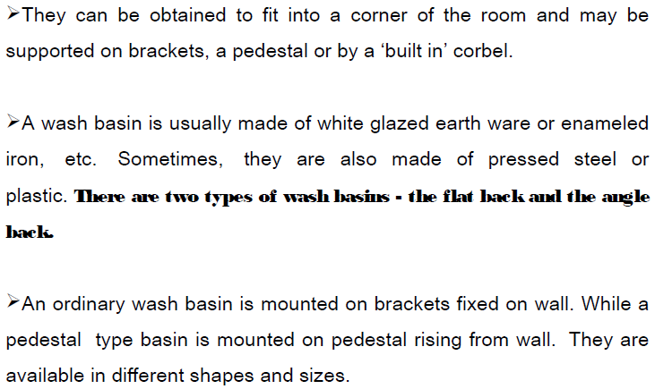
Sanitary Fittings: Wash Basins

Slide 15
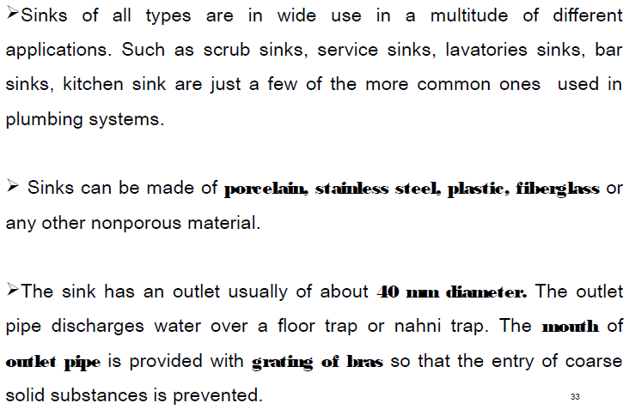
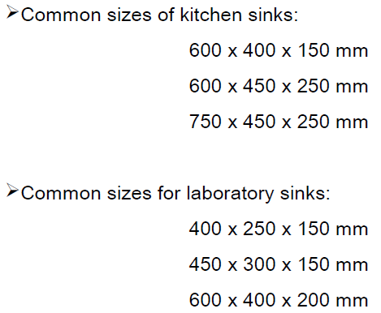
Sanitary Fittings: Sinks

Slide 16
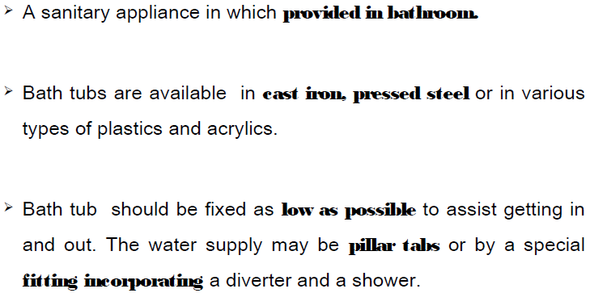
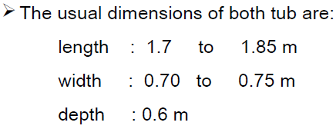
Sanitary Fittings: Bath Tubs

Slide 17
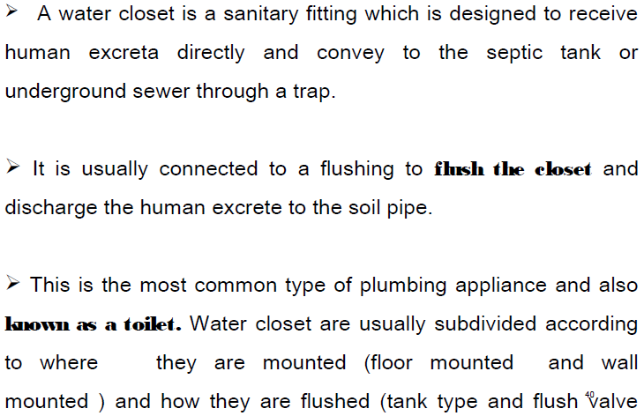
Sanitary Fittings: Water Closets

Slide 18
Sanitary Fittings: Water Closets (Types)

Slide 19
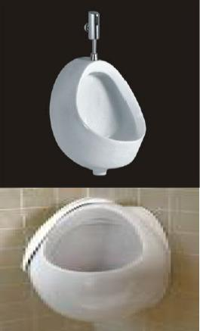
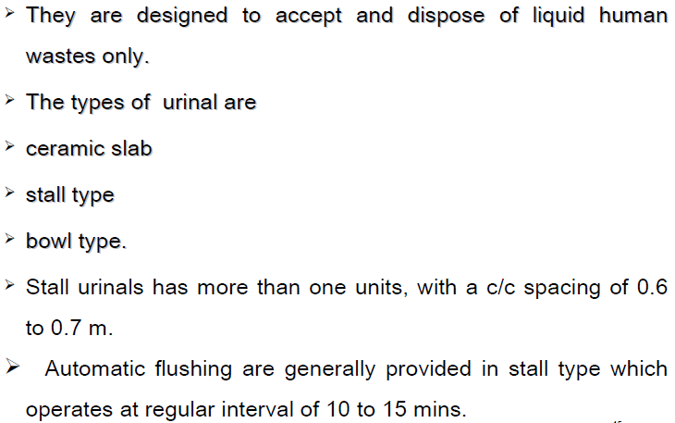
Sanitary Fittings: Urinals

Slide 20
Sanitary Fittings: Flushing Sinks

Slide 21
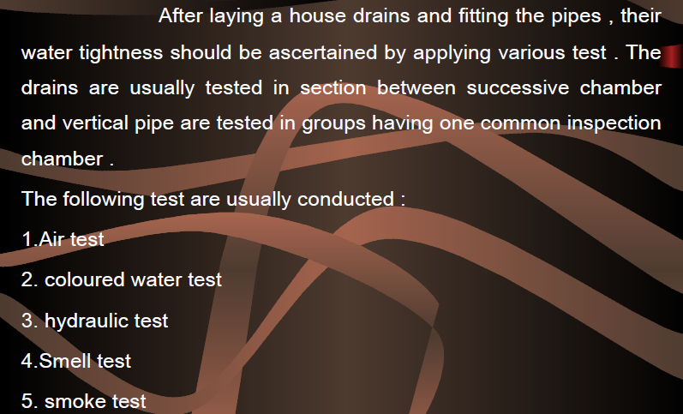
Sanitary Fittings: Maintainace Testing

Slide 22
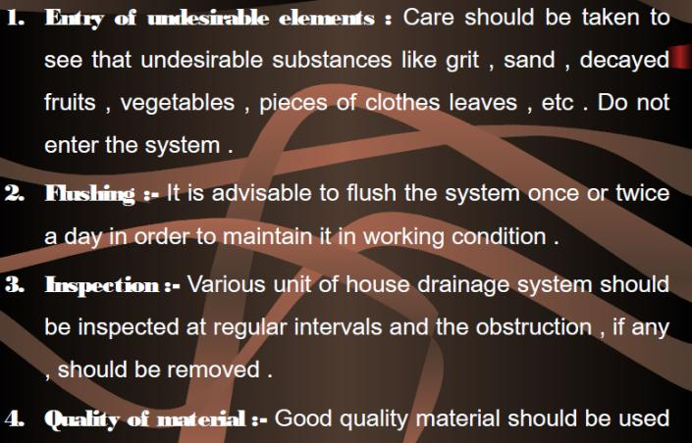
Sanitary Fittings: Wash Basins

Slide 23
