Slide 1
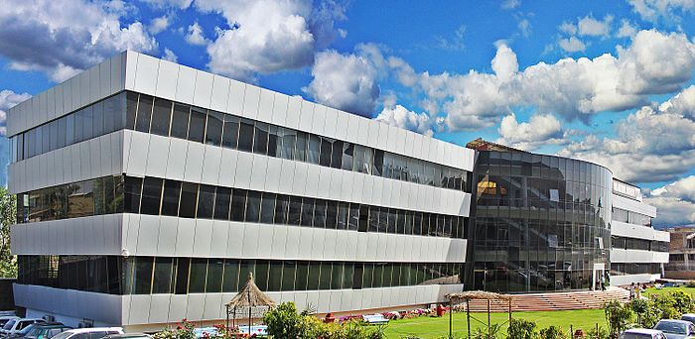
Waste Water Treatment:
Trickling Filters (Design)
Lecture # 11

Slide 2
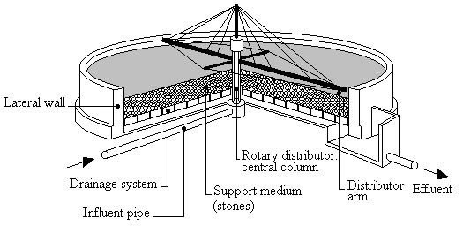
Trickling Filters: Design
Filter Loading Rate
Depth
Number

Slide 3
Trickling Filters: Design
Depth
1.8 to 2.4 m
One Hectare = 10000 m.sq.
Minimum Two
Number
Organic Load per filter Bed Volume = 1000 to 2200 kg BOD/hectare-m/day
BOD/filter media volume = 15 to 30 kg BOD/day/100 m3.
Surface Area of Filter Bed = 25 40 million Liters/hectare of surface area
Filter Bed Vol = 7.50 to 22.50 million liters/hectare/day.
Filter Loading Rate

Slide 4
Trickling Filters: Process Schematic

Slide 5
Trickling Filters: Design Equations

Slide 6
Trickling Filters: Design Equations
Where,
E2= % efficiency in BOD removal of single stage or first stage,
F1.BOD= BOD loading of settled raw sewage in single stage of the two-stage filter in kg/d,
V1= volume of first stage filter, m3,
Rf1= Recirculation factor for first stage.

Slide 7
Trickling Filters: Design Equations
Efficiency Estimation:
Where,
Yi = Influent BOD load to TF
Yo = Effluent BOD from TF.
$$E=\frac{Y_{i}−Y_{o}}{Y_{i}}X 100$$
Recirculation Factor Calculation:
Where,
R = Recirculation percentage
$$F=\frac{1+R}{\left(1+0.1R\right)1^{2}}$$

Slide 8
Any Questions??

