Slide 1
Human Computer Interaction
Waqas Swati
27 Feb. 2018
1100-1400Hrs
Spring 2018 Lecture#1

Slide 2
Introduction
MS(SE) COMSATS IIT Islamabad
BS(CS) Arid Agriculture Rawalpindi
CCNA from UIIT, Arid Agriculture Rawalpindi
muhammadwaqas657@gmail.com
Teaching Methodology: Outcome Based Education (OBE)

Slide 3
Class Introduction
Name, ID
Father name and profession
Belongs to
Favourite subject till date

Slide 4
Grading Criteria
Cheater never prosper
Be faithful

Slide 5
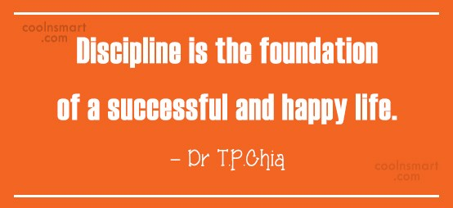
Not Allowed
Eatable
Mobile Phone
Exit after classes has started
Gossip with fellow

Slide 6
Class Introductions

Slide 7
What is about?
Design of Computer Interfaces
The processes to design good interfaces
The evaluation of your design
Can be applied anywhere
Designing interfaces for learning
Designing better mobile phone interaction techniques
etc

Slide 8
Huh!!??
Huh!!??
DESIGN
One Word…Design
Notes:
If you want one word for this course, then it is design . Techniques discusses here can be used to design al most all things you can imagine.

Slide 9
Notes:
Postit is a very successful product. Only 3m was producing it for a long time because it was protected by a patent. Hence they made a lot of money. The innovation is the glue and paper. But the real innovation was the design… the understanding that this is needed and this can be useful.
This course does not really stop at computers but at an abstract level covers all aspects of design.

Slide 10
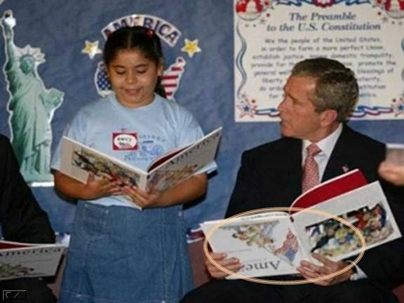
My Naïve Assumptions
You will all work hard
No one will copy
You all are mature
You came here from out of your free will
You all are motivated
You know that grad school is different than undergrad

Slide 11
Human
Computer Interaction

Slide 12
Human
Computer Interaction
Notes:
First and foremost is the human, the person that’s using the system and the other people that they work and communicate with.

Slide 13
Human
Computer
Interaction
Notes:
Then you got the computer, that’s the machine and the networked-up machines that run the system. And then you got the interface that represents the system to the user. HCI is the design, implementation and evaluation of user interfaces. This course is going to teach you a set of tools for doing this effectively.

Slide 14
Human
Computer
Interaction
Notes:
And then you got the interface that represents the system to the user. HCI is the design, implementation and evaluation of user interfaces. This course is going to teach you a set of tools for doing this effectively.

Slide 15
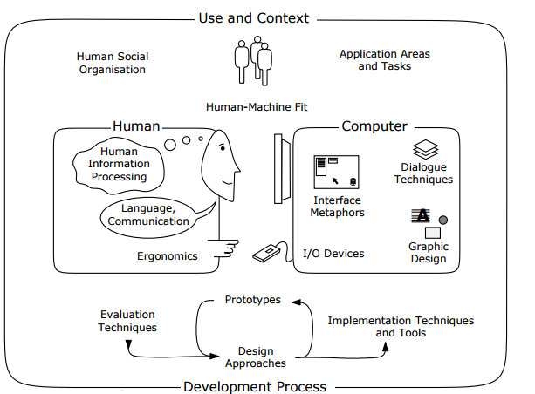
What is HCI?
Notes:
HCI (human-computer interaction) is the study of how people interact with computers and to what extent computers are or are not developed for successful interaction with human beings.

Slide 16
Design
Implementation
Evaluation
Notes:
HCI is the design, implementation and evaluation of user interfaces. This course is going to teach you a set of tools for doing this effectively.

Slide 17
Goal of HCI
The goals of HCI are to produce usable and safe systems, as well as functional systems. In order o produce computer systems with good usability, developers must attempt to:
understand the factors that determine how people use technology
develop tools and techniques to enable building suitable systems
achieve efficient, effective, and safe interaction
put people first

Slide 18
Good Design
Notes:
Good design should be non obtrusive. Users should not be even to notice it. If users note it then their focus is on the interface not the task at hand

Slide 19
What is a Good Design
Effective
Accomplish what is required
SMS Typing: write the SMS with min errors
Efficient
Do it easily, naturally and fast
SMS Typing: You type is in lesser time than before
Satisfaction
Make people want to use it
Be attractive, engaging, fun
SMS Typing: People feel good after using it

Slide 20
Exercise
If you want to design a new interface for finding contacts on a smart phone
What would efficiency , effectiveness and satisfaction mean?
Efficiency: Users find required contact quickly
Effectiveness: Users actually are able to find their friend’s contact and not his dad ☺
Satisfaction: You feel happy after using the interface

Slide 21
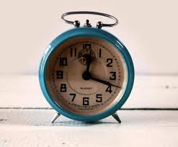
Alarm Clock (Good or Bad Design)
Notes:
I used to turn off alarm even when I was sleepy but when I was very sleepy it used to be easy for me to turn off the alarm and go back to sleep

Slide 22
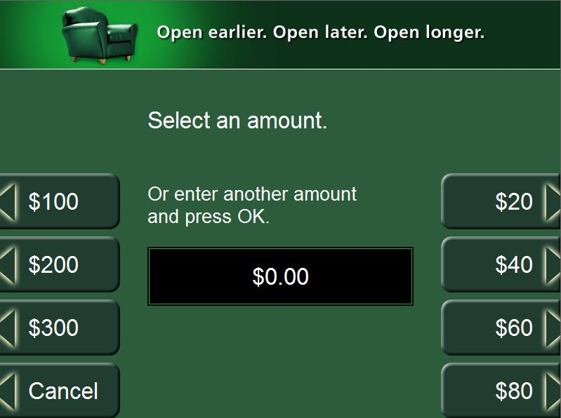
ATM Withdrawal Amount
Notes:
Why do I have to enter 3 0s to get 1000 out????????/

Slide 23
Bad Design is Costly
Lets make up a realistic example
Assume 50,000,000 Pakistani use ATMs, they use it 10 times a month on average
Time lost by a person due to entering 0’s is 5 sec each time
Pakistani’s are losing 694,444 or about 7 lakh hours a year!
Each one of us is losing 5 hours from our life!

Slide 24
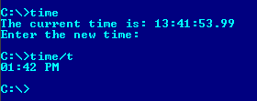
Why Study HCI – Software Perspective
Notes:
There are 3 different ways to change time in computer systems. Each designed for different platform and different kind of users who use it in different environments

Slide 25
Why Study HCI – Software Perspective

Slide 26
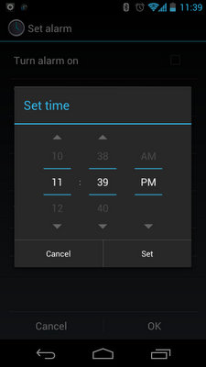
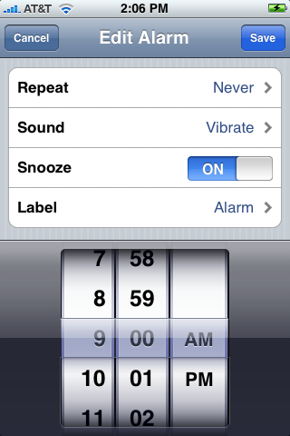
Why Study HCI – Software Perspective

Slide 27
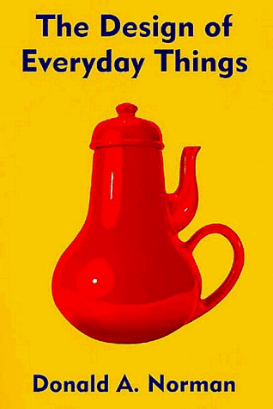
Don Norman’s Door Example
A classic book. Read it!
I will share its pdf soon
Main Point: no one reads manuals, so things should be designed so that manuals are not needed
BTW what is wrong with the kettle on the book cover?

Slide 28
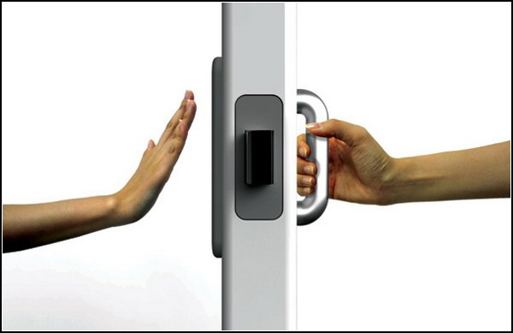
Don Norman’s Door Example
A plate naturally says “ push me” and a handle naturally says “pull me “

Slide 29
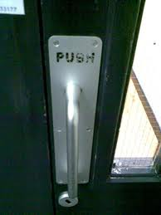
Don Norman’s Door Example
When Don Norman’s advice is not followed

Slide 30
Why Study HCI – Conclusions [1/2]
Few attempts to use any product
If not successful
Loses hope
Gives up
What are the consequences?

Slide 31
Why Study HCI – Conclusions [2/2]
To develop products / interaction techniques
Easy to use
Easy to learn
Easy to remember
To design user friendly systems
Efficient
Avoid unnecessary complexity

Slide 32
Some HCI Areas
Usability eng./testing
User interface design
Human factors/Ergonomics
Web design/usability
Graphic design
Information visualization
Many more…

Slide 33
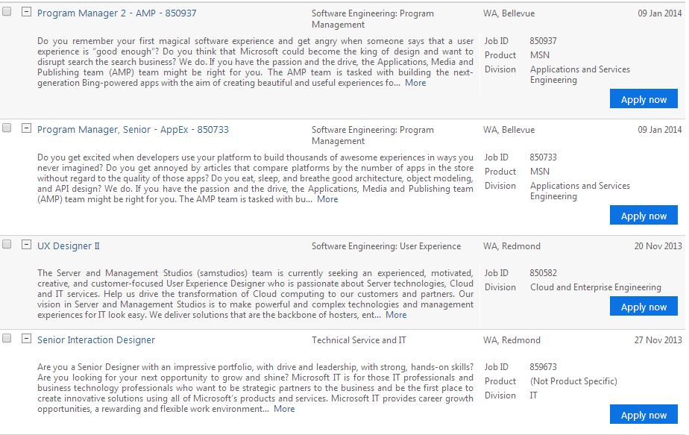
HCI Jobs
Is there any job for HCI experts? ☺

Slide 34
Origins of HCI

Slide 35
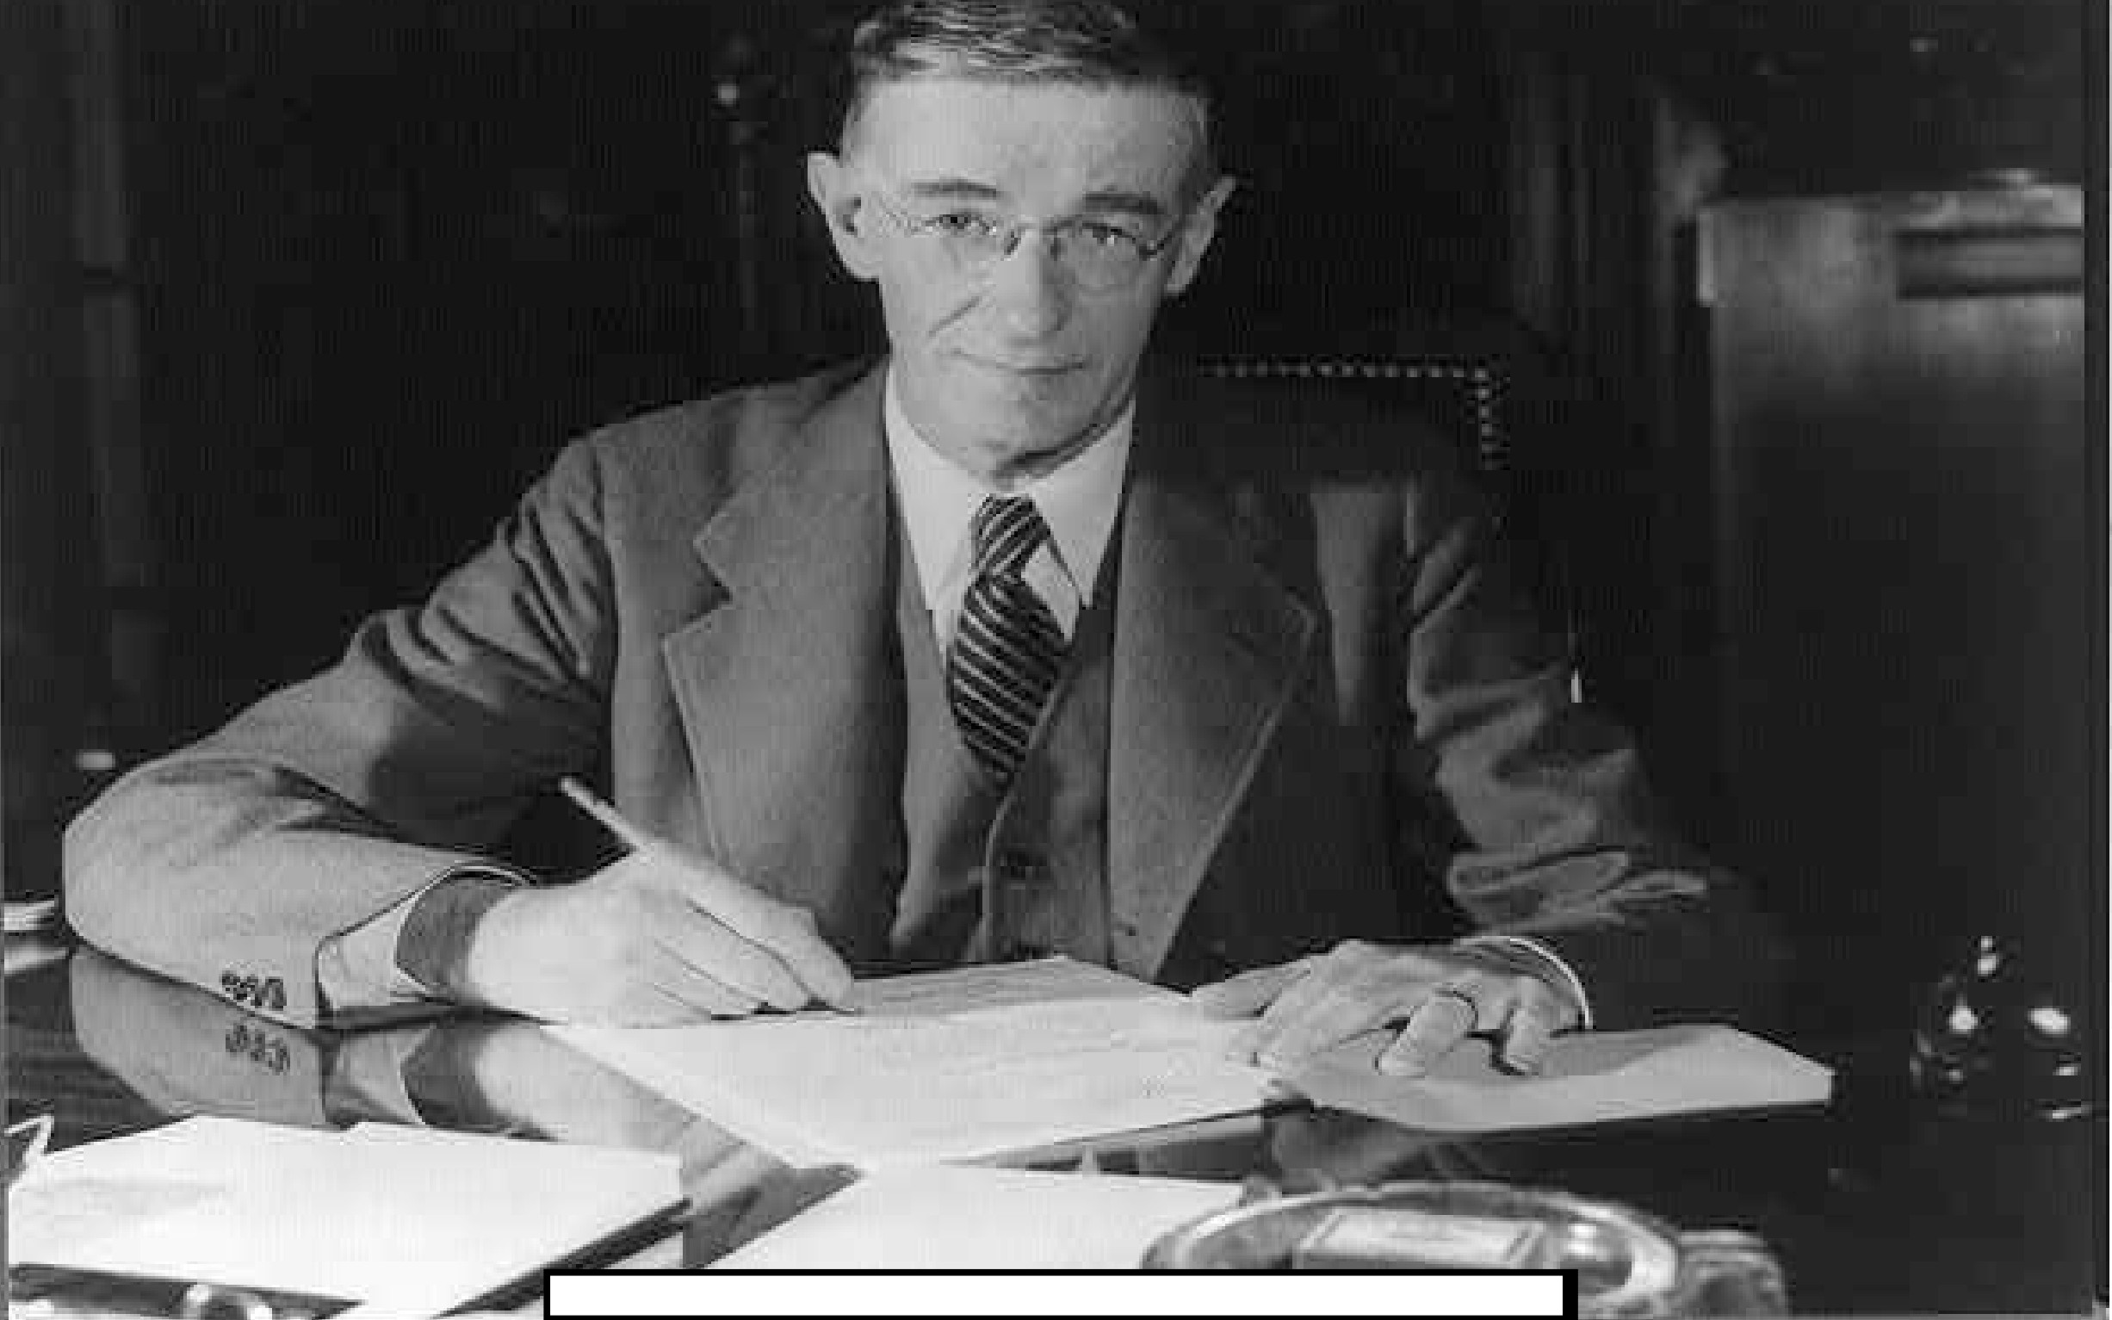
2
Image Courtesy of Wikipedia: http://en.wikipedia.org/wiki/File:Vannevar_Bush_portrait.jpg

Slide 36
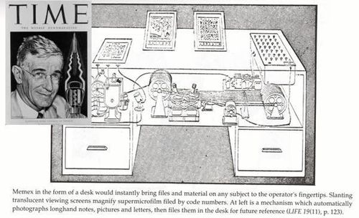

Slide 37
Memex
Notes:
The memex (a portmanteau of "memory" and "index"^{[1]} or "memory" and "extender") is the name of the hypothetical proto-hypertext system that Vannevar Bush described in his 1945 The Atlantic Monthly article "As We May Think". Bush envisioned the memex as a device in which individuals would compress and store all of their books, records, and communications, "mechanized so that it may be consulted with exceeding speed and flexibility." The memex would provide an "enlarged intimate supplement to one's memory"

Slide 38
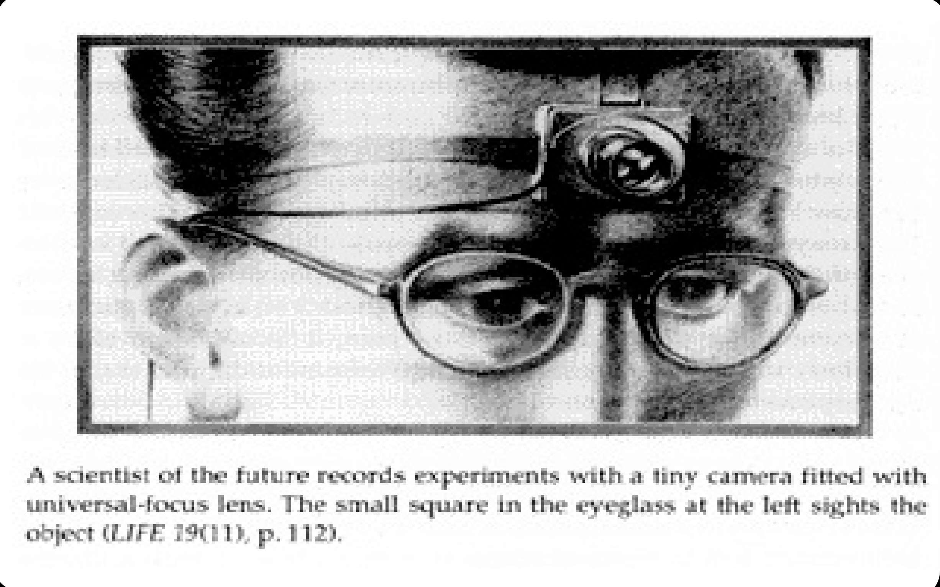
4

Slide 39
ENIAC

Slide 40
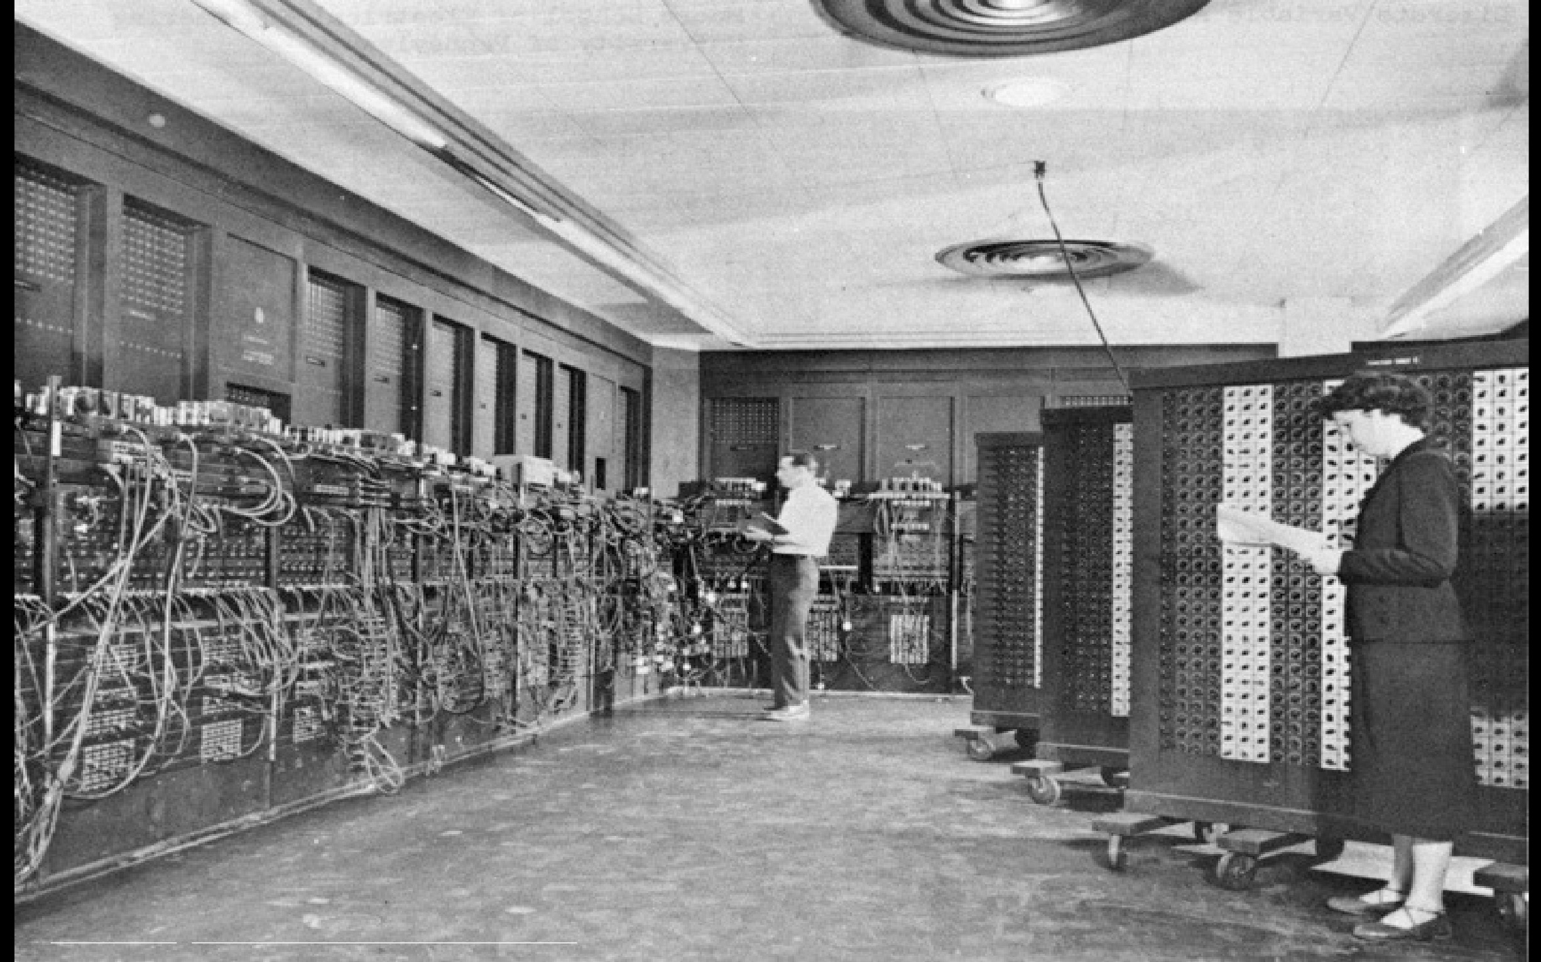
Image Courtesy of Wikipedia: http://en.wikipedia.org/wiki/File:Eniac.jpg
5
Notes:
ENIAC (/ˈini.æk/ or /ˈɛni.æk/; Electronic Numerical Integrator And Computer)^{[1][2][3]} was the first electronic general-purposecomputer. It was Turing-complete, digital, and capable of being reprogrammed to solve "a large class of numerical problems".^{[4][5]}
ENIAC was initially designed to calculate artillery firing tables for the United States Army's Ballistic Research Laboratory.^{[6][7]} When ENIAC was announced in 1946 it was heralded in the press as a "Giant Brain.

Slide 41
How do you think the users interacted with ENIAC?

Slide 42
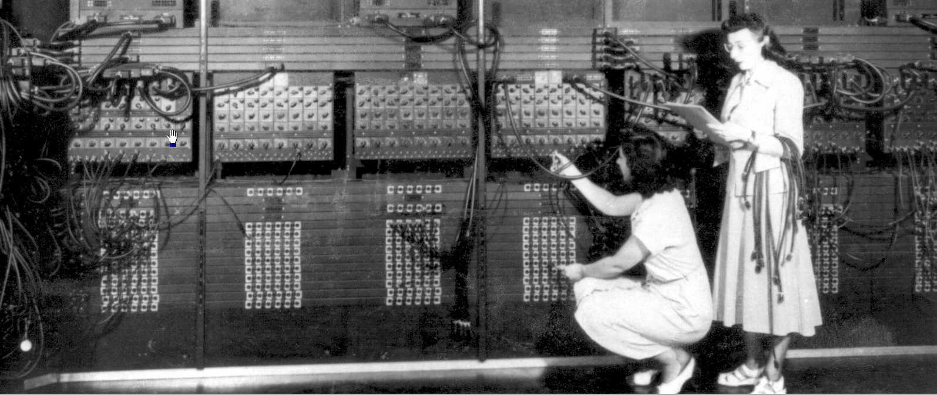
Notes:
Functionality was controlled by changing the wires which connected different units that performed different arithmetic operations

Slide 43
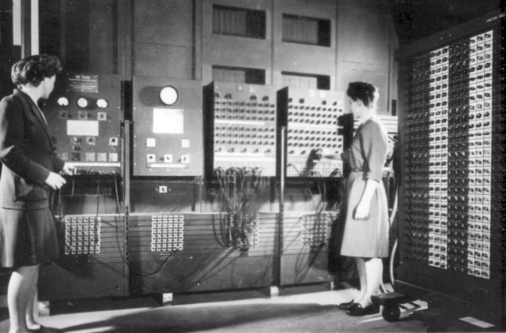
Notes:
Data i.e. numbers was entered using these boards

Slide 44
Compilers
Life became easier when compilers were introduced
First compiler Compiler A was written by Grace Hopper
Compilers translates human like programming languages to object code

Slide 45
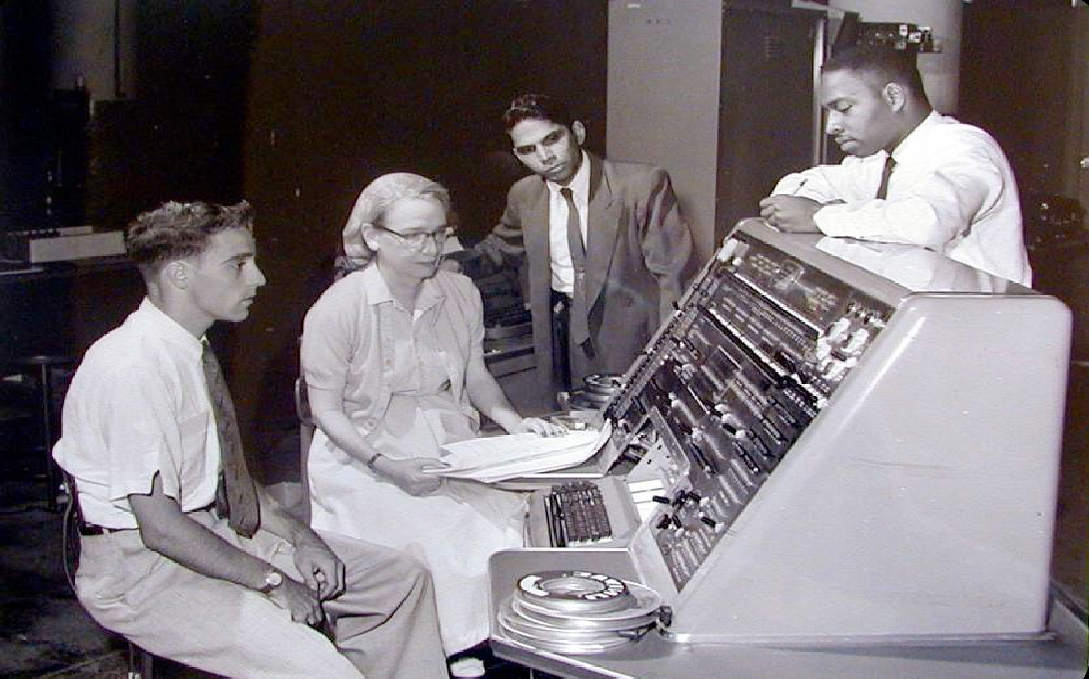
6
Notes:
Grace hopper working on a UNIVAC machine

Slide 46
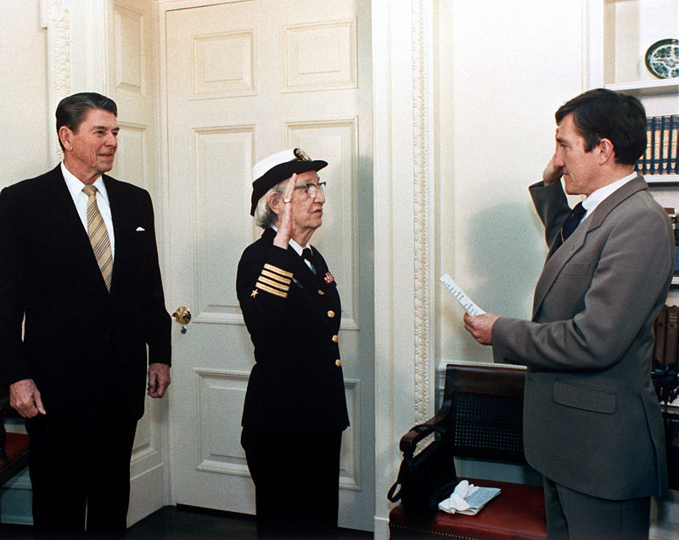
Notes:
She retired in 1960 at age of 60 but was recalled to active duty after a few months and remained in duty for a long time. This pic is from 1983 when she was promoted to rank of comodore. She retired as a rear admniral

Slide 47
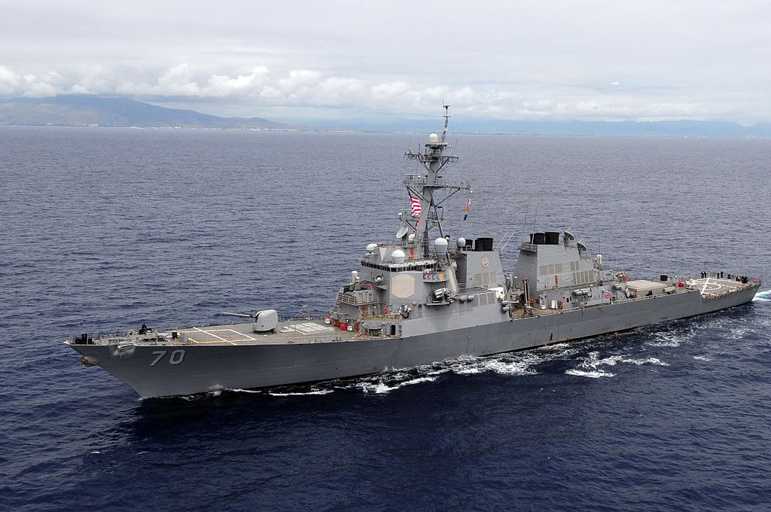
USS Hopper

Slide 48
The Road Ahead
It was a long way from the compiler to the computer in the current form.
There are 3 major miles stones that enabled this
Input on Output
Mouse
Graphical User Interface

Slide 49
The Graphical User Interface

Slide 50
The Graphical User Interface
Input over Output
Powerful as it makes it easier
The first such system was developed at MIT Lincon Lab and was called the Sketchpad in 1963.
It used a light pen in conjunction with a CRT display
A light pen detects a change of brightness of nearby screen pixels
Notes:
In 1963 most computers ran jobs in batch job mode only, using pucnh card ang magentic tapes submitted by professional programmers or tech students. A considerable amount of work was required to make the TX-2 operate in interactive mode with a large CRT screen. When Sutherland had finished with it, it had to be reconverted to run in batch mode again.

Slide 51
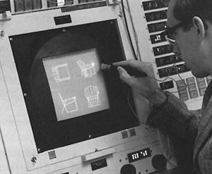
Courtesy of MIT Lincoln Laboratory, Lexington Massachusetts
8

Slide 52
The Mouse
9

Slide 53
Mouse
The first mouse was developed at Stanford and was first used in a Xerox computer in 1973
Called X-Y indicator
Flopped
First successful commercial mouse was introduced in Apple’s Lisa in 1980s

Slide 54
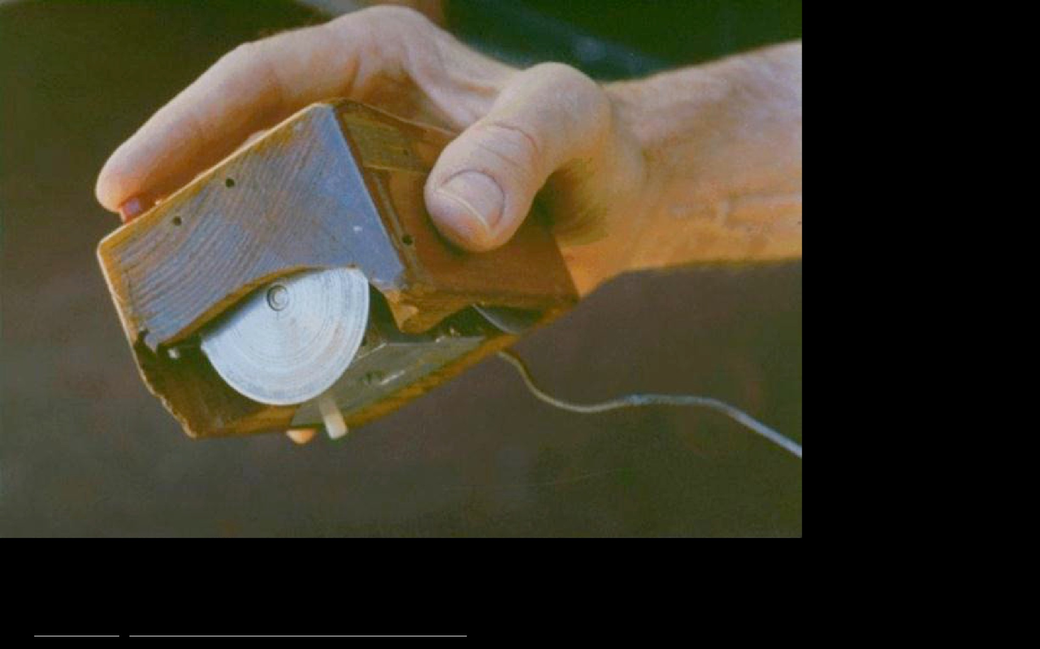
Image Courtesy of Wikipedia: http://en.wikipedia.org/wiki/File:Firstmouseundersidejpg
11

Slide 55
Video
Lets now watch a movie clip of the first mouse in action

Slide 56
Graphical User interface
Credited to Alan Kay
Student of inventor of sketchpad,
Saw demo of mouse and got inspired
Went on to develop Xerox Star OS 1982
He also made a rough prototype of Dynabook
A iPad type computer
A computer for kids

Slide 57
Video of Star OS

Slide 58
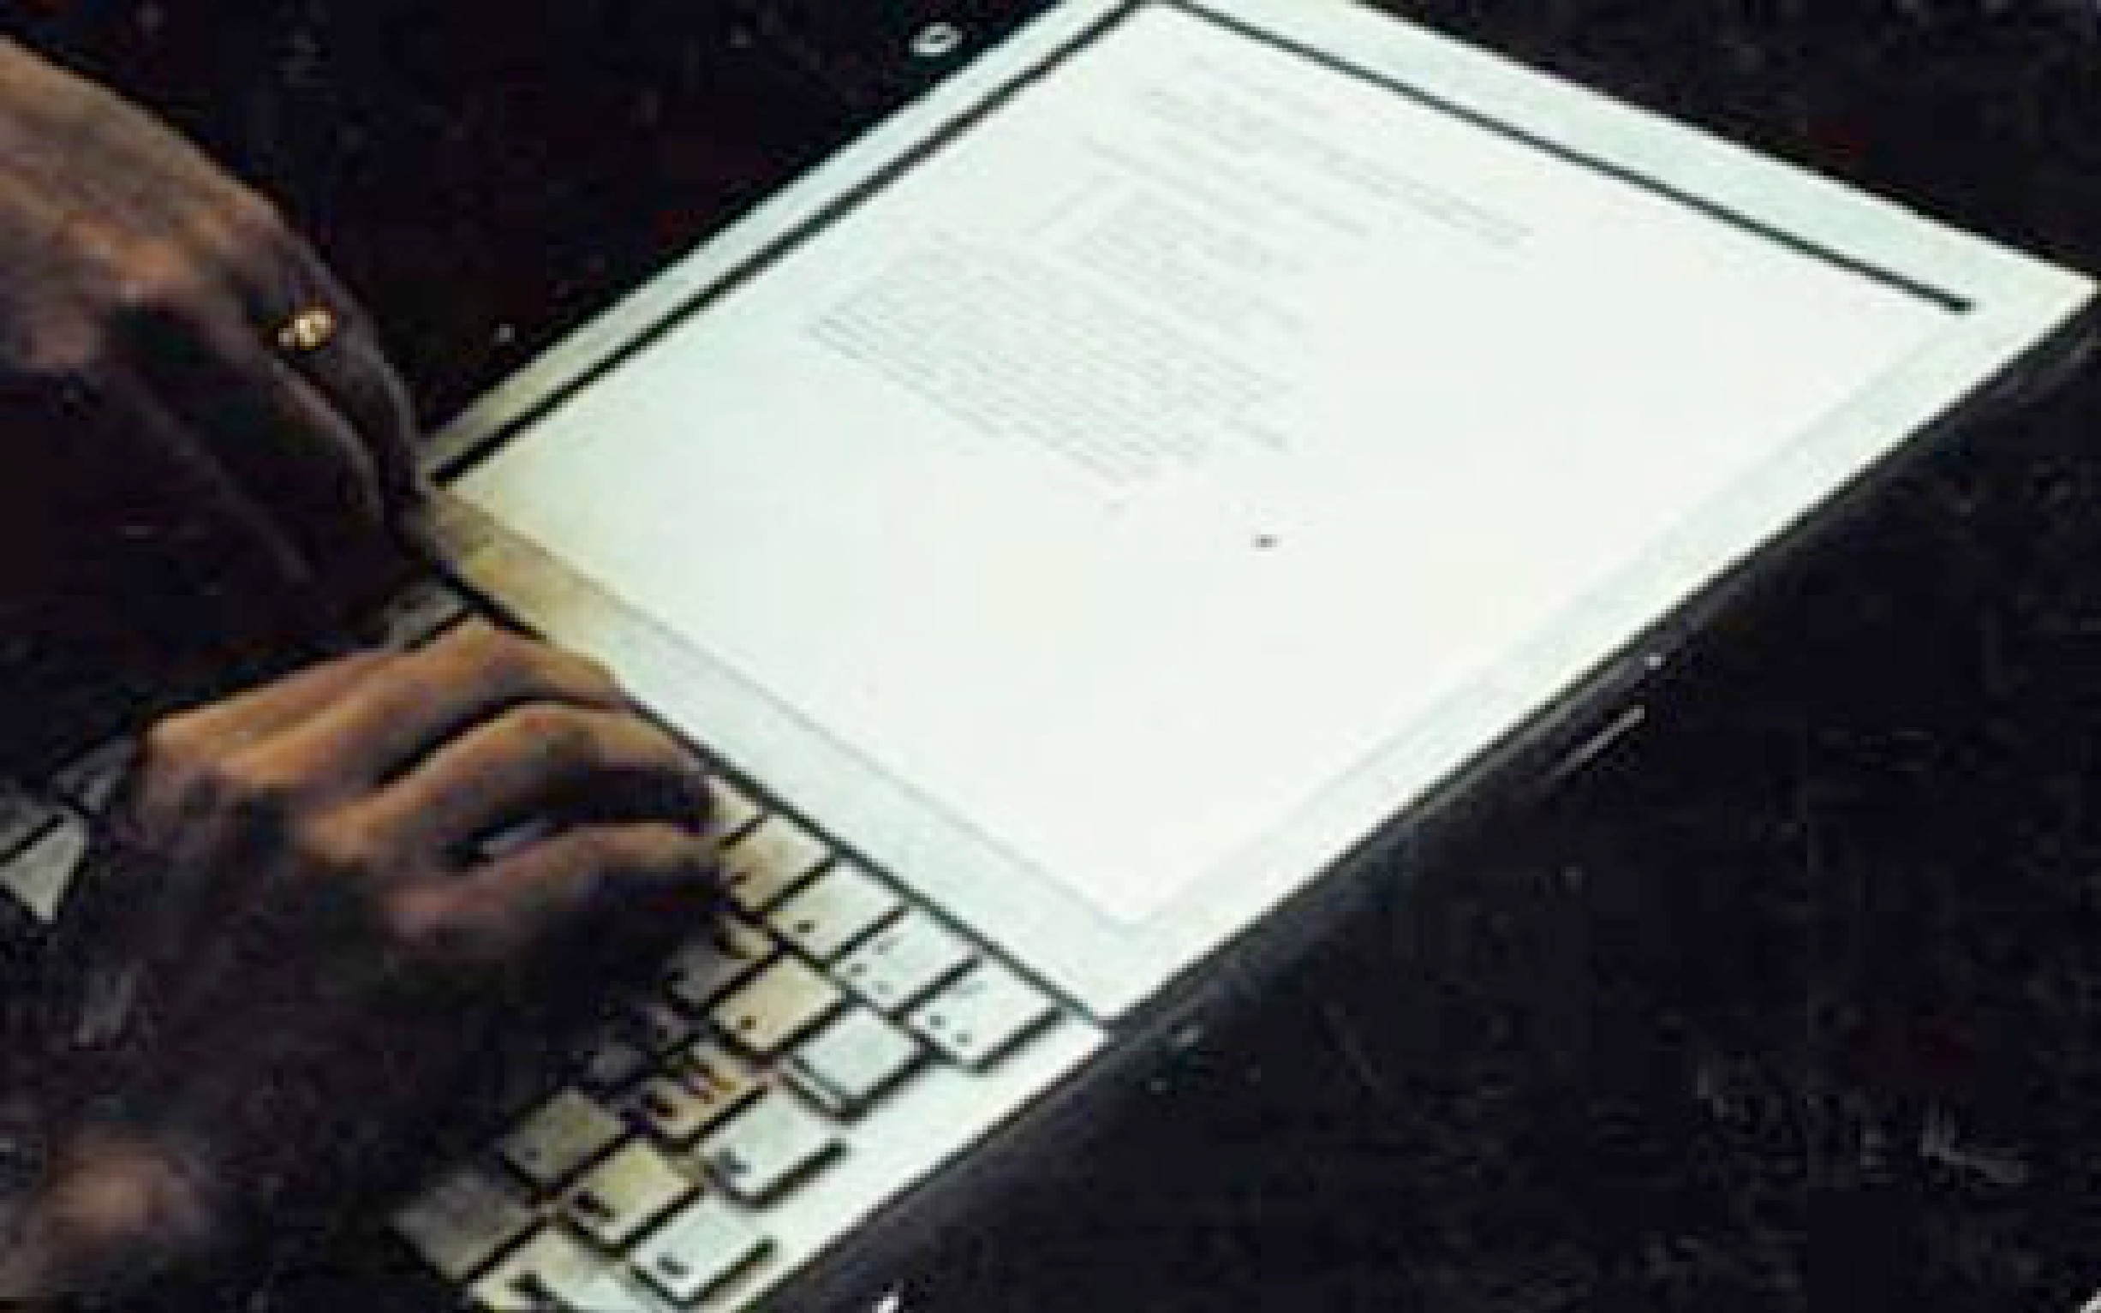
Dynabook
14

Slide 59
The “Long Nose” of Innovation (Buxton)
Notes:
These are examples of what Bill Buxton calls “the ‘Long Nose’ of Innovation”, that the early ideas behind a new technology paradigm are often seeded decades before the major commercial adoption.

Slide 60
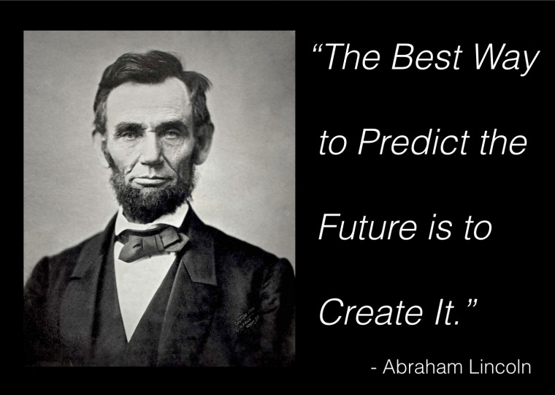
13

Slide 61
Introduction to prototyping

Slide 62
Prototyping Grounds Communication
Images Courtesy Bjoern Hartmann
2

Slide 63
Image Courtesy IDEO
3

Slide 64
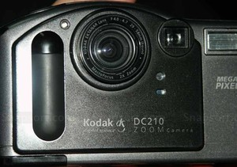
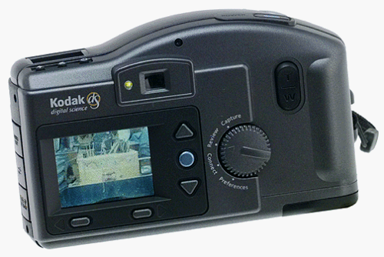

Slide 65
Prototyping is a strategy for efficiently dealing with things that are hard to predict
4

Slide 66
What do Prototype Help you Find?
Your known unknowns
Your unknown unknowns

Slide 67
Humans are bad at estimating the range of possibilities
They limit themselves to small possibilities
Common mistake is to come up with one idea you think is super cool and stick to that
Good thing is to consider many possible options

Slide 68
Focus on Goals Evolve the Designs
5

Slide 69
Good Strategy
Begin with a wide range of possible designs…very rough in form
Reduce the number of designs
Add some variations
Continue this and gradually reduce the number of possible options
Until you are considering small variations like font or shade of blues

Slide 70
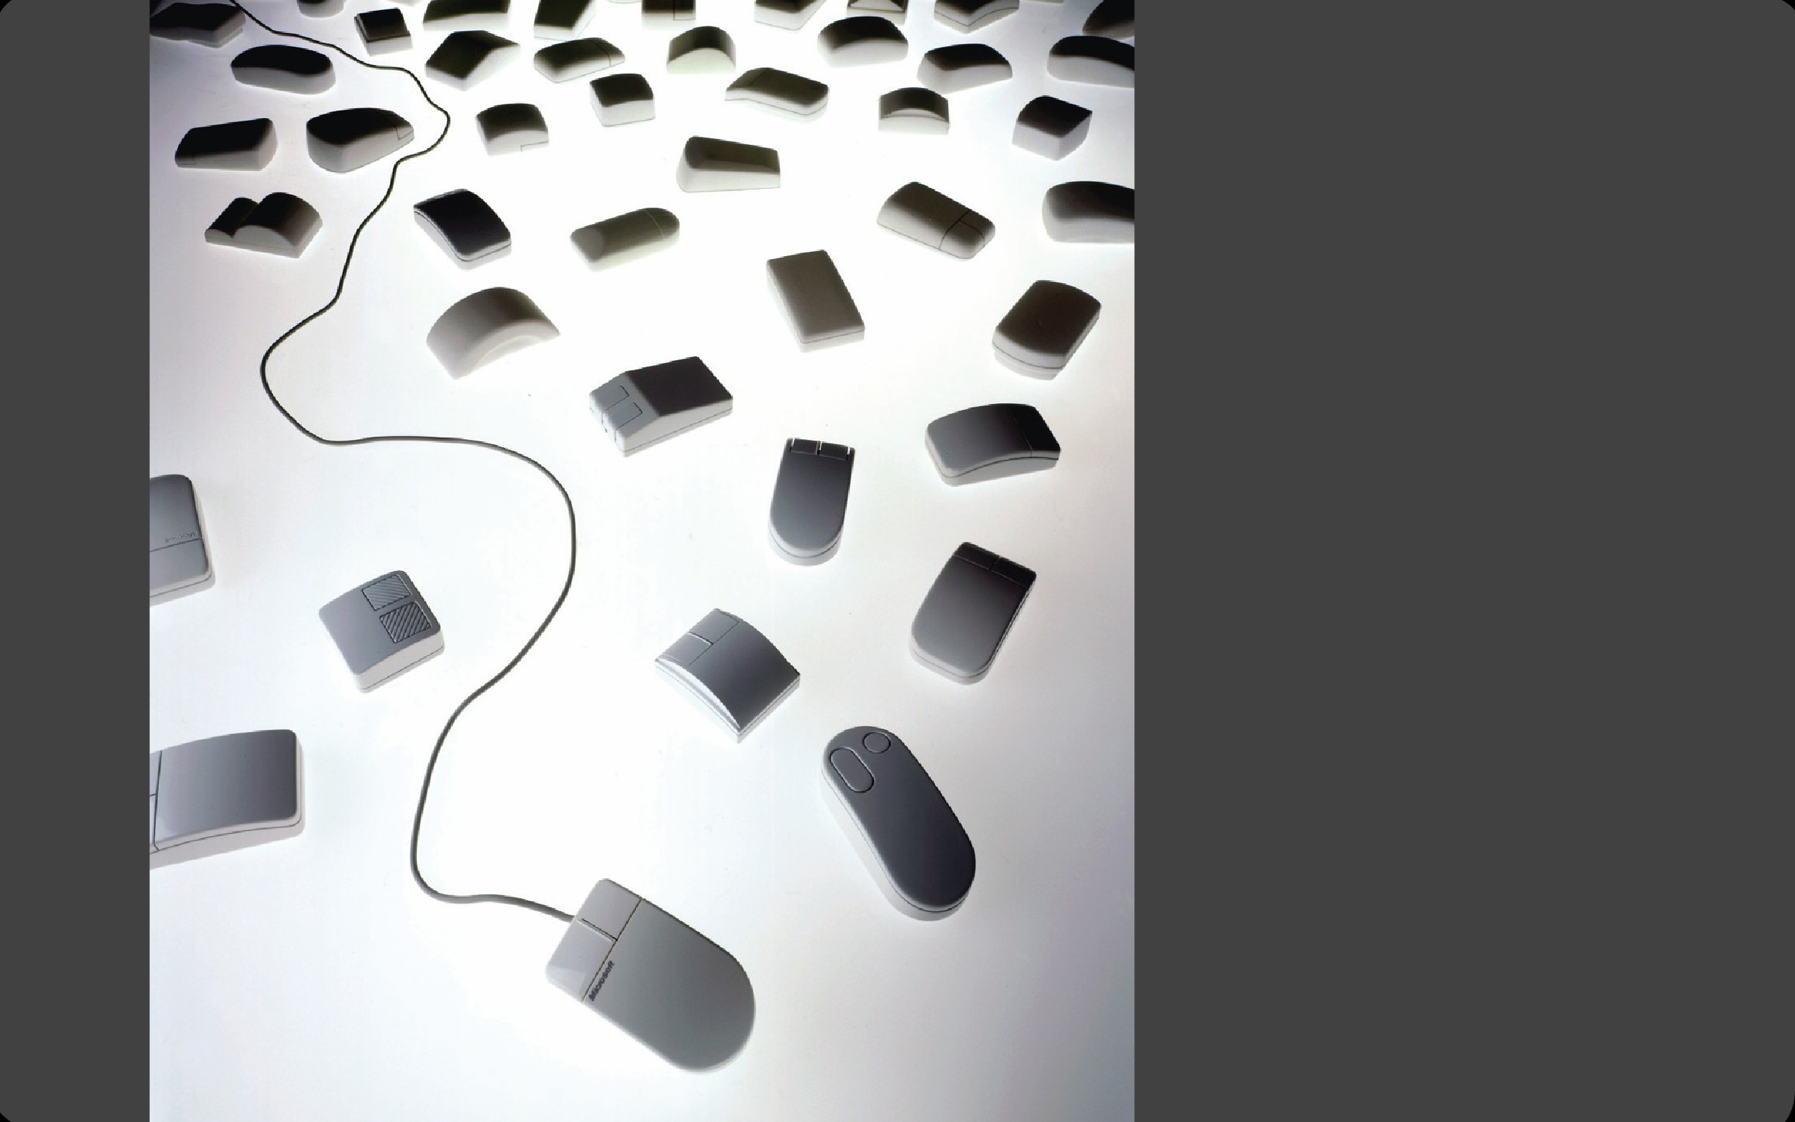
IDEO Prototypes for Microsoft Mouse
Some aim for beauty
Other aim for comfort
By trying these different options they were able to reach a good compromise
Image Courtesy IDEO
138

Slide 71
The rights of a prototype
Should not be required to be complete
Should be easy to change Gets to retire
8

Slide 72
What Do Prototypes Prototype?
Feel
What might it look like?
Implementation
What might it work like?
Role
What might the experience be like?
Houde & Hill

Slide 73
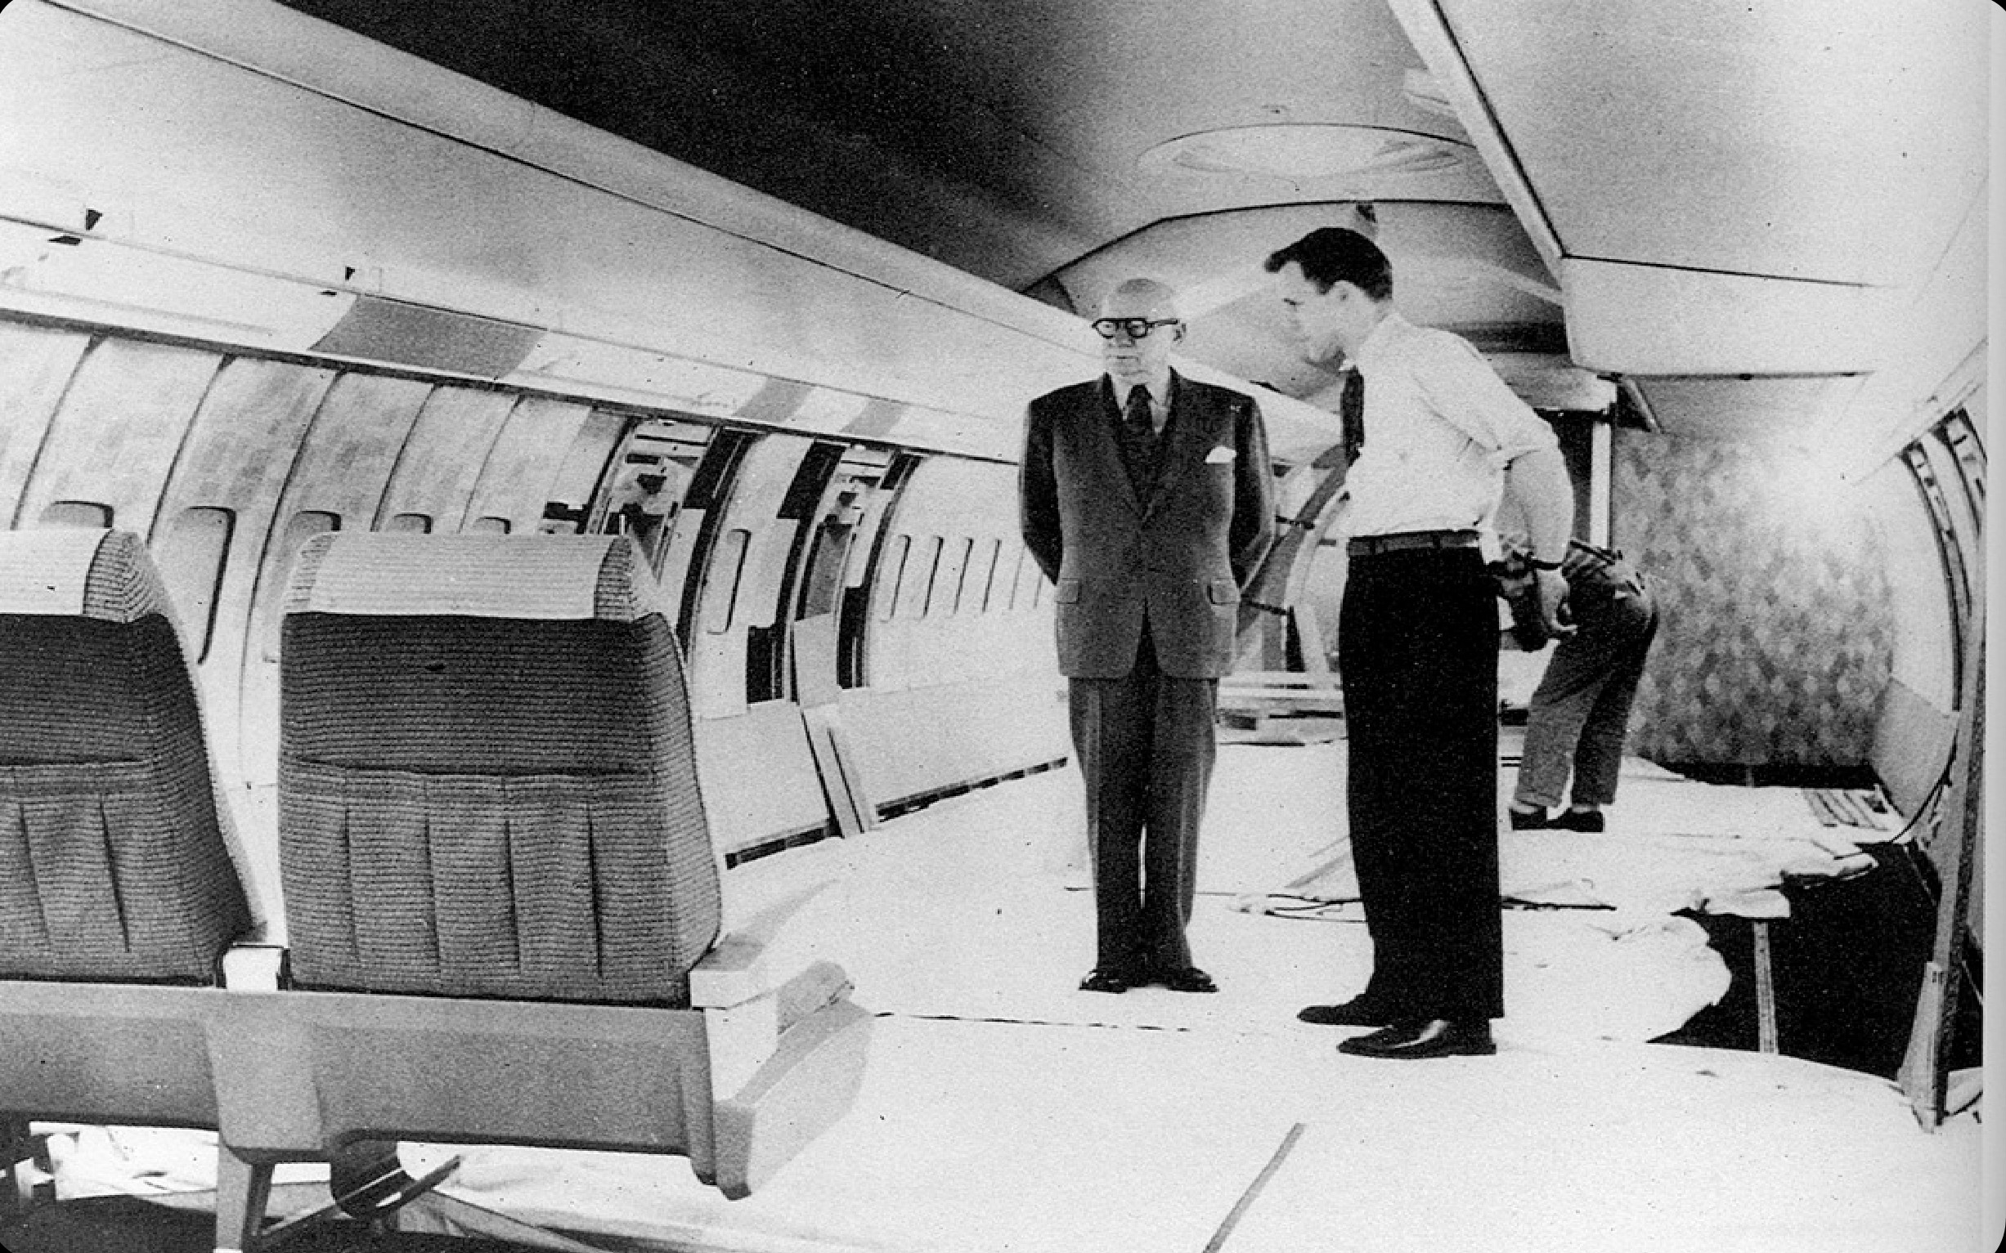
11

Slide 74
“The best way to have a good idea is to have lots of ideas.”
-Linus Pauling
Image Courtesy Wikipedia: http://en.wikipedia.org/wiki/File:L_Pauling.jpg
12

Slide 75
Evaluating Designs

Slide 76
How can we measure success? How do we know?
2

Slide 77
Why Evaluate Designs with
People?
3

Slide 78
What are some things you might want to learn about an interface? How would you find them out?
4

Slide 79
Different Methods
Achieve Different Goals
Some Examples...
5

Slide 80
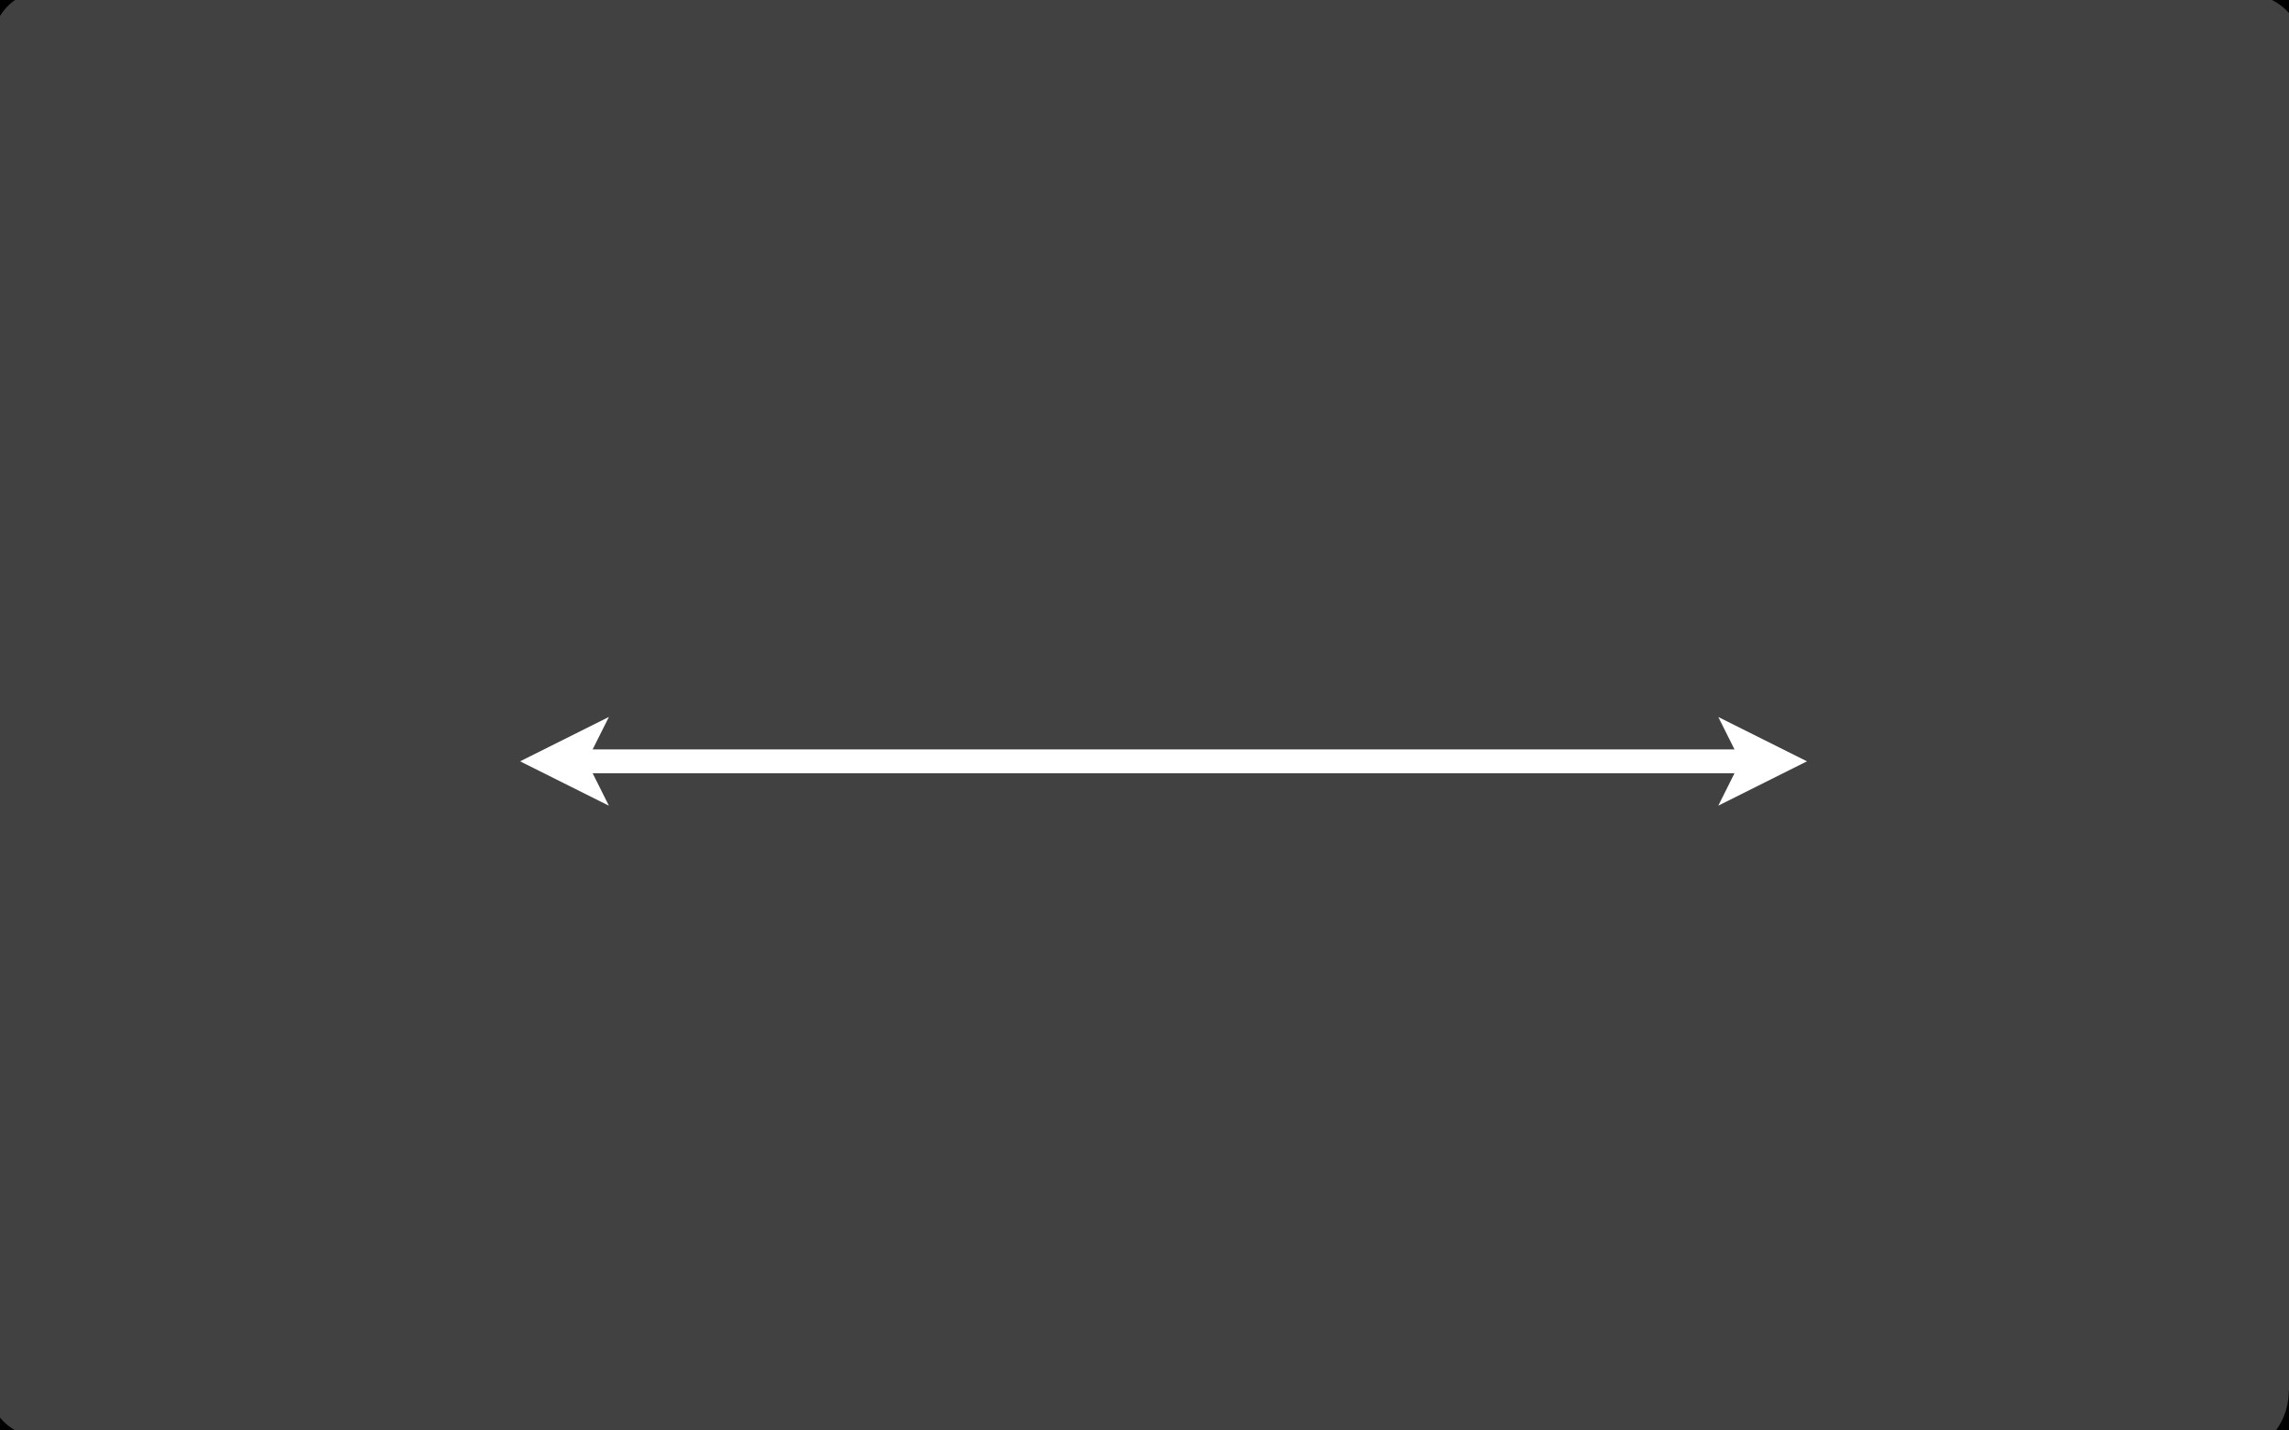
Usability Studies
informal
formal
6

Slide 81
Surveys & Focus Groups
http://sfpuc.c.topica.com/maapeWDab5NjaaU3oZpeaeQK6z/
7

Slide 82
Feedback from Experts

Slide 83
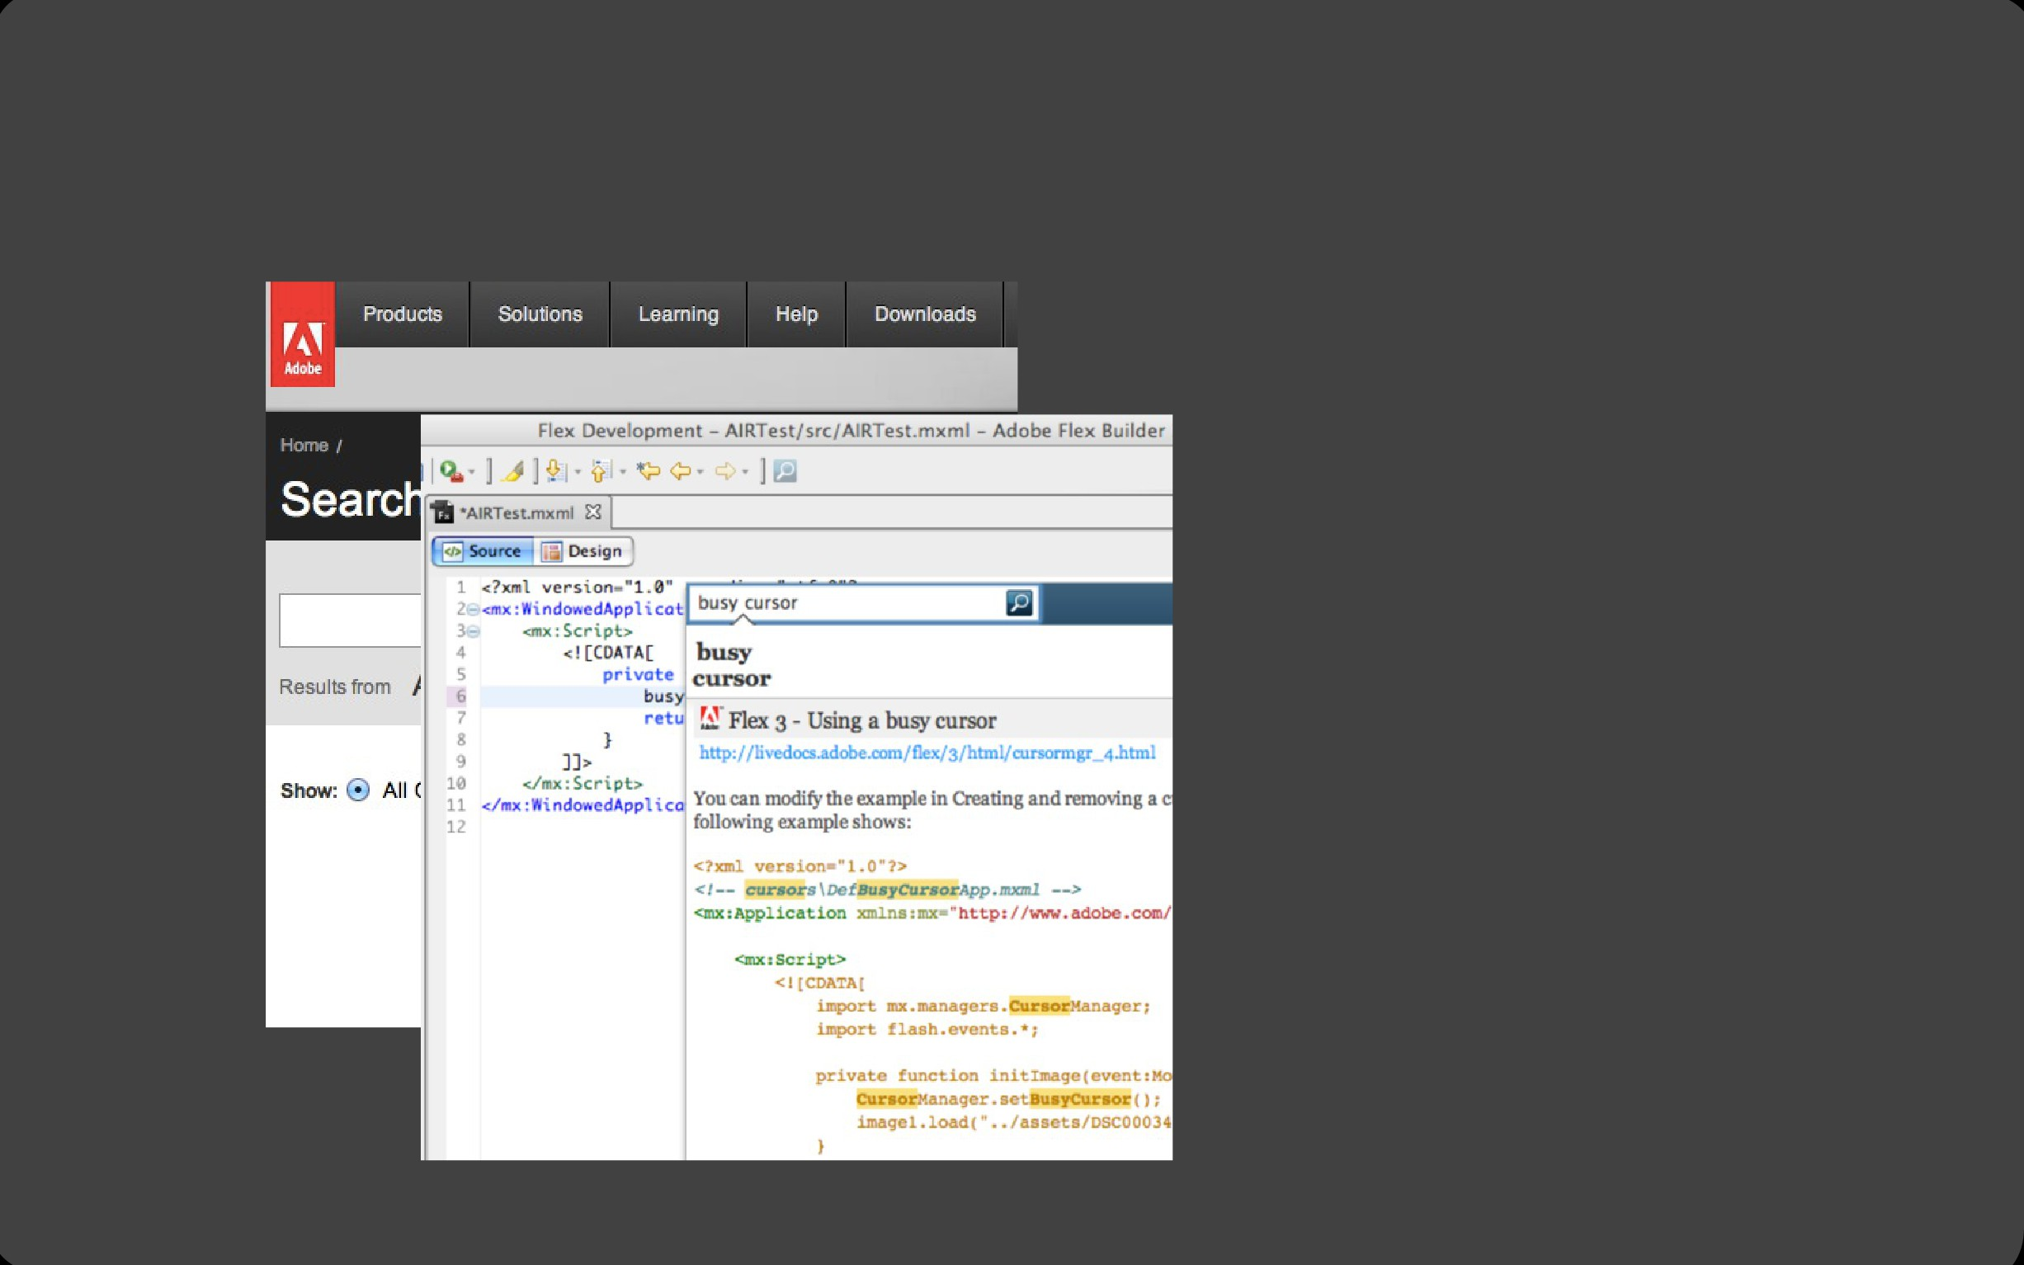
Comparative Experiments
Joel Brandt et al., comparing Community Help and Blueprint
9

Slide 84
Quiz#1 06-03-2018
If you want to design a new interface for scientific calculator in a smart phone
What would efficiency , effectiveness and satisfaction mean?
Notes:
Efficiency: Users perform required task with minimum errors
Effectiveness: Users actually are able to find the required sign quickly ☺
Satisfaction: You feel happy after using the interface

Slide 85
Projects

Slide 86
Project
Most of the value will be from the projects
Work seriously
Groups of 3 (group of 4 might be allowed if project is big)
I will suggest some projects, but you can come up with your own project proposals

Slide 87
Proposal 1
Redesigning Smart Phone Contact Book
Contact books are essentially a copy of paper pen contact books.
I think there are several issues with the contact book
One problem I personally observed is that I do not remember the person name but I remember the context
Relationship to some friend, place of meeting, etc etc…..
I think people use context someway

Slide 88
Proposal 2
Redesigning Smart Phone Contact Book
Another problem is that I personally seem to call certain people at certain times
Driver early morning
My friends mostly on weekends and evenings
Redesign contact book to cater for this
Not rearrangement of UI components projects
A data collection app will be provided

Slide 89
Project Proposal 3
Expense Tracker
In a country like Pakistan, most people don’t have a lot of money
They would want to spend it wisely
Many web, computer and mobile system are available
Hard to use because of the data entry requirements
Can some improvement be made?

Slide 90
Project Proposal 4
Urdu Learning
My five year old daughter has a hard time learning Alif, bay, Pay…. In school
She hates it probably because the shapes don’t make any sense to her
Can you help her?

Slide 91
Next Project Task
Form Groups this week and choose a project
Each group will then give a presentation next class
Audience will give feedback and suggest changes if needed

