Slide 1
Chapter 1
Introduction

Slide 2
Programming Languages
Programming languages are notations for describing computations to people and to machines.
All the software running on all the computers was written in some programming language.
But, before a program can be run, it first must be translated into a form in which it can be executed by a computer (binary).
The software systems that do this translation are called compilers.

Slide 3
Compilers
A compiler is a program that can read a program in one language the source language and translate it into an equivalent program in another language.
An important role of the compiler is to report any errors in the source program that it detects during the translation process

Slide 4
Interpreters Vs Compilers [1]
An interpreter, like a compiler, translates high-level language into low-level machine language.
The difference lies in the way they read the source code.
A compiler reads the whole source code and then translates.
While an interpreter reads a statement from the input program, translates it and executes it, then takes the next statement in sequence.
If an error occurs, an interpreter stops execution and reports it.
Whereas a compiler reads the whole program even if it encounters several errors and reports them in the end.

Slide 5
Interpreters Vs Compilers [2]
The machine-language target program produced by a compiler is usually much faster than an interpreter.
An interpreter, however, can usually give better error diagnostics than a compiler, because it executes the source program statement by statement.

Slide 6
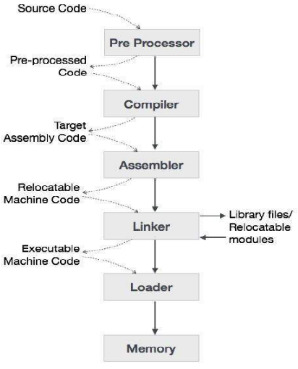
Preprocessors, Compilers, Assemblers, and Linkers [1]
The high-level language is converted into binary language in various phases.
In addition to a compiler, several other programs may be required to create an executable target program.
For example a source program may be divided into modules stored in separate files.
The task of collecting the source program is sometimes entrusted to a separate program, called a preprocessor.
The preprocessor may also expand short hands, called macros, into source language statements..

Slide 7
Preprocessors, Compilers, Assemblers, and Linkers [2]
The modified source program is then fed to a compiler.
A compiler is a program that converts high-level language to assembly language.
The compiler may produce an assembly-language program as its output, because assembly language is easier to produce as output and is easier to debug.
The assembly language is then processed by a program called an assembler that produces re-locatable machine code as its output

Slide 8
Preprocessors, Compilers, Assemblers, and Linkers [3]
Large programs are often compiled in pieces, so the re-locatable machine code may have to be linked together with other locatable object files and library files into the code that actually runs on the machine.
The linker resolves external memory addresses, where the code in one file may refer to a location in another file.
The loader then puts together all of the executable object files into memory for execution.

Slide 9
The Structure of a Compiler [1]
Up to this point we have treated a compiler as a single box.
if we open up this box a little, there are two parts to this mapping:
1) Analysis:
breaks up the source program into constituent pieces and imposes a grammatical structure on them.
this structure is used to create an intermediate representation of the source program.
It must inform the user about syntax or semantics errors.
It also collects information about the source program and stores it in a data structure called a symbol table, which is passed along with the intermediate representation to the synthesis part.

Slide 10
The Structure of a Compiler [2]
2) synthesis.
Constructs the desired target program from the intermediate representation and the symbol table.
The analysis part is often called the front end of the compiler; the synthesis part is the back end.
the compilation process operates as a sequence of phases, each of which transforms one representation of the source program to another.

Slide 11
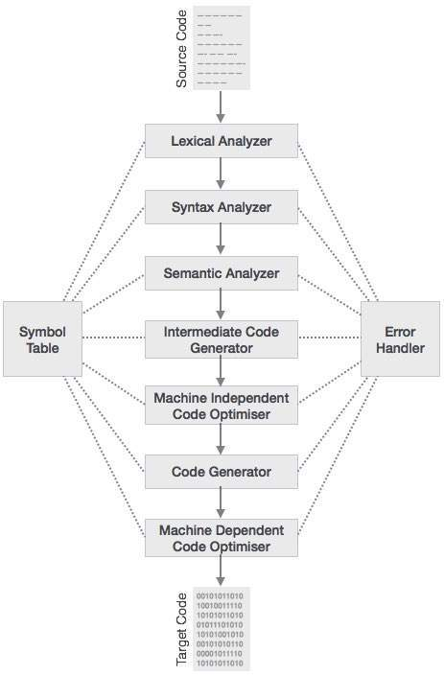
Phases of a Compiler [1]
In practice, several phases may be grouped together, and the intermediate representations between the grouped phases need not be constructed explicitly.
The symbol table stores information about the source program which is used by all phases of the compiler

Slide 12
Phases of a Compiler [2]
Some compilers have a machine-independent optimization phase between the front end and the back end.
Optimization phase transforms the intermediate representation, so that the back end can produce a better target program from intermediate representation.
Optimization is optional, one or the two optimization phases shown in the previous figure may be missing.

Slide 13
Lexical Analysis [1]
Also called scanning.
Reads the source program groups the characters into meaningful sequences called lexemes.
For each lexeme, produces an output token of the form (token-name, attribute-value) that it passes on to syntax analysis.
token-name is an abstract symbol that is used during syntax analysis, and attribute-value points to an entry in the symbol table for this token.

Slide 14
Lexical Analysis [2]
Symbol-table entry is needed for semantic analysis and code generation.
For example, suppose a source program contains the assignment statement
Characters in this assignment could be grouped into the following lexemes and mapped into the following tokens passed on to the syntax analyzer:
Position is a lexeme mapped into a token (id, 1), where id is an abstract symbol standing for identifier and 1 points to the symbol table entry for position .
The symbol-table entry for an identifier holds as its name and type.

Slide 15
Lexical Analysis [3]
The assignment symbol = is a lexeme mapped into the token (=). Since this token needs no attribute-value, we have omitted the second component.
Initial is a lexeme mapped into the token (id, 2), where 2 points to the symbol-table entry for initial .
+ is a lexeme mapped into the token (+).
rate is a lexeme mapped into the token (id, 3), where 3 points to the symbol-table entry for r a t e .
* is a lexeme mapped into the token (*).
60 is a lexeme mapped into the token (60).
Blanks are discarded by the lexical analyzer.

Slide 16
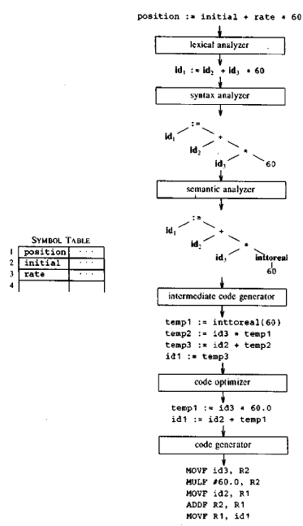
Translation of the assignment statement.

Slide 17
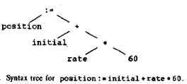
Syntax Analysis [1]
Also called parsing.
Uses the first components of the tokens to create a tree-like intermediate representation that depicts the grammatical structure of the token stream.
A typical representation is a syntax tree in which
each interior node represents an operation and the children of the node represent the arguments of the operation.
Tree shows the order in which the operations in the assignment are to be performed.
The tree has an interior node labeled * with (id, 3) as its left child and the integer 60 as its right child.
The node (id, 3) represents the identifier rate.

Slide 18
Syntax Analysis [2]
The node labeled * means that we must first multiply the value of rate by 60.
The node labeled + indicates that we must add the result of this multiplication to the value of initial.
The root of the tree, labeled =, indicates that we must store the result of this addition into the location for the identifier position.
This ordering of operations is consistent with the usual conventions of arithmetic which tell us that multiplication has higher precedence than addition, and hence that the multiplication is to be performed before the addition.

Slide 19
Semantic Analysis
Uses the syntax tree and the symbol table to check the source program for semantic consistency with the language definition.
Also gathers type information and saves it in the syntax tree or the symbol table.
semantic analysis performs type checking, where the compiler checks that each operator has matching operands.
The language specification may permit some type conversions called coercions.
For example, if a binary arithmetic operator is applied to a floating-point number and an integer, the compiler may convert or coerce the integer into a floating-point number.
Such a coercion appeared in our earlier example.

