Slide 1
Data Communication

Slide 2
Multiplexing
Whenever the bandwidth of a medium linking two devices is greater than the bandwidth needs of the devices, the link can be shared.
Multiplexing is the set of techniques that allow the simultaneous transmission of multiple signals across a single data link.
Today’s technology includes high-bandwidth media.
Each has a bandwidth far in excess of that needed for the average transmission signal.
If the bandwidth of a link is greater than the bandwidth needs of the devices connected to it, the bandwidth is wasted.
An efficient system maximizes the utilization of all resources; bandwidth is one of the most precious resources we have in data communications.

Slide 3
Multiplexing

Slide 4
Multiplexing
In a multiplexed system, n lines share the bandwidth of one link.
Figure shows the basic format of a multiplexed system.
The lines on the left direct their transmission streams to a multiplexer (MUX), which combines them into a single stream (many-to-one).
At the receiving end, that stream is fed into a de-multiplexer (DEMUX).
Link refers to the physical path while channel refers to the portion of a link that carries a transmission between a given pair of lines.
One link can have many (n) channels.

Slide 5
Categories of multiplexing
There are three basic multiplexing techniques: frequency-division multiplexing, wavelength-division multiplexing, and time-division multiplexing.
The first two are techniques designed for analog signals, the third, for digital signals.

Slide 6
FDM (Frequency Division multiplexing)
Frequency-division multiplexing (FDM) is an analog technique that can be applied when the bandwidth of a link (in hertz) is greater than the combined bandwidths of the signals to be transmitted.
In FDM, signals generated by each sending device modulate different carrier frequencies.
These modulated signals are then combined into a single composite signal that can be transported by the link.
Carrier frequencies are separated by sufficient bandwidth to accommodate the modulated signal.
These bandwidth ranges are the channels through which the various signals travel.
Channels can be separated by strips of unused bandwidth—guard bands—to prevent signals from overlapping.
In addition, carrier frequencies must not interfere with the original data frequencies.

Slide 7
FDM (Frequency Division multiplexing)

Slide 8
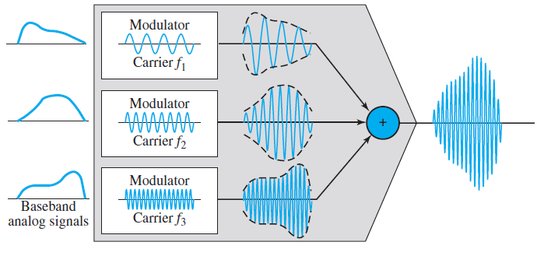
FDM Process

Slide 9
FDM Process
Figure above is a conceptual illustration of the multiplexing process.
Each source generates a signal of a similar frequency range.
Inside the multiplexer, these similar signals modulate different carrier frequencies ( f1, f2, and f3).
The resulting modulated signals are then combined into a single composite signal that is sent out over a media link that has enough bandwidth to accommodate it.

Slide 10
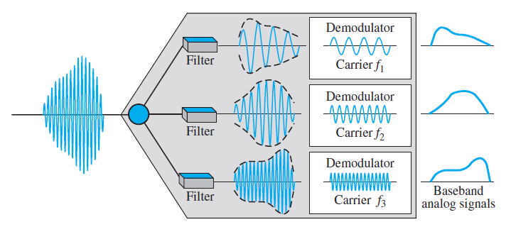
De-multiplexing Process

Slide 11
De-multiplexing Process
The de-multiplexer uses a series of filters to decompose the multiplexed signal into its constituent component signals.
The individual signals are then passed to a demodulator that separates them from their carriers and passes them to the output lines.
Figure above is a conceptual illustration of de-multiplexing process.

Slide 12
De-multiplexing Process
The de-multiplexer uses a series of filters to decompose the multiplexed signal into its constituent component signals.
The individual signals are then passed to a demodulator that separates them from their carriers and passes them to the output lines.
Figure above is a conceptual illustration of de-multiplexing process.

Slide 13
Example:
Assume that a voice channel occupies a bandwidth of 4 kHz. We need to combine three voice channels into a link with a bandwidth of 12 kHz, from 20 to 32 kHz. Show the configuration, using the frequency domain. Assume there are no guard bands.
Solution
We shift (modulate) each of the three voice channels to a different bandwidth, as shown in Figure. We use the 20- to 24-kHz bandwidth for the first channel, the 24- to 28-kHz bandwidth for the second channel, and the 28- to 32-kHz bandwidth for the third one. Then we combine them as shown in Figure

Slide 14
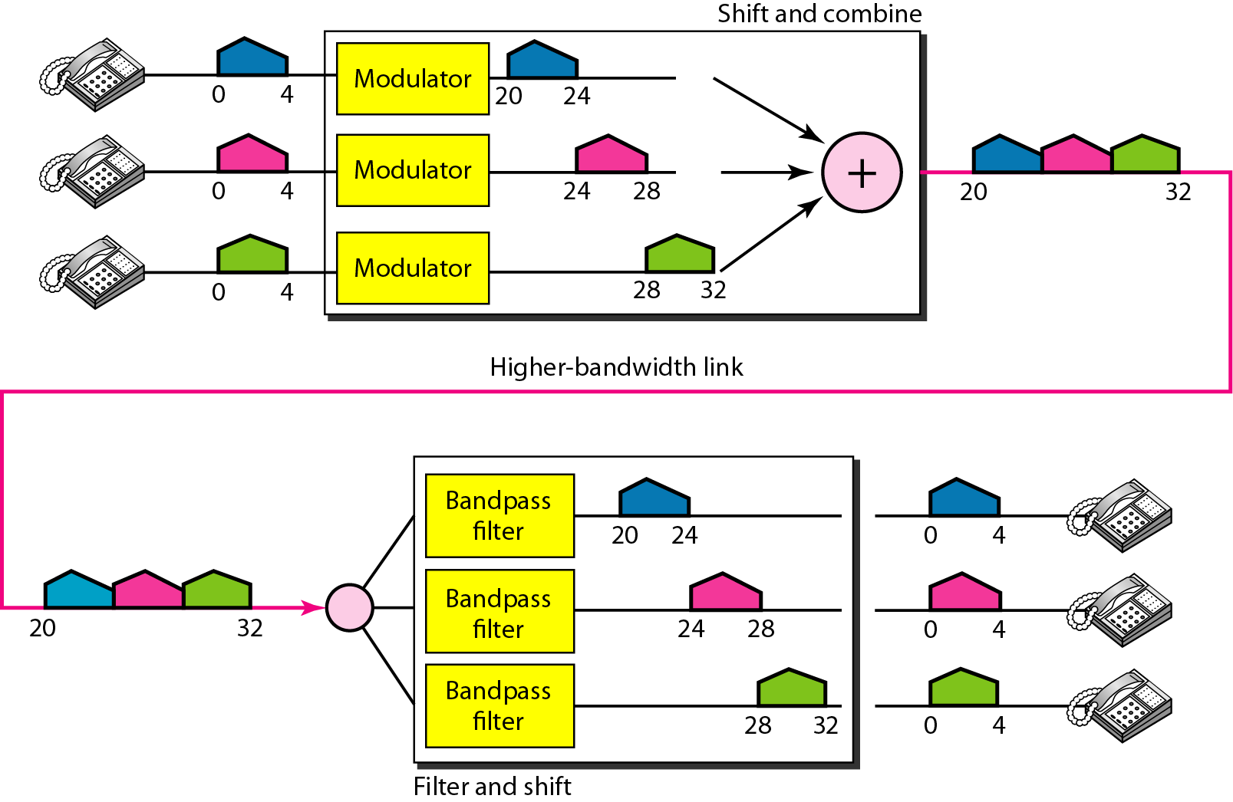

Slide 15
Example:
Five channels, each with a 100-kHz bandwidth, are to be multiplexed together. What is the minimum bandwidth of the link if there is a need for a guard band of 10 kHz between the channels to prevent interference?
Solution
For five channels, we need at least four guard bands. This means that the required bandwidth is at least
5 × 100 + 4 × 10 = 540 kHz,
as shown in Figure.

Slide 17
WDM (Wavelength Division multiplexing)
Wavelength-division multiplexing (WDM) is designed to use the high-data-rate capability of fiber-optic cable.
The optical fiber data rate is higher than the data rate of metallic transmission cable, but using a fiber-optic cable for a single line wastes the available bandwidth.
Multiplexing allows us to combine several lines into one.
WDM is conceptually the same as FDM, except that the multiplexing and demultiplexing involve optical signals transmitted through fiber-optic channels.

Slide 18
WDM (Wavelength Division multiplexing)
The idea is the same: We are combining different signals of different frequencies.
The difference is that the frequencies are very high.
Figure gives a conceptual view of a WDM multiplexer and demultiplexer.
Very narrow bands of light from different sources are combined to make a wider band of light.
At the receiver, the signals are separated by the demultiplexer.

Slide 19
WDM (Wavelength Division multiplexing)

Slide 20
WDM (Wavelength Division multiplexing)
Although WDM technology is very complex, the basic idea is very simple.
We want to combine multiple light sources into one single light at the multiplexer and do the reverse at the demultiplexer.
The combining and splitting of light sources are easily handled by a prism.

Slide 21
TDM (Time Division multiplexing)
Time-division multiplexing (TDM) is a digital process that allows several connections to share the high bandwidth of a link.
Instead of sharing a portion of the bandwidth as in FDM, time is shared.
Each connection occupies a portion of time in the link.
Figure gives a conceptual view of TDM.
Note that the same link is used as in FDM; here, however, the link is shown sectioned by time rather than by frequency.
In the figure, portions of signals 1, 2, 3, and 4 occupy the link sequentially.

Slide 22
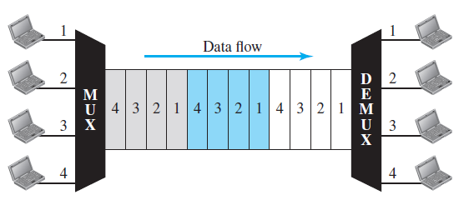
TDM (Time Division multiplexing)

Slide 23
TDM (Time Division multiplexing)
Note that in Figure we are concerned with only multiplexing, not switching.
This means that all the data in a message from source 1 always go to one specific destination, be it 1, 2, 3, or 4.
The delivery is fixed and unvarying, unlike switching.
We also need to remember that TDM is, in principle, a digital multiplexing technique.
Digital data from different sources are combined into one timeshared link.
However, this does not mean that the sources cannot produce analog data.
Analog data can be sampled, changed to digital data, and then multiplexed by using TDM.

Slide 24
Synchronous TDM
In synchronous TDM, each input connection has an allotment in the output even if it is not sending data.
The data flow of each input connection is divided into units, where each input occupies one input time slot.
A unit can be 1 bit, one character, or one block of data.
Each input unit becomes one output unit and occupies one output time slot.
However, the duration of an output time slot is n times shorter than the duration of an input time slot.
If an input time slot is T s, the output time slot is T/n s, where n is the number of connections.
In other words, a unit in the output connection has a shorter duration; it travels faster.

Slide 25
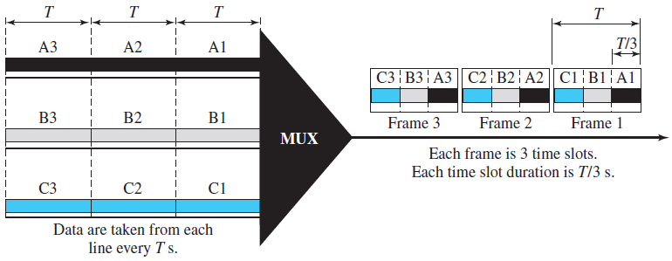
Synchronous TDM

Slide 26
Synchronous TDM
In synchronous TDM, a round of data units from each input connection is collected into a frame.
If we have n connections, a frame is divided into n time slots and one slot is allocated for each unit, one for each input line.
If the duration of the input unit is T, the duration of each slot is T/n and the duration of each frame is T.
The data rate of the output link must be n times the data rate of a connection to guarantee the flow of data.
Time slots are grouped into frames.
A frame consists of one complete cycle of time slots, with one slot dedicated to each sending device.
In a system with n input lines, each frame has n slots, with each slot allocated to carrying data from a specific input line.

Slide 27
Thank you

