Slide 1
GPS (Global Positioning System)

Slide 2


Old Days, old methods
In old days, the navigation was by compass & land marks on land, & by the sun & stars at sea. Neither technique was accurate & result in ship wrecks, lost planes & lost travelers in foggy & stormy weather.
In WWII, the need for accurate target location was immensely felt & this has led to the development of GPS (global Positioning System)

Slide 3
Frequency of Satellite
The GPS satellite transmit on L band that is modulated by two types of code on two Quadrature phases.
P code (P for precise) for military use. Error up to 3m
C/A code (C/A for coarse acquisition) for public use. Error up to 50m

Slide 4
Frequency & the Band in use
Parameters | C/A code | P code
Transmit frequency | L1= 1575.42 MHz | L2 = 1227.6 MHZ & also on quadrature phase of L1
Transmission modulation method | BPSK | BPSK
Code length in bits | 1023 Gold bits | 15345000 X1 bits & 37 bit X2 bits
Code length in time | 1ms | 1.5 s

Slide 5
GPS Satellite constellation
GPS network is composed of 24 satellites in MEO orbit.
The orbital period is approximately 12 hours so a satellite appears in the same position in the sky twice each day.
The 24 satellites ensure that at any time, any where in the world, a GPS satellite can receive signals from any four satellites.

Slide 6
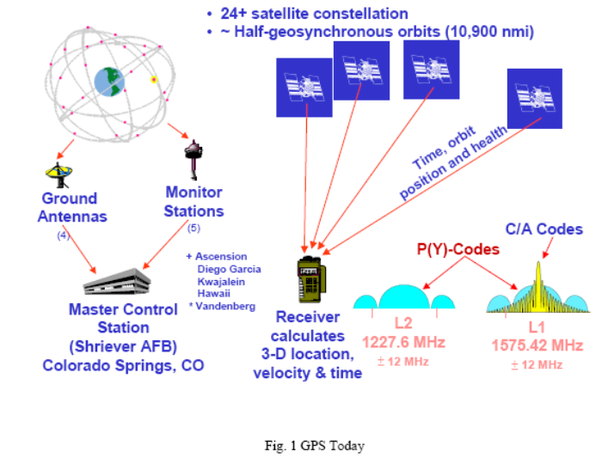
GPS NETWORK

Slide 7
GPS network
The 24 satellites are operated by main control station of U.S air force at Falcon air base in Colarado.
The series of main control station & Sub control station monitor the satellite & calculate the satellite location from the orbital elements of satellite, the atomic clock errors & numerous other parameters required for navigation message.
This information is then transmitted back to satellite by using S band.
This is done after every 1.5 s& used to provide updates for the navigation message.

Slide 8
Trilateron method.
The GPS receiver find its current position by Trilateron method.
In this method the distance of an unknown point from 3 known points is measured. Three measurements are enough to give the latitude, longitude & the elevation of the receiver.

Slide 9
Trilateron
Each distance can be thought of as the radius of the sphere with a GPS satellite at its centre.
The receiver lies at the intersection of three such spheres, with the satellite at the centre of each sphere.
There is another point in outer space where the three spheres intersect, but it is easily eliminated in the calculation process.

Slide 10
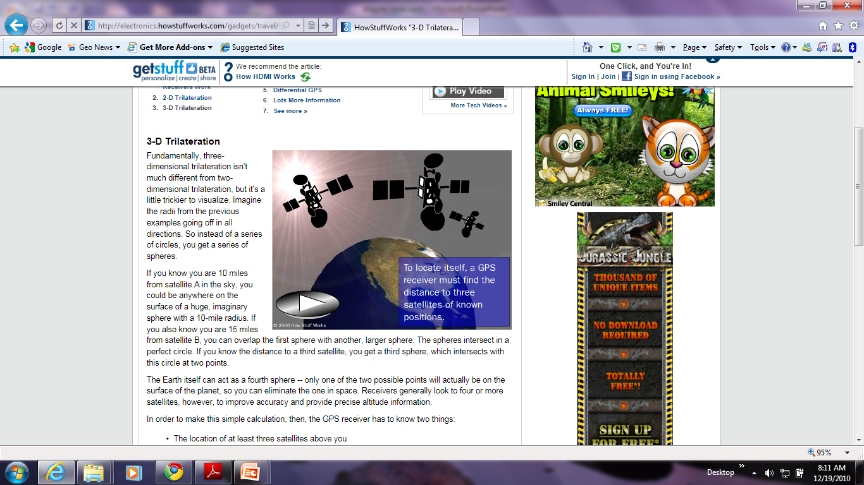
Trilateron

Slide 11
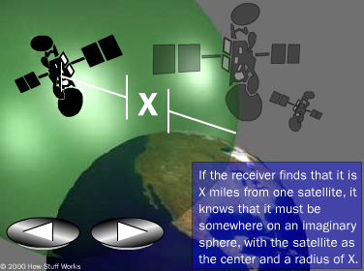
Trilateron

Slide 12
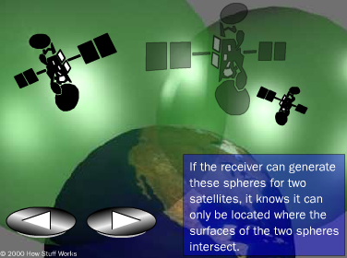
Trilateron

Slide 13

Trilateron

Slide 14
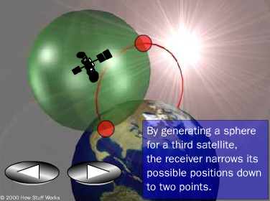
Trilateron

Slide 15
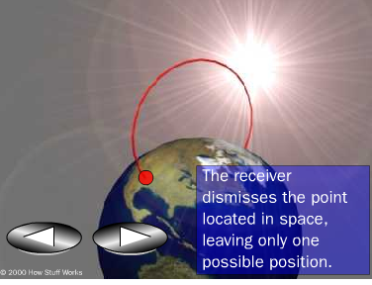
Trileteron

Slide 16
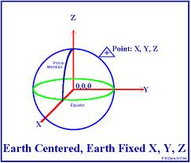
Reference OF GPS measurements

Slide 17
Reference OF GPS measurements
All measurements of distance are made in rectangular coordinate system with origin at the centre of Earth. This co-ordinate system is called ECEF (Earth Centered Earth fixed.)
the Z-axis is directed to earth’s north pole.
The X-axis passes through Greenwich meridian.
The Y axis passes through 90 east meridian

Slide 18
Position calculation
The receiver co-ordinates are Ux, Uy,Uz,
The satellite coordinates are Xi, Yi,Zi (where i=1,2,3,4)
The measured distance is called psedurange PRi (from satellite i), because it uses receiver internal clock to make distance measurement.
PRi = Ti* c

Slide 19


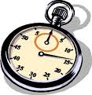
Distance measurement from Satellite
Satellite
Distance in meters = c * time
Sent time = 0 s
GPS receiver
Time of reception = 15 sec so
Time elapsed = 15 s
distance = 15 * 3 e8 = 45 e 8 m
Notes:
19
19

Slide 20
CLOCKS OF SATELLITE
Each satellite carries several high accuracy atomic clocks (Cesium & Rubidium) & radiates a sequence of bits that starts at a precisely known time. these clocks are calibrated against time standards in GPS control station. The accuracy is 1 part in 10e11.12 PPM correspond to one second per day roughly. So 500 PPM mean the clock is off by about 43 seconds per day. Only poor old mechanical wristwatches are worse. .
The clocks are updated by the controlling ground station to keep them within 1 µS of the Universal Coordinated Time (UTC). (UTC is a worldwide time standard equal to GMT (Greenwich Mean Time) )
The Navigation message broadcast by each satellite contains its current clock errors relative to GPS time.

Slide 21

CLOCK OF Receiver
It would be too expensive to include atomic clock in GPS receiver, so a standard crystal oscillator with accuracy of 1 in 10 e5 is used instead. So due to small difference in satellite & GPS receiver clock an error in measurement of distances occurred called clock offset denoted by ז.

Slide 22

Pseudorange duo to clock offset
Satellite
Distance in meters = c * time
Sent time = 0 s
GPS receiver
Receiver is 5 s ahead of transmitter
Actual time elapsed = 10 s
So actual distance = 30 e 8 m
Time of reception = 15 sec so
Time elapsed = 15 s
distance = 15 * 3 e8 = 45 e 8 m
Notes:
22
22

Slide 23
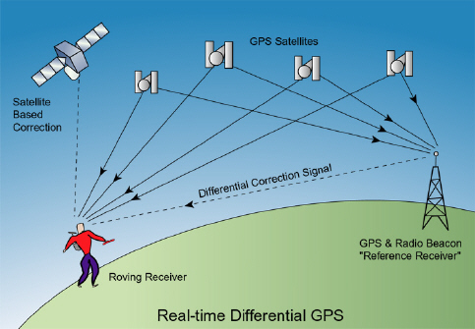
Why forth satellite?

Slide 24
Why forth satellite?
Suppose the receiver clock has an offset of 10 ms relative to GPS time. All distance measurements will have an error of 3000 Km.
It is surprisingly easy to remove the clock error between the satellite & receiver clocks.
All that is needed is a time measurement from a forth satellite.

Slide 25
Navigation Message
The navigation message contains the following information
Header: health of satellite & the handover word. (handover word contains the starting time of P code, if handover word is decrypted the receiver can lock to P code)
Sub frame 1: GPS Week, Satellite clock correction data & the Age of transmitted data.
Sub frame 2 & 3:Accurate position of satellite
Sub frame 4:rough estimate of ionospheric conditions
Sub frame 5: rough estimate of neighboring satellite position & their IDs
Header
Sub frame 1
Sub frame 2
Sub frame 3
Sub frame 4
Sub frame 5

Slide 26

Selective Availability
The U.S department of Defense has the ability to degrade the position measurement accuracy of C/A code receivers by applying selective availability (SA). SA was switched off on 1st May 2000 & will not be used again unless the security of US is threatened.

