Slide 1

Data Communication & Networks

Slide 2
Data and Signals

Slide 3
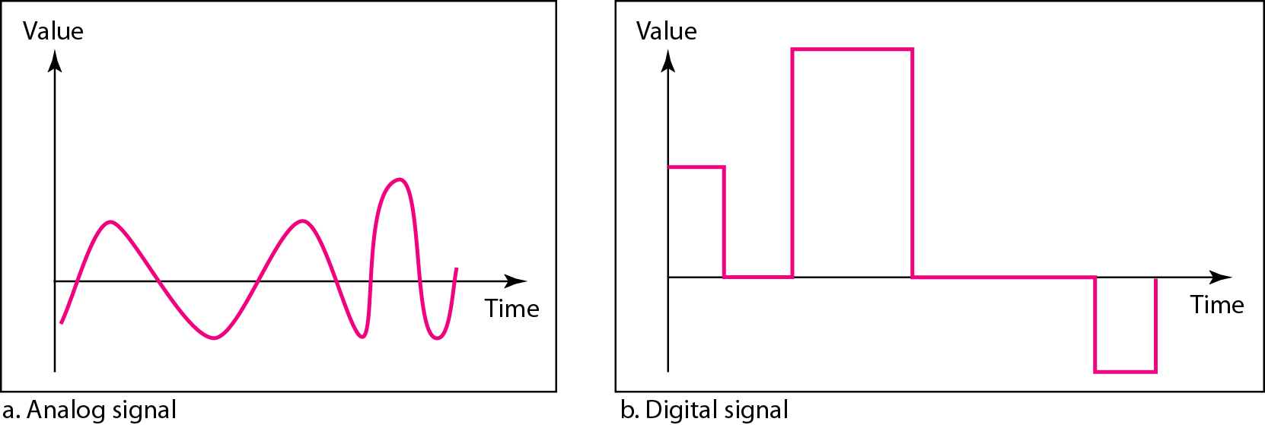
ANALOG AND DIGITAL
To be transmitted, data must be transformed to electromagnetic signals.
Data can be analog or digital. Analog data are continuous and take continuous values. Digital data have discrete states and take discrete values.
Signals can also be analog or digital. Analog signals can have an infinite number of values in a range; digital signals can have only a limited number of values.

Slide 4
ANALOG AND DIGITAL
Both analog and digital signal can be periodic or non periodic.
A periodic signal completes a pattern within a measurable time frame called period and repeats the pattern over subsequent identical period.
Completion a full pattern is called a cycle.
In data communications, we commonly use periodic analog signals and nonperiodic digital signals.

Slide 5
PERIODIC ANALOG SIGNALS
Periodic analog signals can be classified as simple or composite.
A simple periodic analog signal, a sine wave, cannot be decomposed into simpler signals.
A composite periodic analog signal is composed of multiple sine waves.
The sine wave is the most fundamental form of a periodic analog signal.
A sine wave can be represented by three parameters: the peak amplitude, the frequency and the phase

Slide 6
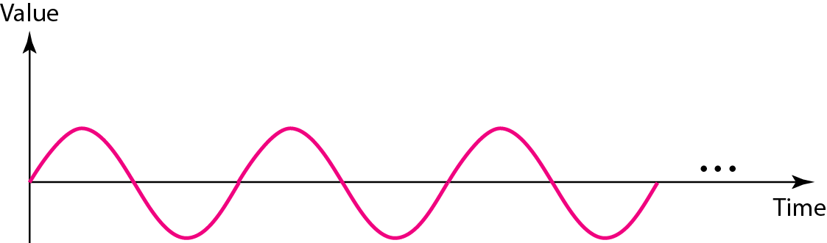
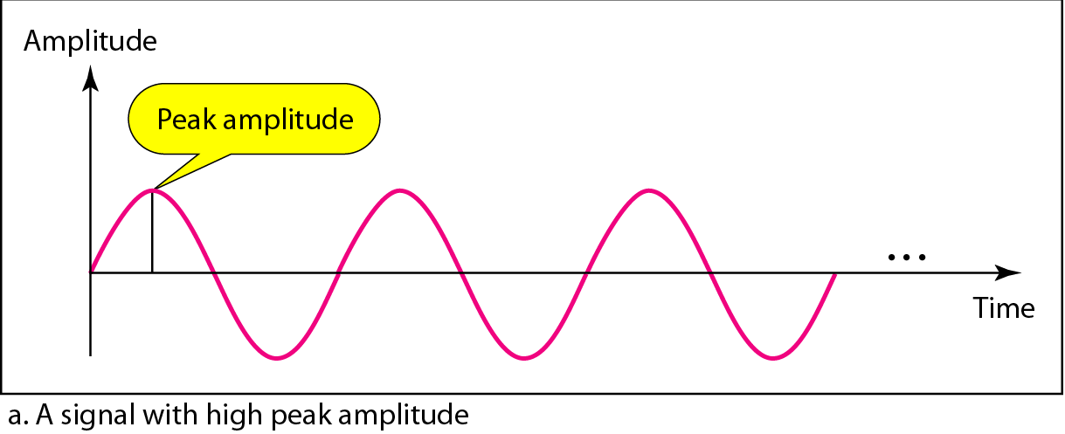
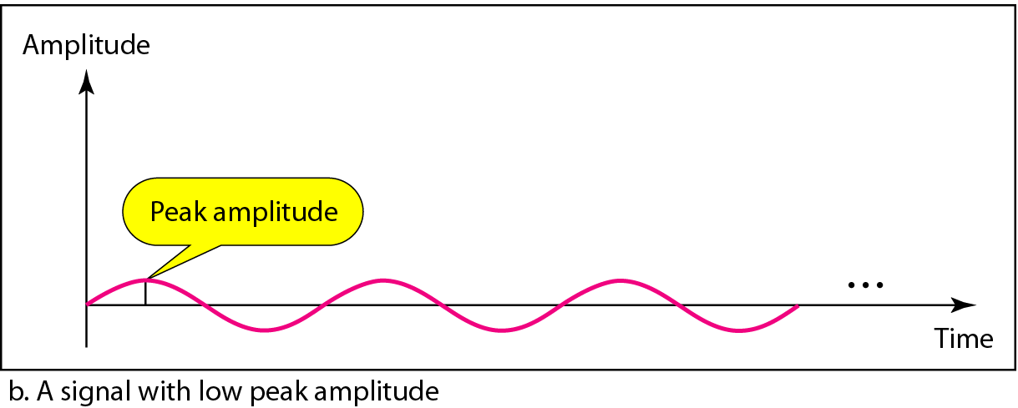
PERIODIC ANALOG SIGNALS
Figure A sine wave
Figure Two signals with the same phase and frequency, but different amplitudes
Frequency and period are the inverse of each other.
Frequency is the rate of change with respect to time. Change in a short span of time means high frequency. Change over a long span of
time means low frequency.

Slide 7
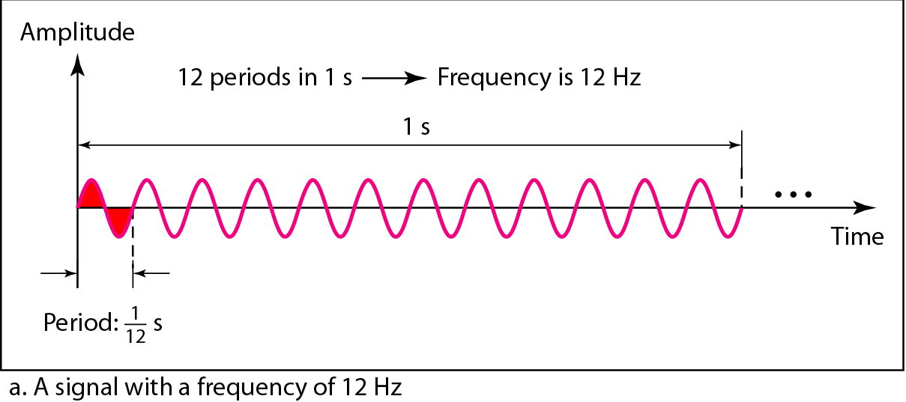
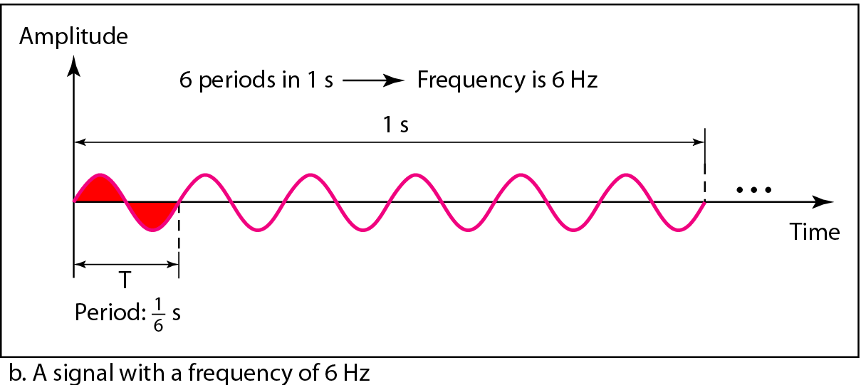

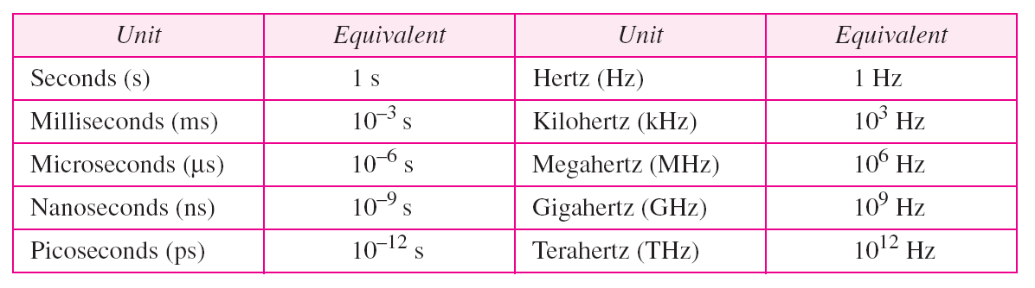
PERIODIC ANALOG SIGNALS
Figure Two signals with the same amplitude and phase, but different frequencies
Table Units of period and frequency

Slide 8
Example
The power we use at home has a frequency of 60 Hz. The period of this sine wave can be determined as follows:
Example
The period of a signal is 100 ms. What is its frequency in kilohertz?
Solution
First we change 100 ms to seconds, and then we calculate the frequency from the period (1 Hz = 10⁻³ kHz).

Slide 9
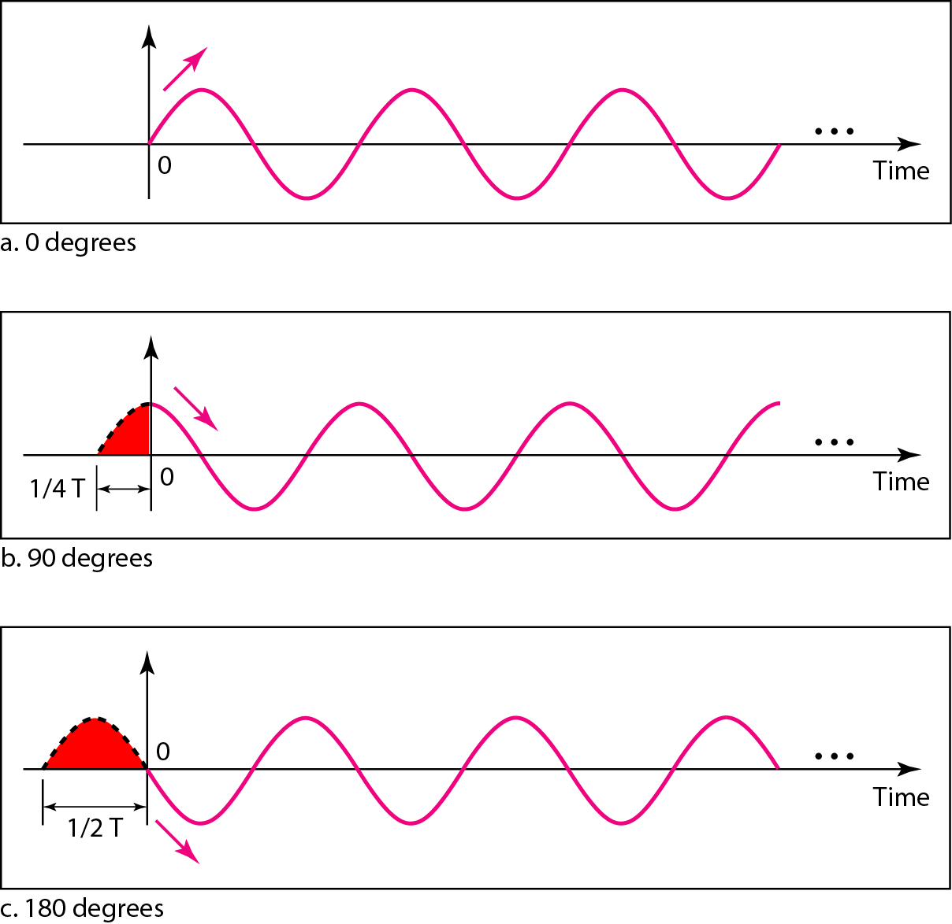
Frequency and phase
If a signal does not change at all, its frequency is zero.
If a signal changes instantaneously, its frequency is infinite.
Phase describes the position of the waveform relative to time 0.
Figure Three sine waves with the same amplitude and frequency, but different phases

Slide 10
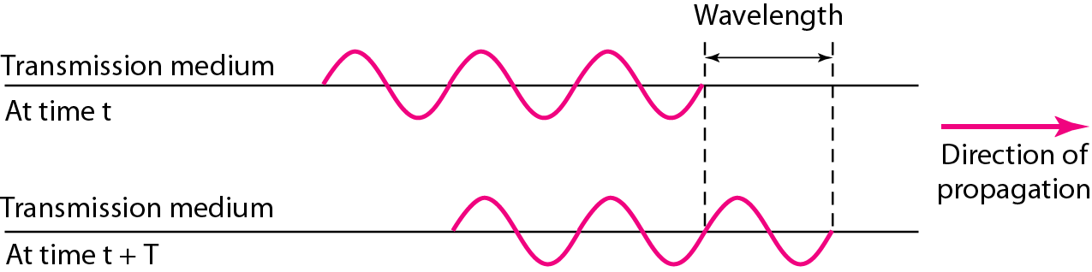

Wavelength and propagation speed
Wavelength: the distance a simple signal can travel in one period.
Propagation speed: the rate at which a signal or bit travels; measured by distance/second.
Propagation time: the time required for a signal to travel from one point to another.
Wavelength = propagation speed x period = propagation speed /frequency

Slide 11
Wavelength and propagation speed
The propagation speed of electromagnetic signals depends on the medium and on the frequency of the signal.
For example, in a vacuum, light is propagated with a speed of 3 x 10⁸ m/s.
That speed is lower in air and even lower in cable.
The wavelength is normally measured in micrometers (microns) instead of meters.
In a coaxial or fiber-optic cable, however, the wavelength is shorter because the propagation speed in the cable is decreased.

Slide 12
Time domain and frequency domain
A complete sine wave in the time domain can be represented by one single spike in the frequency domain.
The frequency domain is more compact and useful when we are dealing with more than one sine wave.
For example, Figure shows three sine waves, each with different amplitude and frequency. All can be represented by three spikes in the frequency domain.

Slide 13
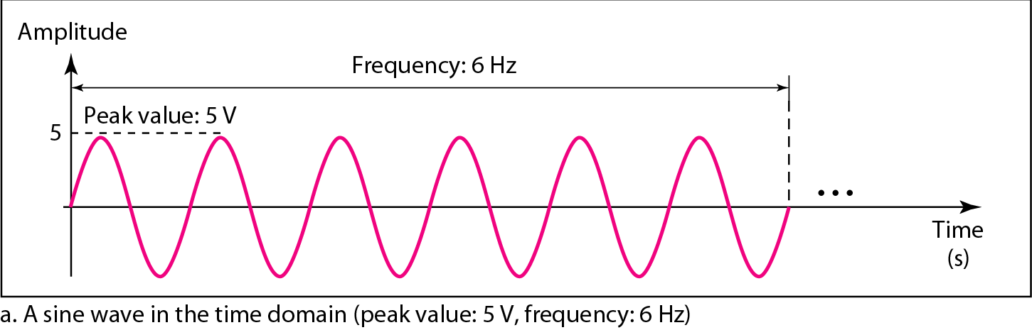
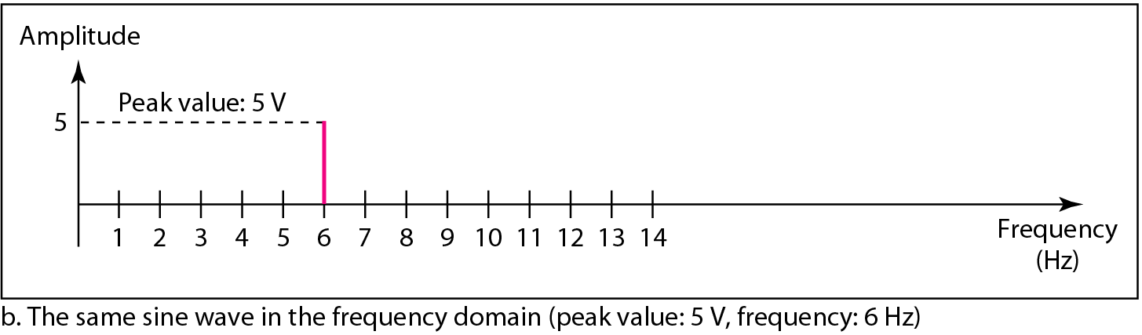
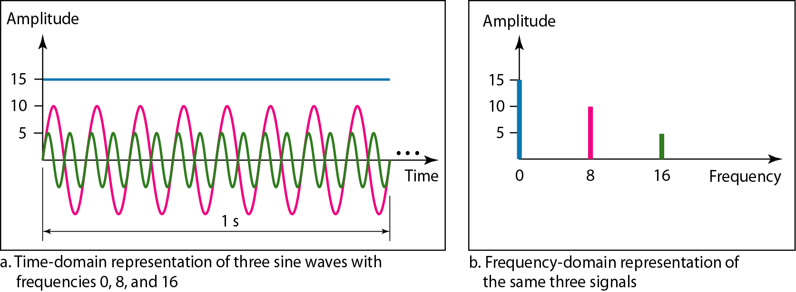
Time domain and frequency domain

Slide 14
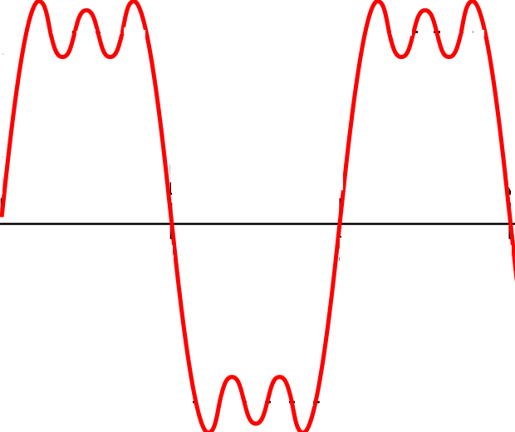
Composite signal
A single-frequency sine wave is not useful in data communications; we need to send a composite signal, a signal made of many simple sine waves.
Composite signal is a signal composed of more than one sine wave.
According to Fourier analysis, any composite signal is a combination of simple sine waves with different frequencies, amplitudes, and phases.

Slide 15
Composite signal
The amplitude of the sine wave with frequency f is almost the same as the peak amplitude of the composite signal.
As the frequency of the composite signal is same as the frequency of this signal so it is called fundamental frequency or first harmonic.
The amplitude of the sine wave with frequency 3f is one third of the first frequency. As the frequency is 3 times of the first frequency so it is 3rd harmonic.
The amplitude of the sine wave with frequency 9f is one ninth of the first frequency. As the frequency is 9 times of the first frequency so it is 9th harmonic.
Frequency can not be 1.2f or 2.6f

Slide 16
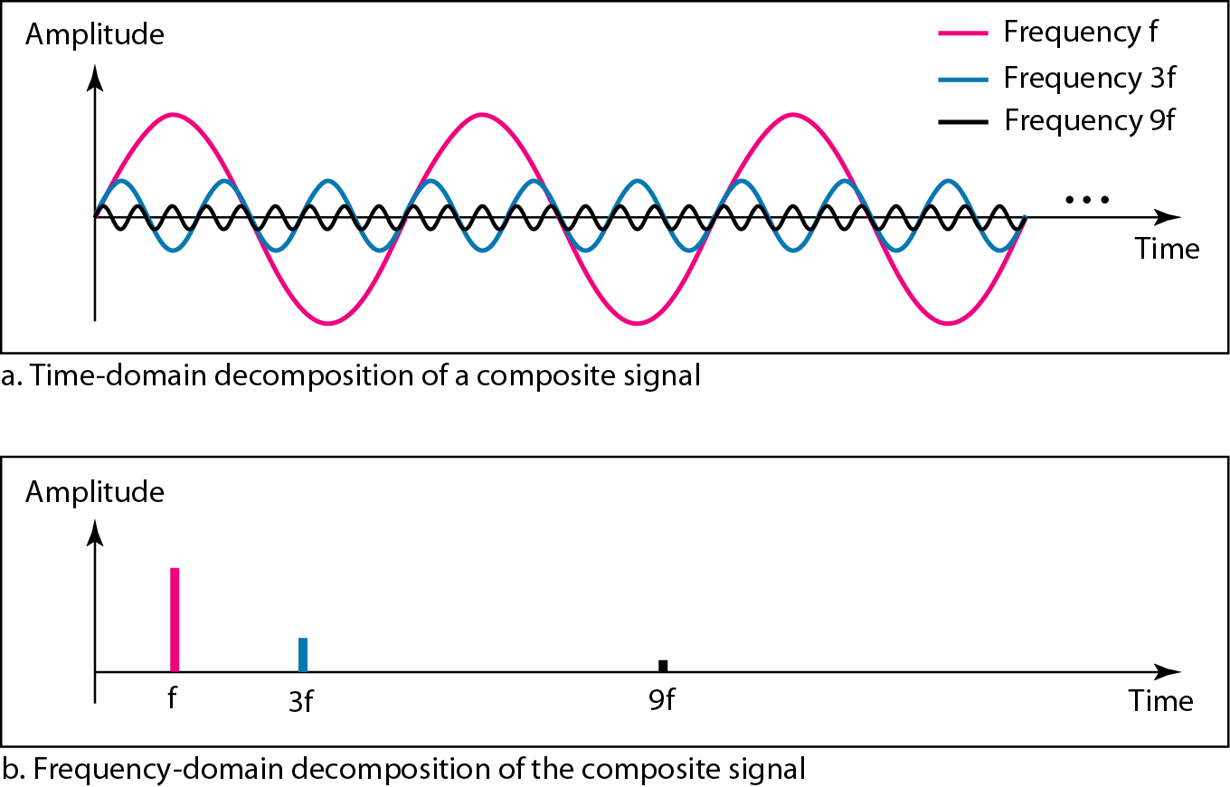
Figure Decomposition of a composite periodic signal in the time and
frequency domains

Slide 17
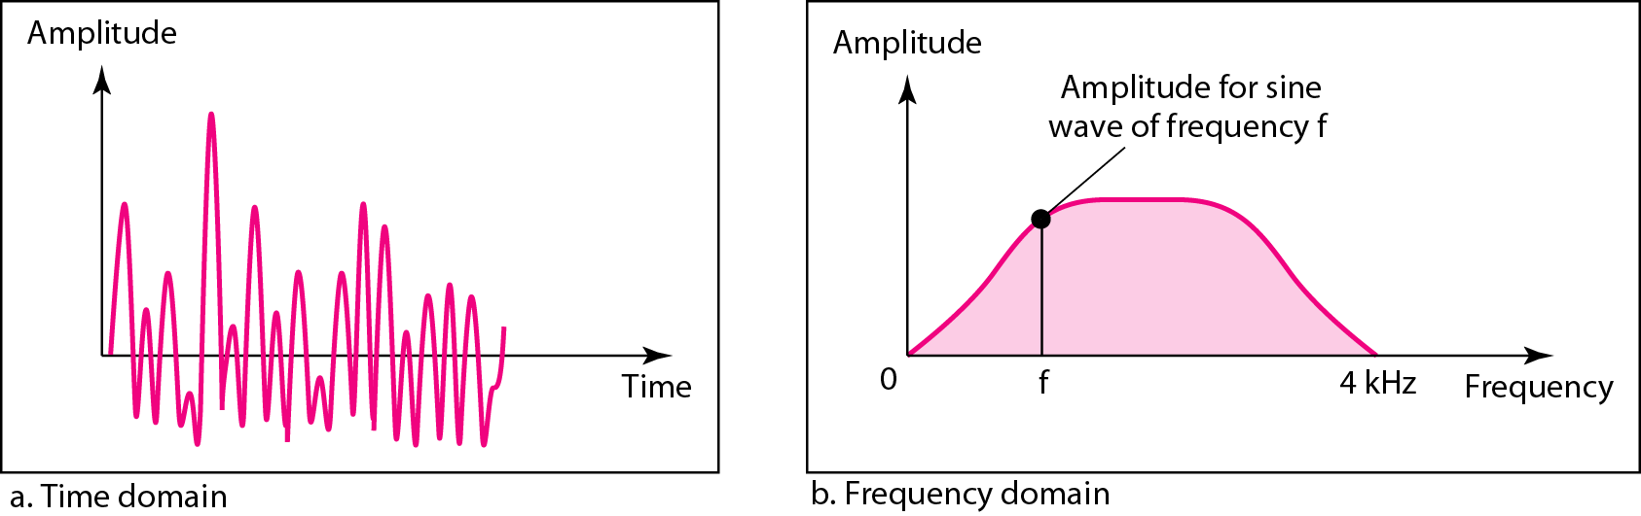
Example
Figure shows a nonperiodic composite signal. It can be the signal created by a microphone or a telephone set when a word or two is pronounced. In this case, the composite signal cannot be periodic, because that implies that we are repeating the same word or words with exactly the same tone.
Figure The time and frequency domains of a nonperiodic signal

Slide 18
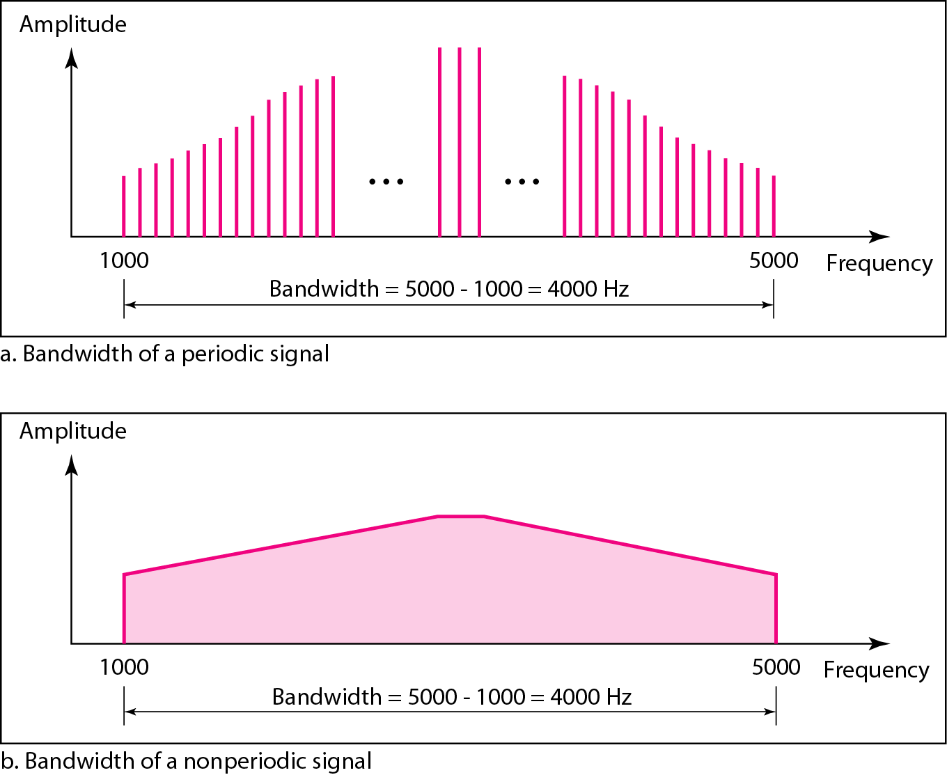
Bandwidth
The bandwidth of a composite signal is the difference between the
highest and the lowest frequencies contained in that signal.

Slide 19
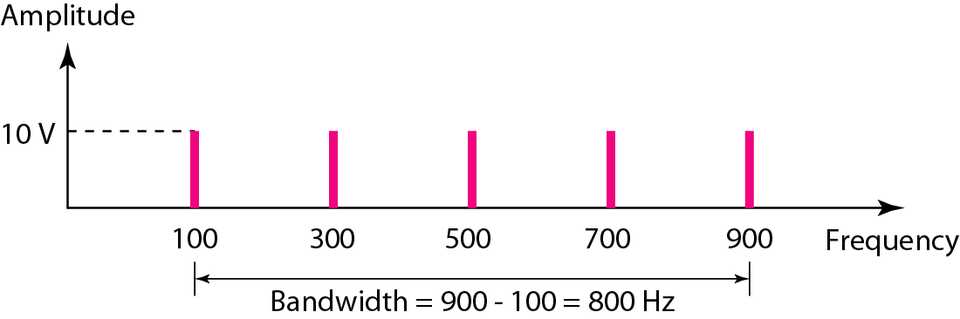
Example
If a periodic signal is decomposed into five sine waves with frequencies of 100, 300, 500, 700, and 900 Hz, what is its bandwidth? Draw the spectrum, assuming all components have a maximum amplitude of 10 V.
Solution
Let f_{h} be the highest frequency, f_{l} the lowest frequency, and B the bandwidth. Then
The spectrum has only five spikes, at 100, 300, 500, 700, and 900 Hz .
Figure The bandwidth for Example

Slide 20
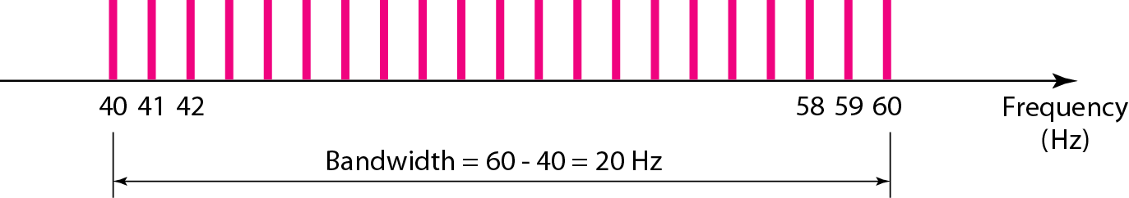
Example
A periodic signal has a bandwidth of 20 Hz. The highest frequency is 60 Hz. What is the lowest frequency? Draw the spectrum if the signal contains all frequencies of the same amplitude.
Solution
Let f_{h} be the highest frequency, f_{l} the lowest frequency, and B the bandwidth. Then
The spectrum contains all integer frequencies. We show this by a series of spikes.
Figure The bandwidth for Example

Slide 21
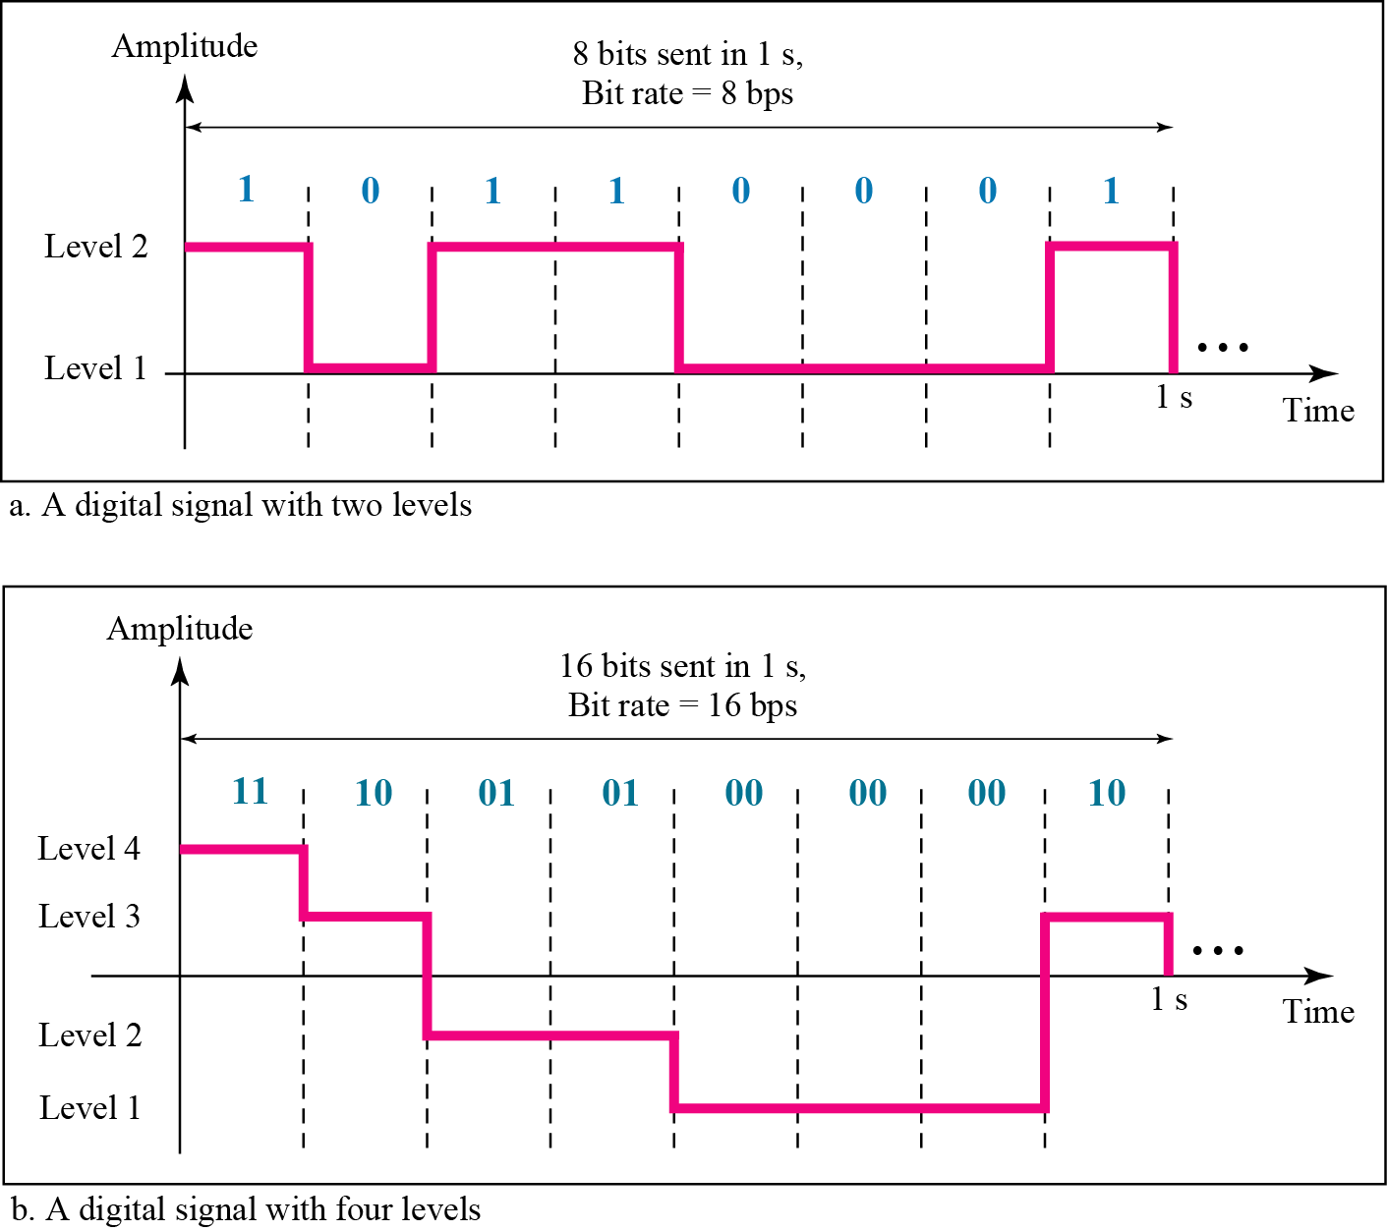
DIGITAL SIGNALS
In addition to being represented by an analog signal, information can also be represented by a digital signal. For example, a 1 can be encoded as a positive voltage and a 0 as zero voltage. A digital signal can have more than two levels. In this case, we can send more than 1 bit for each level.
Figure Two digital signals: one with two signal levels and the other
with four signal levels

Slide 22
Example
A digital signal has eight levels. How many bits are needed per level? We calculate the number of bits from the formula:
Each signal level is represented by 3 bits.
The bit rate is the number of bits sent in 1 s, expressed in bits per second (bps). Figure shows the bit rate for two signals.
Example
Assume we need to download text documents at the rate of 100 pages per minute. What is the required bit rate of the channel?
Solution
A page is an average of 24 lines with 80 characters in each line. If we assume that one character requires 8 bits, the bit rate is

Slide 23
Example
A digitized voice channel is made by digitizing a 4-kHz bandwidth analog voice signal. We need to sample the signal at twice the highest frequency (two samples per hertz). We assume that each sample requires 8 bits. What is the required bit rate?
Solution
The bit rate can be calculated as:

Slide 24
Bit Length
We discussed the concept of the wavelength for an analog signal: the distance one cycle occupies on the transmission medium.
We can define something similar for a digital signal: the bit length.
The bit length is the distance one bit occupies on the transmission medium.
Bit length = propagation speed * bit duration
Digital Signal as a Composite Analog Signal
Based on Fourier analysis, a digital signal is a composite analog signal.
The bandwidth is infinite, but the periodic signal has discrete frequencies while the nonperiodic signal has continuous frequencies.

Slide 25
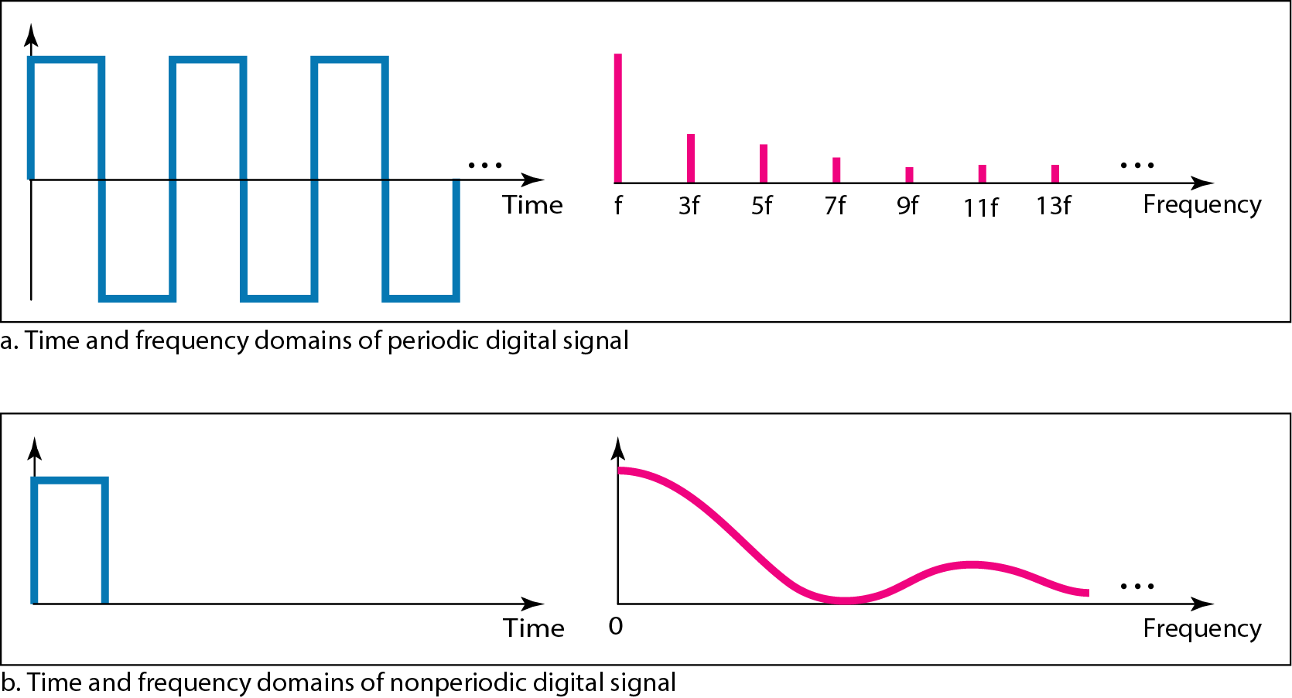
The time and frequency domains of periodic and nonperiodic digital signals

Slide 26
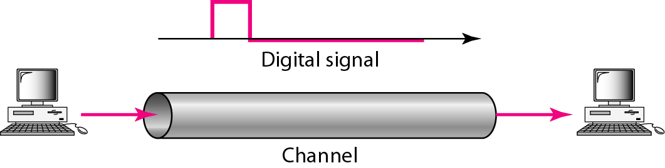
Transmission of Digital Signals
We can transmit a digital signal by using one of two different approaches:
baseband transmission.
broadband transmission (using modulation).
Baseband transmission means sending a digital signal over a channel without changing the digital signal to an analog signal.

Slide 27
_{Baseband Transmission}
Baseband transmission requires that we have a low-pass channel, a channel with a bandwidth that starts from zero.
This is the case if we have a dedicated medium with a bandwidth constituting only one channel.
For example, the entire bandwidth of a cable connecting two computers is one single channel.
As another example, we may connect several computers to a bus, but not allow more than two stations to communicate at a time.

Slide 28
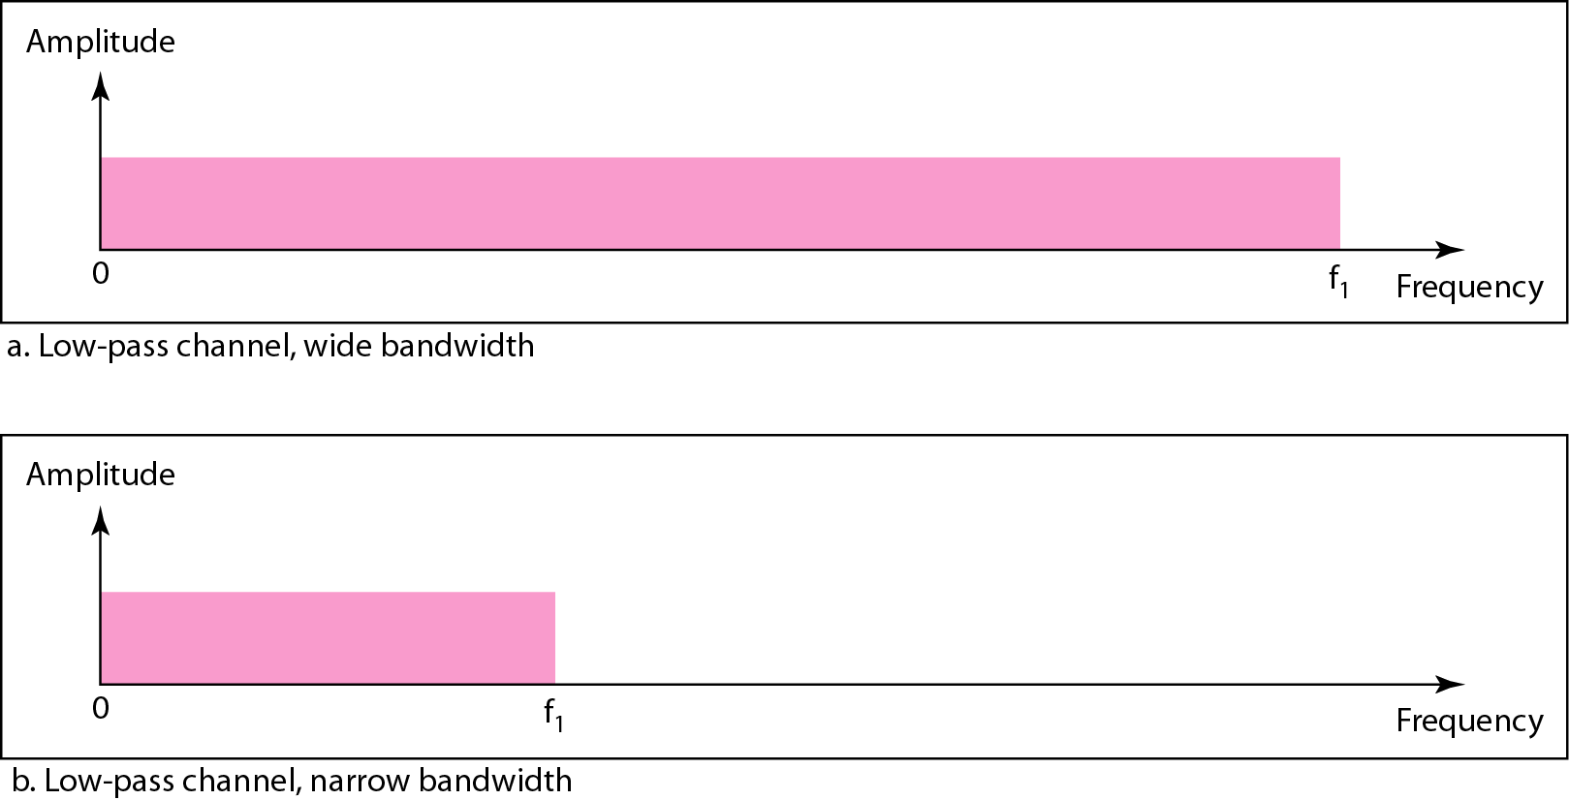
Figure Bandwidths of two low-pass channels
A low-pass channel with infinite band-width is ideal, but we cannot have such a channel in real life. However, we can get close.

Slide 29
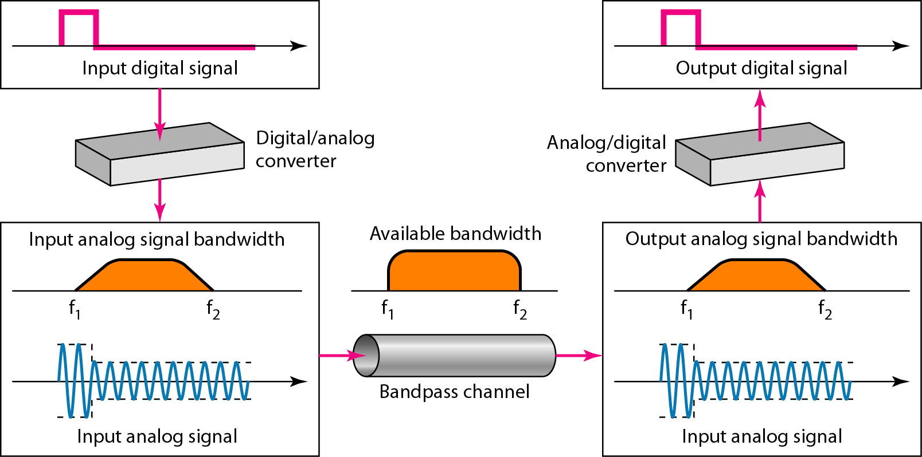
_{Broadband Transmission}
If the available channel is a bandpass channel, we cannot send the digital signal directly to the channel.
We need to convert the digital signal to an analog signal before transmission.

Slide 30
TRANSMISSION IMPAIRMENT
Signals travel through transmission media, which are not perfect.
The imperfection causes signal impairment.
This means that the signal at the beginning of the medium is not the same as the signal at the end of the medium.
What is sent is not what is received.
Three causes of impairment are attenuation, distortion, and noise.

Slide 31
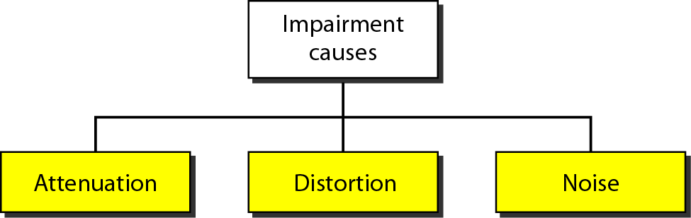
TRANSMISSION IMPAIRMENT
Figure Causes of impairment

Slide 32
Attenuation
Attenuation means a loss of energy.
When a signal, simple or composite, travels through a medium, it loses some of its energy in overcoming the resistance of the medium.
That is why a wire carrying electric signals gets warm, if not hot, after a while.
Some of the electrical energy in the signal is converted to heat.
To compensate for this loss, amplifiers are used to amplify the signal.

Slide 33
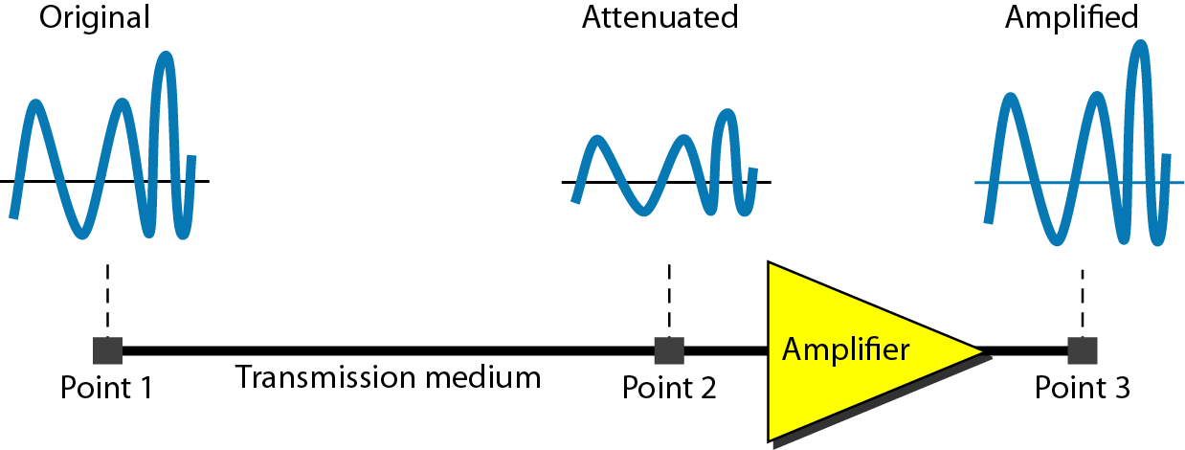
Figure Attenuation

Slide 34


Example:
Suppose a signal travels through a transmission medium and its power is reduced to one-half. This means that P₂ is (1/2)P₁. In this case, the attenuation (loss of power) can be calculated as:
A loss of 3 dB (–3 dB) is equivalent to losing one-half the power.
Example:
A signal travels through an amplifier, and its power is increased 10 times. This means that P₂ = 10P₁ . In this case, the amplification (gain of power) can be calculated as

Slide 35
Distortion
Distortion means that the signal changes its form or shape.
A digital signal is a composite analog signal with an infinite bandwidth.
Distortion can occur in a composite signal made of different frequencies.
Each signal component has its own propagation speed through a medium and, therefore, its own delay in arriving at the final destination.

Slide 36
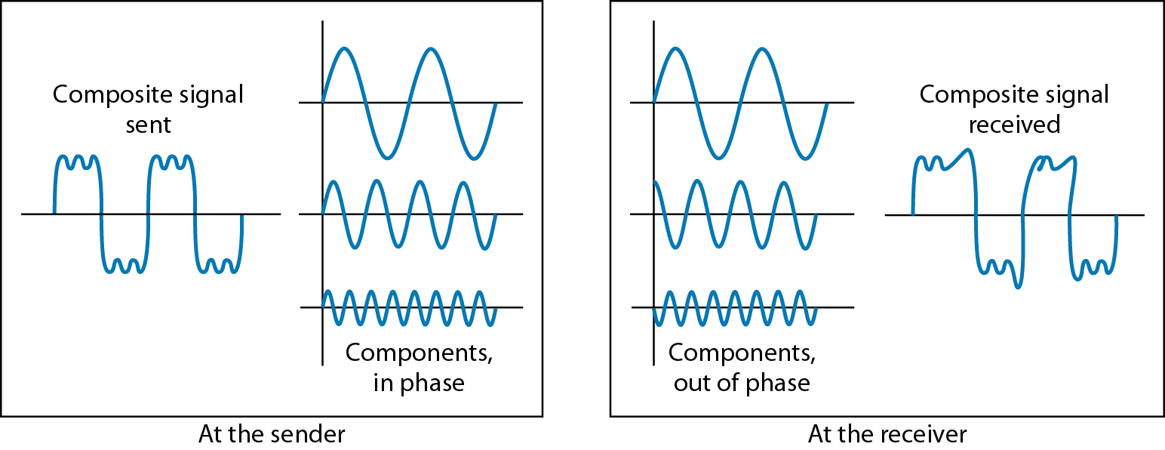
Distortion
Differences in delay may create a difference in phase if the delay is not exactly the same as the period duration.
In other words, signal components at the receiver have phases different from what they had at the sender.
The shape of the composite signal is therefore not the same.

Slide 37
Noise
Noise is another cause of impairment.
Several types of noise may corrupt the signal:
  Thermal noise is the random motion of electrons in a wire which creates an extra signal not originally sent by the transmitter.
  Induced noise comes from sources such as motors and appliances.
  Crosstalk is the effect of one wire on the other. One wire acts as a sending antenna and the other as the receiving antenna.
  Impulse noise is a spike (a signal with high energy in a very short time) that comes from power lines, lightning, and so on.

Slide 38
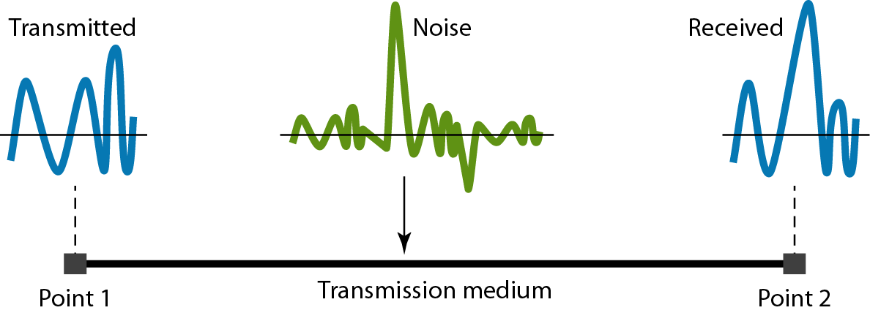
Noise

Slide 39
SNR (Signal to Noise Ratio)
To find the theoretical bit rate limit, we need to know the ratio of the signal power to the noise power.
The signal-to-noise ratio is defined as
SNR = average signal power /average noise power
We need to consider the average signal power and the average noise power because these may change with time.

Slide 40
SNR (Signal to Noise Ratio)
SNR is actually the ratio of what is wanted (signal) to what is not wanted (noise).
A high SNR means the signal is less corrupted by noise; a low SNR means the signal is more corrupted by noise.
Because SNR is the ratio of two powers, it is often described in decibel units, SNR dB, defined as SNR db = 10 log₁₀ SNR

Slide 41
Example:
The power of a signal is 10 mW and the power of the noise is 1 μW; what are the values of SNR and SNR_{dB} ?
Solution
The values of SNR and SNR_{dB} can be calculated as follows:

Slide 42
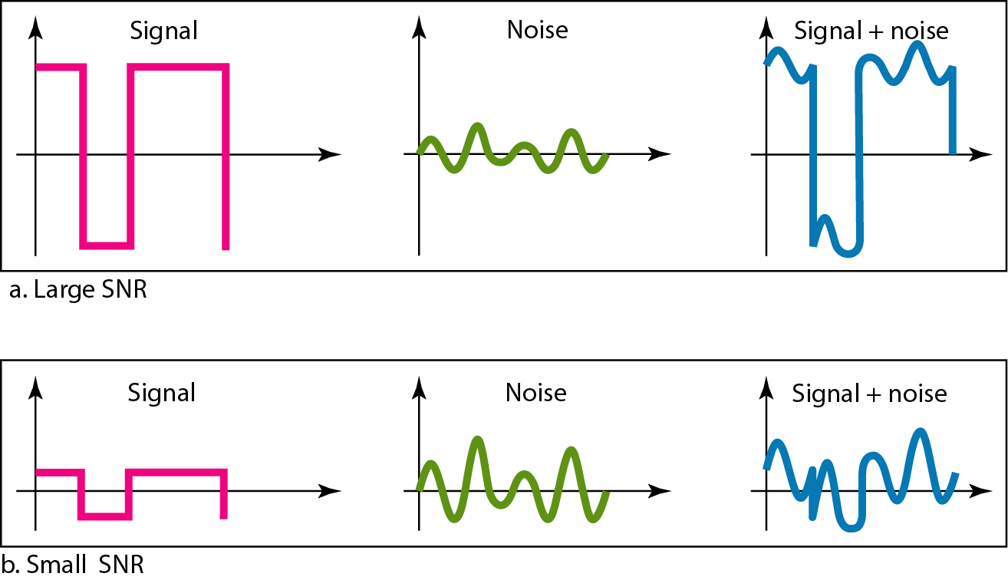
Example
The values of SNR and SNR_{dB} for a noiseless channel are
We can never achieve this ratio in real life; it is an ideal.
Figure Two cases of SNR: a high SNR and a low SNR

Slide 43
Data rate Limits
A very important consideration in data communications is how fast we can send data, in bits per second, over a channel.
Data rate depends on three factors:
1. The bandwidth available
2. The level of the signals we use
3. The quality of the channel (the level of noise)

Slide 44
Data rate Limits
Increasing the levels of a signal may reduce the reliability of the system.
Two theoretical formulas were developed to calculate the data rate: one by Nyquist for a noiseless channel, another by Shannon for a noisy channel.
The Shannon capacity gives us the upper limit; the Nyquist formula tells us how many signal levels we need.

Slide 45
DATA RATE LIMITS
Noiseless channel:
The Nyquist bit rate formula defines the theoretical maximum bit rate:
BitRate = 2 * bandwidth * log ₂ L
Noisy Channel: Shannon Capacity :
In reality, we cannot have a noiseless channel; the channel is always noisy.
Shannon capacity is used to determine the theoretical highest data rate for a noisy channel:
Capacity = bandwidth * log ₂ (1 + SNR)

Slide 46
Example:
Consider a noiseless channel with a bandwidth of 3000 Hz transmitting a signal with two signal levels. The maximum bit rate can be calculated as
Example:
Consider the same noiseless channel transmitting a signal with four signal levels (for each level, we send 2 bits). The maximum bit rate can be calculated as
Example:
We need to send 265 kbps over a noiseless channel with a bandwidth of 20 kHz. How many signal levels do we need?
Solution
We can use the Nyquist formula as shown:

Slide 47
Example :
Consider an extremely noisy channel in which the value of the signal-to-noise ratio is almost zero. In other words, the noise is so strong that the signal is faint. For this channel the capacity C is calculated as
This means that the capacity of this channel is zero regardless of the bandwidth. In other words, we cannot receive any data through this channel.
Example :
We can calculate the theoretical highest bit rate of a regular telephone line. A telephone line normally has a bandwidth of 3000. The signal-to-noise ratio is usually 3162. For this channel the capacity is calculated as
This means that the highest bit rate for a telephone line is 34.860 kbps. If we want to send data faster than this, we can either increase the bandwidth of the line or improve the signal-to-noise ratio.

Slide 48
Performance
One important issue in networking is the performance of the network—how good is it?
The performance is measured by:
  Bandwidth;
  Throughput;
  Latency (Delay);

Slide 49
Bandwidth
In networking, we use the term bandwidth in two contexts.
The first, bandwidth in hertz, refers to the range of frequencies in a composite signal or the range of frequencies that a channel can pass.
The second, bandwidth in bits per second, refers to the speed of bit transmission in a channel or link.
An increase in bandwidth in hertz means an increase in bandwidth in bits per second.

Slide 50
Throughput
The throughput is a measure of how fast we can actually send data through a network.
Bandwidth and throughput is not same.
For example a link with bandwidth 1 Mbps but can handle only 200 kbps so throughput will be 200 kbps.

Slide 51
Latency
The latency or delay defines how long it takes for an entire message to completely arrive at the destination from the first bit is sent out from the source.
Latency= propagation time+ transmission time + queuing time + processing time
Propagation time measures the time required for a bit to travel from the source to the destination.
Transmission time is the time between the first bit leaving the sender and the last bit arriving at the receiver.
Queuing time is the required time for each intermediate or end device to hold the message before it can be processed.

Slide 52
Thank you

