Slide 1
Deployment Models Architecture and Anatomy
Lecture 3

Slide 2
Deployment Model
There are four primary cloud deployment models :
Public Cloud
Private Cloud
Community Cloud
Hybrid Cloud
Notes:
Each can exhibit the previously discussed characteristics; their differences lie primarily in the scope and access of published cloud services, as they are made available to service consumers.

Slide 3
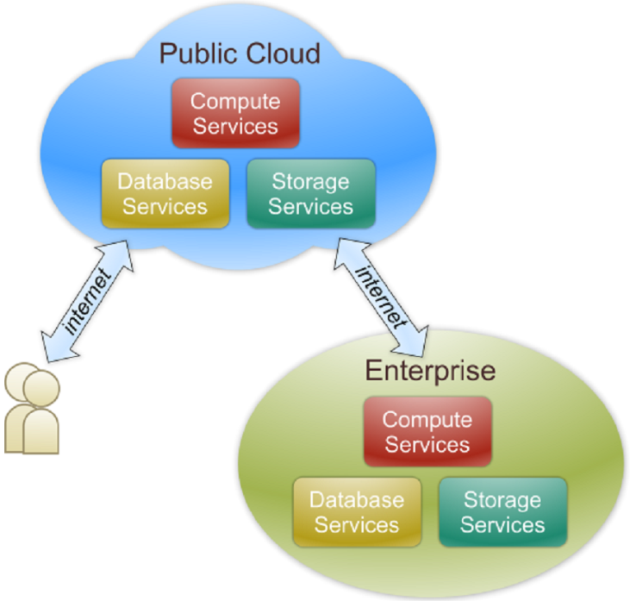
Public Cloud
Public cloud definition
The cloud infrastructure is made available to the general public and is owned by an organization selling cloud services.
Also known as external cloud or multi-tenant cloud, this model essentially represents a cloud environment that is openly accessible.
Basic characteristics :
Homogeneous infrastructure
Shared resources and multi-tenant
Leased or rented infrastructure

Slide 4
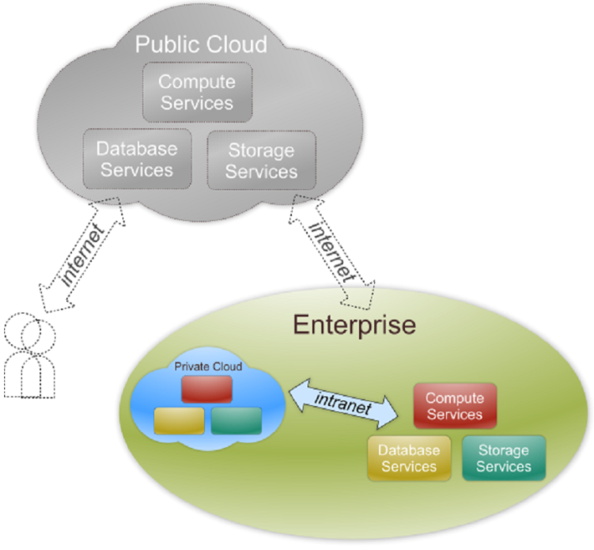
Private Cloud
Private cloud definition
The cloud infrastructure is operated solely for an organization.
Managed by:
the organization
A third party
May exist on premise or off premise.
Also referred to as internal cloud or on-premise cloud,
a private cloud intentionally limits access to its resources to service
consumers that belong to the same organization that owns the cloud.
Basic characteristics :
Heterogeneous infrastructure
Dedicated resources
In-house infrastructure

Slide 5
Public vs. Private
 | Public Cloud | Private Cloud
Infrastructure | Homogeneous | Heterogeneous
Resource Model | Shared & Multi-tenant | Dedicated
Cost Model | Operational expenditure | Capital expenditure

Slide 6
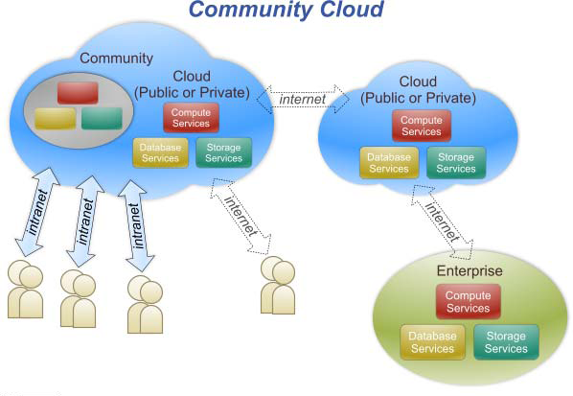
Community Cloud
Community cloud definition
The cloud infrastructure is shared by several organizations and supports a specific community that has shared concerns (e.g., mission, security requirements).

Slide 7
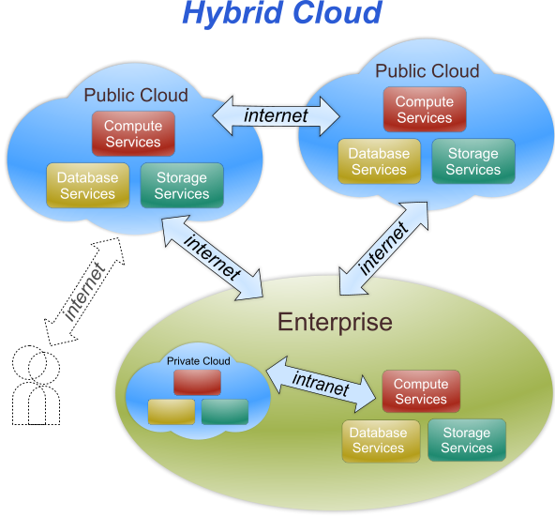
Hybrid Cloud
Hybrid cloud definition
The cloud infrastructure is a composition of two or more clouds (private, community, or public) that remain unique entities but are bound together by standardized or proprietary technology that enables data and application portability (e.g., cloud bursting for load-balancing between clouds).

Slide 8
Architecture
Anatomy

Slide 9
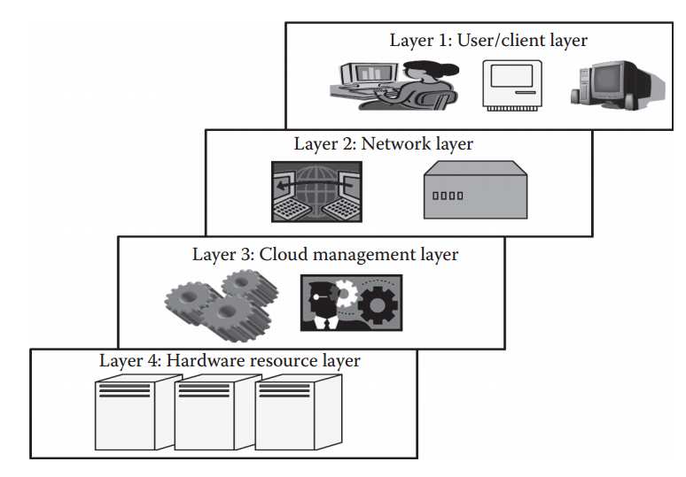
Cloud Architecture

Slide 10
Layer 1
All the users or clients belong to this layer
Client can be thin/thick device
The clients initiate the connection to the cloud

Slide 11
Layer 2
Allow user to connect to the cloud
The whole cloud infrastructure depends on this layer
Primarily the Internet in case of public cloud
LAN in case of private cloud
This layer does not come under the purview of SLAs

Slide 12
Layer 3
Consists of softwares that are used in managing the cloud
Softwares can be:
Cloud OS
Management software allows scheduling, provisioning
This layer comes under the purview of SLAs
Examples of public cloud
Amazon Web Service (AWS)
Microsoft Azure
Examples of private cloud
OpenStack
Eucalyptus

Slide 13
Layer 4
This layer consists of actual hardware resource
Usually a data center is used at the backend
This is the most important layer that governs the SLAs
Therefore, DCs have high speed network connection and very efficient algorithms

Slide 14
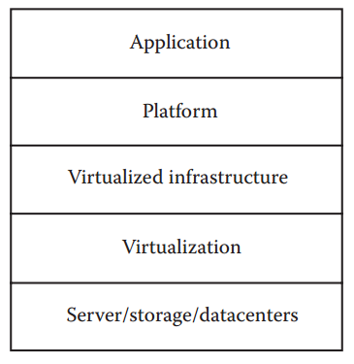
Anatomy of the Cloud
Anatomy is different from architecture.
It does not include the dependency on which or
Over which the technology works.
However, anatomy is considered as part of the architecture.

Slide 15
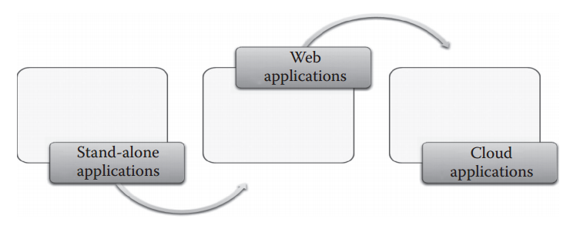
Applications on the cloud
Stand-alone Application:
depends solely on the resources of the system where installed
cannot be accessed by other users
Web Application drawbacks:
cannot handle highly varying loads (no elasticity)
not multitenant
does not provide quantitative measurement
services are offered based on certain charges
not provided on pay-as-you-go basis

Slide 16
Applications on Cloud
Multitenancy
Elasticity
Heterogeneous cloud platform
Any type of application can be deployed
Quantitative measurement
On-demand service

Slide 17
Cloud Management
Cloud Management deals with managing cloud resources to maintain the QOS.
Managing the infrastructure
Managing the Application
All Management Methods are based on:
→ Load Fluctuation

Slide 18
Managing the Infrastructure
Infrastructure is considered the backbone of the cloud.
Infrastructure is mainly responsible for the QOS factor.
The whole cloud can fail if Infrastructure is not managed properly.
The core of the cloud management is resource management:
1. resource scheduling
2. load balancing

Slide 19
Issues in Managing the Infrastructure
Poor resource Management results in poor performance, functionality, and cost.
Poor performance results in violation of SLAs.
Therefore, the basic functionality must be provided at any cost.
The main thing for Cloud Service Providers is the cost of managing the cloud.
If they incur high cost, they will increase the cost and hence they will have a weak user base. Ultimately their profit margin will decrease.
Few more issues:
Power consumption
optimization of multiple objectives to further reduce the cost
Solutions:
server and storage consolidation

Slide 20
Managing the Application
Businesses move application to cloud to improve agility or to meet dynamic demands.
Issues: availability and uptime (which requires careful analysis of the cloud infrastructure)
Cloud Application Management deals with such issues

Slide 21
Migrating Application to Cloud
Phases
Evaluation
Migration Strategy
Prototyping
Provisioning
Testing

Slide 22
Summary
Architecture is a basic hierarchical structure with dependencies of components specified.
Anatomy is a part of architecture where the dependency of components is not shown.
Cloud management consists of : infrastructure management and application management
Both these affect the QOS

