Slide 1
Industrial Electronics
Industrial Power Supplies
Engr.Sanaullah Ahmad
Lecturer EED

Slide 2
Power Supplies to industrial loads
Electrical Network
Power Generation
Power Transmission
Power Distribution

Slide 3
Distributions System
Electricity distribution
Upon arrival at the
substation, the power will be stepped down
in voltage—from a transmission level voltage
to a distribution level voltage. As it exits the
substation, it enters the distribution wiring.
Finally, upon arrival at the service location,
the power is stepped down again from the
distribution voltage to the required service
voltage(s).

Slide 4
Type of Industries
Small Industries
Medium Industries
Heavy Industries.
Voltage requirement may varies according to type and nature of industry.

Slide 5
Power supplies in Industries
AC source.
Load such as Induction Motors used in Industries
DC Source.
DC Motors, and all other electronics devices involved in industries.

Slide 6
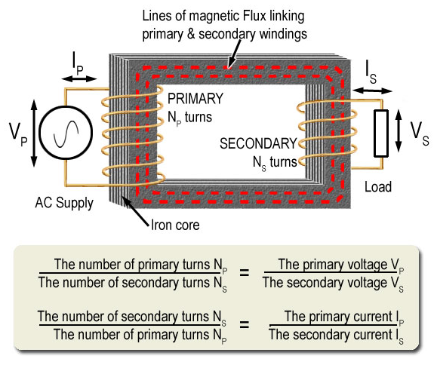
Transformer
An Electromagnetic static machine step down /Up distribution voltages.

Slide 7
Cascade Arrangement of Transformers
In order to have high voltages for heavy industries/ testing laboratories.
Transformers are arranged in such a way to achieve high voltages.
Easy to arrange and dismantle/ occupy less space compared single step-up transformer of same ratings.
Considering 3 units of 200V/200KV transformers

Slide 8
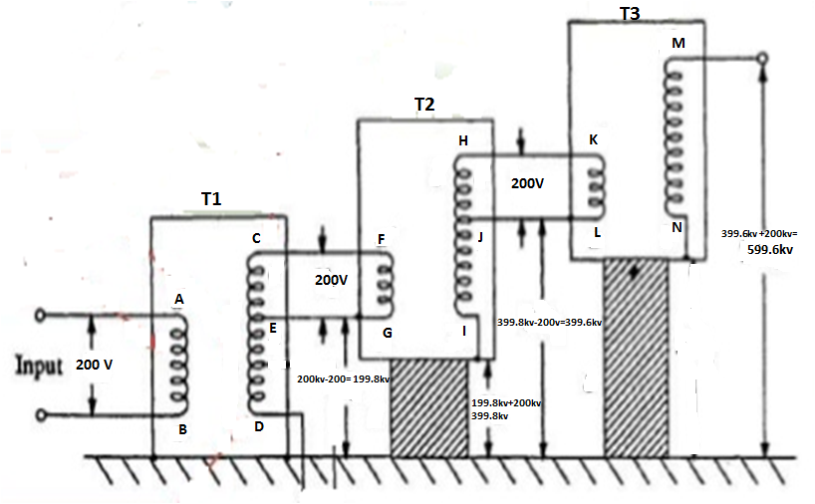
Schematic
200V / 200KV
200V / 200KV
T3
T2
200V / 200 KV
T1

Slide 9
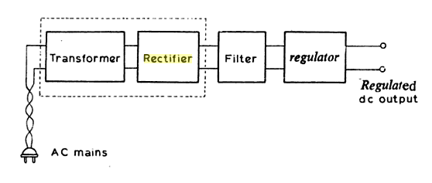
Rectifiers
Another important part of industrial power supplies is rectifier .
Industrial application like thermal power stations , cement etc.

Slide 10
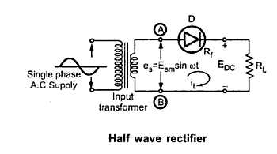
Half-wave

Slide 11
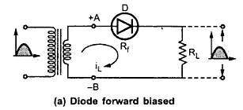
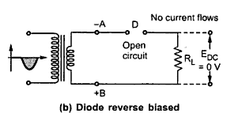
Operation of Half Wave Rectifier

Slide 12
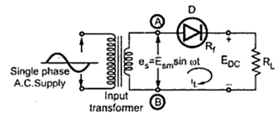
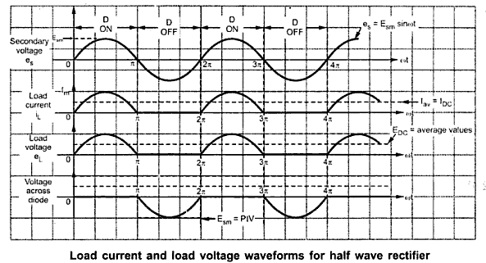
Waveform of Half Wave Rectifier

Slide 13
Full Wave Rectifier
Current Flow during the positive half of the input cycle
Current Flow during the negative half of the input cycle

Slide 14
