Slide 1
LECTURE # 3 PART TWO

Slide 3
Liquid culture: bacteria, algae, and some fungi can be used in culture tubes (test tubes) in a liquid medium.
Liquid medium in tubes is best when you want to rapidly increase the concentration of the organism or when you want to grow motile cells
Culture plates are used when you want to test
(1) antibiotic sensitivity,
(2) estimate culture concentrations from environmental samples, or (3) isolate individual colonies from environmental samples.

Slide 4
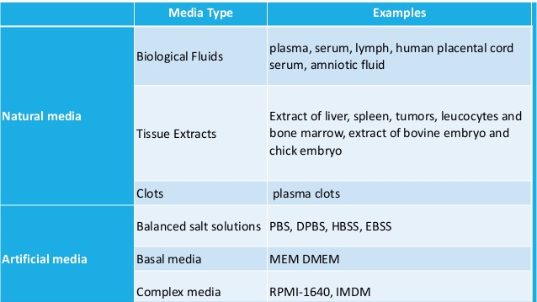

Slide 5
Synthetic Media – The media which contain know concentration of components is called as synthetic media.
Synthetic media is further divided into different types on the basis of requirement.
Selective media
Enriched media
Enrichment medium
Differential medium

Slide 6
1) Selective media
Selective media contain a component that helps in growth of a particular micro-organism and suppresses the growth of other micro-organism.
Examples of Selective media– MacConkey’s agar, Eosin methylene blue agar, Deoxycholate citrate agar and Wilson and Blair medium etc.

Slide 8
2) Enriched media
It is a media which is able to enhance the growth of particular micro-organism without inhibiting growth of other micro-organism.
Examples of Enriched medium – Blood agar and chocolate agar
Heart infusion broth, Tryptone soya broth,

Slide 9
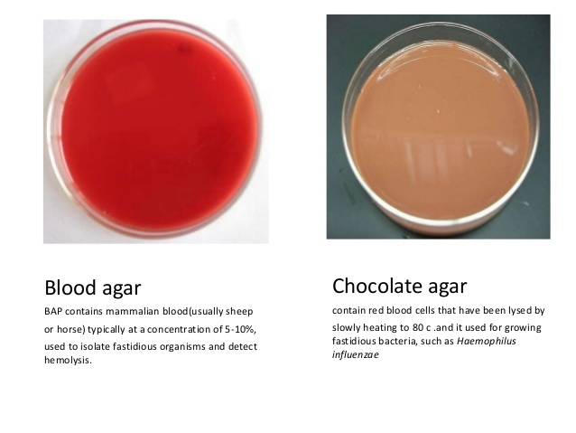

Slide 10
3) Enrichment medium
It is normally a liquid medium or broth which increase or permit the growth of given type of organism in comparison of other organism present in innoculum.

Slide 11
4) Differential medium
Differential media contain some components that allows us to distinguish between different group of bacteria.
Examples of Differential media – Blood agar and Eosin methylene blue agar.

