Slide 1
Fundamental of
Basic properties of protozoa, fungi and Algae
Lecture # 2
By Amir Afzal Khan

Slide 2
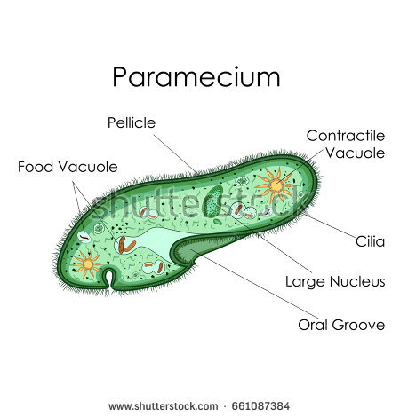
1.Protozoa
Protozoa are typically unicellular, microscopic, eukaryotic organisms that lack a cell wall
Range in size from as little as 1 micrometre to several millimetres, or more
They are not photosynthetic, that move by flagella or cilia.
In oceans and lakes, the small 2-10 um long flagellates are the most important predators on bacteria.
The larger ciliates (e.g., Paramecium) prey mostly upon photosynthetic cyanobacteria and small eukaryotic algae.
In some termites, anaerobic protozoans in the gut degrade cellulose.

Slide 4
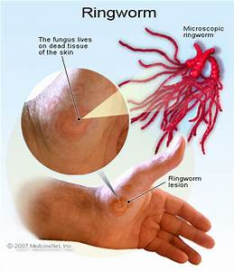

Slide 5
2.Fungi

Slide 7
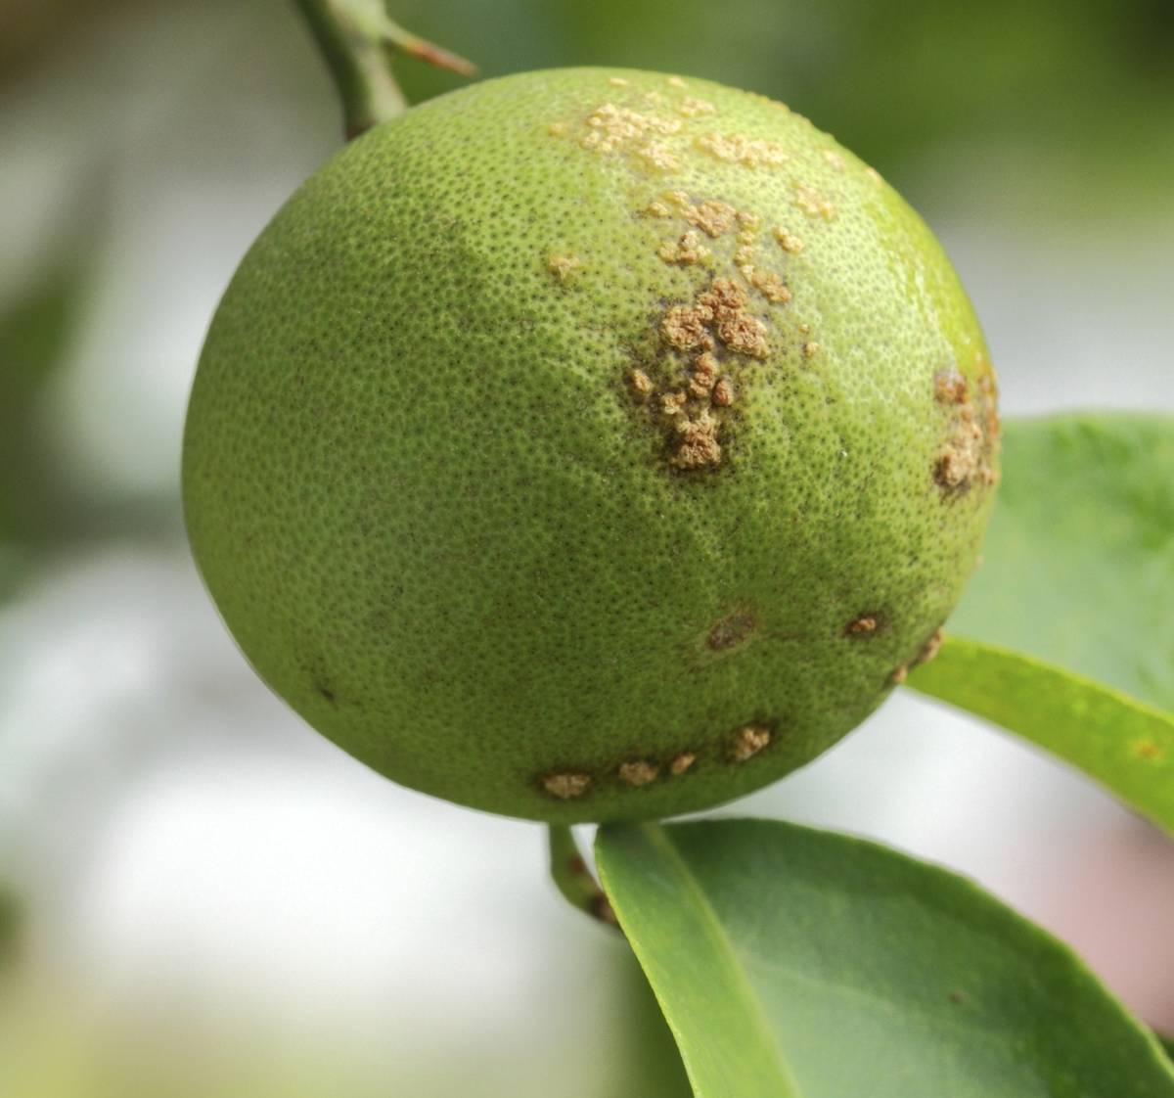
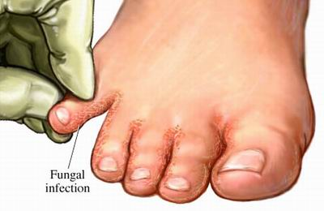
The reproductive organs of the fungi are called fruiting bodies or sporangia (e.g., the aboveground structure of a mushroom), which are sacs or other tissues that contain the fungi spores.
Fungi are uncommon in aquatic environments.
On land, the amount of hyphae in the soil is measured in hundreds or thousands of meters of length per gram of soil.

Slide 8
Fungi Reproduce asexually by budding.
Molds are typically filamentous, eukaryotic fungi that reproduce by producing asexual reproductive spores.
Fungi grow in the form of a finely-branched network of strands called hyphae, which are 5-10 um in diameter.
These hyphae can release digestive enzymes and take up nutrients over their entire length.
Fungi can absorb only small molecules such as sugars or peptides less than the size amino acids.

Slide 9
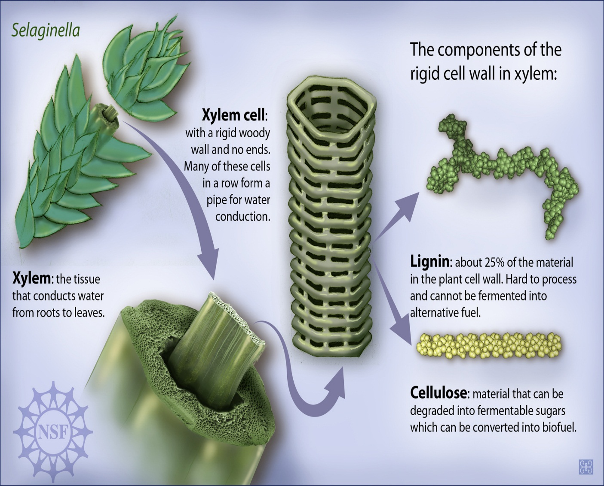
Fungi secrete enzymes that can break down cellulose into glucose, one of the few kinds of organisms able to do this.
Fungi are the only known organisms that degrade lignin completely.
Cellulose and lignin are structural materials in plants that are difficult to degrade.

Slide 11
3. Algae

Slide 12
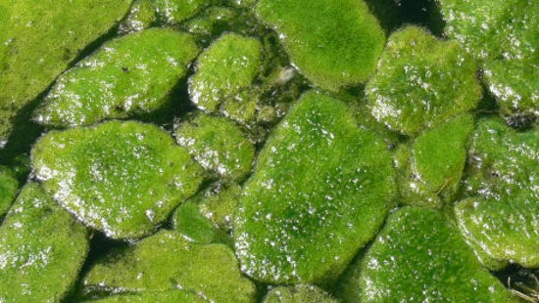
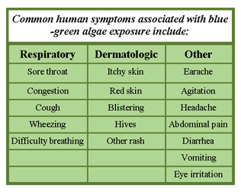
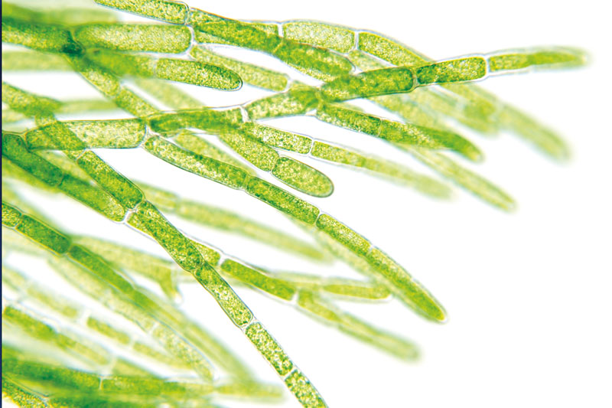
Algae are typically eukaryotic microorganisms that carry out photosynthesis.

Slide 13
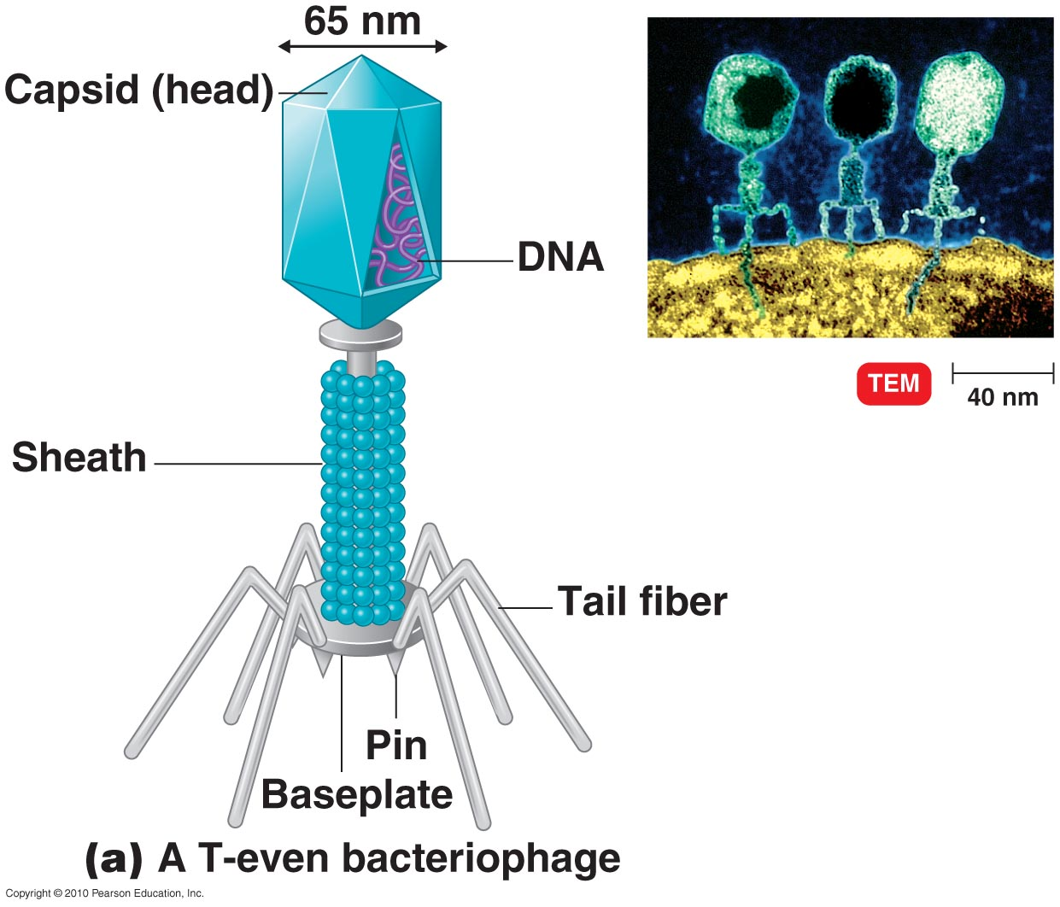
4. Viruses
Viruses are typically submicroscopic, acellular infectious particles that can only replicate inside a living host cell.
The vast majority of viruses possess either DNA or RNA, but not both.

