Slide 1
Quantitative Techniques For Managers
Instructor Zohaib Ali

Slide 2
CONTENTS
1.0 Aims and Objectives
1.1 Introduction
1.2 Historical Development
1.3 About Quantitative Technique
1.4 Methodology of Quantitative Techniques
1.4.1 Formulating the Problem
1.4.2 Defining the Decision Variables and Constraints
1.4.3 Developing a Suitable Model
1.4.4 Acquiring the Input Data
1.4.5 Solving the Model
1.4.6 Validating the Model
1.4.7 Implementing the Results

Slide 3
1.5 Advantages of Mathematical Modelling
1.6 Scope of Quantitative Technique
1.7 Statistics : An Introduction
1.7.1 Origin and Growth of Statistics
1.7.2 Meaning and Definition of Statistics
1.7.3 Statistics as Data
1.7.4 Statistics as a Science
1.7.5 Statistics as a Science different from Natural Sciences
1.7.6 Statistics as a Scientific Method
1.7.7 Statistics as a Science or an Art
1.8 Let us Sum Up
1.9 Lesson-end Activities
1.10 Keywords
1.11 Questions for Discussion
1.12 Terminal Questions
1.13 Model Answers to Questions for Discussion
1.14 Suggested Readings

Slide 4
Aim and objective
In this first lesson we discuss the distinguished approaches to quantitative techniques and its various applications in management, statistical analysis and other industries. Here we will discuss the approaches of quantitative techniques.

Slide 5
INTRODUCTION
Scientific methods have been man’s outstanding asset to pursue an abundant number of activities. It is analysed that whenever some national crisis, emerges due to the impact of political, social, economic or cultural factors the talents from all walks of life join together to overcome the situation and rectify the problem. In this chapter we will see how the quantitative techniques had facilitated the organization in solving complex problems on time with greater accuracy.

Slide 6
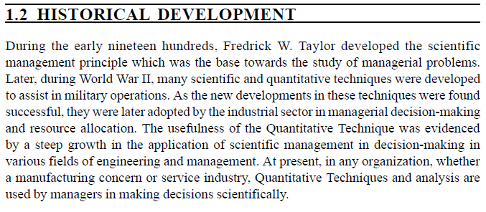

Slide 7
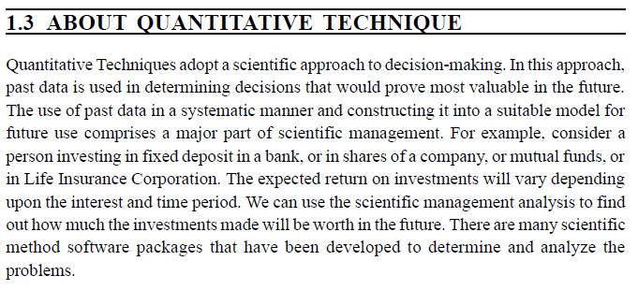

Slide 8
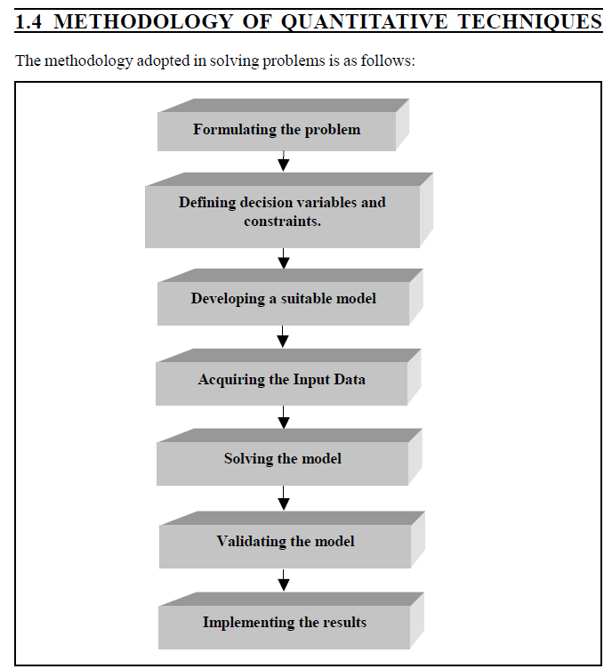

Slide 10
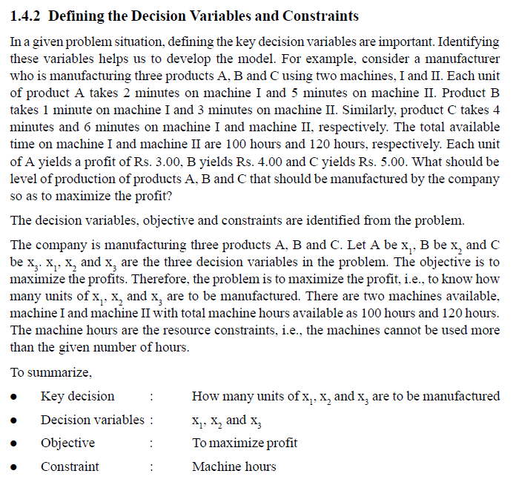

Slide 13
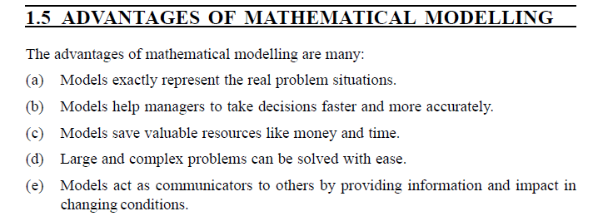

Slide 14
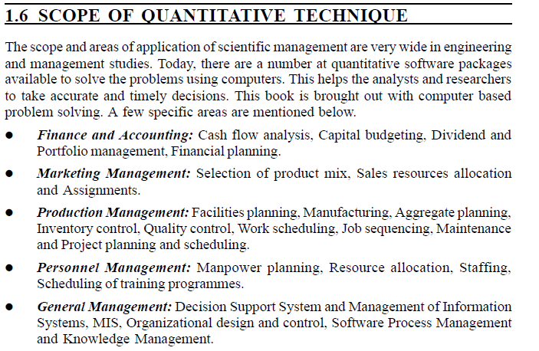

Slide 15
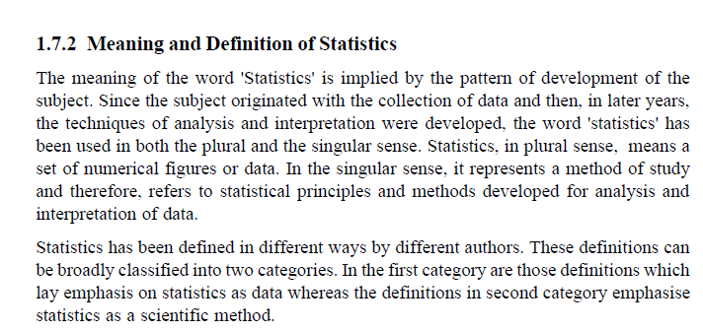

Slide 16
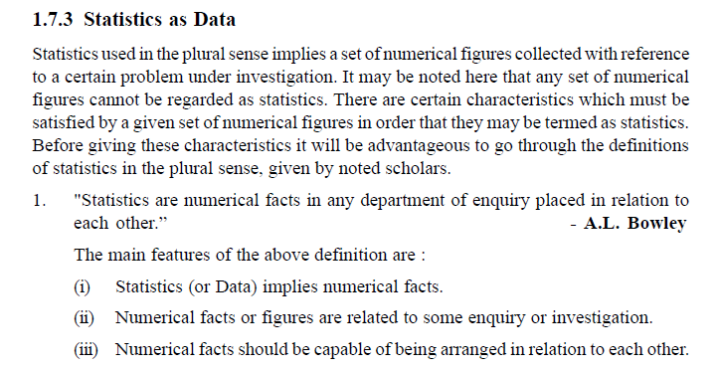

Slide 17
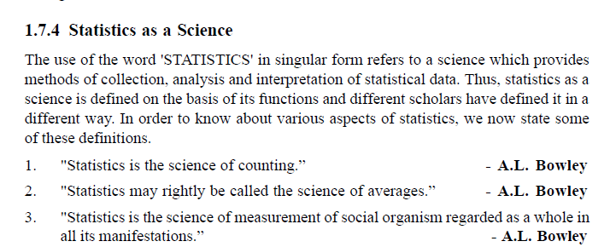

Slide 18
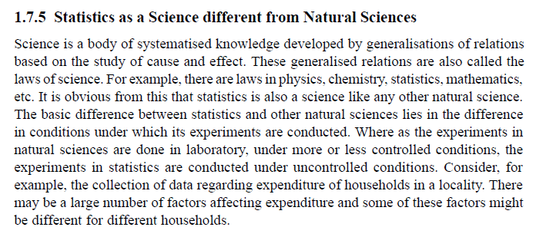

Slide 20
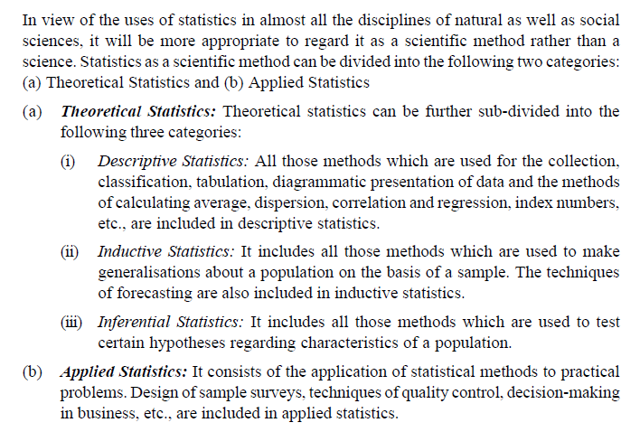

Slide 21
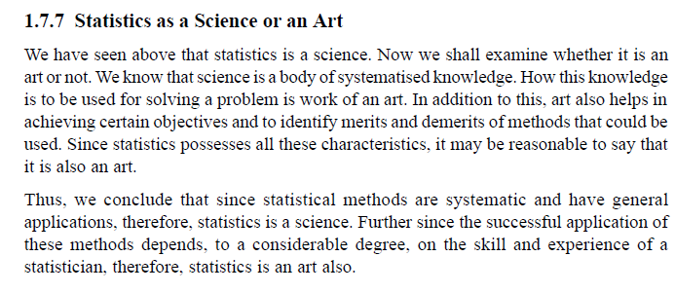

Slide 22
