Slide 1
SMART GRID FUNDAMENTALS

Slide 2
Why Do We Need the Smart Grid?
Increasing electrical demand
Worsening reliability of the electric grid
  2003 saw a large blackout on the east coast
  Significant business losses attributed to unreliable power
Inability to determine outages
  Utilities do not know when outages occur until informed by customer

Slide 3
Why Do We Need the Smart Grid?
Aging infrastructure
  Expected life of electric transformers → 40 years
  Average electric transformer has been operating 42 years
Reduction of greenhouse gases
  40% of U.S. carbon dioxide emissions are from electric grid with an additional 20% coming from transportation
Improved Customer Information
  Customers can obtain interval (hour, 15 min.) energy usage
  Enables dynamic pricing
  Provides the infrastructure and time of use (TOU) pricing to enable PHEV (Plugin Hybrid Electric Vehicles) and EVs (Electric Vehicles) at homes

Slide 4
Why Do We Need the Smart Grid?
Environmentally Responsible
  Desire to reduce dependency on oil, need to have two-way supply capability for renewables such as solar, wind, and tidal
Need for Improved Storage, and Delivery
  Better able to integrate, coordinate, and optimize storage
  Improve and optimize transmission and distribution operations
  Current operation has 3-5% loss of electricity every 100 miles; can work to reduce that to 1% every 100 miles
Reduce and Address Congestion Issues
  Lessen transmission congestion in parts of the U.S.

Slide 5
Why Do We Need the Smart Grid?
Better Security
  Today’s centralized grid is open to attack
  Able to implement physical and cyber security
Creates jobs
  Aging workforce: retiring with the knowledge and nuances of the mechanical work place
  Important opportunity to train people in future careers
Theft and fraud detection
  Ability to monitor, identify and mitigate fraud and theft of electricity
Improved Service and On-going Maintenance
  Electronically enables certain activities formerly done via service call e.g., connect and disconnect customers
  Lack of significant investment for the last 25 years at utilities

Slide 6
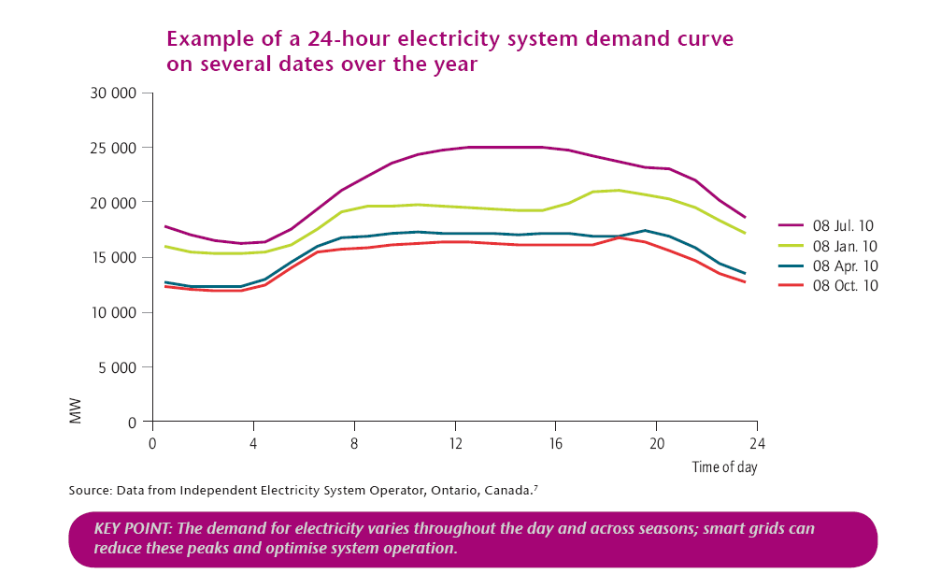
Load Varitations

Slide 7
Smart Grid – Definition
“A Smart Grid delivers electricity from suppliers to consumers using digital technology to save energy, reduce cost, and increase reliability and transparency.”
Smart grid. (2010, November 16). In Wikipedia, The Free Encyclopedia. Retrieved 06:00,
November 17, 2010, from
http://en.wikipedia.org/w/index.php?title=Smart_grid&oldid=397073903

Slide 8
Smart Grid Evolution
Digital Relaying Algorithms Started in Late 1960s
Till 1980: Electromagnetic Relays
1980 – 1990 : Static Relays
1990 : Numerical/Digital relays
Components of Digital Relays
Smart metering concepts raised in 1980s
AMI: Advanced metering infrastructure: 1990s
Smart Grid concept for the first time 2005
Toward the smart Grid

Slide 9
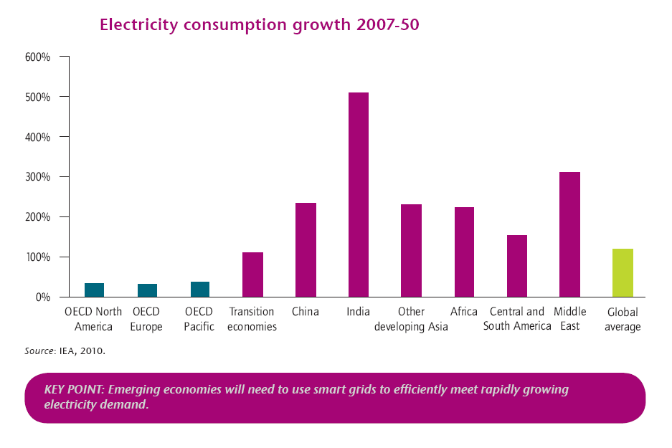
Electricity Consumption Growth

Slide 10
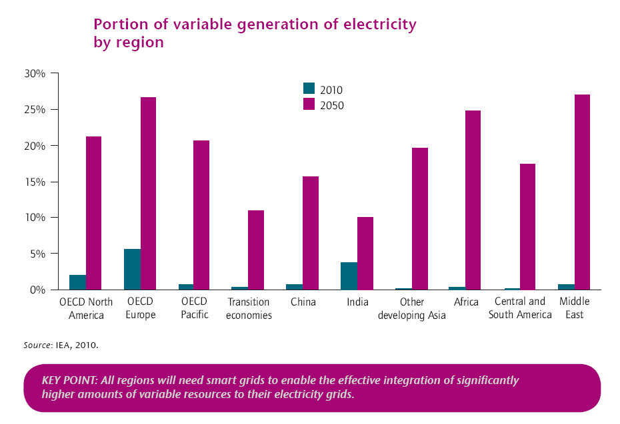
Integration of Renewable

Slide 11
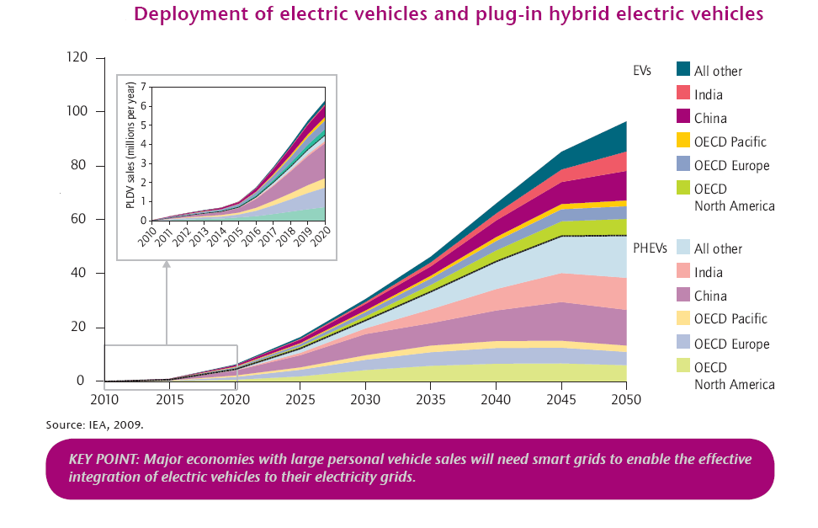
Sale of PHEVs

Slide 12
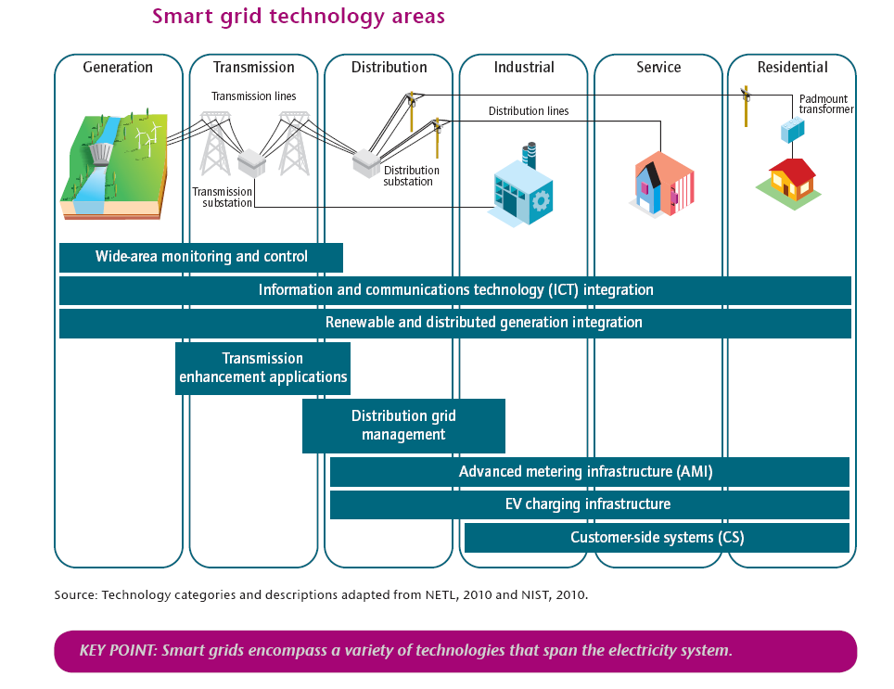
Smart Grid Technology Areas

Slide 13
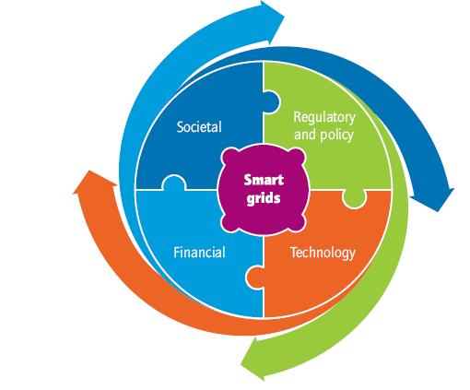
Co-ordination of Different Stakeholders

Slide 14
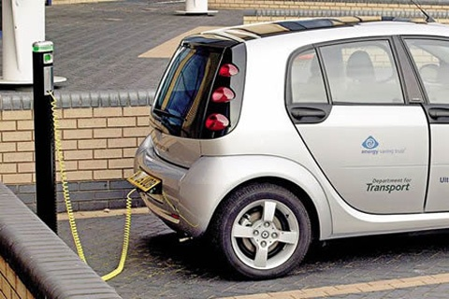
PHEVs
  An electric vehicle (EV) owner has a chip in his car. He is able to plug in anywhere and be charged to his home account
  EVs can act as a supply source and provide electricity to the grid during demand peaks i.e., at charging station they are asked to discharge electricity

Slide 15
NETWORKING BASICS

Slide 16
Components of any Computer
Keyboard,
Mouse
Computer
Processor
(active)
Memory
(passive)
(where
programs,
data live
when
running)
Devices
Input
Control
(“brain”)
Disk,
Network
Output
Data
path
Display,
Printer
Notes:
That is, any computer, no matter how primitive or advance, can be divided into five parts:
1. The input devices bring the data from the outside world into the computer.
2. These data are kept in the computer’s memory until ...
3. The datapath request and process them.
4. The operation of the datapath is controlled by the computer’s controller.
All the work done by the computer will NOT do us any good unless we can get the data back to the outside world.
5. Getting the data back to the outside world is the job of the output devices.
The most COMMON way to connect these 5 components together is to use a network of busses.

Slide 17
General Architecture of Computer Networks

Slide 18
Connection of Networks

Slide 19
Network Topology
a) bus, b) star, c) ring, d) tree structure
a)
b)
c)
d)

Slide 20
Network Attributes
Topology (the interconnection ‘shape’ or physical layout)
Bandwidth (rate at which the network can deliver data from a sender to the
destination host)
Latency (amount of time required to transfer a bit of data from one place to another)
Reliability
Protocol

Slide 21
The OSI Model
Physical Layer
(Data) Link Layer
Network Layer
Transport Layer
Session Layer
Presentation Layer
Application Layer

Slide 22
Physical Layer
Transmission of energy onto the medium
  Collection of energy from the medium
  This layer is concerned with the physical transmission of raw bits
  This bits are transmitted through mechanical, electrical, and procedural interfaces which include
    interface card standard
    modem standards
    certain portions of the ISDN and LAN MAN standards
Notes:
4

Slide 23
THE NETWORK LAYER
The router has millions of IP addressing built into
the software, and knows where to send the packets.
IP stands for Internet Protocol and is basically an
address that the packets will be sent to.
An example would be 216.27.61.137

Slide 24
Why Use Standards?
Avoid re-inventing the wheel
Learn from industry best practices
Specify requirements more easily
Reduce integration costs
Prevent single vendor “lock-in”
Vendors share a much larger market

Slide 25
Making Standards Work
Items critical to a successful standard:
Mature spec
Involved user group
Certification process
Revision process
Marketing, labeling
Implementations
Tool sets

Slide 26



Why International Standards?
Several Advantages
  Time-tested process
  Proven fair and open
  Can be accelerated if needed

Slide 27
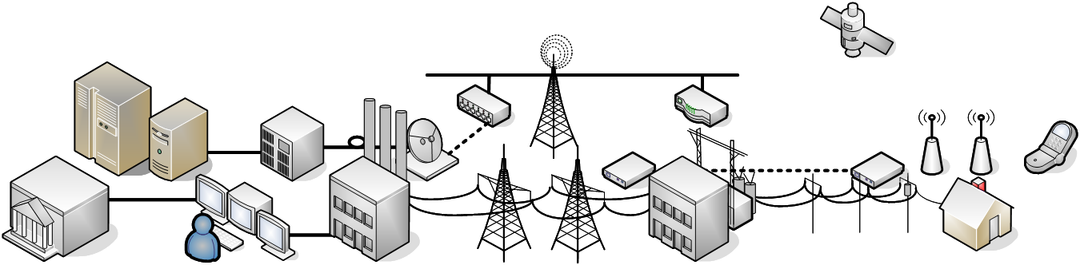
Standards in the Smart Grid
Real-time Simulation
Wide-Area Reliability
Network Optimization
Customer Participation
Participation in Energy Markets

Slide 28
Introduction
IEEE 802 refers to a family of IEEE standards
  Dealing with local area network and metropolitan area network.
  Restricted to networks carrying variable-size packets.
  Specified in IEEE 802 map to the lower two layers
    Data link layer
      LLC sublayer
      MAC sublayer
    Physical layer
The most widely used standards
  The Ethernet family, Token Ring, Wireless LAN.
  Bridging and Virtual Bridged LANs.
  An individual Working Group provides the focus for each area.

Slide 29
IEEE 802 Working Groups
Active working groups | Inactive or disbanded working groups
802.1 Higher Layer LAN Protocols Working Group 802.3 Ethernet Working Group 802.11 Wireless LAN Working Group 802.15 Wireless Personal Area Network (WPAN) Working Group 802.16 Broadband Wireless Access Working Group 802.17 Resilient Packet Ring Working Group 802.18 Radio Regulatory TAG 802.19 Coexistence TAG 802.20 Mobile Broadband Wireless Access (MBWA) Working Group 802.21 Media Independent Handoff Working Group 802.22 Wireless Regional Area Networks | 802.2 Logical Link Control Working Group 802.4 Token Bus Working Group 802.5 Token Ring Working Group 802.7 Broadband Area Network Working Group 802.8 Fiber Optic TAG 802.9 Integrated Service LAN Working Group 802.10 Security Working Group 802.12 Demand Priority Working Group 802.14 Cable Modem Working Group
a

Slide 30
IEEE802
IEEE 802 refers to a family of IEEE standards dealing with local area networks and metropolitan area networks
IEEE 802.11 a/b/g/n Wireless LAN (WLAN) & Mesh (Wi-Fi certification)
IEEE 802.15 Wireless PAN
IEEE 802.15.1 Bluetooth certification
IEEE 802.15.4
Low-Rate wireless PAN e.g., ZigBee

Slide 31
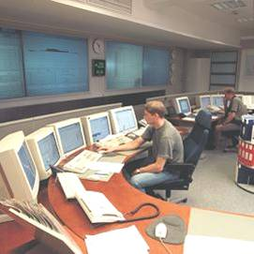
Enterprise and Control Center
Name / No. | Description | Status
IEC 60870-6 | Inter-Control Center Protocol | Widespread
IEC 62325 | ebXML for Power Systems | In development
IEC 61970 | Common Information Model / Generic Interface Definitions (CIM/GID) | In use; mostly single-vendor
IEC 61968 | Interfaces for Distribution Management | Mostly still in development
Multispeak | NRECA Enterprise web services | In use; not flexible
There is a culture of manual integration
Very labour-intensive and costly
Object models and services defined, but…
A variety of underlying technologies: UML, XML, OWL, XSD, RDF, OPC
Working on agreement on a design framework

Slide 32
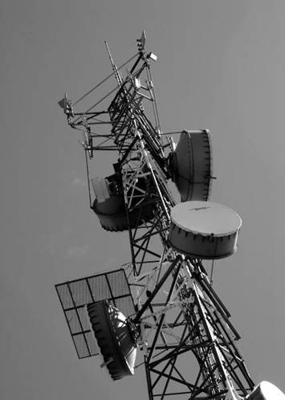
T&D Wide-Area Networks
Name | Notes
Frame Relay | Packet-switched, no reliability guarantee
SONET | Campus or city backbones
WDM | Wavelength Division Multiplexing – follows SONET
Microwave | Proprietary, used in geographically difficult areas
Satellite | Various proprietary technologies, costly
Trunked Radio | Licensed, one broadcast channel, one return
Spread-Spectrum | Unlicensed frequencies, more efficient
IP Radio | Like trunked radio but with IP addressing
Many of these are considered obsolete or aging in the general IT world
Still in common use in the power system

Slide 33
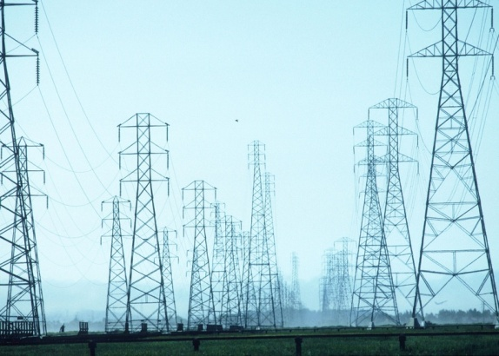
T&D Substations
Name / No. | Description | Status
IEC 61850 | Object models, self-describing, high-speed relaying, process bus | Widespread in Europe, beginning here
DNP3 | Distributed Network Protocol | Most popular in NA
Modbus | Evolved from process automation | Close second
COMTRADE | Fault Capture file format | Widespread
PQDIF | Power Quality file format | In use
IEC 62351 | Security for power systems | Recently released
Automation common in transmission
Business case tough in distribution
Well-known problems and solutions
Moving to the next level

Slide 34
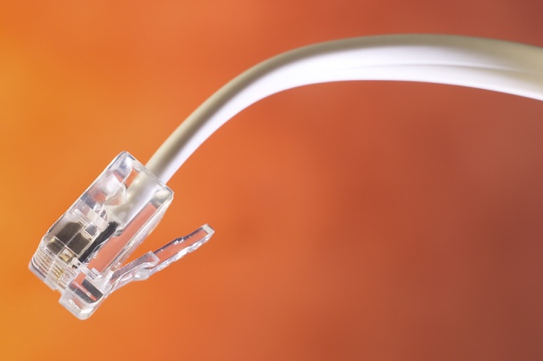
Home Area Networks
Name | Number | Notes
Ethernet | IEEE 802.3 | Substation LANs, usually fiber optic
WiFi | IEEE 802.11 | Access by field tool, neighborhood AMI net
ZigBee | IEEE 802.15.4 | Customer premises automation network
HomePlug | 1.0, AV, BPL | Powerline comms, in and outside premises
6LowPAN | IEEE 802.15.4 | The “approved” IPv6 wireless interface
OpenHAN | HAN SRS v1.04-2008 | Power Industry requirements definition!
ZigBee and HomePlug alliance
  Popular open specifications
LONWorks, Insteon, Z-Wave, X10 – popular proprietary networks
Challenges coming in Electric Vehicles

Slide 35
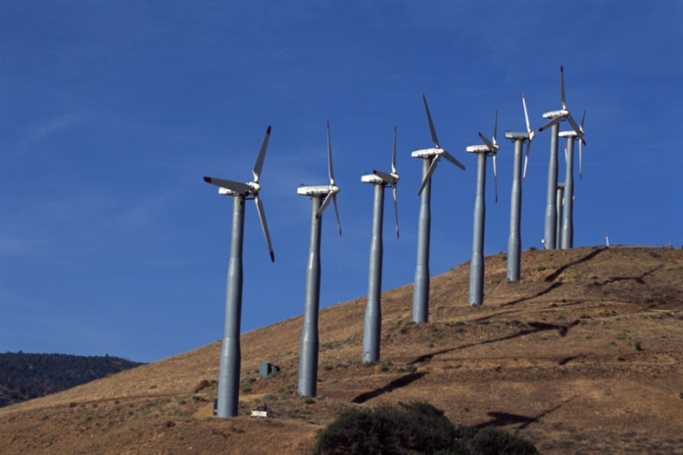
Distributed Resources and Commercial
Name / No. | Description | Status
OPC | Application interface | Widespread in industry
IEC 61400-25 | Wind Power | In use; turf war
DRBizNet | California initiative | In development
BACNet | Building automation | In use; many profiles
OpenADR | Automated Demand Response | In development
IEEE 1547 | Basic principles of DER | In use
IEC 61850-7-420 | Information models for DER | Just released
Rapidly growing, but tend to be “islands of automation”
Concerns over integration with power utilities
Need to get people talking

Slide 36
What is a Smart Meter?
A smart meter is an advanced meter that identifies consumption in more detail than a conventional meter and communicates that information via a network back to the utility for monitoring and billing purposes
  Could provide remote disconnect/connect, reduce load (via a price signal), power outage notification and power quality monitoring
  Smart meters are part of the Advanced Metering Infrastructure (AMI) which would include the Meter Data Management System (MDMS)
  Smart Meters or AMI may be part of a Smart Grid, but alone do not constitute a Smart Grid

Slide 37
