Slide 1
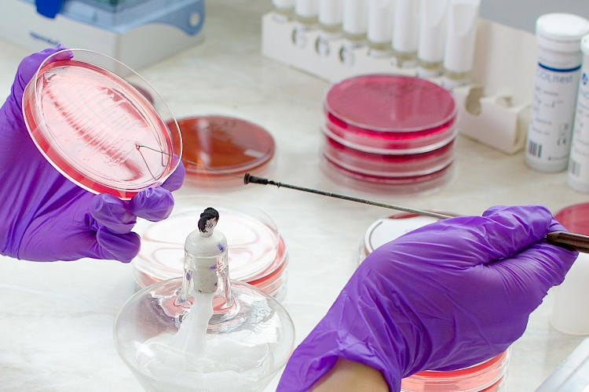
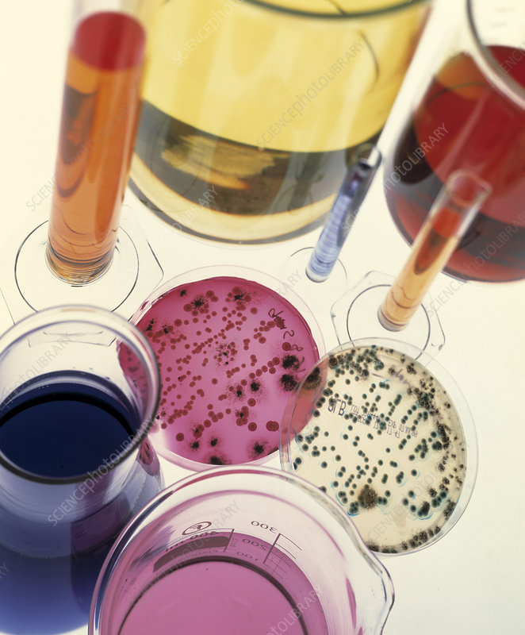
SYSTEMIC DIAGNOSTIC BACTERIOLOGY
Lecture # 1
By AMIR AFZAL KHAN

Slide 2
Microbiology is the study of microscopic organisms, such as bacteria, viruses, archaea, fungi and protozoa.
Bacteriology is the identification and characterization of bacterial species.
Diagnostic bacteriology
The scientific study of bacteria, especially in relation to disease.

Slide 4
Classification of Bacteria
All prokaryotes, are keep in kingdom Monera which are further divided into eubacteria and Archaebacteria
They are tiny, single-cell organisms which cannot be seen by the naked human eye called microbes.
They do not have a nucleus and they lack membrane-bound organelles.
When we look at them through a microscope, we find that archaea and bacteria resemble each other in shape and size.
Both archaea and bacteria have flagella, thread-like structures that allow organisms to move by propelling them through their environment

Slide 5
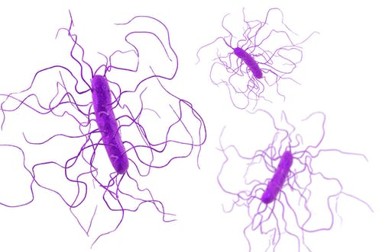
1: Bacteria
Bacteria are typically unicellular, microscopic, prokaryotic organisms
The word prokaryote comes from the Greek (pro) "before" and (karyon) "nut or kernel".
They lacks a membrane-bound nucleus (karyon), mitochondria, or any other membrane-bound organelle
e.g: E. coli (a common bacterium in the human gut) and the cyanobacteria (blue-green algae).

Slide 6
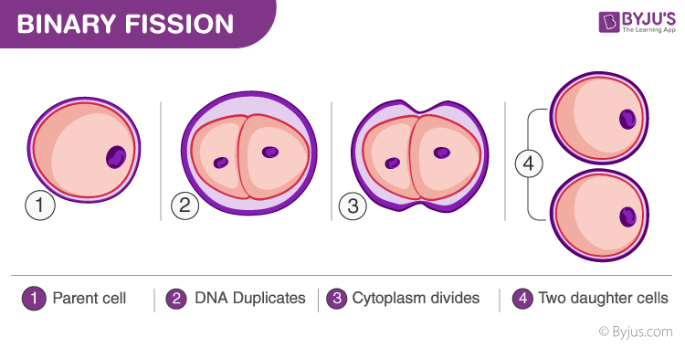
Bacteria reproduce by binary fission.

Slide 9
2. Archaebacteria
It is type of prokaryote, that is, a unicellular organism without a cell nucleus
In structure, they are like unicellular prokaryotes, but the genetic transcription and translation underlying their creation is similar to that of the more complex eukaryotes.
Live in a variety of environments, archaebacteria are known as extremophiles.
Certain species are able to live in temperatures above boiling point at 100° Celsius or 212° Fahrenheit.
They can also thrive in very saline, acidic, or alkaline aquatic environments.

Slide 10
Why Archaebacteria differ then Bacteria?

Slide 11
CLASSIFICATION OF BACTERIA
Bacteria can be classified depending upon:
• Morphology
• Gram staining
• Requirement for oxygen
• DNA homology

Slide 12
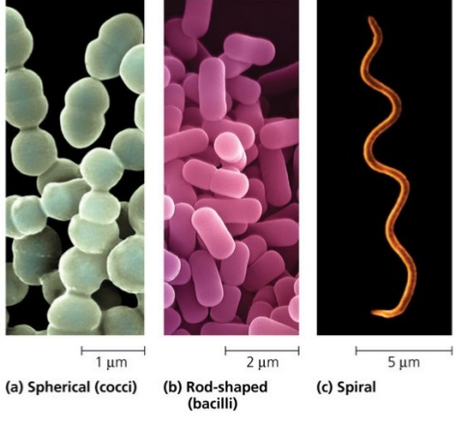
1. MORPHOLOGICAL CLASSIFICATION
On the basis of morphology bacteria are divided
into the following groups:
a. Cocci: round or oval in shape
b. Bacilli: rod shaped
c. Vibrios: coma shaped
d. Spirochaetes: spiral like

Slide 15
2. CLASSIFICATION BASED ON GRAM STAINING
Bacteria are divided into Gram-negative and Gram-positive on the basis of their cell wall structure
Gram-positive: Bacteria staining purple in Gram stained smear. They have thick layer of peptidoglycan.
Gram-negative: Bacteria staining pink in Gram stained smear. Gram-positive bacteria, when dead may stain red.
They have thick outer membrane.
Gram-Variable: The organism is Gram positive but appears Gram-negative or is Gram-negative but appears Gram positive.

Slide 16
3. CLASSIFICATION BASED ON OXYGEN

Slide 17
c. Carboxyphilic: These require presence
of high percentage (10%) of carbon
dioxide.
d. Microaerophilic: These require only
small amounts of oxygen for their
growth and higher concentration of the
oxygen will kill the organism.

Slide 18
4.CLASSIFICATION BASED ON TEMPERATURE
Based on the temperature requirement for their growth bacteria are classified into following three groups:
a. Mesophilic
b. Psychrophilic, and
c. Thermophilic

Slide 19
A mesophile is an organism that grows best in moderate temperature, neither too hot nor too cold, typically between 20 and 45 °C (68 and 113 °F).
Examples. Some notable mesophiles include Listeria monocytogenes, Staphylococcus aureus, and Escherichia coli.
Other examples of species of mesophiles are Clostridium, Pseudomonas , Streptococcus pyogenes, and Streptococcus pneumoniae

Slide 20
Psychrophiles or cryophiles organisms that are capable of growth and reproduction in low temperatures, ranging from −20 °C to +10 °C.
They are found in places that are permanently cold, such as the polar regions and the deep sea.
Psychrophiles (cold-loving) can grow at 0ºC, and some even as low as -10ºC; their upper limit is often about 25ºC.

Slide 21
Thermophiles are heat-loving, with an optimum growth temperature of 50º or more, a maximum of up to 70ºC or more, and a minimum of about 20ºC.
OR
A thermophile is an organism—a type of extremophile—that thrives at relatively high temperatures, between 41 and 122 °C (106 and 252 °F).
Many thermophiles are archaea.
Thermophilic eubacteria are suggested to have been among the earliest bacteria

