Slide 1
Referencing

Slide 2
What is Referencing?
Referencing is a standardized way of acknowledging the sources of information and ideas that you have used in your document.

Slide 3
Why Reference?
Referencing is important to avoid plagiarism, to verify quotations and to enable readers to follow up what you have written and locate the cited author’s work.

Slide 4
Steps In Referencing
Keep a record of the full bibliographic details and relevant page numbers of all the sources from which information is taken.
Insert brief citations at the appropriate places in the text of your document.
Compile a reference list at the end of the document that includes full details of all references cited.

Slide 5
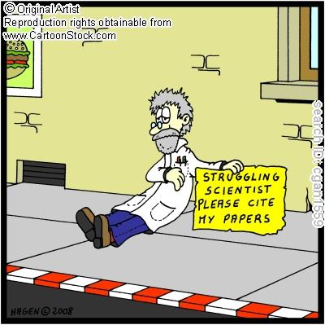
In-text Citations
In an author-date style, in-text citations usually require the name of the author(s) and the year of publication.
A page number is included if you have a direct quote, paraphrase a passage or you want to direct the reader to a specific page. Page numbers may also be included if the you are referring to a long work and the page numbers might be useful to the reader.

