Slide 1
MODAL SPLIT

Slide 2
What is modal split?
Split trips to different available transportation modes, by analyzing people’s decisions regarding mode of travel they use.

Slide 3
General
Trip maker can select between several travel modes.
Modal Split Model is concerned with trip makers behaviour regarding the selection of travel mode.
Pattern of mode choice remains constant as long as the conditions remain unchanged.
When conditions change, respond will change with varying degree.

Slide 4



What affects Mode Choice?
Characteristics of the trip maker: HH, Income, autos available, family size, residential density, gender
Characteristics of the trip: trip purpose, trip length, time of day,
Characteristics of the transportation system: Accessibility ratio, Travel time ratio, comparative riding time, waiting time, transfers, basically door to door time and travel cost ratio
Other Characteristics : Comfort, convenience, reputation, luggage, safety

Slide 5
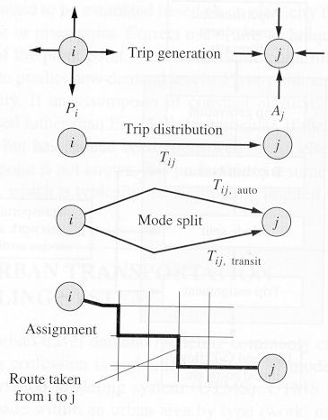
SURVEYS
Trip Ends
Trips by purpose
Time of the Day pattern
Trip Direction
Trips changed to traffic
Car Occupancy levels, different trip purpose wise
Transit, forced on different categories, may be dealt differently
Trip Interchanges
Traffic
CONTINUED

Slide 6
Travel Estimation Process:
Trips loaded to net work considering time of the day
Tij(Organization)
Production Pi
INU
2
1
47
HMC
6
2
66
Other
1
3
110
8
Tij
Tij (Income)
F
r
o
m
Z
o
n
e
s
To Zones
Tij(Mode)
1
2
3
High
1
Mode I
25
1
10
18
19
47
Medium
8
Mode II
40
2
30
32
4
66
Low
3
65
3
5
65
110
12
40
45
90
88
233
Tij(Purpose)
Tij(Route)
Attraction Aj
Education
3
Route A
5
Work
12
1
45
Route B
17
Other
2
2
90
Route C
3
17
3
88
25
CONTINUED

Slide 7
Remember
i\j | 102 | 103 | 104 | 105 | 106 | 107
102
103
104 |  |  |  |  | 4312
105
106
107
Exercises will be restricted to one cell only as indicated. Same will be applicable to other cells. One matrix will split into number of matrices according to modes

Slide 8
Categories of Modal Split Models

Slide 9
Trip-end
models
Trip-interchange models

Slide 10
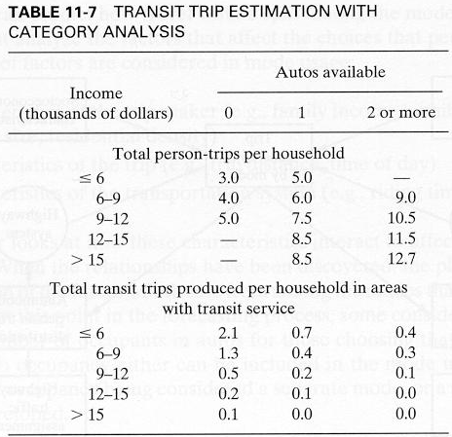
Trip-end Models
Use separate models, like:
P(T) = A + B(POP) – C(INC)
P(A) = A + B (POP) – C(AUTO)
    Pre Distribution Models (Direct Generation Usage)
  At trip generation stage
    Separate regression equations for each mode
    Fails to account for future changes in transportation system/ restraint on use of cars, insensitive
  After trip generation stage
    Assumption that mode does not influence generation
    Trips distributed after splitting generations according to mode
CONTINUED

Slide 11
Trips generated by mode are distributed and assigned to highway and transit network.
Suited for small communities or in developing countries where ridership is primarily a function of socioeconomic variables
Suited to areas without major transit services.
Less difficult and less costly
Different lengths of car and transit trips provided is desirable
Average area basis, does not reflect zone to zone travel which is more precise
Cannot reflect “change of mind” of trip makers responding to policy and service changes
CONTINUED

Slide 12
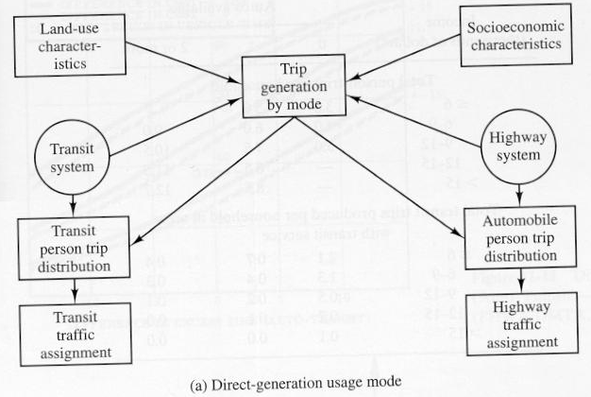

Slide 13
Trip Interchange Models
Post Trip Distribution Models ( Trip Interchange Usage)
Suitable for large cities and areas
Trip characteristics like purpose, orientation, income, auto ownership and trip purpose are used in models
Characteristics of transportation system, Cost, difference in ‘in-vehicle’ time, excess time for pair of zones is used
CONTINUED

Slide 14
More complex
Used where serious consideration to transit
Wide range of variables influencing modal choice are used
Zone to zone basis considerations
Logit formulation is used. Like a share model that divides persons between various modes depending on mode’s variability.
CONTINUED

Slide 15
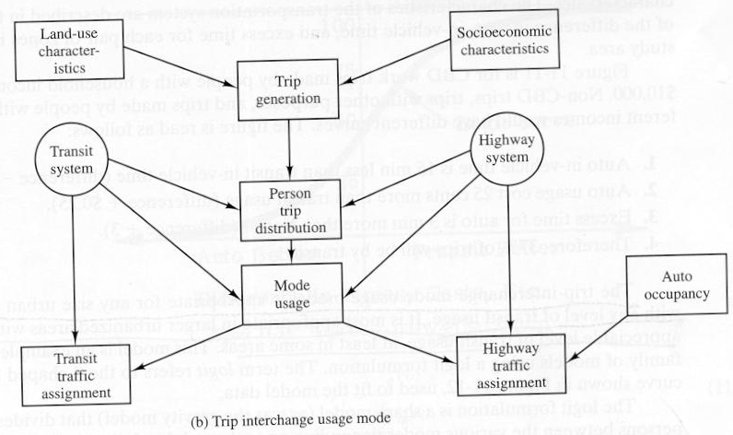
Influencing all three phases.
CONTINUED

Slide 16
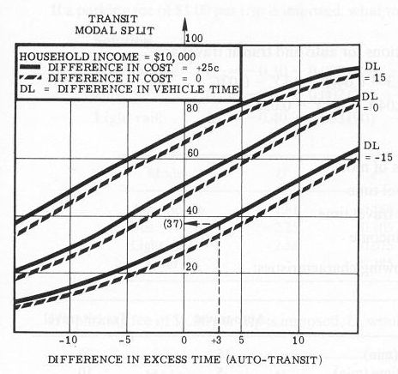
Let’s see how service and trip makers characteristics can affect the trip maker’s decision using Fig. 11-11.
Difference In vehicle time (Auto – Transit) = -15 min
Out of pocket cost (Auto – Transit) = 25 cents
Excess time (Auto – Transit) = 3 min
Under above conditions approximately 37% of trips will be made by transit.

Slide 17
Background to Modal Split Models

Slide 18
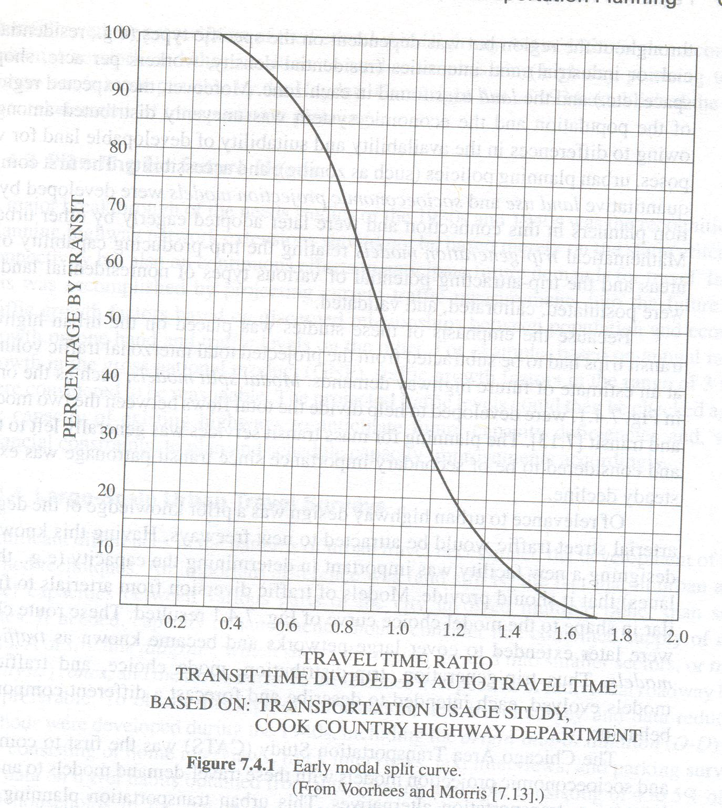
Diversion Curves
One of the simplest methods is diversion curves,
  simple, stratified by trip maker, mode and attributes,
  awkward to calibrate and use
  Washington 160 curves were used.
  Now supplanted

Slide 19
Probability Based Models
Probabilistic distinct choice models based upon principle of utility maximization, to include Discriminant analysis, Probit analysis and Logit analysis
Each is described by utility/ disutility function and person’s choosing each of competing alternatives, extended to groups, using probability, proportion likely to use each of competing modes is worked out
Two step model development
  Selection of mathematical form
  Calibration, model reproduces the base year data

Slide 20
Utility and Disutility
Measure degree of satisfaction that people derive from their choices.
Represents the generalized cost associated with each choice.
Magnitude depends upon the characteristics of trip, trip maker & transportation system

Slide 21
Generalized Cost
Cost may be considered in terms of distance, time, money or a combination of these.
  The generalized cost is typically a linear function
  Includes weighted coefficients
  These coefficients attempt to present their relative importance as perceived by the traveller

Slide 22
Utility function
Represented by linear weighted sum of independent variables of their transformation
U₀ = a₀ + a₁x₁ +a₂x₂ + ---------
U is the Utility derived from a choice defined by
Magnitude of attributes X
Weighted by model parameters a
Capturing effect not explicitly included a₀
Disutility it is negative ………. Why?

Slide 23
Utility Function – Earlier Attempts
Calibrated separate utility for each mode
Same attributes assigned with different 0.9 X₃
weightages( eg cost LOS convenience)
mode specific (choice specific)
Not to include same attributes
More validity
Inclusion of new mode is problematic because absence of base year data.
U₁ = 6.2 + 2.8 X₁ +1.2 X₂
U₂ = 2.2 + 1.8 X₂ +1.2 X₃
U₃ = 4.3 + 2.2 X₁ +1.2 X₃

Slide 24
Utility function – Lancaster Approach
Choice abstract (attribute specific)
People perceive goods and services indirectly in terms of their attributes which are weighed identically across choices.
Single equation to measure utility
Difference in utilities associated with attributes of modes
Strong conceptual foundation
All attributes may not be included
CONTINUED

Slide 25
U_{k} = a_{k} + 2.8 X₁ +1.2 X₂ + 0.9 X₃
  U_{k} Utility of mode K
  a_{k} Mode specific constant, to capture the effect of variables which are not explicitly included in the model, represents fixed advantages/ disadvantages of a mode
  X₁ X₂ X₃ are attributes and have different values for different modes
  If value of attribute is same, more dependence is on mode specific constant

Slide 26
New Trends
Practical difficulties call for mixed one, attribute specific and mode specific
Added utility, to CBD or from CBD, added utility for high cost of parking.
Socio economic may be included, ratio of travel cost to trip makers income level

Slide 27
In Short
Models discussed are probabilistic not deterministic (knowledge of outcome)
Estimates market share of each mode or probability of using a particular mode in aggregate and disaggregate cases respectively
Logit Model is most popular, can be applied to more than two competing modes

Slide 28
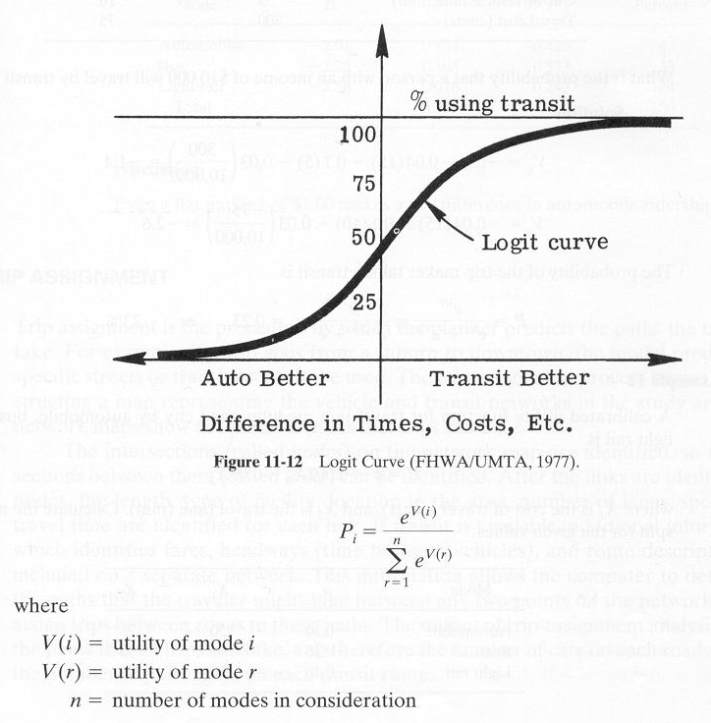
Use of Logit Models for Modal Choice
The logit model trades off the relative utilities of various modes.
“The better a mode is, the more utility it has for the potential user”

Slide 29
Logit Models

Slide 30
Multinomial Logit (MNL) Model
Calculates the probability of choosing mode k if disaggregate
Or
Proportion of traveller in aggregate case
That will select a specific mode ‘k’
e ^{Uk}
P(K) = --------------
Σ_{x}e ^{Ux}
CONTINUED

Slide 31
Multinomial Logit (MNL) Model
Resembles fractional term of gravity model
All trips at specific interchange, the equation should be satisfied.
T_{ij} = Σ_{x} T_{ij} _{x}
This equation will be satisfied by writing proportion attracted by each mode
U_{k}
P(K) = --------------
Σ_{x}U_{x}
CONTINUED

Slide 32
Multinomial Logit (MNL) Model
But for certain reasons the preferred one is
e ^{Uk}
P(K) = --------------
Σ_{x}e ^{Ux}

Slide 33
Application of the Logit Model
Problem-01
A calibration study results in the following Utility Equation
Uk= ak - 0.025X1 - 0.032X2 - 0.015X3 - 0.002X4
X1 | Access plus egress time, in minutes
X2 | Waiting time, in minutes
X3 | Line-haul time, in minutes
X4 | out-of-pocket cost, in cents

Slide 34


Application of the Logit Model
Attributes | X1 | X2 | X3 | X4 | ak
Automobile | 5 | 0 | 20 | 100 | 0
Local Bus | 10 | 15 | 40 | 50 | -0.1

Slide 35
Application of Model Logit Model
The Utility Equation Yields
U(Auto) = -0.625
U(Bus) = -1.530
e ^{-0.0625}
p(A) = -------------- = 0.71
e ^{-0.0625} + e^{-1.53}
e ^{Uk}
P(K) = --------
Σ_{x}e ^{Ux}
e ^{-1.53}
p(B) = -------------- = 0.29
e ^{-0.0625} + e^{-1.53}

Slide 36
Application of Model Logit Model
The market share of each mode is:
Qij(Auto) = 0.71 x 5000 = 3550 trips/day
Qij(Bus) = 0.29 x 5000 = 1450 trips/day
The fare-box revenue estimate is:
1450 trips/day x $ (50/100)/trip = $725/day

Slide 37
Application of the Logit Model
Problem-02
Given the Utility Equation for total trips of Qij as 8570 to be made per day:
Uk= ak - 0.003X1 - 0.04X2
X1 | out-of-pocket cost, in cents (100-cents = 1$)
X2 | Travel time, in minutes
Mode K | X1 | X2 | ak
Automobile | 120 | 30 | -0.2
Express bus | 60 | 45 | -0.4
Regular Bus | 30 | 55 | -0.6

Slide 38
Application of Model Logit Model
(a) | Calculate the market share of all the travel modes and fare box revenue estimate
(b) | Estimate the effect of 50% increase in the fare of all modes on fare box revenue estimate
Solution-Part-a
Uk= ak - 0.003X1 - 0.04X2
Automobile | U(a) | -1.76
Express bus | U(E-b) | -2.38
Regular Bus | U(R-b) | -2.89
e ^{Uk} P(K) = -------- Σ_{x}e ^{Ux}
Automobile | P(a) | 0.54
Express bus | P(E-b) | 0.29
Regular Bus | P(R-b) | 0.17

Slide 39
Application of Model Logit Model
Qij (k) = U(k) x P(k)
Qij (Auto) | 4605 | trips/day
Qij (E-Bus) | 2477 | trips/day
Qij (R-Bus) | 1488 | trips/day
Fare-box revenue estimate = Qij (k) x Xi(k)
The fare-box revenue estimate for Express bus: | 1486-$
The fare-box revenue estimate for Express bus: | 446-$
Total revenue per day | 1933-$

Slide 40
Application of Model Logit Model
Solution-Part-b
Uk= ak - 0.003X1 - 0.04X2
After 50% increase in out-of-pocket cost
Mode K | X1 | X2 | ak
Automobile | 120 | 30 | -0.2
Express bus | 60 | 45 | -0.4
Regular Bus | 30 | 55 | -0.6
Uk= ak - 0.003X1 - 0.04X2
Automobile | U(a) | -1.94
Express bus | U(E-b) | -2.47
Regular Bus | U(R-b) | -2.935

Slide 41
Application of Model Logit Model
e ^{Uk} P(K) = -------- Σ_{x}e ^{Ux}
Automobile | P(a) | 0.45
Express bus | P(E-b) | 0.26
Regular Bus | P(R-b) | 0.17
Qij (k) = U(k) x P(k)
Qij (Auto) = | 3847 | trips/day
Qij (E-Bus) = | 2264 | trips/day
Qij (R-Bus) = | 1422 | trips/day
Fare-box revenue estimate = Qij (k) x Xi(k)
The fare-box revenue estimate for Express bus: = | 2038 | $
The fare-box revenue estimate for Express bus: = | 640 | $
Total Revenue per day = | 2678 | $
% Increase in Revenue after 50% increase in cost of all modes = | 38.55 | %

Slide 42
Application of the Logit Model
Problem-03
It is desired to examine the effect of introducing a rapid transit (RT) system in the city as in Problem-01
The service attributes of the proposed system of (RT) are as follow.
Attributes | X1 | X2 | X3 | X4 | ak
Rapid transit (RT) | 10 | 5 | 30 | 75 | -0.06
Find the market share of each mode due to introduction of new mode and the effects on the revenues of the public transportation authority, which operates both the local bus and the rapid transit systems.

Slide 43
Application of the Logit Model
Attributes | X1 | X2 | X3 | X4 | ak
Automobile | 5 | 0 | 20 | 100 | 0
Local Bus | 10 | 15 | 40 | 50 | -0.1
Rapid transit | 10 | 5 | 30 | 75 | -0.06
e ^{Uk} P(K) = -------- Σ_{x}e ^{Ux}
Automobile | P(a) | 0.489
Local Bus | P(b) | 0.198
Rapid transit | P(RT) | 0.313
Uk= ak - 0.025X1 - 0.032X2 - 0.015X3 - 0.002X4
Automobile | U(a) | -0.625
Local Bus | U(b) | -1.53
Rapid transit | U(RT) | -1.07
Qij (k) = U(k) x P(k)
Qij (Auto) = | 2445 | trips/day
Qij (Bus) = | 989 | trips/day
Qij (RT) = | 1567 | trips/day
Fare-box revenue estimate = Qij (k) x Xi(k)
The fare-box revenue estimate for Local bus: = | 494 | $
The fare-box revenue estimate for Rapid transit: = | 1175 | $
Total Revenue Per day = | 1669 | $

Slide 44
Application of the Logit Model
Problem-04
A city council is contemplating a proposal to change the fare of rapid transit (RT) system to 150-cents instead of 75-cents as is in the service attributes of Problem-03
Attributes | X1 | X2 | X3 | X4 | ak
Rapid transit (RT) | 10 | 5 | 30 | 150 | -0.06
Find the market share of each mode due to the introduction of this new policy and the effects on the revenues of the public transportation authority, which operates both the local bus and the rapid transit systems.

Slide 45
Application of the Logit Model
Attributes | X1 | X2 | X3 | X4 | ak
Automobile | 5 | 0 | 20 | 100 | 0
Local Bus | 10 | 15 | 40 | 50 | -0.1
Rapid transit | 10 | 5 | 30 | 150 | -0.06
e ^{Uk} P(K) = -------- Σ_{x}e ^{Ux}
Automobile | P(a) | 0.511
Local Bus | P(b) | 0.207
Rapid transit | P(RT) | 0.282
Uk= ak - 0.025X1 - 0.032X2 - 0.015X3 - 0.002X4
Automobile | U(a) | -0.625
Local Bus | U(b) | -1.53
Rapid transit | U(RT) | -1.22
Qij (k) = U(k) x P(k)
Qij (Auto) = | 2556 | trips/day
Qij (Bus) = | 1034 | trips/day
Qij (RT) = | 1410 | trips/day
Fare-box revenue estimate = Qij (k) x Xi(k)
The fare-box revenue estimate for Local bus: = | 517 | $
The fare-box revenue estimate for Rapid transit: = | 2115 | $
Total Revenue per day = | 2632 | $

Slide 46
The Incremental (or Pivot- Point) Logit Model
If policy change leads to change in utilities of one or more alternatives where ∆Ux represents the change in utility of alternative x, then revised probability P’(K) of choosing K is computed by pivoting about base line proximities P(x)
e ^{(Uk + ∆Uk)}
P’(K) = -------------------
Σ_{x} e ^{(Ux + ∆Ux)}
e ^{Uk} * e ^{∆Uk}
P’(K) = -------------------- (A)
Σ_{x} e ^{Ux} * e ^{∆Ux}
Dividing the numerator and denominator by the denominator of Eq-A we get the expression
P(K) * e ^{∆Uk}
P’(K) = -----------------------
Σ_{x}P(x) * e ^{∆Ux}

Slide 47
The Incremental (or Pivot- Point) Logit Model
Problem-05
Assume that the shares of the three modes in problem-03 had been obtained from a base-year survey. Calculate the effect that the policy of example-04 will have on the patronage (aid) of the local bus.
The only change occurs in the Utility of Rapid transit as its fare changes from 75-cents to 150-cents thus:
Change in Utility = Utility after change – Base year Utility
ΔU(Rapid Transit) = (-1.22) – (-1.07) = -0.15
The incremental utility in other two modes is zero since there is no change in there attributes
Baseline shares
e ^{Uk} P(K) = -------- Σ_{x}e ^{Ux}
Automobile | P(a) | 0.489
Local Bus | P(b) | 0.198
Rapid transit | P(RT) | 0.313

Slide 48
The Incremental (or Pivot- Point) Logit Model
Applying the incremental logit formula to calculate the new share of the local bus:
0.198 x e⁰
P’(B) = ------------------------------------------------- = 0.207
(0.489 x e⁰ )+(0.198 x e⁰)+(0.313 x e^{-0.15})
This is identical as that in Problem-04
The baseline probabilities do not need to be calculated by the Multinomial Logit model; they may be obtained from surveys of existing conditions.

Slide 49
Independence of Irrelevant Alternatives (IIA) property
The ratio of probabilities in choice set of two alternatives A & B in Multinomial Logit model (MNL) is a function of the difference in the utilities of the two alternatives and is not affected by the utility of any other alternative which becomes ‘irrelevant’
In other words change in utility of third alternative will affect the shares of A & B by the same proportionally (culprit).
This condition is known as the independence of irrelevant alternatives (IIA) property
P(A) e^{(UA)}
------ = ------------- = e^{(UA - UB)}
P(B) e^{(UB)}

Slide 50
Independence of Irrelevant Alternatives (IIA) property
In Problem-01 the ratio of:
P(Auto) / P(Bus) = 0.71 / 0.29 = 2.45
After the introduction of the rapid transit mode (Problem-03) there was a reduction in the shares of both the automobile (A) and the local bus (B) so that the ratio of the probabilities remained:
P(Auto) / P(Bus) = 0.489 / 0.198 = 2.45

Slide 51
Independence of Irrelevant Alternatives (IIA) property
Moreover, increasing the cost of rapid transit (Problem-04) had a proportional effect on the share of the other two modes with no change in their ratio;
P(Auto) / P(Bus) = 0.511/0.207 = 2.45.
In many instances this result is counterintuitive.
For example,
it would be reasonable to expect that changes in the cost of rapid transit would have a proportionally greater impact on the local. bus (i.e., another transit mode) than on the automobile.

Slide 52
The Nested Logit Model
To rectify the expected implication of IIA property of the MNL model, nested (i.e hierarchical) structure is formulated where similar alternatives are clustered.
Choice (Three Mode)
Rail
Local Bus
Automobile
Choice (Nested)
Composite Transit
Local Bus
Automobile
Rail
Bus and Rail affect each other more than auto which is not nested
Greater degree of choice substitution is allowed with in the nest than between nests
CONTINUED

Slide 53
The Nested Logit Model
exp (U_{A})
P(A) = ------------------------
exp (U_{T}) + exp (U_{A})
exp (U_{T})
P(T) = ------------------------
exp (U_{T}) + exp (U_{A})
  Where composite transit utility U_{T} = f (U_{B} ,U_{R})
CONTINUED

Slide 54
The Nested Logit Model
Conditional probabilities at lower transit level are
exp (U_{B})
P(B\T) = ------------------------
exp (U_{B}) + exp (U_{R})
exp (U_{R})
P(R\T) = ------------------------
exp (U_{B}) + exp (U_{R})
P(B) = P(B\T) x P(T)
P(R) = P(R\T) x P(T)
CONTINUED

Slide 55
The Nested Logit Model
A transit utility expression is introduced to capture characteristics of all transit sub modes.
U_{T} = a_{T}+ . . . + a_{n} * X_{n} + θ * Logsum
  where Logsum is ‘Transit utility variable’ natural log of denominator of previous equations i.e
    Logsum = ln {e^{UB} + e^{UR}}
    Numerical value of Logsum provides appropriateness of selected nesting structure
  θ is calibration coefficient, reproduces last year data
CONTINUED

Slide 56
The Nested Logit Model
θ = 0
Transit utilities is independent of the utilities of sub modes, sub modes are perfect substitutes of each other
0 < θ < 1
  Selected structure is acceptable
θ = 1
IIA holds, equivalent MNL level
θ > 1
Nesting structure is inappropriate

Slide 57
The Nested Logit Model
Problem-05
An estimation procedure for a mode choice model of the nested logit structure (On Slide no 52) found that: U_{T} = a_{T} + θ * Logsum with a_{T} = -0.52 and θ = 0. For a particular zonal interchange the following model utilities were calculated in accordance with the estimated nested logti model:
U_{A} = -0.26 U_{B} = -0.92 U_{R} = -0.82
U_{T} = a_{T} + θ * Logsum = -0.52 + 0 * Logsum = -0.52
Calculate:
The corresponding mode shares
The effect of policy that is expected to cause a change ΔU_{B} = -0.20

Slide 58
The Nested Logit Model
Part-a: ---Baseline conditions
Nest Level
Mode | U_{m} | e^{Um} | P(m/T)
Bus | -0.92 | 0.399 | 0.475
Rail | -0.82 | 0.440 | 0.525
Summation = |  | 0.839 | 1.0
Primary Choice Level
Mode | U_{m} | e^{Um} | P(m)
Auto | -0.26 | 0.771 | 0.565
Transit | -0.52 | 0.595 | 0.435
Summation = |  | 1.366 | 1.0
P(B) = P(B/T) x P(T) = | 0.207
P(R) = P(R/T) x P(T) = | 0.229
P(A) = | 0.565
Summation = | 1.0

Slide 59
The Nested Logit Model
Part-b: ---After Change
Nest Level
Mode | U_{m} | e^{Um} | P(m/T)
Bus | -1.12 | 0.326 | 0.426
Rail | -0.82 | 0.440 | 0.574
Summation = |  | 0.767 | 1.0
Primary Choice Level
Mode | U_{m} | e^{Um} | P(m)
Auto | -0.26 | 0.771 | 0.565
Transit | -0.52 | 0.595 | 0.435
Summation = |  | 1.366 | 1.0
P(B) = P(B/T) x P(T) = | 0.185
P(R) = P(R/T) x P(T) = | 0.250
P(A) = | 0.565
Summation = | 1.0

Slide 60
The Nested Logit Model
Conclusion:
Since θ = 0, the two transit sub modes are perfect substitutes of each other. Con­sequently the share lost by the local bus Was entirely gained by the rail transit, whereas the auto share remained the same.

