Slide 1
TRANSPORTATION PLANNING
Lecture 4

Slide 2
To Start With
Travel Demand modeling consists of
Standard models by DOTs in 90s, ‘trip based models’ as these consider ‘trip’ as basic unit of travel.
Best practice advanced models by progressive planning organizations, eg motorized society modal choice models.
Alternate paradigm, based upon research, activity base approach, used ‘trip chain concept’, introduction of life style of travel, behavioral, started in 70s and gained momentum.
Special purpose models, specific issue in limited context.

Slide 3
Sequence of Activities
Land-Use survey
Land-Use Allocation
Trip Generation Equations
Zonal Trip ends
Captive Modal Split Model
Trip ends by Mode
Travel survey
Trip Distribution Model
Alternative Transport Systems
Choice Modal Split Model
O-D Volumes by Mode
Route Assignment by Mode
Route Assignment by Mode
Check against Measured Volumes
Volumes by Link and Mode

Slide 4
Background
Trip Generation means” to forecast the number of personal trips that will begin or end in each TAZ for a typical day in target year
Independent Variable (Land use/ socio economic factors)
Dependent Variable (Base year trips)
Calibration (Base year observations and surveys) Relationship between variables and travel quantified, numerical parameters estimated
Calibrated model used for predictive purposes based upon land use and socioeconomic projections in target year
Trip ends Q_{ij} / Tij or P_{I} and A_{J}

Slide 5
Trip Purpose
Trip purposesHB or NHB
Home based School
Home based Work
Home based Shopping
Home based Recreational
Non Home based
Commercial, Light, Medium or Heavy
Separate estimation for each
All have different character
Travel behaviour depends upon trip purpose

Slide 6
Zonal Based verses Household Based Models
Zonal based (Aggregate)
Zones be accurately delineated.
Smaller zones.
Zonal attributes
Population Average income
Average vehicle ownership
Accuracy affected
Sample survey expanded.
Leads to ‘Zonal total trip ends”
Household based (Disaggregate)
Zones may be larger
Household attributes
Family income
Family members
Vehicles
More accurate
Now even individual based
Sample survey expanded.
Different house groups combined to make ‘Zonal total trip ends”

Slide 7
PA and OD

Slide 8
Productions and Attractions
Zone I
Zone J
O
D
NR
R
NR
R
D
O
OD is in terms of direction & PA is in terms of land use
OD easy to collect & PA easy to predict in future

Slide 9
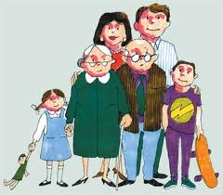
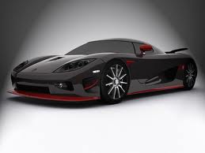
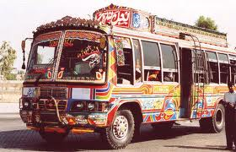
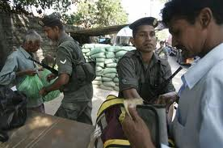
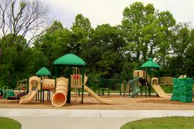
10
40
21
00
30

Slide 10
Other information collected may include
Income
Family Size
Car ownership
etc
10
School
Office
40
HBS (Bus)
21
Network inventory
HBW
(Auto)
HBW
(Auto)
00
Knowing sample Population trips determined and checked for survey accuracy
Home-A
NHBO
(Auto)
HBO
(Bus)
30
HBO
(Auto)
Different matrices may be drawn
Recreation
Home-B

Slide 11
Origin Destination Matrices
HBS |  |  |  |  |  |  | HBW |  |  |  |  |  |  | HBO
O/D | 10 | 21 | 30 | 40 | Total |  | O/D | 10 | 21 | 30 | 40 | Total |  | O/D | 10 | 21 | 30 | 40 | Total
10 |  |  |  | 2 | 2 |  | 10 |  |  |  |  | 0 |  | 10 |  |  |  |  | 0
21 |  |  |  |  | 0 |  | 21 |  |  | 2 |  | 2 |  | 21 |  |  |  |  | 0
30 |  |  |  |  | 0 |  | 30 |  | 2 |  |  | 2 |  | 30 |  |  |  | 4 | 4
40 | 2 |  |  |  | 2 |  | 40 |  | 1 |  |  | 1 |  | 40 |  |  | 3 |  | 3
Total | 2 | 0 | 0 | 2 | 4 |  | Total | 0 | 3 | 2 | 0 | 5 |  | Total | 0 | 0 | 3 | 4 | 7
All HB |  |  |  |  |  |  | NHBO/ NHB |  |  |  |  |  |  | ALL
O/D | 10 | 21 | 30 | 40 | Total |  | O/D | 10 | 21 | 30 | 40 | Total |  | O/D | 10 | 21 | 30 | 40 | Total
10 |  |  |  | 2 | 2 |  | 10 |  |  |  |  | 0 |  | 10 |  |  |  | 2 | 2
21 |  |  | 2 |  | 2 |  | 21 |  |  | 1 |  | 1 |  | 21 |  |  | 3 |  | 3
30 |  | 2 |  | 4 | 6 |  | 30 |  |  |  |  | 0 |  | 30 |  | 2 |  | 4 | 6
40 | 2 | 1 | 3 |  | 6 |  | 40 |  |  |  |  | 0 |  | 40 | 2 | 1 | 3 |  | 6
Total | 2 | 3 | 5 | 6 | 16 |  | Total | 0 | 0 | 1 | 0 | 1 |  | Total | 2 | 3 | 6 | 6 | 17
Auto |  |  |  |  |  |  | PT |  |  |  |  |  |  | & So On
O/D | 10 | 21 | 30 | 40 | Total |  | O/D | 10 | 21 | 30 | 40 | Total |  | O/D | 10 | 21 | 30 | 40 | Total
10 |  |  |  |  | 0 |  | 10 |  |  |  | 2 | 2 |  | 10 |  |  |  | 2 | 2
21 |  |  | 3 |  | 3 |  | 21 |  |  |  |  | 0 |  | 21 |  |  | 3 |  | 3
30 |  | 2 |  | 4 | 6 |  | 30 |  |  |  |  | 0 |  | 30 |  | 2 |  | 4 | 6
40 |  | 1 |  |  | 1 |  | 40 | 2 |  | 3 |  | 5 |  | 40 | 2 | 1 | 3 |  | 6
Total | 0 | 3 | 3 | 4 | 10 |  | Total | 2 | 0 | 3 | 2 | 7 |  | Total | 2 | 3 | 6 | 6 | 17
Production Attraction Matrices
HB |  |  |  | NHB |  |  |  | Auto |  |  |  | PT |  |  |  | All Trip Ends
Zone | P | A |  | Zone | P | A |  | Zone | P | A |  | Zone | P | A |  | Zone | P | A
10 |  | 4 |  | 10 |  |  |  | 10 |  |  |  | 10 |  | 4 |  | 10 |  | 4
21 |  | 5 |  | 21 | 1 |  |  | 21 | 1 | 5 |  | 21 |  |  |  | 21 | 1 | 5
30 | 4 | 7 |  | 30 |  | 1 |  | 30 | 4 | 5 |  | 30 |  | 3 |  | 30 | 4 | 8
40 | 12 |  |  | 40 |  |  |  | 40 | 5 |  |  | 40 | 7 |  |  | 40 | 12
Total | 16 | 16 |  | Total | 1 | 1 |  | Total | 10 | 10 |  | Total | 7 | 7 |  | Total | 17 | 17

Slide 12
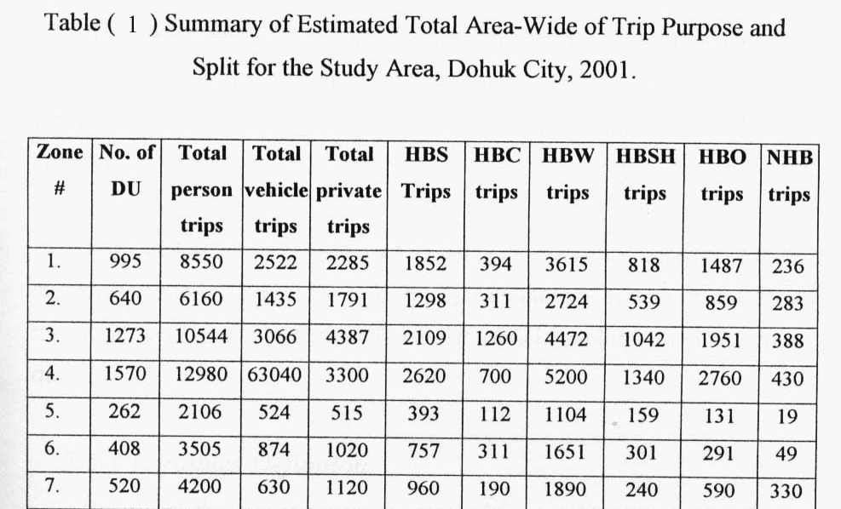

Slide 13
Four Step Modeling

Slide 14
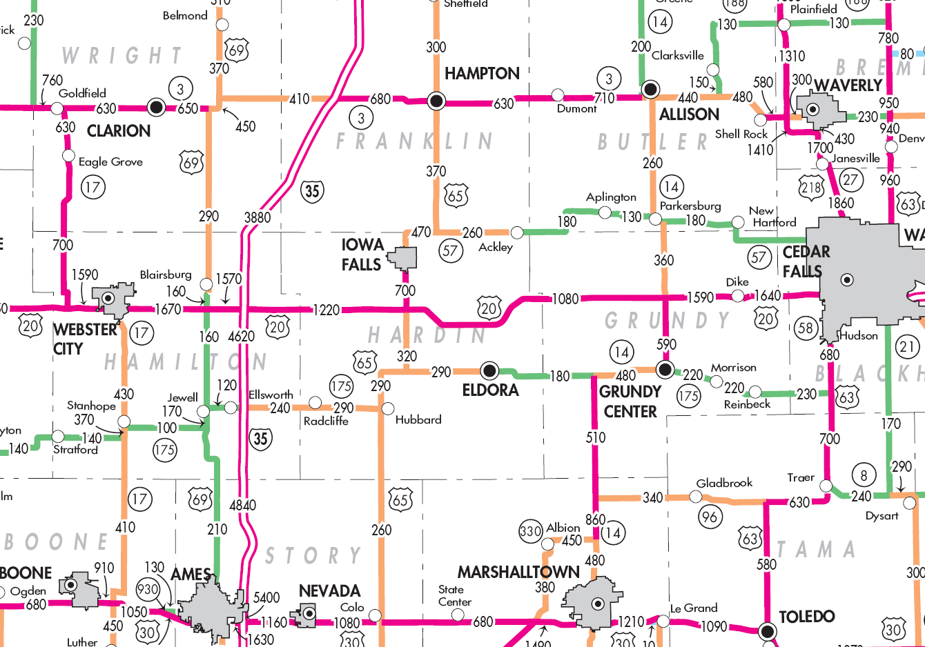
Four Step Modeling
1. Trip Generation modilling
2. Trip Distribution
3. Mode Split
4. Traffic Assignment

Slide 15
Four Step Modeling
Base Year 2013
Target Year 2028
Trip
generation
Trip
Distribution
Modal Split
Person trips interchanges by mode
Vehicle trips by mode
Peak hour flows auto and PT
Traffic Assignment

Slide 16
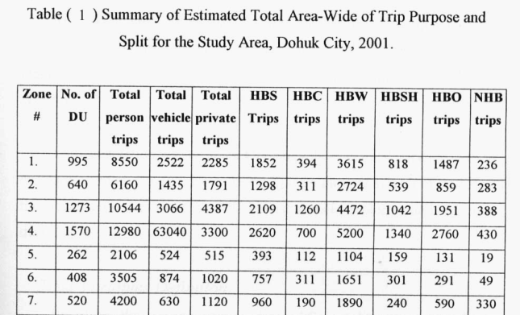
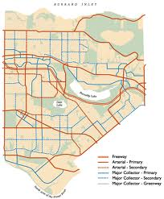
Four Step Modeling
BASE YEAR GENERATIONS
HBS
O/D | 10 | 21 | 30 | 40 | Total
10 |  |  |  | 2 | 2
21 |  |  |  |  | 0
30 |  |  |  |  | 0
40 | 2 |  |  |  | 2
Total | 2 | 0 | 0 | 2 | 4
BASE YEAR DISTRIBUTION
BASE YEAR MODAL SPLIT
HB
Zone | P | A
10 |  | 4
21 |  | 5
30 | 4 | 7
40 | 12
Total | 16 | 16
CHANGING TRIPS TO AUTOS/ PT
BASE YEAR ROAD NETWORK
BASE YEAR PT ROAD NETWORK
LOS/ BASE YEAR DEFICIENCY

Slide 17
BASE YEAR GENERATION (PRODUCTION AND ATTRACTION)
BASE YEAR LANDUSE/ SOCIO ECONOMIC FACTORS
PREDICTIONS
TARGET YEAR GENERATION (PRODUCTION AND ATTRACTION)
TARGET YEAR LANDUSE/ SOCIO ECONOMIC FACTORS
PREDICTIONS

Slide 18
Changed attractions, new markets, changed policies, changed priorities
TARGET YEAR DISTRIBUTION
TARGET YEAR MODAL SPLIT
ASSIGNMENT
CHANGING TRIPS TO AUTOS/ PT
TARGET YEAR ROAD NETWORK
TARGET YEAR PT ROAD NET WORK
LOS/ TARGET YEAR DEFICIENCY
IMPACT STUDIES
CONSTRUCTION IN TIME

Slide 19
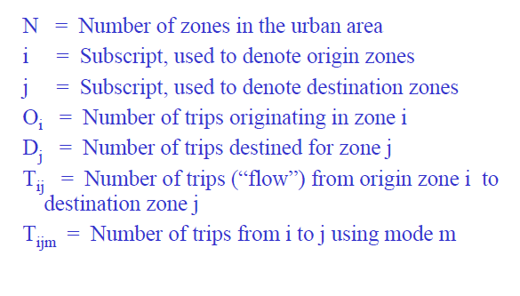
DEFINITIONS

Slide 20
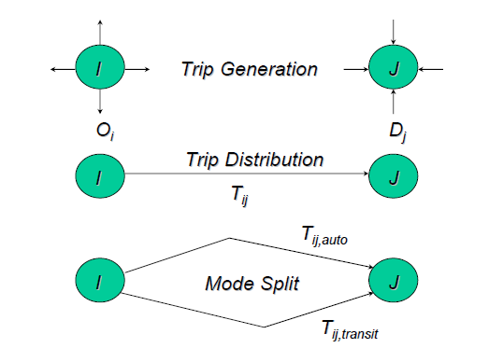
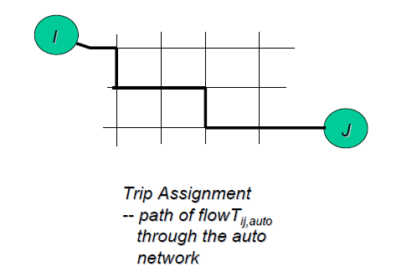
4 STAGES OF TDM

Slide 21
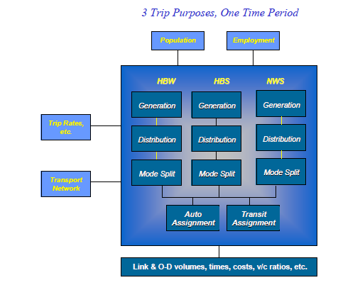
GREATER TORONTO AREA MODEL

Slide 22
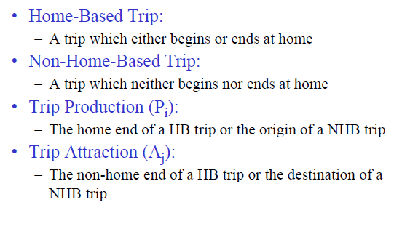
TRIP DEFINITION

Slide 23
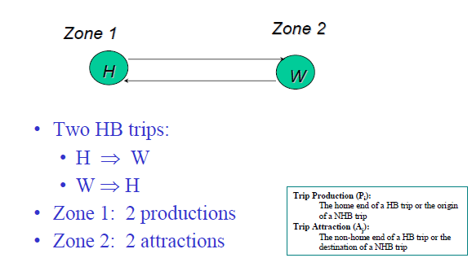
PRODUCTION-ATTRACTION Example 1

Slide 24
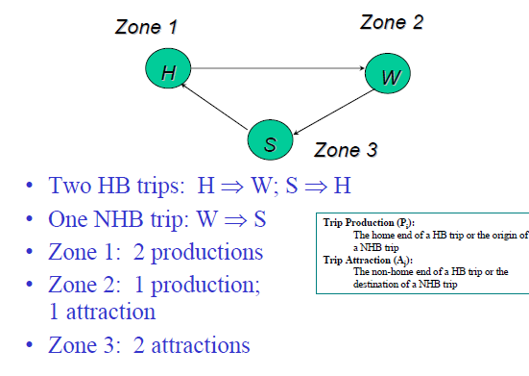
PRODUCTION-ATTRACTION Example 2

Slide 25
Trip making and Factors Influencing

Slide 26
Trip making
A function of three basic factors
Land use pattern, development in the area.
Socio economic characteristics of trip making population/ home.
Nature extent and capabilities of transportation systems.
These independent variables keep changing with time and geographical locations
Once present nature is understood future can be predicted or assessed.

Slide 27
Factors Influencing
Land use pattern, Development in the Area
High and low density compared
Area allocated for shopping, manufacturing, services, hole sale, educational, recreational etc
Trips can be represented /person,/ acre, / DU
Small facilities (educational, commercial) may be ignored.
Large can not be ignored.
Developments in the area.
Government policies.

Slide 28
Socio economic characteristics of trip making population/ home
Family size
Relationship exists between family size and trips.
E.g. 0.8 trips/ day: what about family
Vehicle ownership
Satisfy needs
Social status
Number
Accessibility
System to move on , single vs more, effect on car usage
Family size large or small, high or low car ownership

Slide 29
DU
Permanent and temporary
Hotels and hostels
Occupation
Employed persons
Recreational trips for employed and unemployed
Increase status
Family Income

Slide 30
Other Factors
Property values
Age group
Blue and white collars
Urbanization
Female working
Distance from central area
System quality

