Slide 1
Data Communications & Networks
Ghassan Hasnain

Slide 2
Introduction to Data communications

Slide 3
Theory of communication
The fundamental problem of communication is that of reproducing at one point either exactly or approximately a message selected at another point - The Mathematical Theory of Communication, Claude Shannon
Data communications deals with the transmission of signals in a reliable and efficient manner.
Networking deals with the technology and architecture of the communications networks used to interconnect communicating devices.

Slide 4
Trends in Data communication
Trends
traffic growth at a high & steady rate
development of new services
advances in technology
Data Transmission & Network requirements
emergence of high-speed LANs
corporate WAN needs
digital electronics

Slide 5
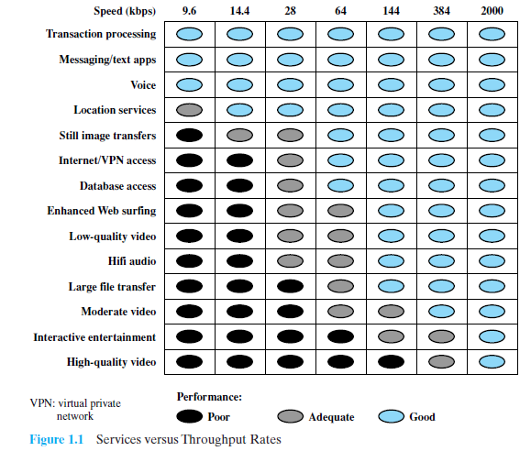
Services vs Data rate

Slide 6
A communication model
The fundamental purpose of a communications system is the exchange of data between two parties.
An example is shown in the next slide, which is communication between a workstation and a server over a public telephone network.
Another example is the exchange of voice signals between two telephones over the same network.

Slide 7
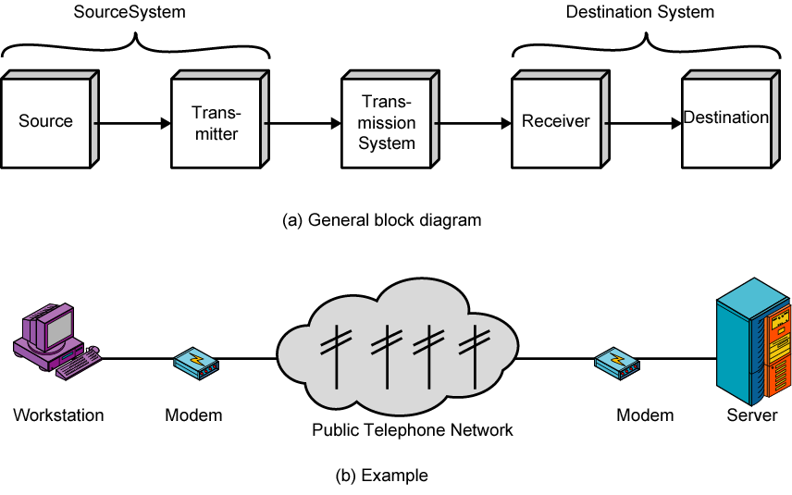
Basic communication model

Slide 8
Key elements of a communication model
1. Source: This device generates the data to be transmitted; examples are telephones and personal computers.
2. Transmitter: Usually, the data generated by a source system is not transmitted directly in the form in which they were generated.
Rather, a transmitter transforms and encodes the information so that it can be transmitted across some sort of transmission system.
For example, a modem takes a digital bit stream from an attached device such as a personal computer and transforms that bit stream into an analog signal that can be handled by the telephone network.

Slide 9
Key elements of a communication model
3. Transmission system: This can be a single transmission line or a complex network connecting source and destination.
4. Receiver: The receiver accepts the signal from the transmission system and converts it into a form that can be handled by the destination device.
5. Destination: Takes the incoming data from the receiver.

Slide 10
Communications Tasks
Transmission system utilization | Addressing
Interfacing | Routing
Signal generation | Recovery
Synchronization | Message formatting
Exchange management | Security
Error detection and correction | Network management
Flow control

Slide 11
Communications tasks
Transmission system utilization refers to the need to make efficient use of transmission facilities that are typically shared among a number of communicating devices.
Various techniques (referred to as multiplexing) are used to allocate the total capacity of a transmission medium among a number of users.
Congestion control techniques may be required to assure that the system is not overwhelmed by excessive demand for transmission services.

Slide 12
Communications tasks
To communicate, a device must interface with the transmission system.
Generally communication depend on the use of electromagnetic signals propagated over a transmission medium.
Once an interface is established, signal generation is required for communication.
The properties of the signal, such as form and intensity, must be such that the signal is
capable of being propagated through the transmission system, and
interpretable as data at the receiver.

Slide 13
Communications tasks
There must be some form of synchronization between transmitter and receiver.
The receiver must be able to determine when a signal begins to arrive and when it ends.
It must also know the duration of each signal element.
Exchange management handles a variety of requirements for communication between two parties.
If data is to be exchanged in both directions over a period of time, the two parties must cooperate.

Slide 14
Communications tasks
For example, for two parties to engage in a telephone conversation, one party must dial the number of the other, causing signals to be generated that result in the ringing of the called phone.
The called party completes a connection by lifting the receiver.
For data processing devices, more will be needed than simply establishing a connection.
Certain conventions must be decided.
These conventions may include whether both devices may transmit simultaneously or must take turns, the amount of data to be sent at one time, the format of the data, and what to do if certain contingencies such as an error arise.

Slide 15
Communication tasks
In all communications systems, there is a potential for error.
Transmitted signals are distorted to some extent before reaching their destination.
Error detection and correction are required in circumstances where errors cannot be tolerated.
This is usually the case with data processing systems.
For example, in transferring a file from one computer to another, it is simply not acceptable for the contents of the file to be accidentally altered.

Slide 16
Communication tasks
Flow control is required to assure that the source does not overwhelm the destination by sending data faster than they can be processed and absorbed.
Addressing handles information about addresses that a source system must indicate the identity of the intended destination.
The transmission system must assure that the destination system, and only that system, receives the data.
Further, the transmission system may itself be a network through which various paths may be taken.
A specific route through this network must be chosen which is known as routing.

Slide 17
Communication tasks
Recovery is a concept distinct from that of error correction.
Recovery techniques are needed in situations in which an information exchange is interrupted due to a fault somewhere in the system.
The objective is either to be able to resume activity at the point of interruption.
Or at least to restore the state of the systems involved to the condition prior to the beginning of the exchange.

Slide 18
Communication tasks
Message formatting has to do with an agreement between two parties as to the form of the data to be exchanged or transmitted e.g. binary data.
Frequently, it is important to provide some measure of security in a data communications system.
The sender of data may wish to be assured that only the intended receiver actually receives the data.
And the receiver of data may wish to be assured that the received data have not been altered in transit and that the data actually come from the purported sender.

Slide 19
Communication tasks
Network management capabilities are needed to configure the system, monitor its status, react to failures and overloads, and plan intelligently for future growth.

Slide 20
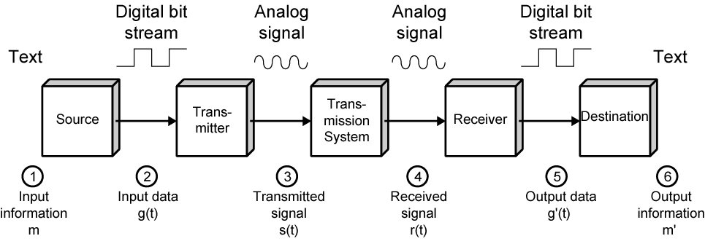
Data communications model

Slide 21
Data communications model
Take electronic mail as an example for data communications model.
The process is modeled as follows:
User keys in message m comprising bits g buffered in source PC memory
Input data is transferred to I/O device (transmitter) as sequence of bits g(t) using voltage shifts
Transmitter converts these into a signal s(t) suitable for transmission media being used
Whilst transiting media, signal may be impaired so received signal r(t) may differ from s(t)
Receiver decodes signal recovering g’(t) as estimate of original g(t)
Which is buffered in destination PC memory as bits g’ being the received message m’

Slide 22
Transmission Medium
The basic building block of any communications facility is the transmission line.
For use within the business premises, this choice is generally completely up to the business.
For long-distance communications, the choice is generally but not always made by the long-distance carrier.
In either case, changes in technology are rapidly changing the mix of media used.

Slide 23
Transmission Medium
The ever-increasing capacity of fiber optic channels is making channel capacity a virtually free resource.
The growing use of wireless transmission, is a result of the trend toward universal personal telecommunications and universal access to communications.
Despite the growth in the capacity and the drop in cost of transmission facilities, transmission services remain the most costly component of a communications budget.
Thus, techniques that increase the efficiency of the use of these facilities, such as multiplexing and compression become important.

Slide 24
Networking
The number of computers in use worldwide is in the hundreds of millions.
Advances in technology have led to greatly increased capacity and the concept of integration, allowing equipment and networks to deal simultaneously with voice, data, image, and even video.
There are two broad categories of networks: Local Area Networks (LAN) and Wide Area Networks (WAN).

Slide 25
Wide Area Networks
Wide area networks generally cover a large geographical area.
Typically, a WAN consists of a number of interconnected switching nodes.
Traditionally, WANs have been implemented using one of two technologies: circuit switching and packet switching.
More recently, frame relay and ATM networks have assumed major roles.

Slide 26
Circuit Switching
A dedicated communications path is established between two stations through the nodes of the network.
That path is a connected sequence of physical links between nodes, with a logical channel dedicated to the connection.
Data generated by the source station are transmitted along the dedicated path as rapidly as possible.
The most common example of circuit switching is the telephone network.

Slide 27
Packet Switching
Data is sent in a sequence of small chunks, called packets.
Each packet is passed through the network from node to node along some path leading from source to destination.
At each node, the entire packet is received, stored briefly, and then transmitted to the next node.
Packet-switching networks are commonly used for terminal-to-computer and computer-to-computer communications.

Slide 28
Frame Relay
Frame relay was developed to take advantage of high data rates and low error rates on modern WAN links.
Original packet-switching networks were designed with a data rate to the end user of about 64 kbps.
Frame relay networks are designed to operate efficiently at user data rates of up to 2 Mbps.
The key to achieving these high data rates is to strip out most of the overhead involved with error control.

Slide 29
Asynchronous Transfer Mode
ATM is a result of developments in circuit switching and packet switching.
ATM can be viewed as an evolution from frame relay.
ATM uses fixed-length packets, called cells.
As with frame relay, ATM provides little overhead for error control.

Slide 30
Asynchronous Transfer Mode
By using a fixed packet length, the processing overhead is reduced even further for ATM compared to frame relay.
The result is that ATM is designed to work in the range of 10s and 100s of Mbps, and in the Gbps range.
ATM allows the definition of multiple virtual channels with data rates that are dynamically defined at the time the virtual channel is created.

Slide 31
Local Area Networks
A LAN is a communications network that interconnects a variety of devices and provides a means for information exchange among those devices.
The scope of the LAN is small, typically a single building or a cluster of buildings.
It is usually the case that the LAN is owned by the same organization that owns the attached devices.
The internal data rates of LANs are typically much greater than those of WANs.

Slide 32
Local Area Networks
LANs come in a number of different configurations.
The most common are switched LANs and wireless LANs.
The most common switched LAN is a switched Ethernet LAN, others are ATM & Fibre Channel LANs.
Wireless networks provide advantages in the areas of mobility and ease of installation and configuration.

Slide 33
Metropolitan Area Networks
MAN
middle ground between LAN and WAN
private or public network
high speed
large area

Slide 34
The Internet
The Internet evolved from the ARPANET, developed in 1969 by the Advanced Research Projects Agency (ARPA) of the U.S. Department of Defense.
It was the first operational packet-switching network.
The network was so successful that ARPA applied the same packet-switching technology to tactical radio communication (packet radio) and to satellite communication (SATNET).
The need for interworking between these led development of methods and protocols for such internetworking, which led eventually to the development of TCP/IP.

Slide 35
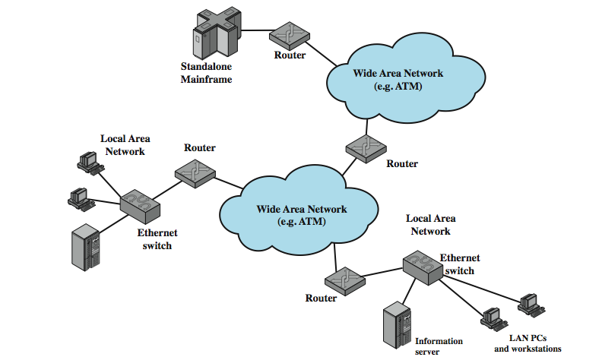
Internet Elements

Slide 36
Internet Elements
Figure illustrates the key elements that comprise the Internet.
The purpose is to interconnect end systems, called hosts; including PCs, workstations, servers, mainframes, and so on.
Most hosts that use the Internet are connected to a network, such as a local area network (LAN) or a wide area network (WAN).
These networks are in turn connected by routers.

Slide 37
Thank you

