Slide 1
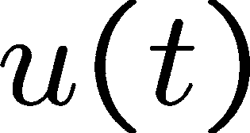
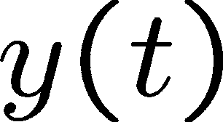
Linear Control Systems
Lecture 7 Linearization, time delays
1
2
What is a linear system?
A system having Principle of Superposition
Linear systems
Easier to understand and obtain solutions
Linear ordinary differential equations (ODEs),
Homogeneous solution and particular solution
Transient solution and steady state solution
Solution caused by initial values, and forced solution
Add many simple solutions to get more complex ones (use superposition!)
Easy to check the Stability of stationary states (Laplace Transform)
System
A nonlinear system does not satisfy the principle of superposition.
3
4

Slide 2
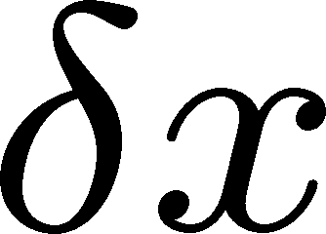
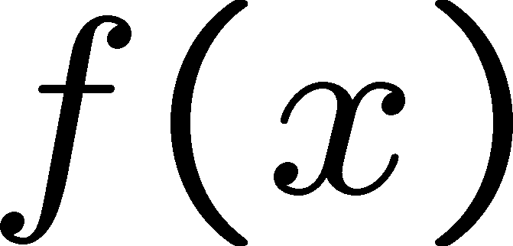
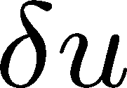
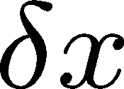
Why linearization?
How to linearize it?
Nonlinearity can be approximated by a linear
Real systems are inherently nonlinear. (Linear systems do not exist!) Ex. f(t)=Kx(t), v(t)=Ri(t)
TF models are only for linear time-invariant (LTI) systems.
Many control analysis/design techniques are available for linear systems.
Nonlinear systems are difficult to deal with mathematically.
Often we linearize nonlinear systems before analysis and design. How?
function for small deviations operating point
Use a Taylor series expansion
around an
Linear approximation
New coordinate
Nonlinear function
Operating point
5
Old coordinate
6
Linearization
Nonlinear system:
Let u₀ be a nominal input and let the resultant state be x₀
Perturbation:
Resultant perturb:
Taylor series expansion:
Linearization (cont.)
notice that
; hence
N. sys
L. sys.
7
8

Slide 3
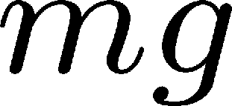
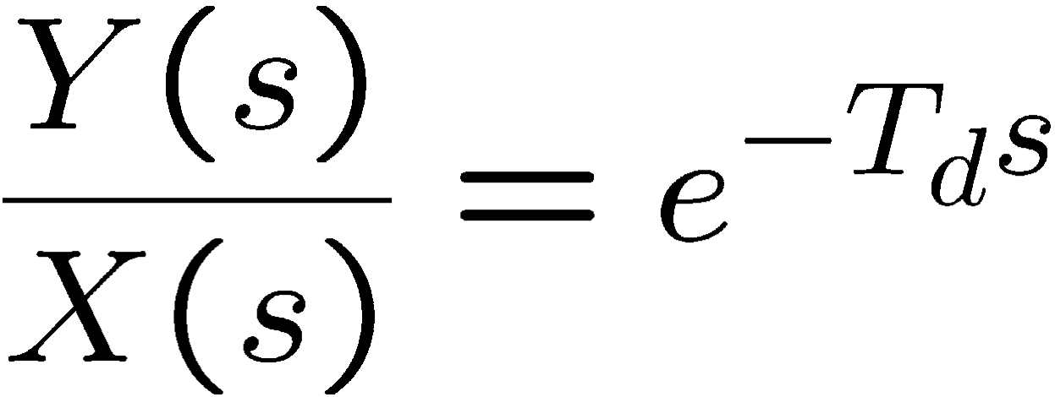
Linearization of a pendulum model
Linearization of a pendulum model (cont’)
Motion of the pendulum
Taylor series expansion of
Linearize it at
Find u₀
New coordinates:
9
10
Time delay transfer function
TF derivation
(Memorize this!)
The more time delay is, the more difficult to control (Imagine that you are controlling the temperature of your shower with a very long hose. You will either get burned or frozen!)
11
12

