Slide 1
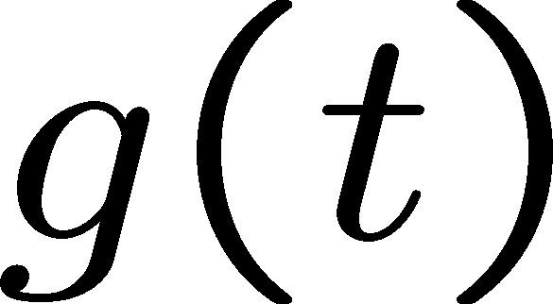
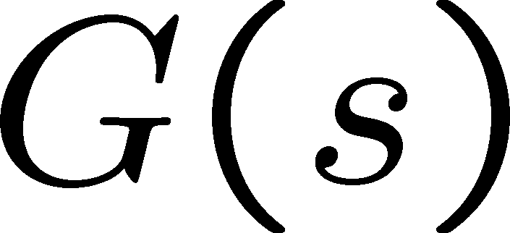
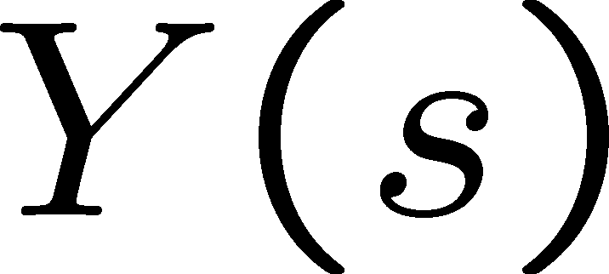
Linear Control Systems
LectureLecture 66 Block diagrams
1
2
Transfer function (review)
A transfer function is defined by
Impulse response (review)
Suppose that u(t) is the unit impulse function and system is at rest.
Laplace transform of system output
Laplace transform of system input
System
The output g(t) for the unit impulse input is called
impulse response.
Since U(s)=1, the transfer function can also be defined as the Laplace transform of impulse response:
A system is assumed to be at rest. (Zero initial condition)
3
4

Slide 2
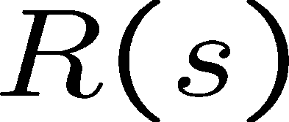
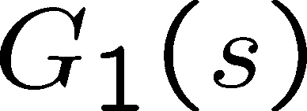
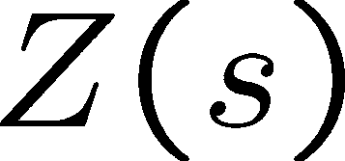
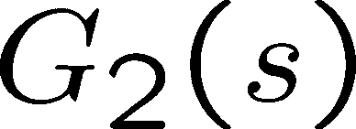
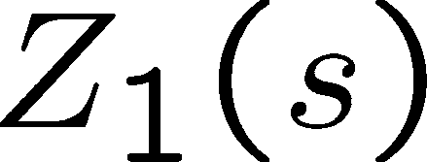
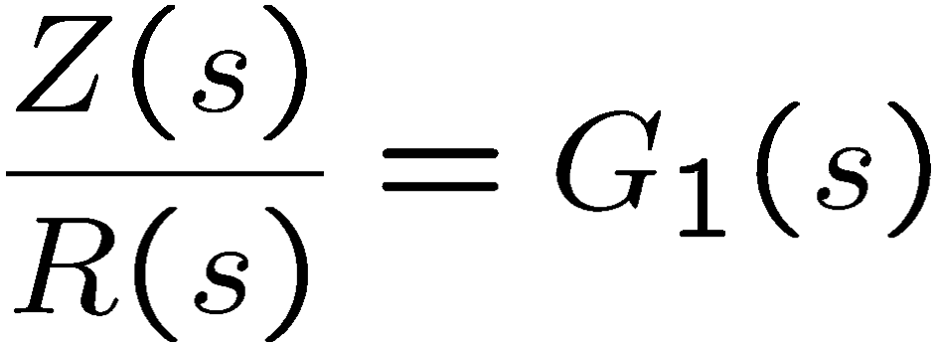
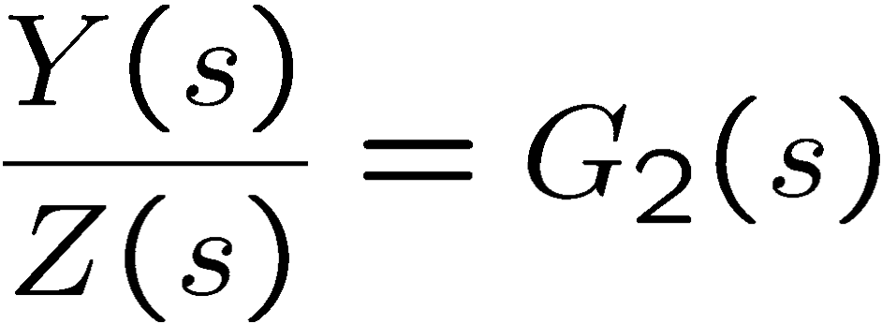
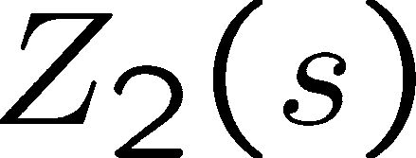
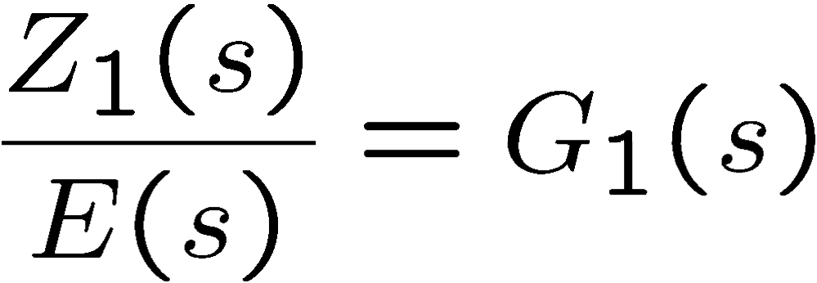
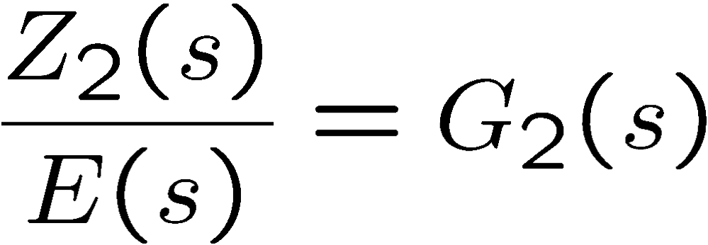
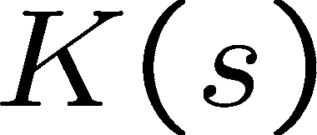
Elementary TF block diagrams
Elementary TF block diagrams
Summing Junction
Series connection
+
-
5
6
Elementary TF block diagrams
Parallel connection
Feedback connection
Negative feedback system
EEaa
Be careful when computing transfer functions from outside to inside the feedback!
7
8

Slide 3
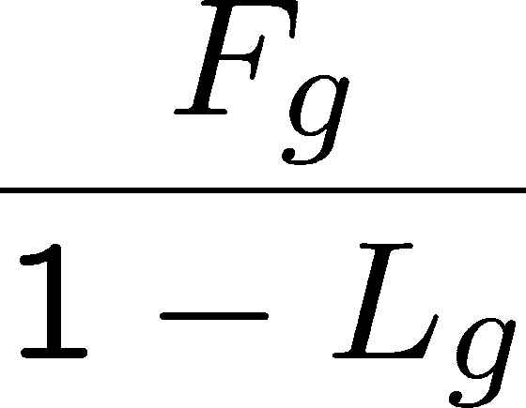
Feedback loop formula,TF_{R→Y}
Feedback loop formula,TF_{R→E}
EEaa
EEaa
The loop gain is the product of
all transfer functions that form the loop
F_{g}: Forward gain from R(s) to Y(s)
L_{g}: Loop gain: G(s)K(s)(-1)
G(s)
F_{g}: Forward gain from R(s) to E(s)
L_{g}: Loop gain: G(s)K(s)(-1)
1
9
10
Exercises
11
12

