Slide 1
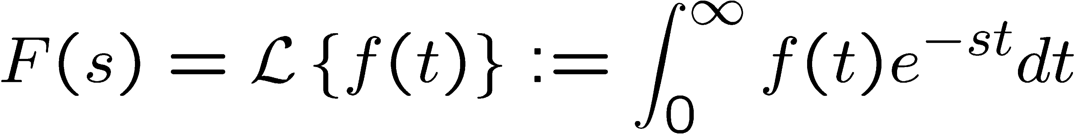

Laplace Transform
Linear Control Systems
1
Laplace transform
One of most important math tools in the course!
Definition: For a function f(t) (f(t)=0 for t<0),
Example of Laplace transform
Step function
f(t)
⎧_{⎪ 5}
t ≥ 0
t < 0
5
f (t ) = 5u(t ) = ⎨ ₀
0
t
⎪⎩
(s: complex variable)
∞ ∞ ∞
F(s) = ∫ f (t )e^{− st} dt = ∫ 5e^{− st} dt = 5∫ e^{− st} dt
0 0 0
f(t)
F(s)
= 5 ⎡− ¹ ⎡⎣e^{− st} ⎤⎦∞ ⎤ = 5 ^{⎡1 ⎤} = ⁵
⎢⎣ 0 ⎥⎦ ⎢_{⎣ s} ⎥⎦
0
t
s s
We denote Laplace transform of f(t) by F(s).
Remember L(u(t)) = 1/s

Slide 2
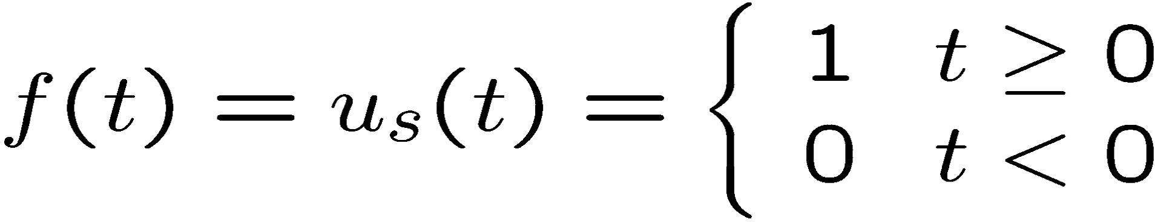
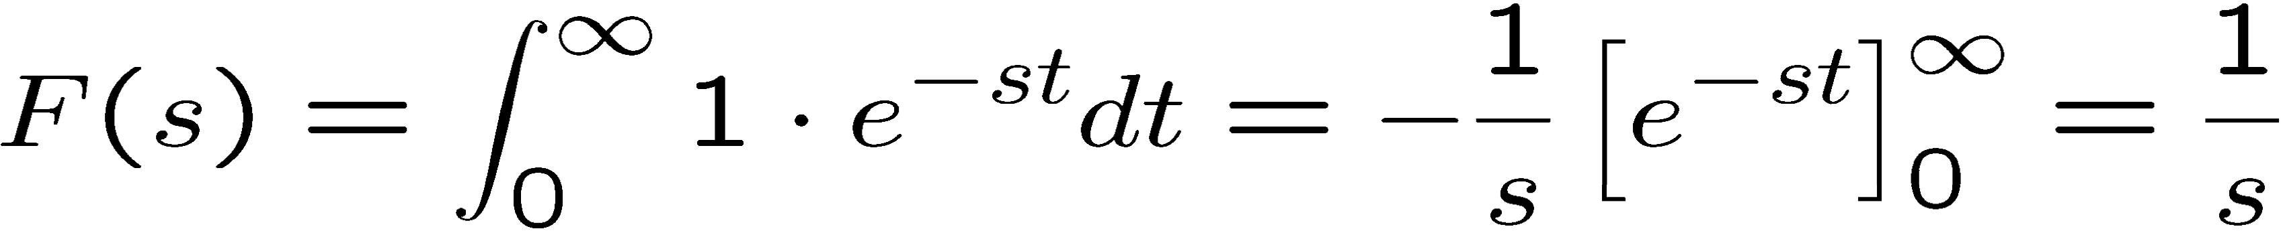
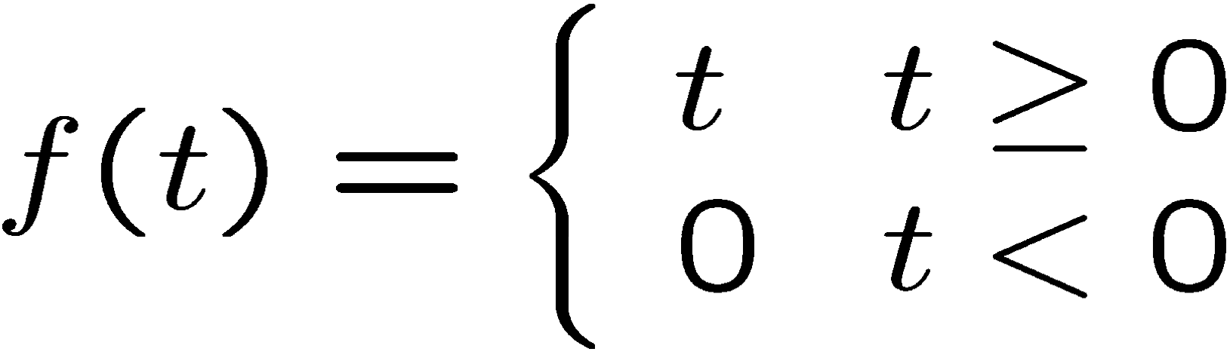
Examples of Laplace transform
Unit step function
f(t) 1
0
(Memorize this!)
t
f(t)
Unit ramp function
0
t
(Integration by parts)

Slide 3
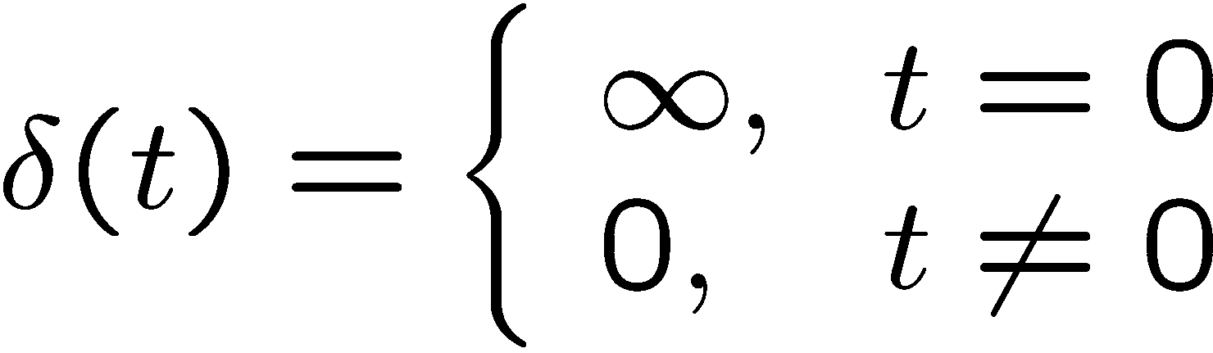
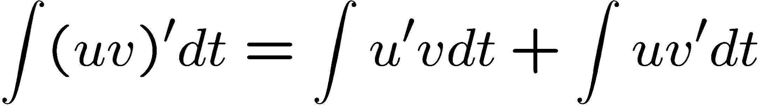
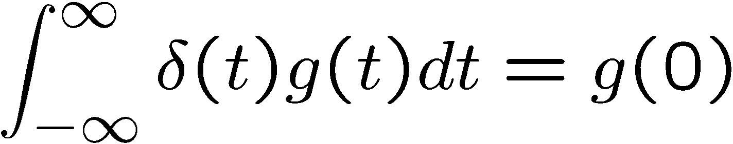
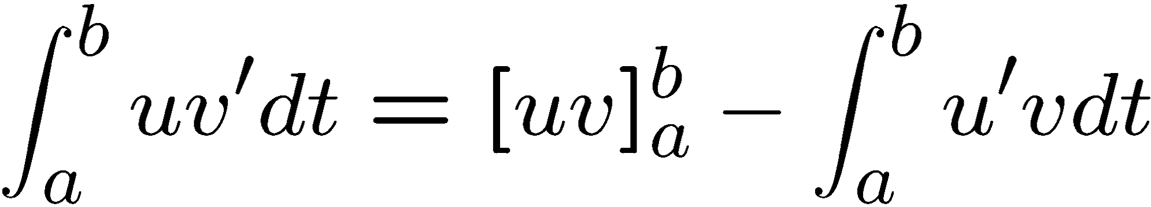
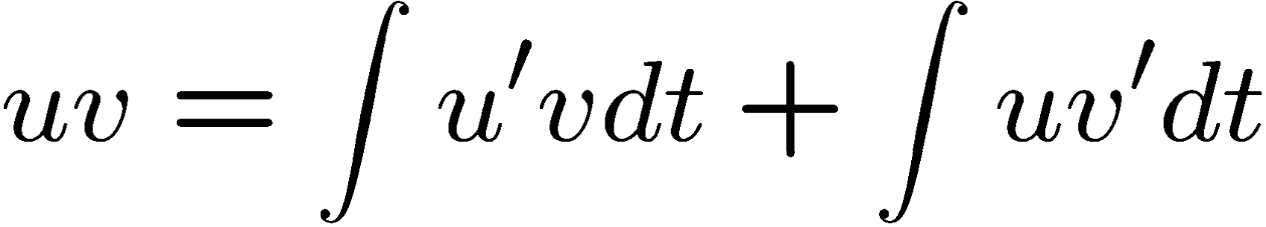
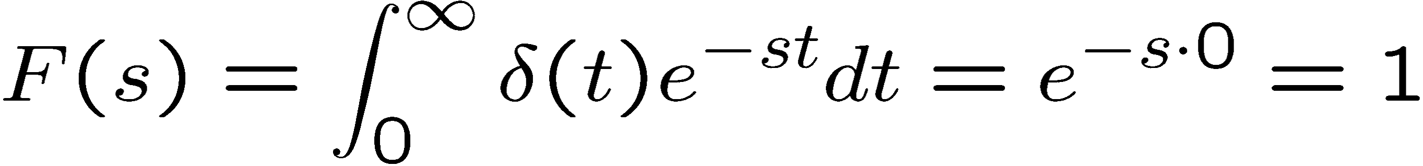
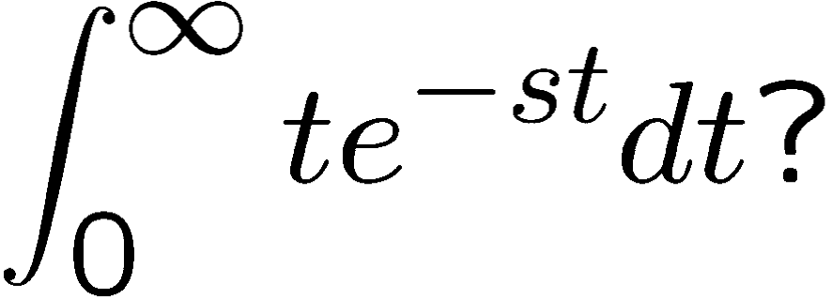
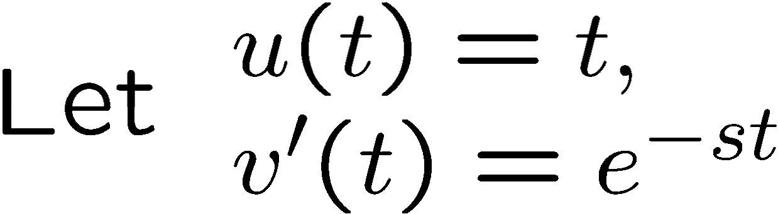
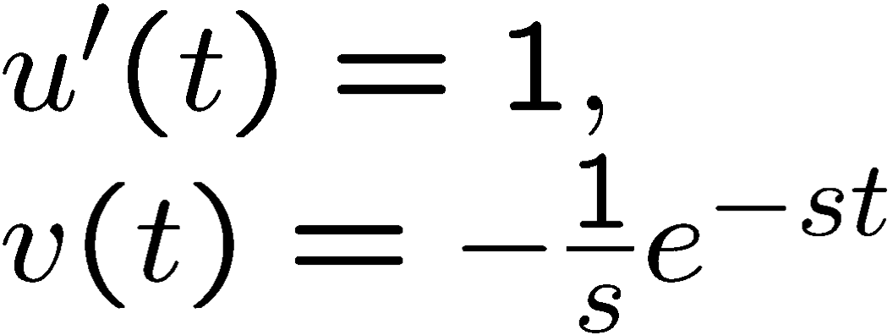
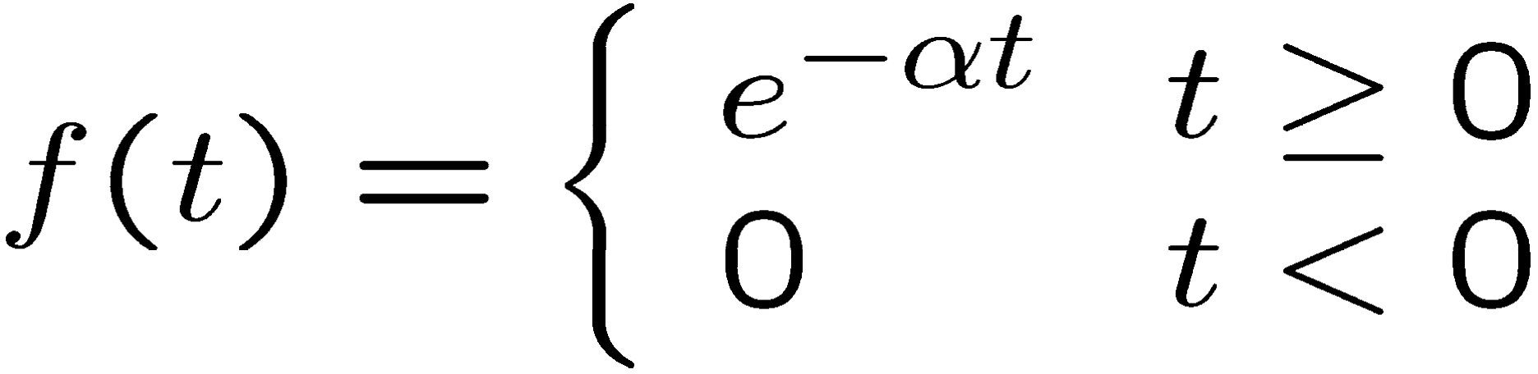
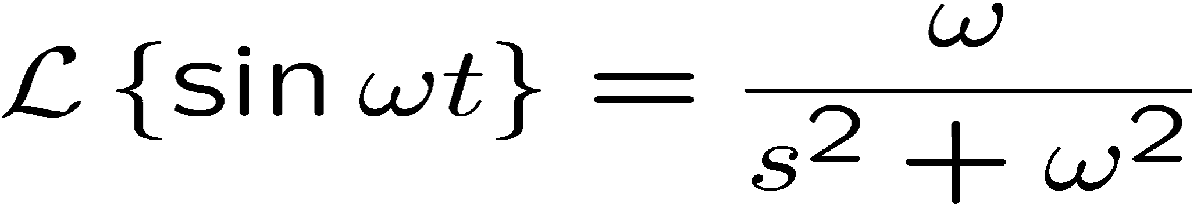
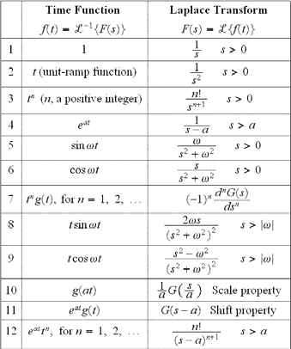

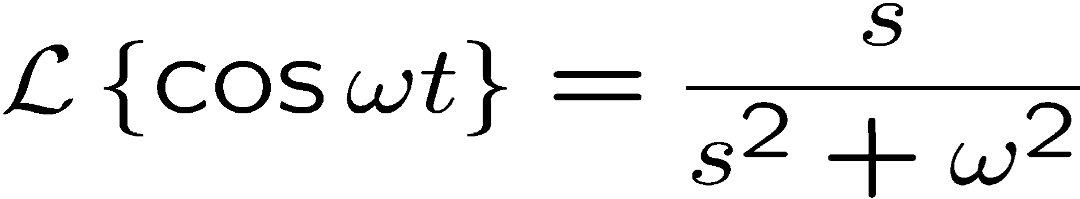


Integration by parts
Examples of Laplace transform (cont’d)
Unit impulse function
f(t)
Width = 0 Height = inf Area = 1
t
0
(Memorize this!)
EX.
Exponential function
f(t) 1
0
t
Examples of Laplace transform (cont’d)
Laplace transform table
Sine function
(Memorize these!)
Cosine function
Remark: Instead of computing Laplace transform for each function, and/or memorizing complicated Laplace transform, use the Laplace transform table !
Inverse Laplace Transform

Slide 4

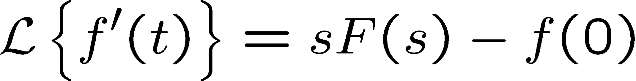
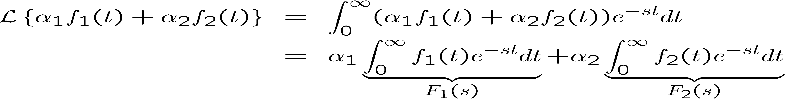
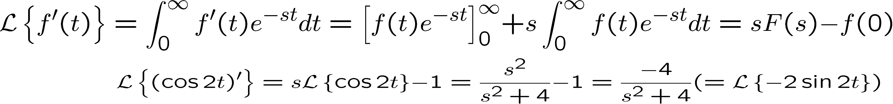


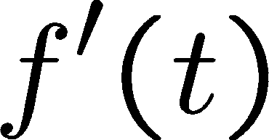

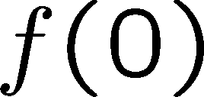

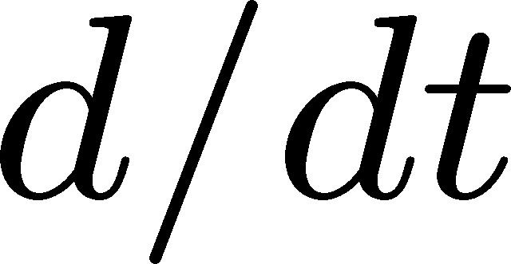

Laplace transform table
(Table B.1 in Appendix B of the textbook)
Integration is Hard
Tables are Easier
Inverse Laplace Transform
Properties of Laplace transform
Linearity
Properties of Laplace transform
Differentiation
Proof.
Proof.
Ex.
Ex.
t-domain
s-domain

Slide 5
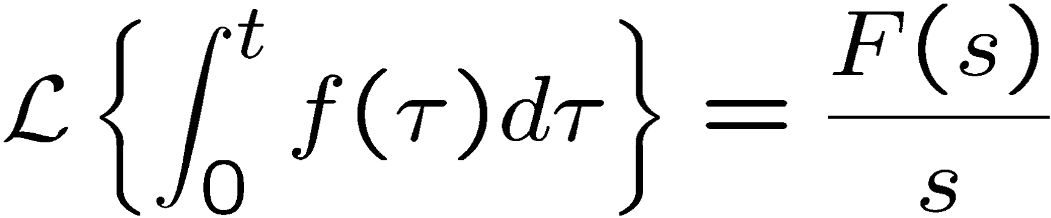
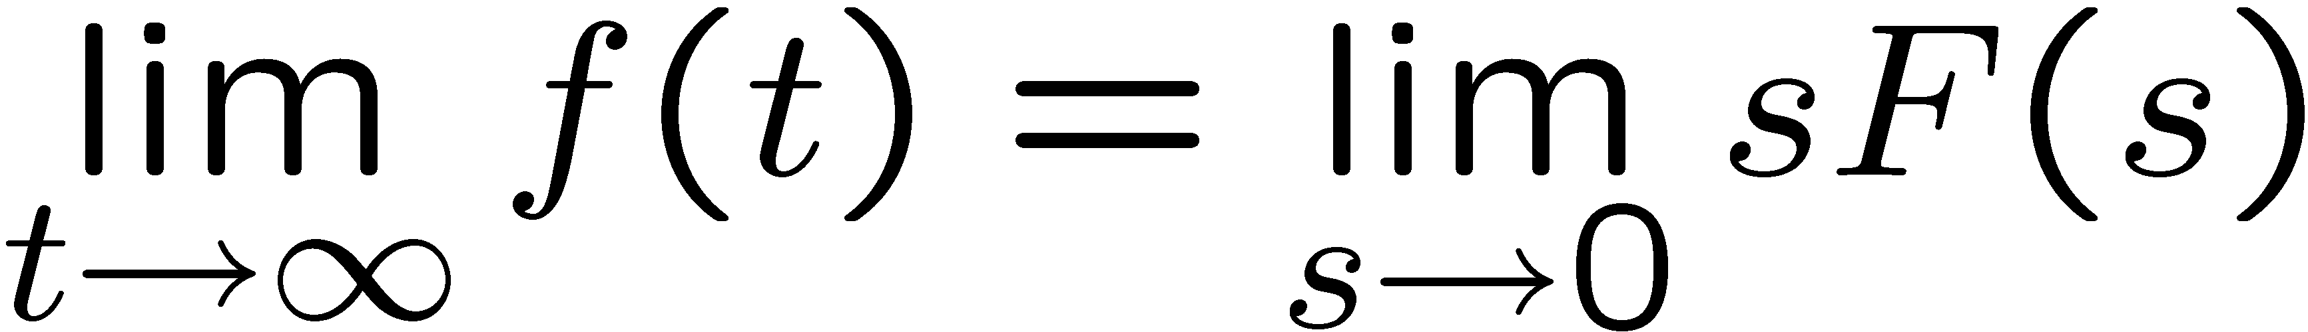
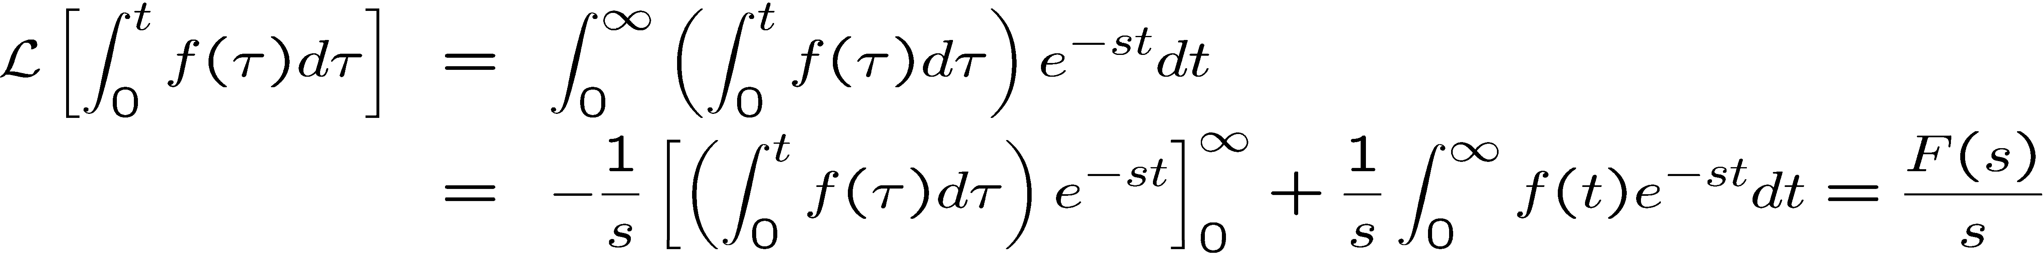
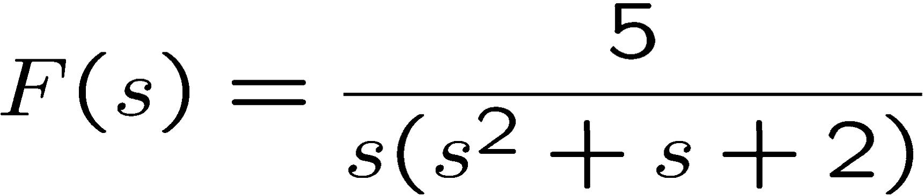
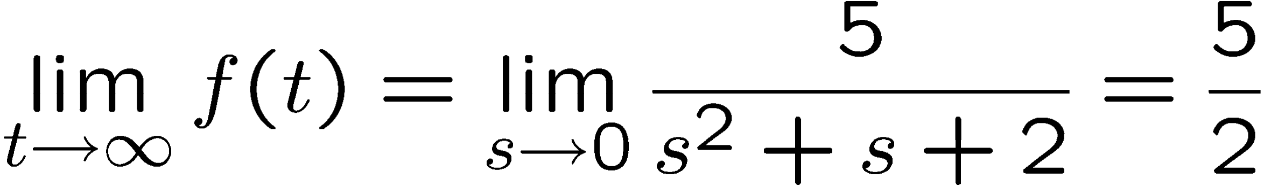
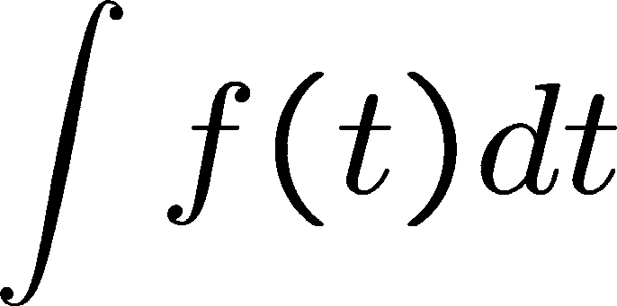
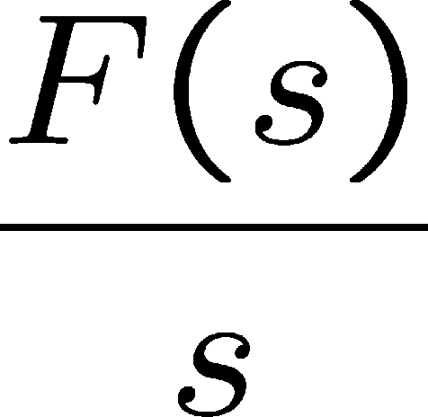
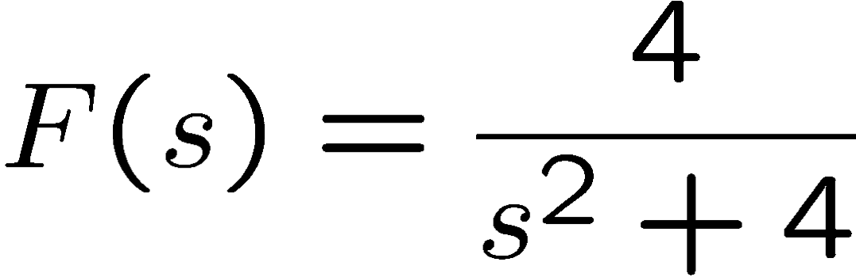
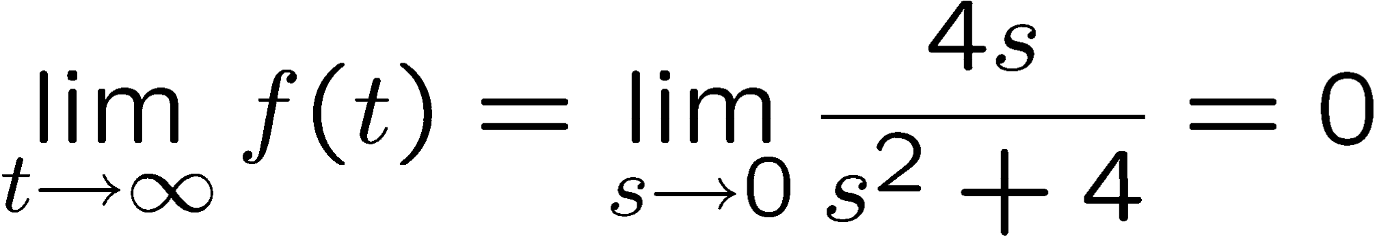


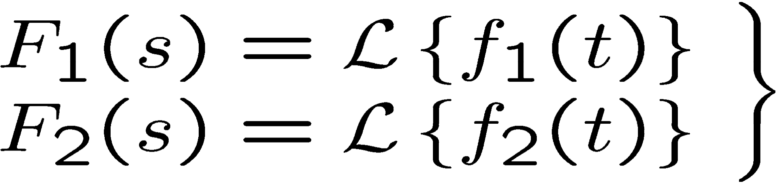
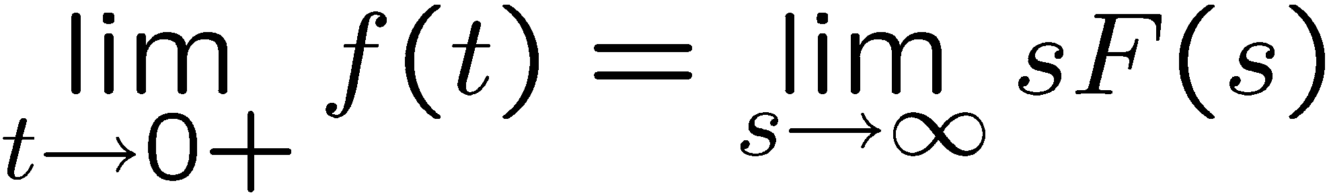
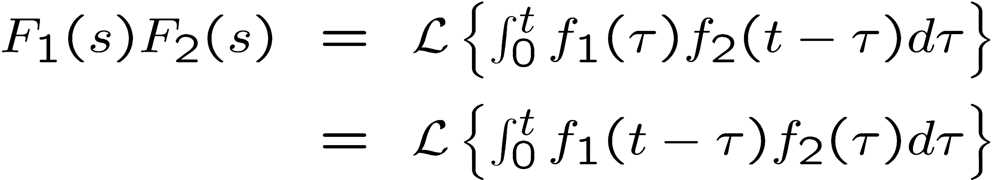

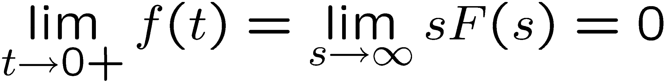

Integration
Properties of Laplace transform
Properties of Laplace transform
Final value theorem
if all the poles of sF(s) are in the left half plane (LHP)
Proof.
Ex.
Poles of sF(s) are in LHP, so final value thm applies.
t-domain
s-domain
Ex.
Some poles of sF(s) are not in LHP, so final value thm does NOT apply.
Properties of Laplace transform
Initial value theorem
Properties of Laplace transform
Convolution
if the limits exist.
Convolution
Remark: In this theorem, it does not matter if pole location is in LHP or not.
Ex.
IMPORTANT REMARK
Ex.
−1
( )
L F (s)F (s) ≠ f (t ) f (t )
1
2 1 2
11
Fall 2010
12

Slide 6


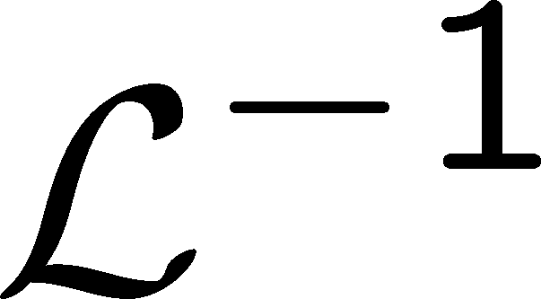

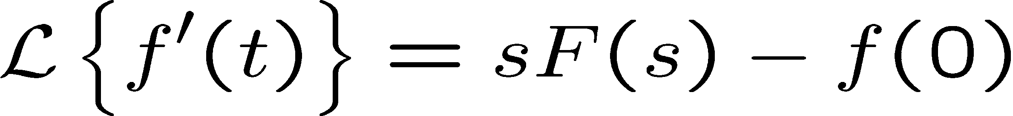
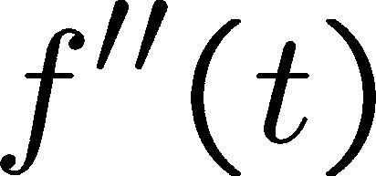
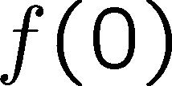
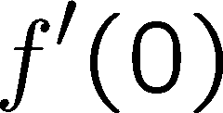
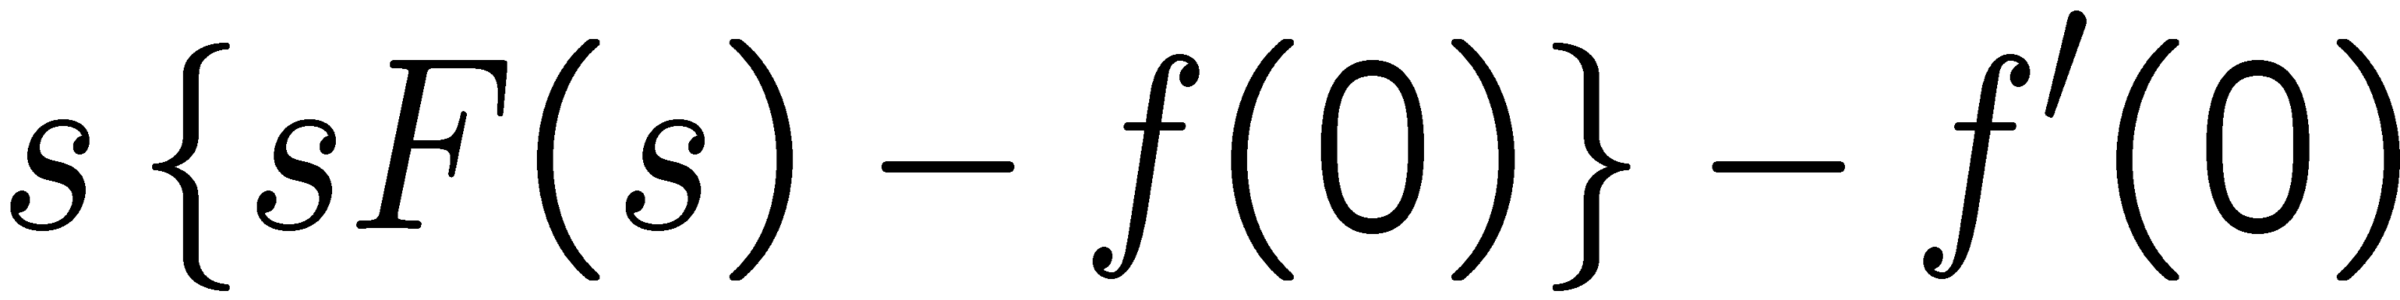
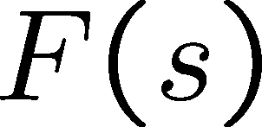
Example 1
An advantage of Laplace transform
We can transform an ordinary differential equation (ODE) into an algebraic equation (AE).
t-domain s-domain
1st Order ODE with input and Initial Condition
5y&(t ) + 10y(t ) = 3u(t ) y(0) = 1
Take Laplace Transform
5[sY (s) − y(0)]+ 10[Y (s)]= 3^{⎡1 ⎤}
ODE
AE
⎢_{⎣ s} ⎥⎦
1
Solve for Y(s)
(5s + 10)Y (s) = 5y(0) + 3^{⎡1 ⎤}
2
Partial fraction expansion
⎢_{⎣ s} ⎥⎦
Solution to ODE
_{Y (s) =} 5 ₊ 3 ₌ 1 ₊ 0.6
3
(5s + 10) s (5s + 10) (s + 2) s (s + 2)
(Initial Condition) + (Input)
Example 1 (cont)
Use table to Invert Y(s) term by term to find y(t)
Properties of Laplace transform
Differentiation (review)
Y (s) =
1 0.6
+
(s + 2) s (s + 2)
From the Table:
t-domain
_{L} ⎛ 1
⎞ _{= e}− at
1
⎜⎝ s + a ⎟⎠
⇒
_{L}−1 ⎛ ⎞ _{= e}−2t
⎜⎝ s + 2 ⎟⎠
⎛ a ⎞ ⎛ (0.3)2 ⎞
L = (1 − e^{− at} ) ⇒ L⁻¹ = 0.3(1 − e^{−2t} )
⎜⎝ s (s + a)⎟⎠ ⎜⎝ s (s + 2)⎠⎟
So that
y(t ) = e^{−2t} + 0.3(1 − e^{−2t} )
(Initial Condition) + (Input)
s-domain

Slide 7
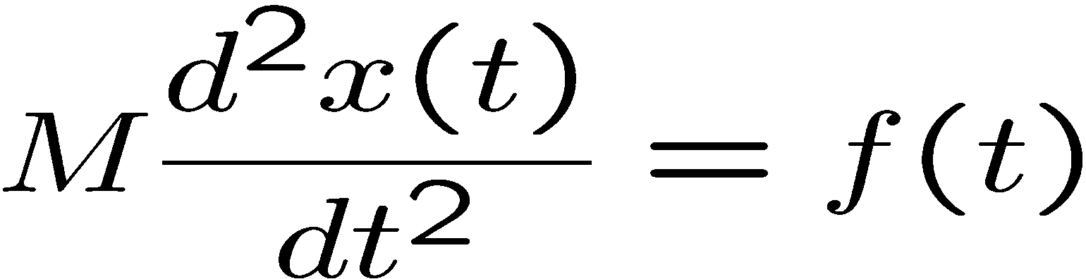
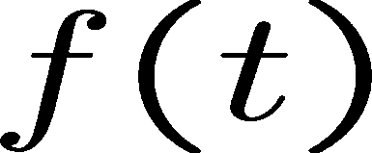
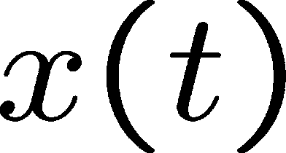
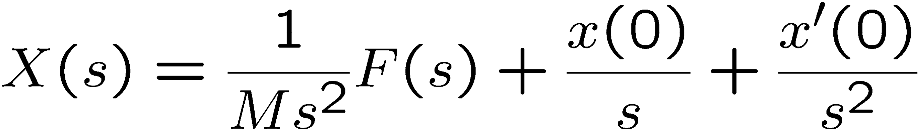
Example: Newton’s law
M
We want to know the trajectory of x(t). By Laplace transform,
(Total response) = (Forced response) + (Initial condition response)

