Slide 1
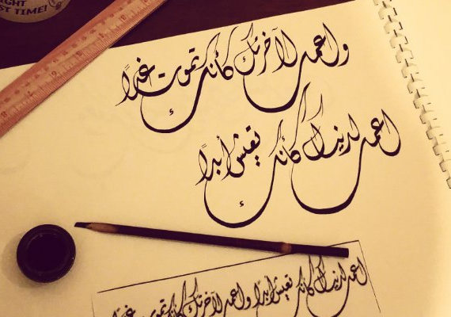
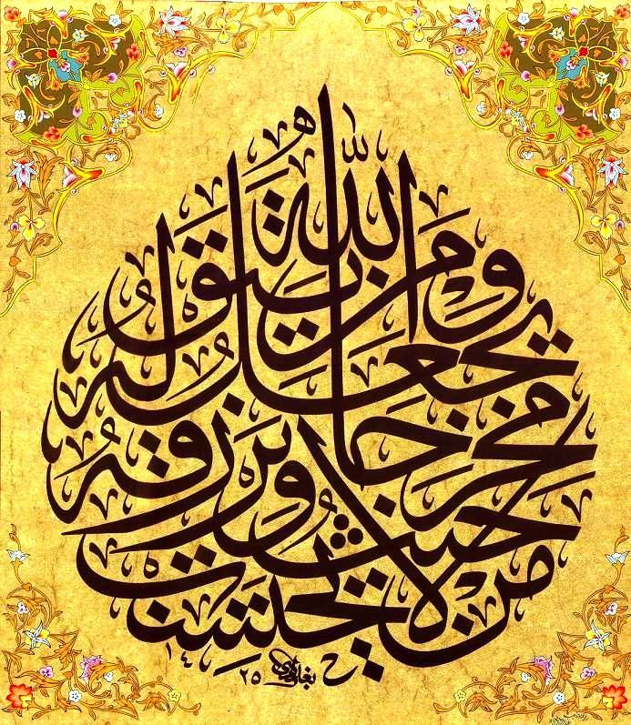
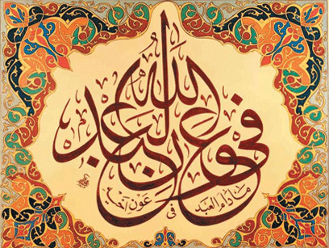
Calligraphy (Khatati)
Engr. Yaseen mahmooD

Slide 2
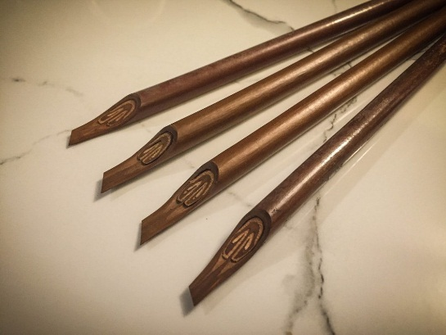
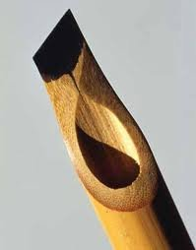
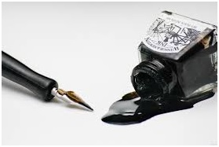
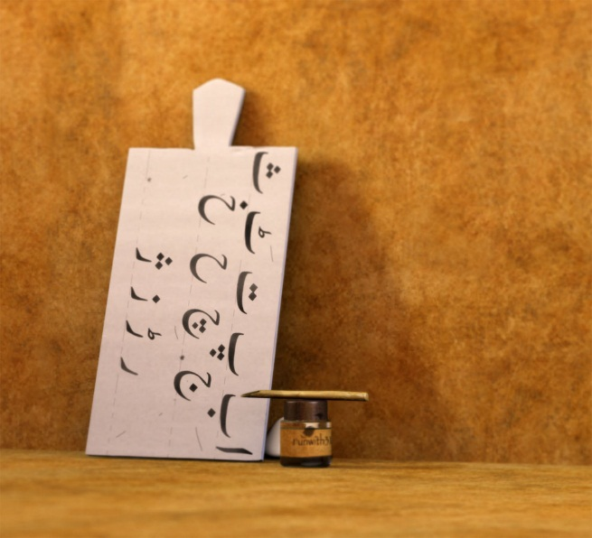
Instruments
Qalam (Reed)
Siyahi (Ink)
Takhti (Riglet/Tablet/Slate)

Slide 3
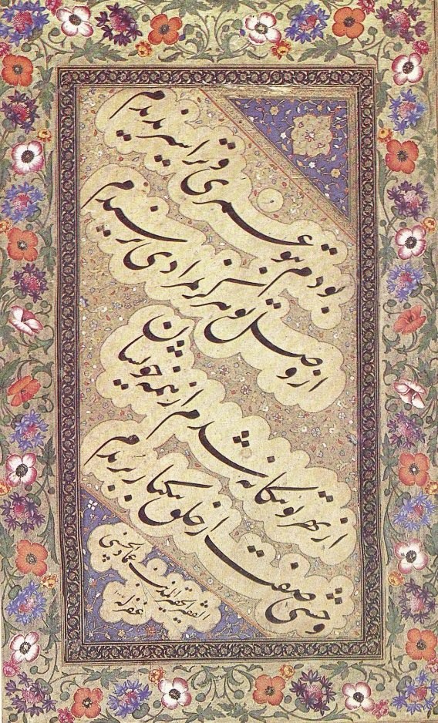
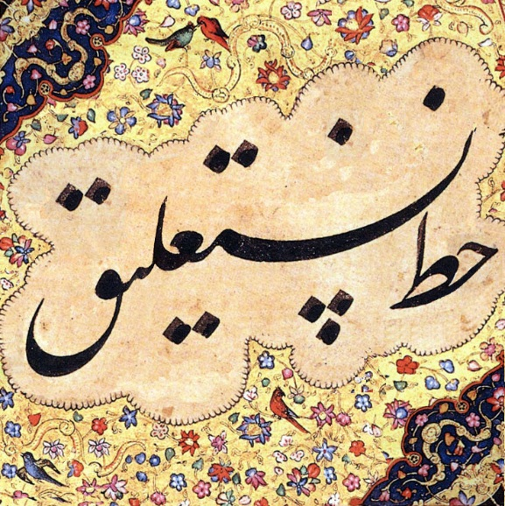
Fonts
5. NASTLIQ :
It is one of the main calligraphic hands used in writing the Persian script, and traditionally the predominant style in Persian calligraphy.
It was developed in Iran in the 14th and 15th centuries.
It is sometimes used to write Arabic-language text but its use has always been more popular in the Persian, Turkic and Urdu sphere of influence.
Nastaʿlīq remains very widely used in Iran, Pakistan, India, Afghanistan and other countries for written poetry and as a form of art.

Slide 4
NASTLIQ
Qa’at:
Width of Qalam (reed) is known as Qa’at.
Alphabets/Letters are drawn or measured by using qa’at.
For-example: Letter Alif has height equal to the 3 times of the width of reed or 3 Qa’at.
Each letter has specific number of qa’at.
Horizontals and verticals:
Nastaliq font follows imaginary vertical and horizontal lines.
Qa’at = Width

Slide 5
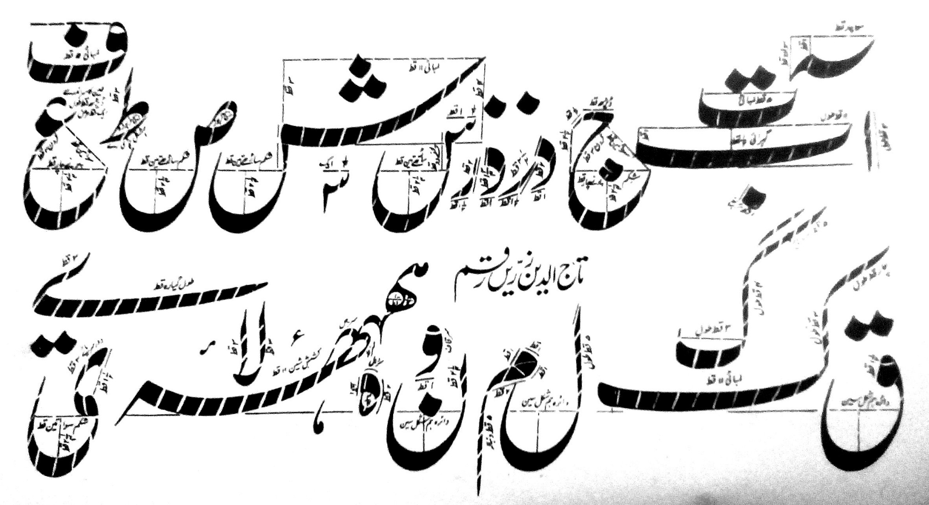
NASTLIQ
Alphabets :

