Slide 1
A.C. Distribution

Slide 2
Introduction:
In the beginning of electrical age, electricity was generated, transmitted and distributed as direct current.
The principal disadvantage of d.c. system was that voltage level could not readily be changed, except by the use of rotating machinery, which in most cases was too expensive
With the development of transformer, a.c. system has become so predominant as to make d.c. system practical extinct in most parts of the world.
The present day large power system has been possible only due to the adoption of a.c. system.
Now-a-days, electrical energy is generated, transmitted and distributed in the form of alternating current as an economical proposition.

Slide 3
A.C. Distribution Calculations:
A.C. distribution calculations differ from those of d.c. distribution in the following respects :
In case of d.c. system, the voltage drop is due to resistance alone. However, in a.c. system, the voltage drops are due to the combined effects of resistance, inductance and capacitance.
In a d.c. system, additions and subtractions of currents or voltages are done arithmetically but in case of a.c. system, these operations are done vectorially.

Slide 4
3) In an a.c. system, power factor (p.f.) has to be taken into account. Loads tapped off form the distributor are generally at different power factors.
There are several ways of solving a.c. distribution problems. However, symbolic notation method has been found to be most convenient for this purpose.
In this method, voltages, currents and impedances are expressed in complex notation and the calculations are made exactly as in d.c. distribution.

Slide 5
Numerical No 1:
A single phase a.c. distributor AB 300 meters long is fed from end A and is loaded as under :
(i) 100 A at 0·707 p.f. lagging 200 m from point A
(ii) 200 A at 0·8 p.f. lagging 300 m from point A
The load resistance and reactance of the distributor is 0·2 Ω and 0·1 Ω per kilometer. Calculate the total voltage drop in the distributor. The load power factors refer to the voltage at the far end.

Slide 6
Solution: The below figure shows the single line diagram of the distributor

Slide 7
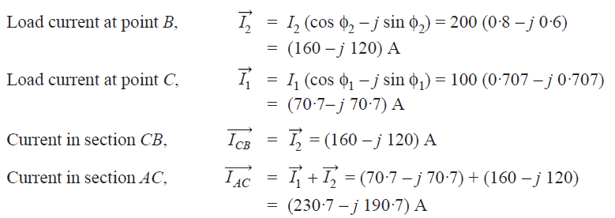

Slide 8
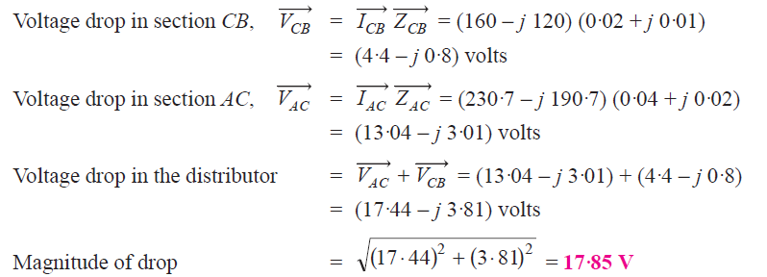

Slide 9
Numerical No 2:
A single phase distributor 2 kilometers long supplies a load of 120 A at 0·8 p.f. lagging at its far end and a load of 80 A at 0·9 p.f. lagging at its mid-point. Both power factors are referred to the voltage at the far end. The resistance and reactance per km (go and return) are 0·05 Ω and 0·1 Ω respectively. If the voltage at the far end is maintained at 230 V, calculate :
(i) voltage at the sending end
(ii) phase angle between voltages at the two ends.

Slide 10
Solution:
The below figure shows the distributor AB with C as the mid-point

Slide 11
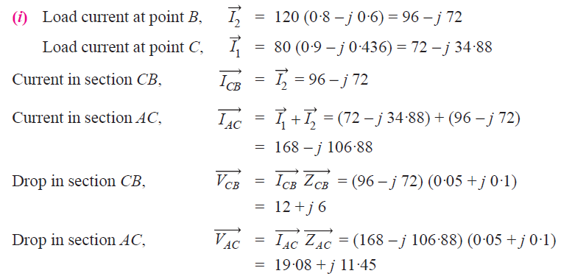

Slide 12
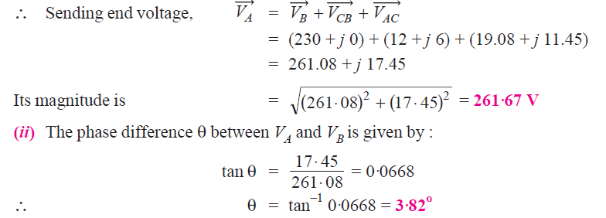

Slide 13
Numerical No 3:
A 3-phase, 400V distributor AB is loaded as shown in the below figure. The 3-phase load at point C takes 5A per phase at a p.f. of 0·8 lagging. At point B, a 3-phase, 400 V induction motor is connected which has an output of 10 H.P. with an efficiency of 90% and p.f. 0·85 lagging. If voltage at point B is to be maintained at 400 V, what should be the voltage at point A ? The resistance and reactance of the line are 1Ω and 0·5Ω per phase per kilometer respectively.

Slide 14
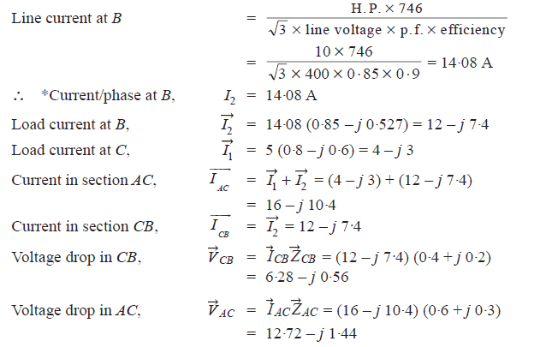

Slide 16
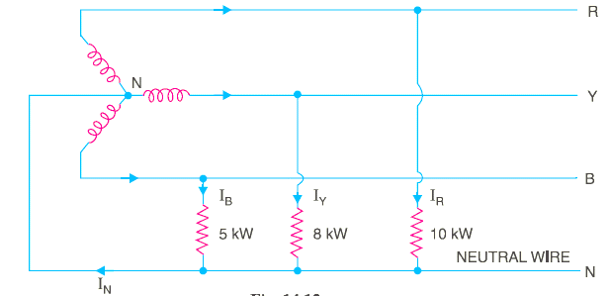
Numerical No 4:
Non-reactive loads of 10 kW, 8 kW and 5 kW are connected between the neutral and the red, yellow and blue phases respectively of a 3-phase, 4-wire system. The line voltage is 400V. Calculate:
The current in each line
The current in the neutral wire

Slide 17
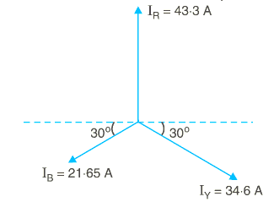
Note that the three line currents are of different magnitude but displaced 120 degrees from one another. The current in the neutral wire will be the phasor sum of the three line currents.

Slide 18
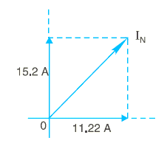
As shown in the below figure, current in neutral wire is

Slide 19
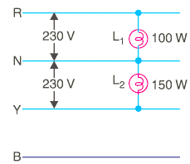
Numerical No 5:
In a 3-phase, 4-wire, 400/230 V system, a lamp of 100 watts is connected to one phase and neutral and a lamp of 150 watts is connected to the second phase and neutral. If the neutral wire is disconnected accidentally, what will be the voltage across each lamp ?
Solution. The below figure shows the lamp connections. The lamp L1 of 100 watts is connected between phase R and neutral whereas lamp L2 of 150 watts is connected between phase Y and the neutral.

Slide 20
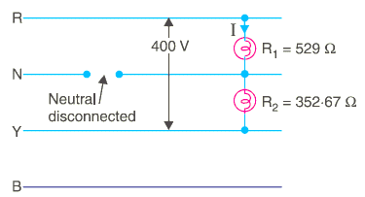
When the neutral wire is disconnected as shown in the above figure, the two lamps are connected in series and the p.d. across the combination becomes equal to the line voltage EL (= 400 V).

