Slide 1
KEYS

Slide 2
KEYS
Used to establish and identify relation between tables
Each record with in a table can be uniquely identified bye combination of one more fields in a table
Help to enforce integrity and identify relationship

Slide 3
Different types of keys
Super Key
Candidate Key
Primary Key
Foreign Key
Secondary / Alternate key
Simple Key
Compound Key
Composite Key

Slide 4
Super Key
A Super key is any combination of fields within a table that uniquely identifies each record within that table.
Superset of candidate key

Slide 6
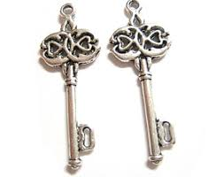
Candidate Key
A subset of a super key.
A candidate key is a single field or the least combination of fields that uniquely identifies each record in the table.
The least combination of fields distinguishes a candidate key from a super key. (ie.Minimal Set of Super Key)
Every table must have at least one candidate key but at the same time can have several.

Slide 7
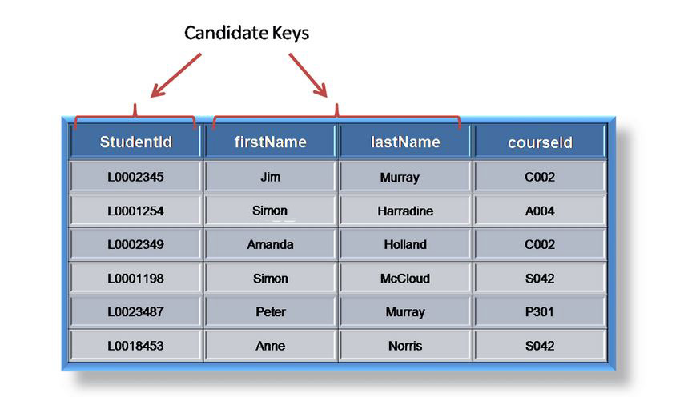

Slide 8
In order to be eligible for a candidate key it must pass certain criteria
It must contain unique values
Must not contain null values
Contain minimum number of fields to ensure uniqueness
Must uniquely identify each record in a table
Note: Once your candidate keys have been identified you can now select one to be your primary key

Slide 9
Primary Key
A primary key is a candidate key that is most appropriate to be the main reference key for the table.
It is the primary key of reference for the table
It is used throughout the database to help establish relationships with other tables.

Slide 10
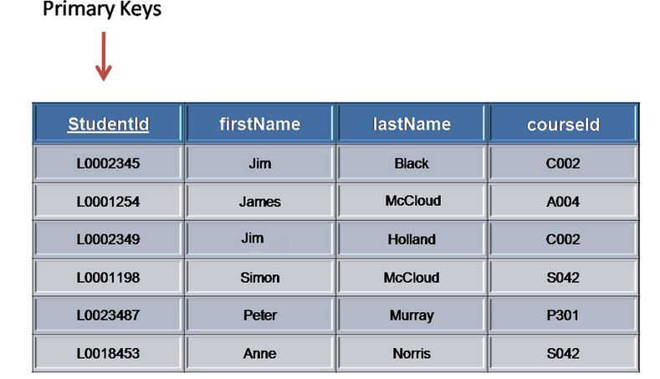

Slide 11
Primary key must contain
Unique values
Must never be null
Uniquely identify each record in the table.
Note : Primary keys are mandatory for every table each record must have a value for its primary key.
Note: When choosing a primary key from the pool of candidate keys always choose a single simple key over a composite key.

Slide 12
Foreign Key
Foreign key is a column(s) that references a column(s) of a table and it can be same table also
A foreign key is generally a Unique key from one table that appears as a field in another where the first table has a relationship to the second.
In other words, if we had a table A with a Unique key X that linked to a table B where X was a field in B, then X would be a foreign key in B.

Slide 13
This relationship ensures
Records cannot be inserted into a detail table if corresponding record in the master table do not exist.
Record of a master table cannot be deleted if corresponding records in the detail table actually exist

Slide 14
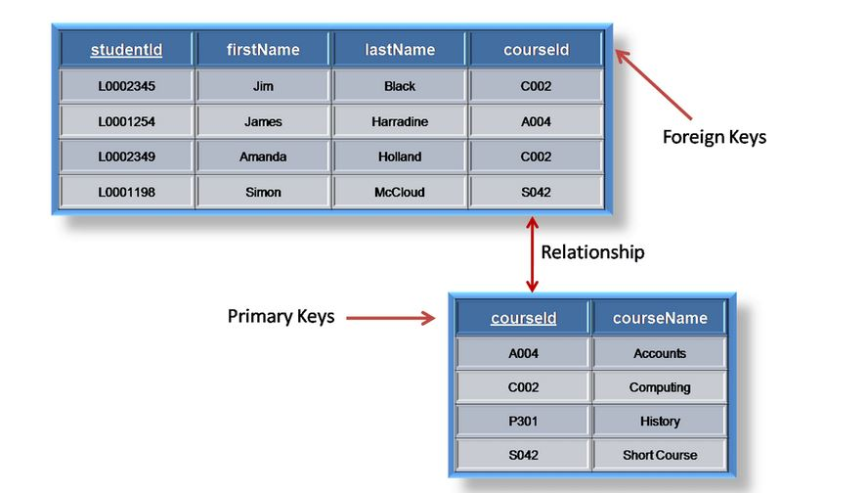
Child
(or) Detail table
Parent
(or)
Master Table

Slide 15
Secondary / Alternate Key
A table may have one or more choices for the primary key. Collectively these are known as candidate keys.
One is selected as the primary key. Those not selected are known as secondary keys or alternative keys.

Slide 16
Simple Key
A simple key consists of a single field to uniquely identify a record.
In addition the field in itself cannot be broken down into other fields

Slide 17
Compound Key
A compound key consists of more than one field to uniquely identify a record.
Each attribute that makes up the compound key is a simple key in its own right.

Slide 18
Composite Key
A composite key consists of more than one field to uniquely identify a record.
This differs from a compound key in that one or more of the attributes, which make up the key, are not simple keys in their own right

