Slide 1
K-means Clustering

Slide 2
What is K-means clustering?
K-means clustering is a type of unsupervised learning, which is used when you have unlabeled data (i.e., data without defined categories or groups).
The goal of this algorithm is to find groups in the data, with the number of groups represented by the variable K.
The algorithm works iteratively to assign each data point to one of K groups based on the features that are provided.
Data points are clustered based on feature similarity.

Slide 3
The result of the K-means clustering algorithm is:
The centroids of the K clusters, which can be used to label new data
Labels for the training data (each data point is assigned to a single cluster)

Slide 4
What are Centroids.
A centroid is a data point (imaginary or real) at the center of a cluster.

Slide 5
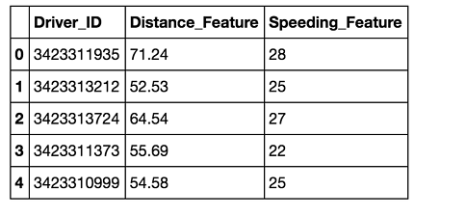
Example: Applying K-Means Clustering To Delivery Fleet Data
Clean and Transform Your Data
For this example, we've already cleaned and completed some simple data transformations.
A sample of the data as a pandas DataFrame is shown below.

Slide 6
Step 2: Choose K and Run the Algorithm
import numpy as np
from sklearn.cluster import KMeans
### For the purposes of this example, we store feature data from our
### dataframe `df`, in the `f1` and `f2` arrays. We combine this into
### a feature matrix `X` before entering it into the algorithm.
f1 = df['Distance_Feature'].values
f2 = df['Speeding_Feature'].values
X=np.matrix(zip(f1,f2))
kmeans = KMeans(n_clusters=2).fit(X)

Slide 7
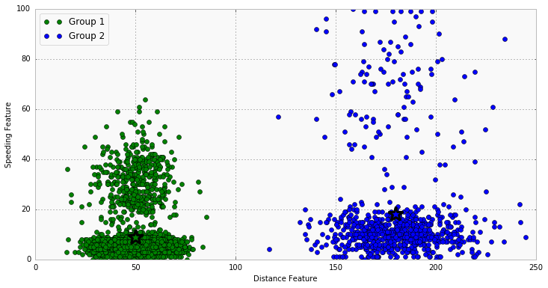
Step 3: Review the Results
The chart below shows the results. Visually, you can see that the K-means algorithm splits the two groups based on the distance feature. Each cluster centroid is marked with a star.
Group 1 Centroid = (50, 5.2)
Group 2 Centroid = (180.3, 10.5)
Using domain knowledge of the
dataset, we can infer that
Group 1 is urban drivers and
Group 2 is rural drivers.

Slide 8
Step 4: Iterate Over Several Values of K
Test how the results look for K=4. To do this, all you need to change is the target number of clusters in
the KMeans() function.
kmeans = KMeans(n_clusters=4).fit(X)
The chart below shows the resulting clusters. We see that four distinct groups have been identified by the algorithm; now speeding drivers have been separated from those who follow speed limits, in addition to the rural vs. urban divide. The threshold for speeding is lower with the urban driver group than for the rural drivers, likely due to urban drivers spending more time in intersections and stop-and-go traffic.

Slide 9
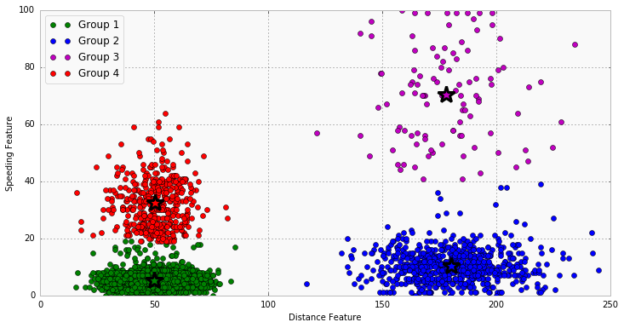

Slide 10
Thanks!

