Slide 1
Introduction to Money & Banking

Slide 2
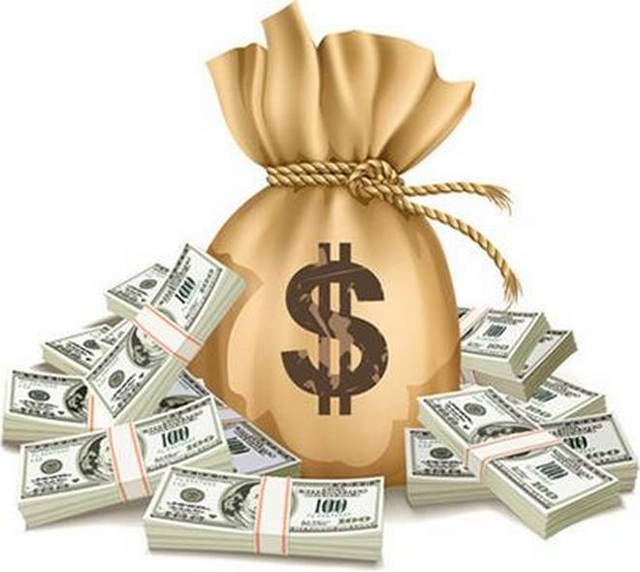
MONEY

Slide 3
Nature and functions of Money
Definition of Money
Stages in development of Money
Barter system
Money and its functions
The role of money

Slide 4
Definition of Money
There are three different definition of Money
Descriptive definition
Legal definitions
General acceptability definitions

Slide 5
Descriptive definitions
Focus on functions of money
Crowther defined as
“ Anything that is generally acceptable as a medium of exchange and that at the same time acts as a measure and store of value”

Slide 6
Coulborn definition
“ Means of valuation and of payment”
Cole definition
“ Money is anything that is widely used as a mean of payment and is generally acceptable in settlement of debts”
These are all narrow definitions as they all just focusing on functions of money.

Slide 7
Legal definitions
These definition are based on state theory of money.
There should be a state force for things to be declared and accepted as money.
Medium should be legal.

Slide 8
Professor Knap definition
“ Any thing which is declared by the state as money is money”
Professor Hartley definition
“ Money should be legal tender”
These definition are also narrow because government cannot force people to accept money

Slide 9
General Acceptability definitions
According to Seligman
“ Money is one thing that possesses general acceptability”
Kents definition
“ Money is any thing that is commonly used and generally accepted as a medium of exchange or as a standard of value”

Slide 10
Mishikin definition
“ Money is anything that is generally accepted in payment for goods and services or in the repayment of debts”
MONEY is different from WEALTH and Income
Money & Near Money

Slide 11
Components of Money
M1 money
M2 money
M3 money
M4 money

Slide 12
EVOLUTION OF MONEY

Slide 13
Stage 1 : Commodity money
Made up of precious metals like gold or silver.
Other valuable commodity like wheat, skin etc.
Primitive Agriculture: Goats, sheep, horses, rice, grain etc
Issues like Durability, Transportability, Divisibility, and homogeneity.
Searched for alternate, lead to Metallic Money.

Slide 14
Stage 2: Metallic money or coins
Gold and silver: issue was Quality and Quantity when mixed with cheaper coins.
Coinage: stamp on both side by competent authority to make equal weightage.
Storage and Transportability issues
Efforts for Alternate → Paper Money

Slide 15
Stage 3: Paper Money
Initially paper money carried a promise that it can be convertible in to fixed quantity of Precious metals.
Befor 1914 various banks were accepting exchange of gold and paper money.
After 1914, eliminated in England.
1933 eliminated in America

Slide 16
Promise written on the paper money was worthless then.
Fiat Money
Money that is legal by state and is not backed by Gold / silver or other.
It was called as token money by J.M Keynes.

Slide 17
Stage 4: Credit money
Also called as Bank Money
Use of checque as medium of exchange (Account holder only)
Make large transactions easier.
It is not real money but backed by an account.
Not legal tender. Can’t force for acceptance.

Slide 18
Stage 5: Electronic money
Modern system
Electronic fund transfer system
Magnetic strip cards like Debit card, credit card etc
Benefits are: reduced processing cost, time and other resources.
Limits defined.
Not legal tender money.

Slide 19
Barter system
Direct exchange of goods for some good without any medium of exchange.
Exist in early stage as life was simple
With passage of time, human needs increased.
Some produced certain goods in greater quantity and vice versa

Slide 20
The direct exchange of surplus commodity for commodity with another person with out the use of money is termed as Barter system in Economics
Later on time mostly found in economically backward and less developed countries.
Modern times, goods are exchanged with money not goods.

Slide 21
Inconveniences of Barter system
Before introduction of Money, following were the inconveniences faced in Barter system.
Double coincidence of Wants

Slide 22
Lack of common measure
Lack of sub-division.
Lack of store of value
Specialization not possible

Slide 23
Payment in the Future.
Difficulties in transfer of wealth

Slide 24
How Money solved these?
Barter system in to Monetary Economy
Accepted Medium of exchange
Overcomed the problem of store of value
Transaction cost is lowered

