Slide 1
Introduction to Telecommunication Systems
Lecture 3
Network Models
Engr. Madeha Mushtaq
Department of Computer Science
Iqra National University

Slide 2
Network Models
Layered Tasks
Sender, Receiver, and Carrier
Hierarchy
  Preparation
  Sending
  Delivering
Services
  Higher layer uses lower layer service.

Slide 3
Layered Tasks

Slide 4
Network Models
For computer networks to communicate with one another, standards are needed.
The two best-known standards are the OSI model and the Internet model.
  The OSI (Open Systems Interconnection) model defines a seven-layer network. ISO introduced the OSI (Open Systems Interconnection) model in the late 1970s.
  The Internet model or TCP/IP protocol suite defines a five-layer network. The TCPI/IP protocol suite became the dominant commercial architecture because it was used and tested extensively in the Internet; the OSI model was never fully implemented.

Slide 5
TCP/IP Protocol Suite
5 Layer Model
  Layer 1 Physical
  Layer 2 Data Link
  Layer 3 Network
  Layer 4 Transport
  Layer 5 Application

Slide 6
Peer-to-Peer Processes
At the physical layer, communication is direct: In figure , device A sends a stream of bits to device B (through intermediate nodes).
At the higher layers, however, communication must move down through the layers on device A, over to device B, and then back up through the layers.

Slide 7
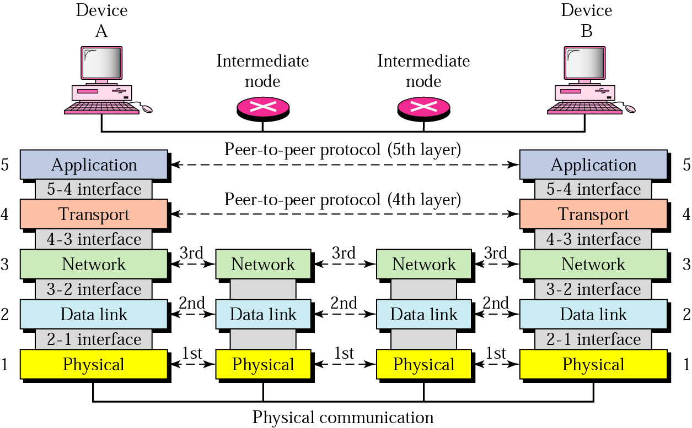
Peer-to-Peer Processes

Slide 8
Interfaces Between Layers
The passing of the data and network information down through the layers of the sending device and back up through the layers of the receiving device is made possible by an interface between each pair of adjacent layers.
Well-defined interfaces and layer functions provide modularity to a network.

Slide 9
Organization of the Layers
The 5 layers can be thought of as belonging to three subgroups.
Physical, data link, and network layers are the network support layers.
  They deal with the physical aspects of moving data from one device to another. Such as
    physical addressing,
    physical addressing,
    electrical specifications,
    transport timings,
    Reliability.

Slide 10
Organization of the Layers
Layer 5, application layer can be thought of as the user support layer.
  File Transport Protocol
  HTTP
Layer 4, the transport layer, links the two subgroups and ensures that what the lower layers have transmitted is in a form that the upper layers can use.
  Transmission Control Protocol (TCP)
  User Datagram Protocol (UDP)

Slide 11
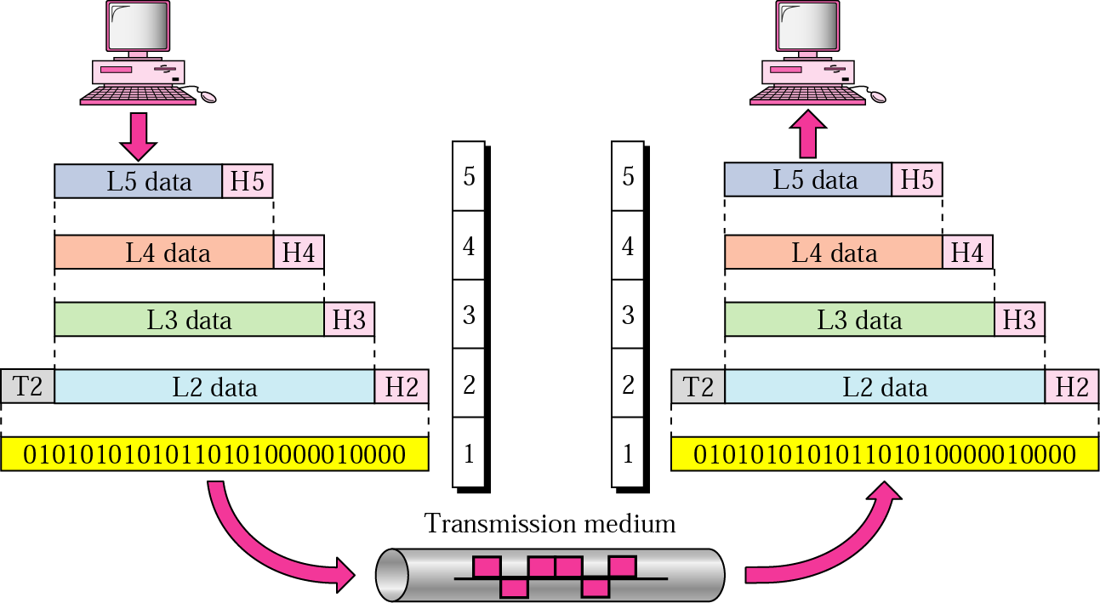
An Exchange Using Internet Model

Slide 12
Physical Layer
The physical layer coordinates the functions required to carry a bit stream over a physical medium.
It deals with the mechanical and electrical specifications of the interface and transmission medium.
The physical layer is also concerned with the Physical topology and line configuration.
The physical layer also defines the direction of transmission between two devices: simplex, half-duplex, or full-duplex.

Slide 13
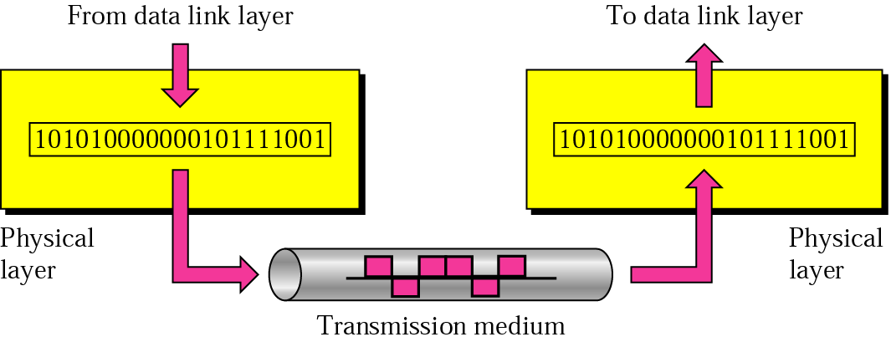
Physical Layer

Slide 14
Data Link Layer
The datalink layer is responsible for moving frames from one node to the next.
The data link layer is responsible for:
  Framing. The data link layer divides the stream of bits received from the network layer into manageable data units called frames.
  Physical addressing. If frames are to be distributed to different systems on the network, the data link layer adds a header to the frame to define the sender and/or receiver of the frame.

Slide 15
Data Link Layer
  Flow control. If the rate at which the data are absorbed by the receiver is less than the rate at which data are produced in the sender, the data link layer imposes a flow control mechanism to avoid overwhelming the receiver.
  Error control. The data link layer adds reliability to the physical layer by adding mechanisms to detect and retransmit damaged or lost frames.
  Access control. When two or more devices are connected to the same link, data link layer protocols are necessary to determine which device has control over the link at any given time.

Slide 16
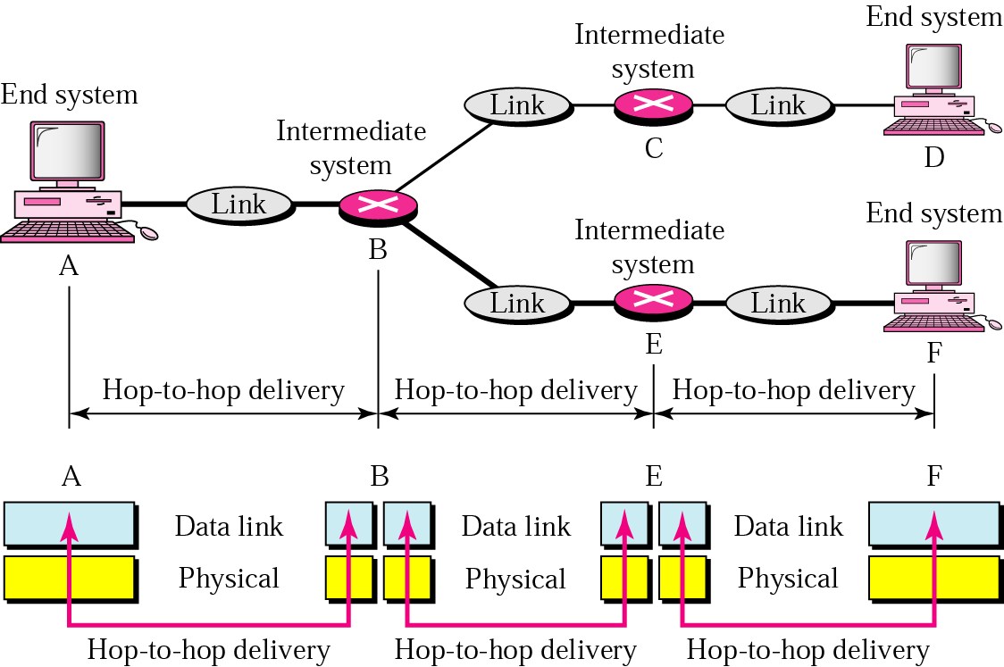
Data Link Layer – Node-to-Node Delivery

Slide 17
Example of a Data Frame
Physical addresses
  Sender node – physical address 10
  Receiver node – Physical address 87
Data
Trailer – extra bits for error detection

Slide 18
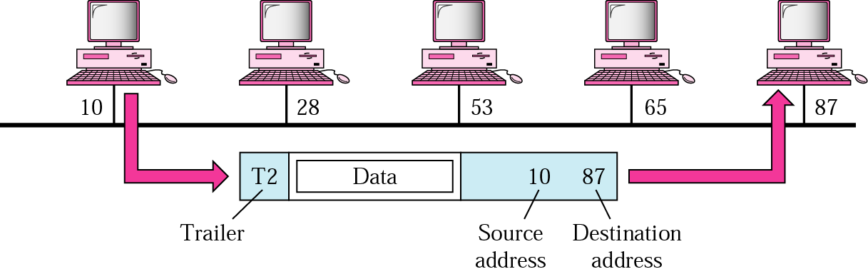
Example of a Data Frame

Slide 19
Physical Address
Most local area networks use a 48-bit (6 bytes) physical address written as 12 hexadecimal digits, with every 2 bytes separated by a colon as shown below:
07:01:02:01:2C:4B
A 6-byte (12 hexadecimal digits) physical address.

Slide 20
Network Layer
The network layer is responsible for the source-to-destination delivery of a packet across multiple networks. The protocol used at network layer is Internet Protocol (IP).
The network layer is responsible for:
Logical addressing: The physical addressing implemented by the data link layer handles the addressing problem locally. If a packet passes the network boundary, we need another addressing system to help distinguish the source and destination systems. The network layer adds a header to the packet coming from the upper layer that, among other things, includes the logical addresses of the sender and receiver.

Slide 21
Network Layer
Routing: When independent networks or links are connected to create internetworks (network of networks) or a large network, the connecting devices (called routers or switches) route or switch the packets to their final destination. One of the functions of the network layer is to provide this mechanism.

Slide 22
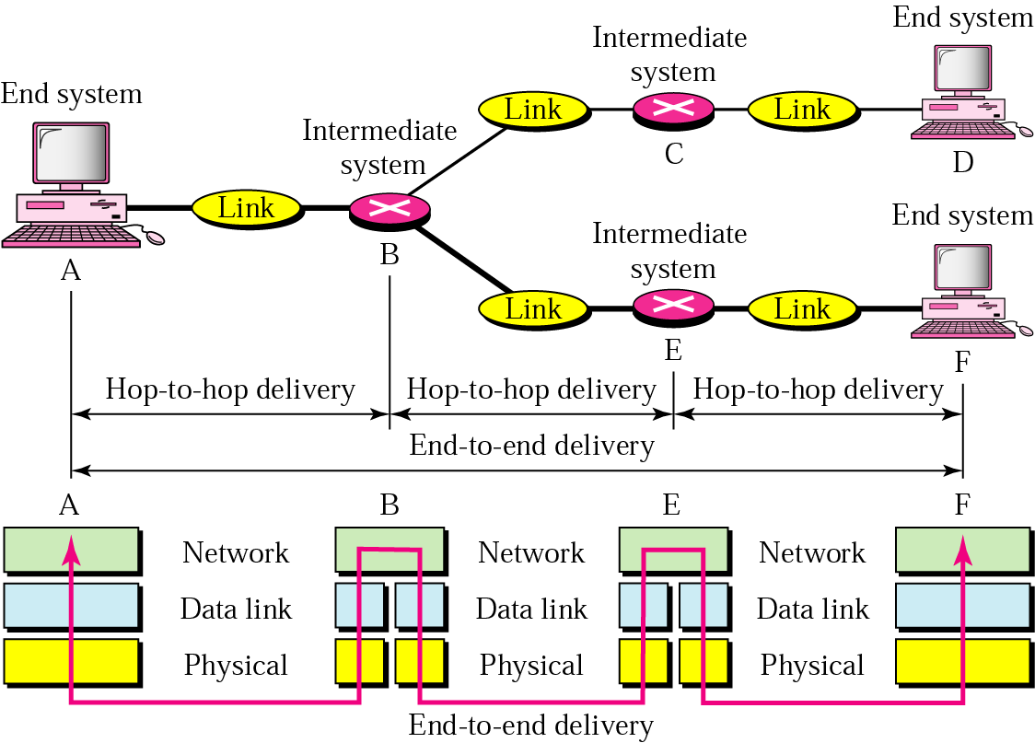
Network Layer

Slide 23
Example
Sender (on one LAN)
  Network address A
  Physical address 10
Receiver (on another LAN)
  Network address P
  Physical address 95
Router

Slide 24
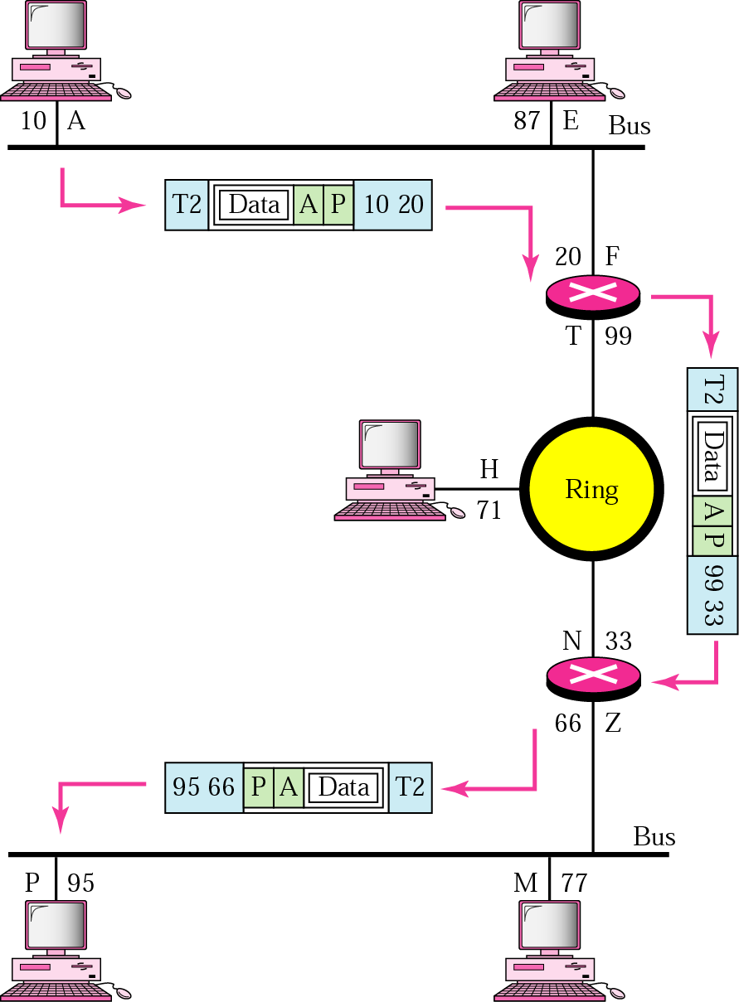
Example
The physical addresses will change from hop to hop, but the logical addresses usually remain the same.

Slide 25
Internet Address
An Internet address (in IPv4) is 32 bits in length, normally written as four decimal numbers, with each number representing 1 byte. The numbers are separated by a dot. Below is an example of such an address.
132.24.75.9
An internet address in IPv4 in decimal numbers

Slide 26
Transport Layer
The transport layer is responsible for process-to-process delivery of the entire message.
Transport layer is responsible for:
  Service-point addressing: The transport layer header include a type of address called a service-point address (or port address). The network layer gets each packet to the correct computer; the transport layer gets the entire message to the correct process on that computer.
  Segmentation and reassembly: A message is divided into transmittable segments, with each segment containing a sequence number. These numbers enable the transport layer to reassemble the message correctly upon arriving at the destination.

Slide 27
Transport Layer
Connection control. The transport layer can be either connectionless or connection oriented. The protocols used at transport layer are TCP and UDP.
Flow control. Like the data link layer, the transport layer is responsible for flow control. However, flow control at this layer is performed end to end rather than across a single link.
Error control. Error control at this layer is performed process-to-process rather than across a single link. The sending transport layer makes sure that the entire message arrives at the receiving transport layer without error (damage, loss, or duplication). Error correction is usually achieved through retransmission.

Slide 28
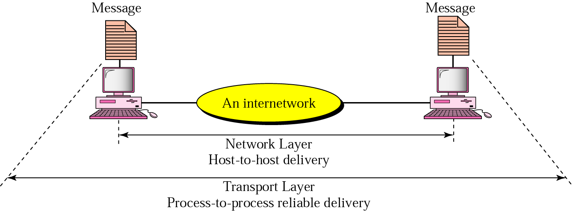
Reliable Process-to-Process Delivery

Slide 29
Port Address
A port address is a 16-bit address represented by one decimal number as shown below.
753
A 16-bit port address represented as one single number.

Slide 30
Application Layer
The application layer enables the user, to access the network.
It provides user interfaces and support for services such as email, remote file access and transfer, shared database management, and other types of distributed information services.

Slide 31
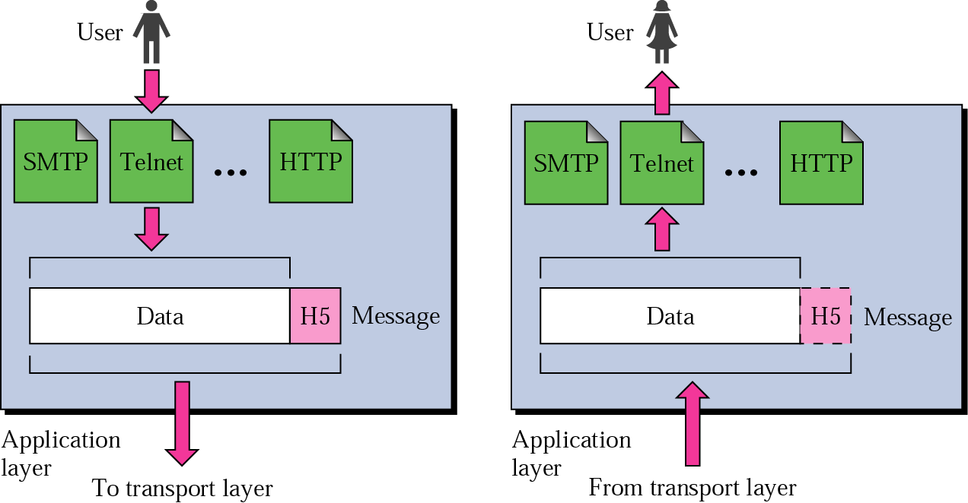
Application Layer

Slide 32
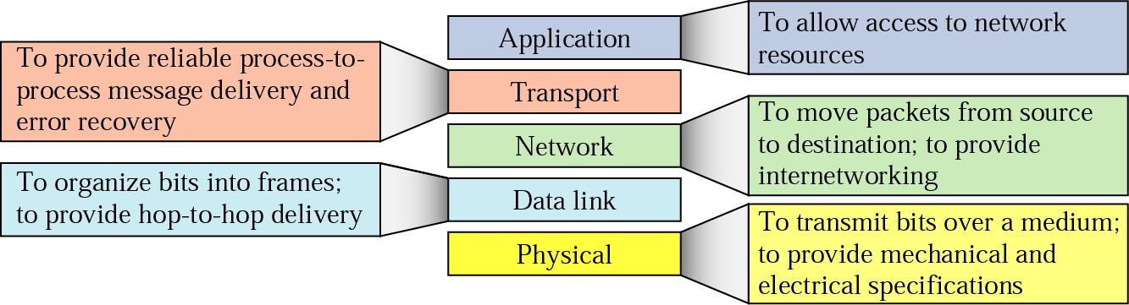
Summary of Layers

Slide 33
The OSI Model
Developed by the International Organization for Standardization (ISO)
The OSI model has seven layers.
Each layer performs a subset of the required communication functions.
Each layer uses services of the layer below it and provides services to the layer above it.
Changes in one layer should not require changes in other layers.
OSI model is theoretical, was never fully implemented.

Slide 34
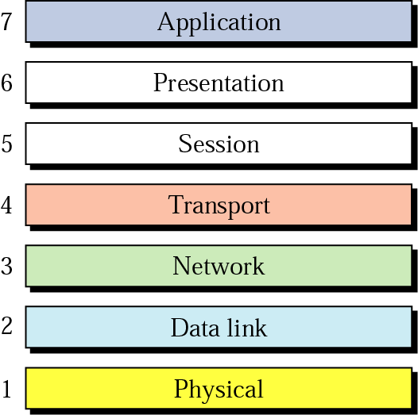
The OSI Model

Slide 35
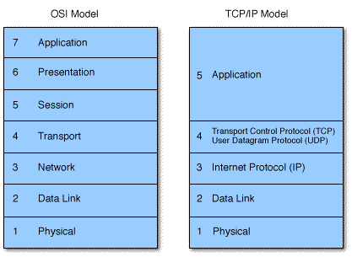
The OSI Model vs TCP/IP

Slide 36
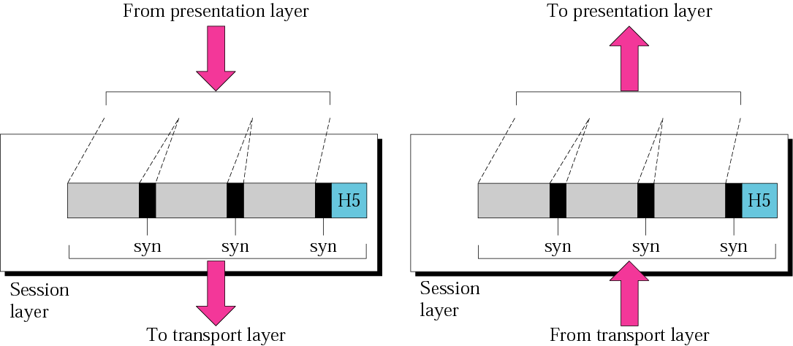
Session Layer
It establishes, maintains, and synchronizes the interaction among communicating systems.

Slide 37
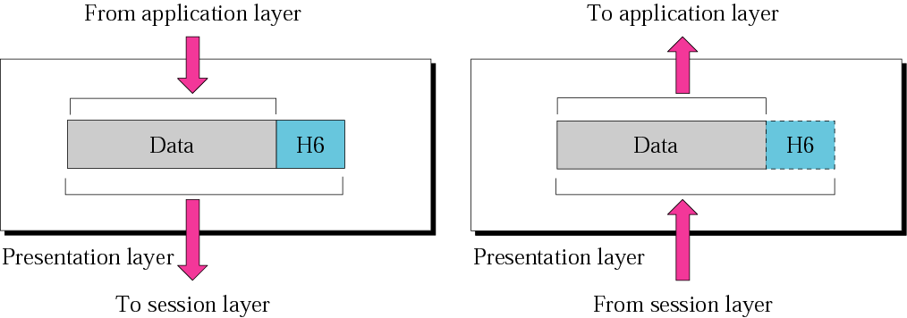
Presentation Layer
The presentation layer is responsible for translation, compression, and encryption.

Slide 38
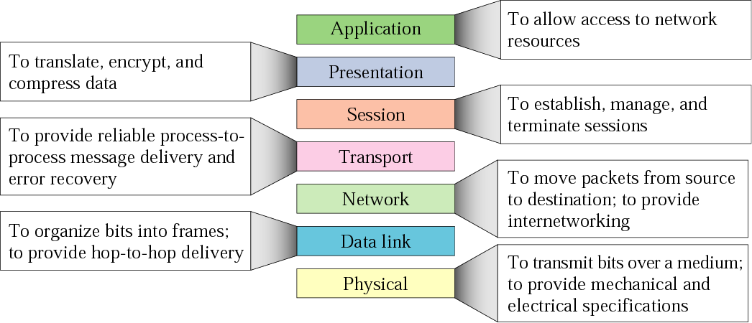
Summary of Layers

Slide 39
End of Slides

