Slide 1
Higher Order Homogeneous
Differential Equations

Slide 2
Consider the equation
$a_{0}\frac{d^{n}y}{dx^{n}}$ + $a_{1}\frac{d^{n−1}y}{dx^{n−1}}+ …+a_{n−1}\frac{dy}{dx}$ + $a_{n}y$ = 0 ------- (1)
Where $a_{o},a_{1},…,a_{n−1},a_{n}$ are real constants.
Using Differential operator D, the equation can be written as
f(D)y = 0
Eq (1) implies
$a_{0}D^{n}$y + $a_{1}D^{n−1}y+ …+a_{n−1}Dy$+ $a_{n}y$ = 0 Here $\frac{d}{dx} =D$
($a_{0}D^{n}$ + $a_{1}D^{n−1}+ …+a_{n−1}D$+ $a_{n})y$ = 0
f(D)y = 0

Slide 3
The characteristic equation is
$a_{0}m^{n}$ + $a_{1}m^{n−1}+ …+a_{n−1}m$+ $a_{n}=0$
According to the fundamental theorem of algebra, a polynomial of degree n has
exactly n roots. In this case the roots can be both real and
complex (even if all the coefficients of a₁,a₂,…,a_{n} are real).
The different cases of the roots of the characteristic equation and the
corresponding formulas for the general solution of differential equations.

Slide 4
Case 1:
Roots are real and distinct:
Let $m_{1},m_{2},…,m_{n}$ be n distinct roots of eq (1)
Then the general solution of differential equation is
y = $c_{1}e^{m_{1}x}+ c_{2}e^{m_{2}x}+…+c_{n}e^{m_{n}x}$

Slide 5
Case 2:
Roots are real and repeated:
Let $m_{1}=m_{2}= m_{n}$ be n repeated roots of eq (1)
Then the general solution of differential equation is
y = ${(c}_{1}+ c_{2}x+…)e^{mx}$

Slide 6
Case 3:
Roots are Complex and distinct:
The complex roots of the characteristic equation will be presented
in the form of conjugate pairs of complex numbers
i.e $m_{1,2}$ = α ± β and $m_{3,4}= ±$
If $m_{1,2}$ ≠ $m_{3,4}$
In this case the general solution is written as
y = $e^{αx}{(c}_{1}cosβx+ c_{2}sinβx)+$ $e^{x}{(c}_{1}cosx+ c_{2}sinx)+…$

Slide 7
Case 4:
Roots are Complex and Repeated:
If $m_{1,2}$ = $m_{3,4}$
i.e $m_{1,2}$ = α ± β and $m_{3,4}=\text{α ± β}$
In this case the general solution is written as
y = $e^{αx}{(c}_{1}cosβx+ c_{2}sinβx)+$ $xe^{αx}{(c}_{3}cosβx+ c_{4}sinβx)+$…

Slide 8
Question: Find the general solution of
differential equation.

Slide 9
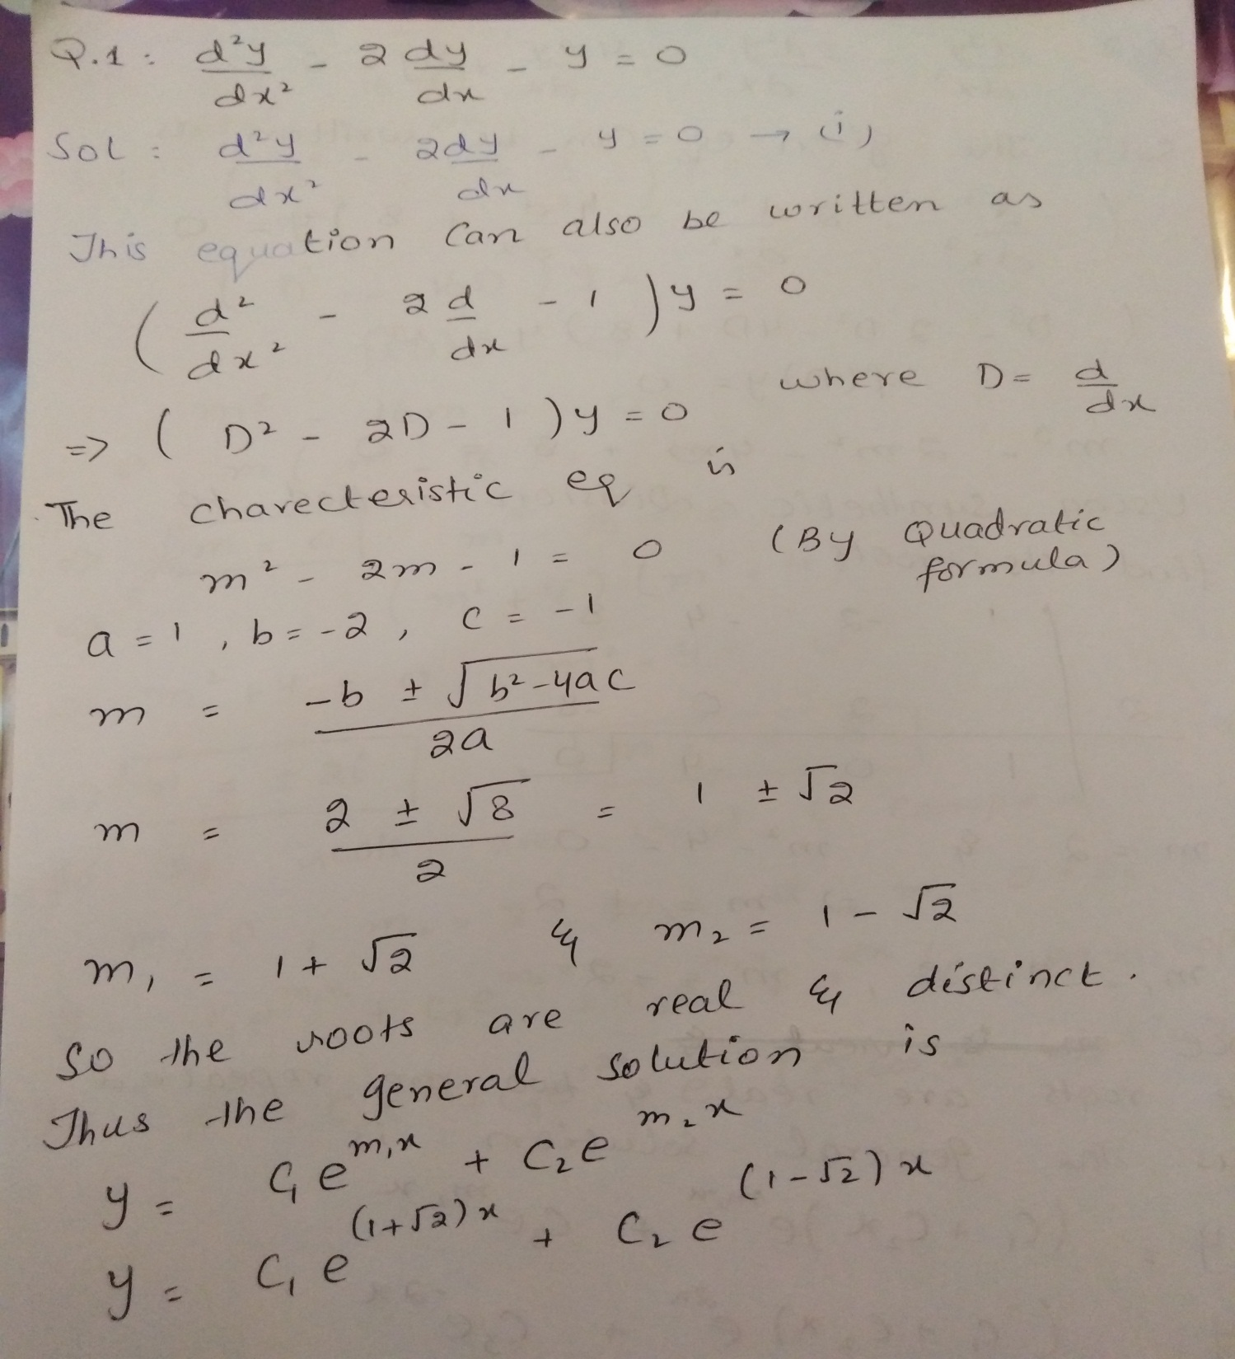

Slide 10
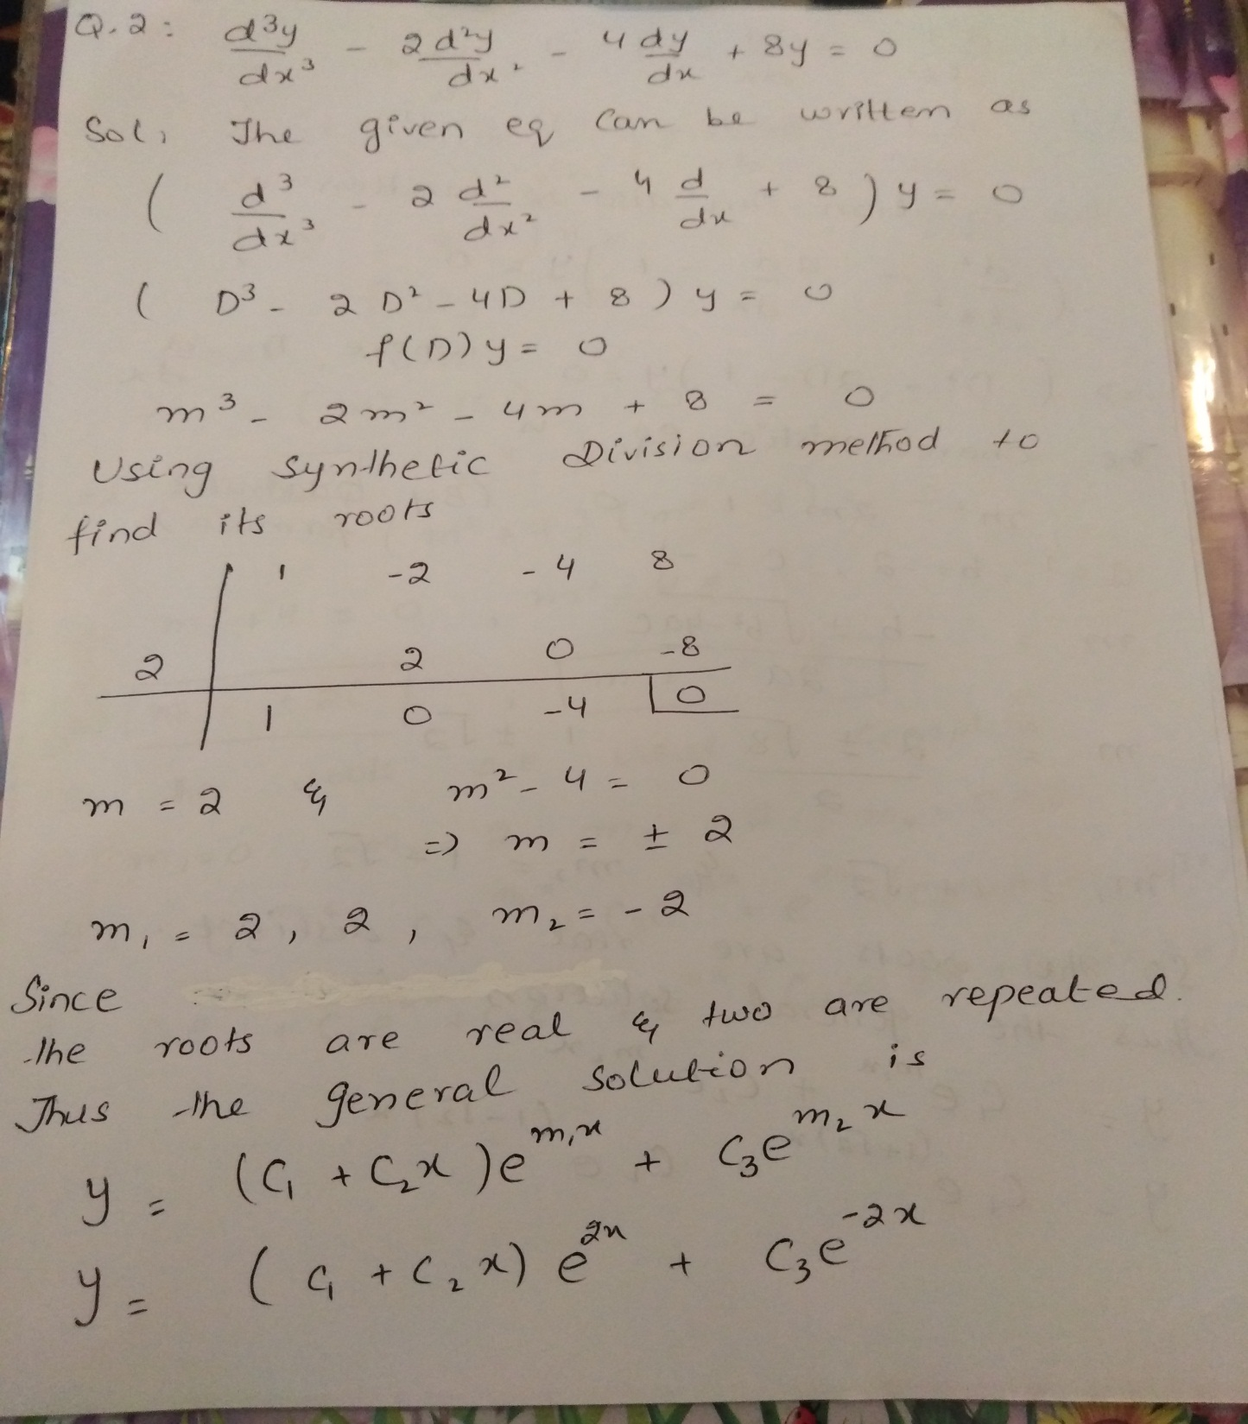

Slide 11
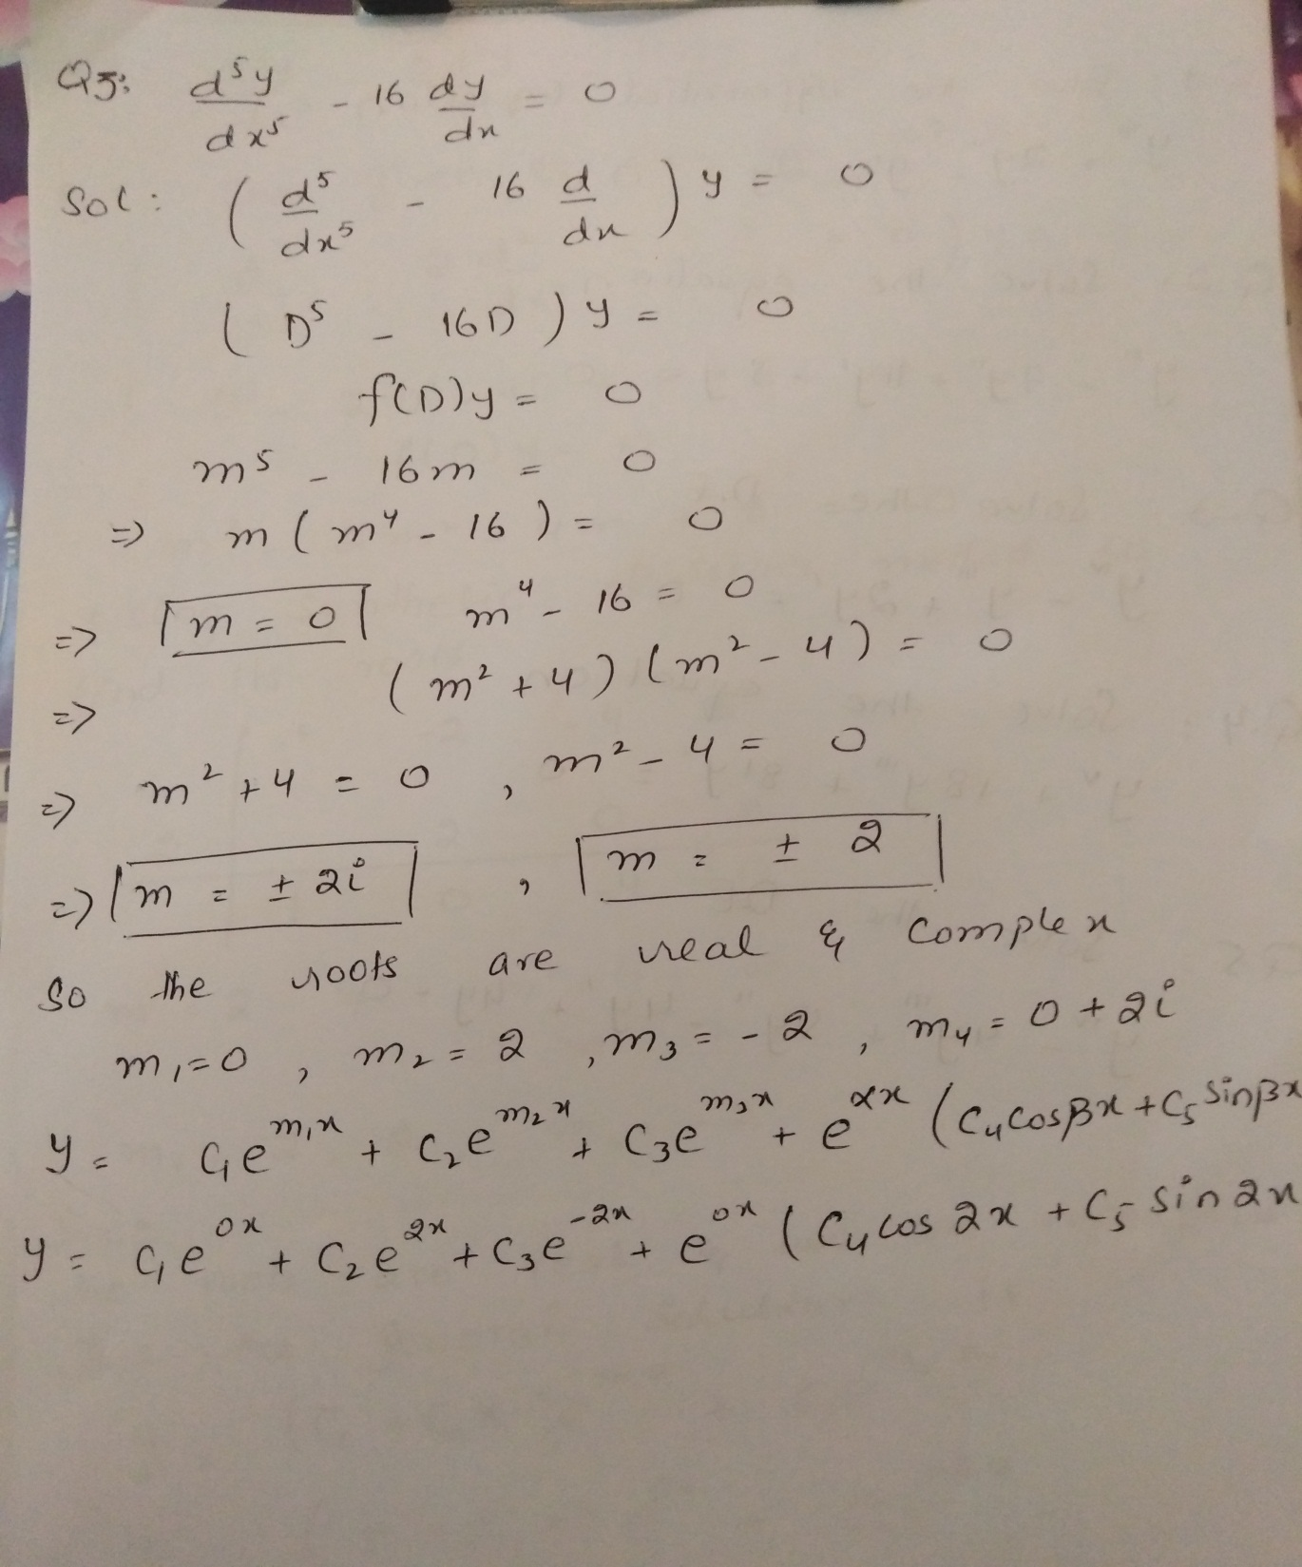

Slide 12
Practice Questions

Slide 13
