Slide 1
HEADWORKS AND BARRAGES
By
Dr. Jahangir Durrani

Slide 2
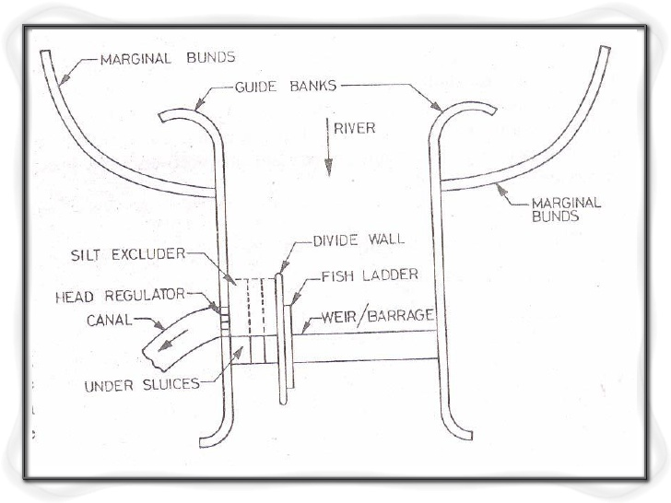

Slide 3
Introduction…
Any hydraulic structure which supplies water to the off-taking canal is called a headwork. Headwork may be divided into two
1. Storage headwork. 2. Diversion headwork.

Slide 4
Storage head works Dam is constructed across a river valley to form storage reservoir, known as storage head works. Water is supplied to the canal from this reservoir through canal regulator. These serves for multipurpose function like hydro- electric power generation, flood control, fishery.

Slide 5
Diversion head works Weir or barrage is constructed across a perennial river to raise water level and to divert the water to canal, is known as diversion head work. Flow of water in the canal is controlled by canal head regulator.

Slide 6
Objective of diversion head work It raises the water level on its upstream side. It regulates the supply of water into canals. It controls the entry of silt into canals It creates a small pond (not reservoir) on its upstream and provides some pondage. It helps in controlling the fluctuation of water level in river during different seasons.

Slide 7
Site selection for diversion head work
The river section at the site should be narrow and well-defined. The river should have high, well-defined, in erodible and non-submersible banks so that the cost of river training works is minimum. The canals taking off from the diversion head works should be quite economical and Should have a large commanded area.

Slide 8
Components of a diversion headwork
Weir or barrage
Undersluices
Divide wall
Fish ladder
Canal head regulator
Silt excluders/ Silt prevention devices
River training works (Marginal bunds and guide banks)

Slide 9
Weir
Normally the water level of any perennial river is such that it cannot be diverted to the irrigation canal. The bed level of the canal may be higher than the existing water level of the river. In such cases weir is constructed across the river to raise the water level. Surplus water pass over the crest of weir. Adjustable shutters are provided on the crest to raise the water level to some required height.

Slide 10
Barrage
When the water level on the up stream side of the weir is required to be raised to different levels at different time, barrage is constructed. Barrage is an arrangement of adjustable gates or shutters at different tires over the weir.

Slide 11
Under sluices Also known as scouring sluices. The under sluices are the openings provided at the base of the weir or barrage. These openings are provided with adjustable gates. Normally, the gates are kept closed. The suspended silt goes on depositing in front of the canal head regulator.

Slide 12
❑ When the silt deposition becomes appreciable the gates are opened and the deposited silt is loosened with an agitator mounting on a boat. The muddy water flows towards the downstream through the scouring sluices. The gates are then closed. But, at the period of flood, the gates are kept opened.

Slide 13
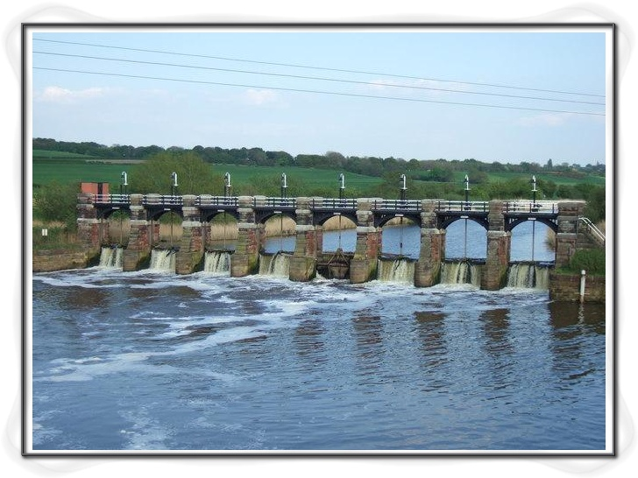
.

Slide 14
Divide wall The divide wall is a long wall constructed at right angles in the weir or barrage, it may be constructed with stone masonry or cement concrete.On the upstream side, the wall is extended just to cover the canal head regulator and on the downstream side, it is extended up to the launching apron.

Slide 15
. The functions of the divide wall are as follows:To form a still water pocket in front of the canal head so that the suspended silt can be settled down which then later be cleaned through the scouring sluices from time to time. It controls the eddy current or cross current in front of the canal head. It provides a straight approach in front of the canal head. It resists the overturning effect on the weir or barrage caused by the pressure of the impounding water

Slide 16
. Fish ladder
The fish ladder is provided just by the side of the divide wall for the free movement of fishes. Rivers are important source of fishes. The tendency of fish is to move from upstream to downstream in winters and from downstream to upstream in monsoons. This movement is essential for their survival. Due to construction of weir or barrage, this movement gets obstructed, and is detrimental to the fishes.

Slide 17
. 

Slide 18
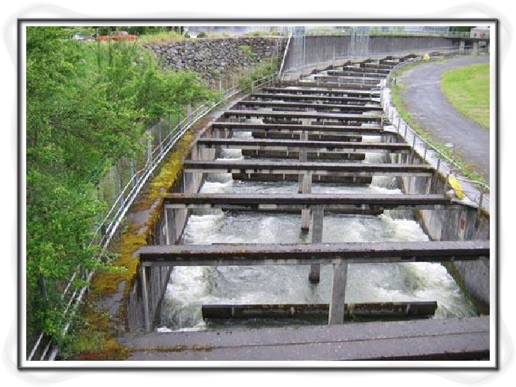

Slide 19
Canal head regulator
A structure which is constructed at the head of the canal to regulate flow of water is known as canal head regulator.It consists of a number of piers which divide the total width of the canal into a number of spans which are known as bays.The piers consist of number tiers on which the adjustable gates are placed.

Slide 20
The gates are operated form the top by suitable mechanical device. A platform is provided on the top of the piers for the facility of operating the gates. Again some piers are constructed on the down stream side of the canal head to support the roadway.

Slide 21
Functions of Canal Head Regulator
It regulates the supply of water entering the canal It controls the entry of silt in the canal It prevents the river-floods from entering the canal

Slide 22
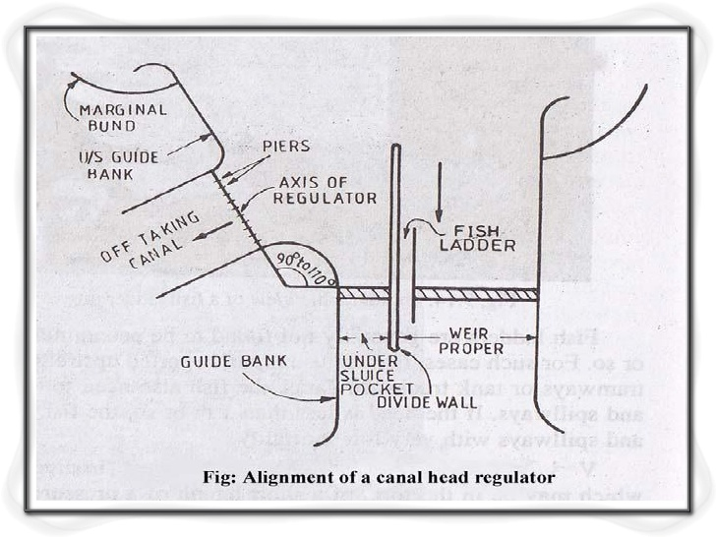

Slide 23
. Silt regulation works
The entry of silt into a canal, which takes off from a head works, can be reduced by constructed certain special works, called silt control works.These works may be classified into the following two types: (a) Silt Excluders (b) Silt Ejectors

Slide 24
Silt Excluders Silt excluders are those works which are constructed on the bed of the river, upstream of the head regulator. The clearer water enters the head regulator and silted water enters the silt excluder. In this type of works, the silt is, therefore,, removed from the water before in enters the canal.

Slide 25
Silt EjectorsSilt ejectors, also called silt extractors, are those devices which extract the silt from the canal water after the silted water has travelled a certain distance in the off-take canal.These works are, therefore, constructed on the bed of the canal, and little distance downstream from the head regulator.

Slide 26
River training works
River training works are required near the weir site in order to ensure a smooth and an axial flow of water, and thus, to prevent the river from outflanking the works due to a change in its course. The river training works required on a canal headwork are: (a) Guide banks (b) Marginal bunds (c) Spurs or groynes

Slide 27
Guide BankWhen a barrage is constructed across a river which flows through the alluvial soil, the guide banks mustbe constructed on both the approaches to protect the structure from erosion.Guide bank serves the following purposes: It protects the barrage from the effect of scouring and erosion. It provides a straight approach towards the barrage. It controls the tendency of changing the course of the river. It controls the velocity of flow near the structure.

Slide 28
Marginal Bunds
The marginal bunds are earthen embankments which are constructed parallel to the river bank on one orboth the banks according to the condition. The top width is generally 3 m to 4 m. The side slope on theriver side is generally 1.5: 1 and that on the country side is 2:1.

Slide 29
The marginal bunds serve the following purposes:➢It prevents the flood water or storage water from entering the surrounding area which may be submerged or may be water logged.➢It retains the flood water or storage water within a specified section.➢It protects the towns and villages from devastation during the heavy flood.➢It protects valuable agricultural lands.

Slide 30
THANK YOU

