Slide 1
HUMAN COMPUTER INTERACTION
LECTURE 4

Slide 2
The Computer Part 02

Slide 3
virtual reality and 3D interaction
positioning in 3D space
moving and grasping
seeing 3D (helmets and caves)

Slide 4
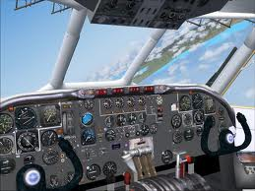
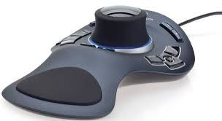
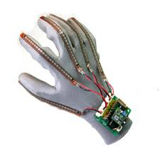
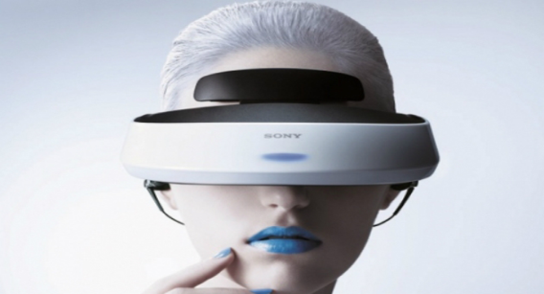
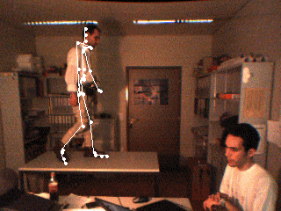
positioning in 3D space
cockpit and virtual controls
  steering wheels, knobs and dials … just like real!
the 3D mouse
  six-degrees of movement: x, y, z + roll, pitch, yaw
data glove
  fibre optics used to detect finger position
VR helmets
  detect head motion and possibly eye gaze
whole body tracking
  accelerometers strapped to limbs or reflective dots and video processing

Slide 5
pitch, yaw and roll
yaw
roll
pitch
up/down angle (called pitch), its left/right orientation (called yaw) and the amount
it is twisted about its own axis called roll

Slide 6
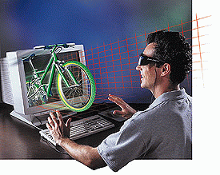
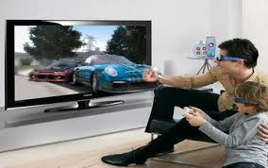
3D displays
desktop VR
  ordinary screen, mouse or keyboard control
  perspective and motion give 3D effect
seeing in 3D
  use stereoscopic vision
  VR helmets

Slide 7

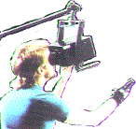

VR headsets
small TV screen for each eye
slightly different angles
3D effect

Slide 8
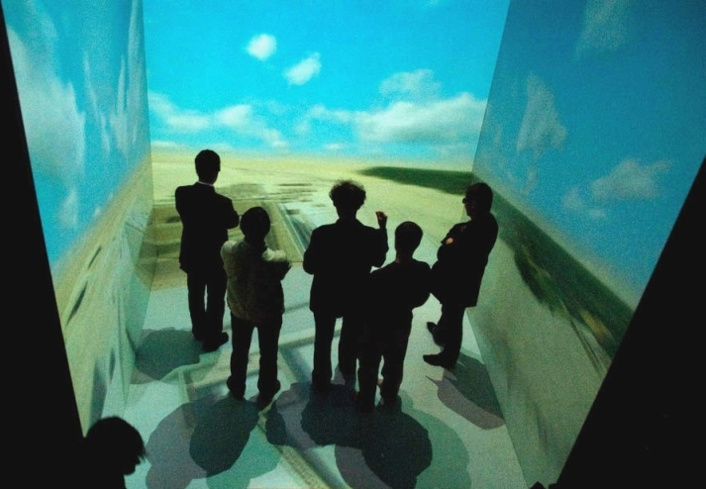
simulators and VR caves
scenes projected on walls
realistic environment
hydraulic rams!
real controls
other people

Slide 9
physical controls, sensors etc.
special displays and gauges
sound, touch, feel, smell
physical controls
environmental and bio-sensing

Slide 10
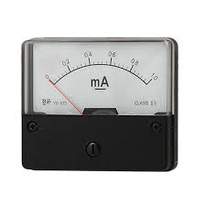
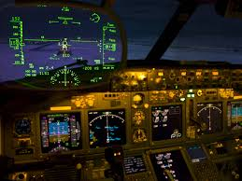
dedicated displays
analogue representations:
  dials, gauges, lights, etc.
digital displays:
  small LCD screens, LED lights, etc.
head-up displays
  found in aircraft cockpits
  show most important controls
  … depending on context

Slide 11
Sounds
beeps, bongs, clonks, whistles and whirrs
used for error indications
confirmation of actions e.g. keyclick
        also see chapter 10

Slide 12
Touch, feel, smell
touch and feeling important
  in games … vibration, force feedback
  in simulation … feel of surgical instruments
  called haptic devices
texture, smell, taste
  current technology very limited

Slide 13
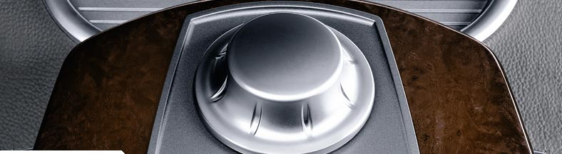
BMW iDrive
for controlling menus
feel small ‘bumps’ for each item
makes it easier to select options by feel
uses haptic technology from Immersion Corp.

Slide 14
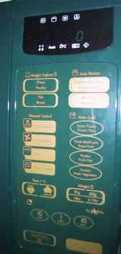
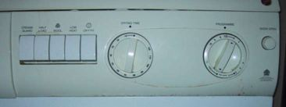
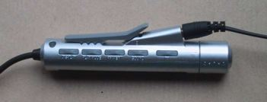
physical controls
specialist controls needed …
  industrial controls, consumer products, etc.
easy-clean
smooth buttons
multi-function
control
large buttons
clear dials
tiny buttons

Slide 15
Environment and bio-sensing
sensors all around us
  ultrasound detectors – security, washbasins
  RFID security tags in shops
  temperature, weight, location
… and even our own bodies …
  iris scanners, body temperature, heart rate, blink rate etc

Slide 16
paper: printing and scanning
print technology
fonts, page description, WYSIWYG
scanning, OCR

Slide 17
Printing
image made from small dots
  allows any character set or graphic to be printed,
critical features:
  resolution
    size and spacing of the dots
    measured in dots per inch (dpi)
  speed
    usually measured in pages per minute
  cost!!

Slide 18
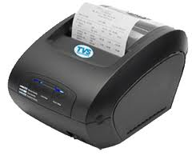
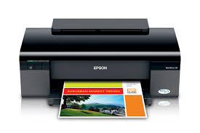
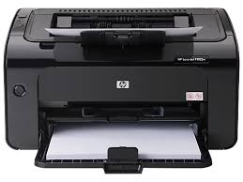
Types of dot-based printers
dot-matrix printers
  use inked ribbon (like a typewriter
  line of pins that can strike the ribbon, dotting the paper.
  typical resolution 80-120 dpi
ink-jet and bubble-jet printers
  tiny blobs of ink sent from print head to paper
  typically 300 dpi or better .
laser printer
  like photocopier: dots of electrostatic charge deposited on drum, which picks up toner (black powder form of ink) rolled onto paper which is then fixed with heat
  typically 600 dpi or better.

Slide 19
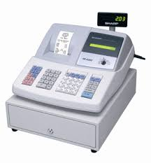
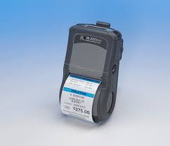
Printing in the workplace
shop tills
  dot matrix
  same print head used for several paper rolls
  may also print cheques
thermal printers
  special heat-sensitive paper
  paper heated by pins makes a dot
  poor quality, but simple & low maintenance
  used in some fax machines

Slide 20
Fonts
Font – the particular style of text
Courier font
Helvetica font
Palatino font
Times Roman font
♣×∝≡↵ℜ ⊗↵∼ (special symbol)
Size of a font measured in points (1 pt about 1/72”)
(vaguely) related to its height
This is ten point Helvetica
This is twelve point
This is fourteen point
This is eighteen point
and this is twenty-four point

Slide 21
Fonts (ctd)
Pitch
  fixed-pitch – every character has the same width
    e.g. Courier
  variable-pitched – some characters wider
    e.g. Times Roman – compare the ‘i’ and the “m”
Serif or Sans-serif
  sans-serif – square-ended strokes
    e.g. Helvetica
  serif – with splayed ends (such as)
    e.g. Times Roman or Palatino

Slide 22
Readability of text
lowercase
  easy to read shape of words
UPPERCASE
  better for individual letters and non-words
  e.g. flight numbers: BA793 vs. ba793
serif fonts
  helps your eye on long lines of printed text
  but sans serif often better on screen

Slide 23
Screen and page
WYSIWYG
  what you see is what you get
  aim of word processing, etc.
but …
  screen: 72 dpi, landscape image
  print: 600+ dpi, portrait
can try to make them similar
but never quite the same
so … need different designs, graphics etc, for screen and print

Slide 24
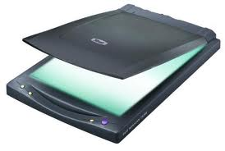
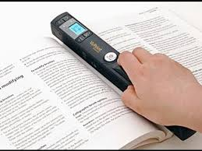
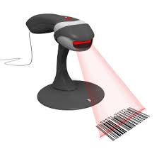
Scanners
Take paper and convert it into a bitmap
Two sorts of scanner
  flat-bed: paper placed on a glass plate, whole page converted into bitmap
  hand-held: scanner passed over paper, digitising strip typically 3-4” wide
Shines light at paper and note intensity of reflection
  colour or greyscale
Typical resolutions from 600–2400 dpi

Slide 25
Optical character recognition
OCR converts bitmap back into text
different fonts
  create problems for simple “template matching” algorithms
  more complex systems segment text, decompose it into lines and arcs, and decipher characters that way

Slide 26
Paper-based interaction
paper usually regarded as output only
can be input too – OCR, scanning, etc.

Slide 27
memory
short term and long term
speed, capacity, compression
formats, access

Slide 28
Short-term Memory - RAM
Random access memory (RAM)
  on silicon chips
  100 nano-second access time
  usually volatile (lose information if power turned off)
  data transferred at around 100 Mbytes/sec
Typical desktop computers:
64 to 256 Mbytes RAM

Slide 29
Long-term Memory - disks
magnetic disks
  floppy disks store around 1.4 Mbytes
  hard disks typically 40 Gbytes to 100s of Gbytes
  access time ~10ms, transfer rate 100kbytes/s
optical disks
  use lasers to read and sometimes write
  more robust that magnetic media
  CD-ROM
  - same technology as home audio, ~ 600 Mbytes
  DVD - for AV applications, or very large files

Slide 30
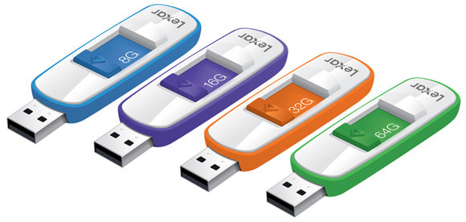
Blurring boundaries
PDAs
  often use RAM for their main memory
Flash-Memory
  used in PDAs, cameras etc.
  silicon based but persistent
  plug-in USB devices for data transfer

Slide 31
speed and capacity
what do the numbers mean?
some sizes (all uncompressed) …
  this book, text only ~ 320,000 words, 2Mb
  the Bible ~ 4.5 Mbytes
  scanned page ~ 128 Mbytes
    (11x8 inches, 1200 dpi, 8bit greyscale)
  digital photo ~ 10 Mbytes
    (2–4 mega pixels, 24 bit colour)
  video ~ 10 Mbytes per second
    (512x512, 12 bit colour, 25 frames per sec)

Slide 32
Compression
reduce amount of storage required
lossless
  recover exact text or image – e.g. GIF, ZIP
  look for commonalities:
    text: AAAAAAAAAABBBBBCCCCCCCC 10A5B8C
    video: compare successive frames and store change
lossy
  recover something like original – e.g. JPEG, MP3
  exploit perception
    JPEG: lose rapid changes and some colour
    MP3: reduce accuracy of drowned out notes

Slide 33
Storage formats - text
ASCII - 7-bit binary code for to each letter and character
UTF-8 - 8-bit encoding of 16 bit character set
RTF (rich text format)
- text plus formatting and layout information
SGML (standardized generalised markup language)
- documents regarded as structured objects
XML (extended markup language)
- simpler version of SGML for web applications

Slide 34
Storage formats - media
Images:
  many storage formats :
  (PostScript, GIFF, JPEG, TIFF, PICT, etc.)
  plus different compression techniques
  (to reduce their storage requirements)
Audio/Video
  again lots of formats :
  (QuickTime, MPEG, WAV, etc.)
  compression even more important
  also ‘streaming’ formats for network delivery

Slide 35
processing and networks
finite speed (but also Moore’s law)
networked computing

Slide 36
Finite processing speed
Designers tend to assume fast processors, and make interfaces more and more complicated
But problems occur, because processing cannot keep up with all the tasks it needs to do
  cursor overshooting because system has buffered keypresses
  icon wars - user clicks on icon, nothing happens, clicks on another, then system responds and windows fly everywhere
Also problems if system is too fast - e.g. help screens may scroll through text much too rapidly to be read

Slide 37
Moore’s law
computers get faster and faster!
1965 …
  Gordon Moore, co-founder of Intel, noticed a pattern
  processor speed doubles every 18 months
  PC … 1987: 1.5 Mhz, 2002: 1.5 GHz
similar pattern for memory
  but doubles every 12 months!!
  hard disk … 1991: 20Mbyte : 2002: 30 Gbyte

Slide 38
Networked computing
Networks allow access to …
  large memory and processing
  other people (groupware, email)
  shared resources – esp. the web
Issues
  network delays – slow feedback
  conflicts - many people update data
  unpredictability

Slide 39
Lecture Video Link
https://www.youtube.com/watch?v=fE8U1RdD_8A&list=PLM8O2eH9K-Mg7UIT1yoHxo6ZNOomyRkO2&index=4

Slide 40
Summary
  The Computer
    input devices
    output devices
    virtual reality
    physical interaction
    paper
    memory
    processing

