Slide 1
HUMAN COMPUTER INTERACTION
By
Shahab Ul Islam

Slide 2
Course Learning Outcomes
Upon completion of the course, students will be able to:
Explain human factors of HCI including human body physical abilities, ergonomics, accessibility, health issues, cognitive load and psychology.
Explain hardware factors of HCI including different input and output devices e.g. keyboard, mouse, and touchscreen.
Understand different key elements from which user interfaces are constructed.
Implement user-centered approach in software development process and apply suitable techniques for collecting user requirement and analyzing task.
Evaluate and compare user interfaces using different techniques such as laboratory experiments and expert reviews.
Notes:
Human factors for HCI. Computer factor for HCI

Slide 3
Recommended Resources
Text book
Human Computer Interaction, A. Dix et al., 3rd edition, Pearson Education,
Other
Designing Interactive Systems: A comprehensive guide to HCI, UX and interaction design, D. Benyon, 3rd edition, Pearson Education, 2013.
Designing the User Interface: Strategies for Effective Human-Computer Interaction, B. Shneiderman et al., 5th edition, Pearson Education, 2009.
The essence of human computer interaction, C. Faulkner, 1st Ed.
The design of everyday things, D. Norman, 2nd Ed.
http://hcibib.org/

Slide 4
Course Outline
Week# | Content
1 | Introduction to class, HCI. Why HCI? its components: Human, Memory, storage and Information processing
2 | Perception, Step for perception, factors, different types of perception, Organization of perception, Discussion on computer part, input, output devices, recognition, drawings, VR, 3D Interaction, physical controls, paper printing and scanning, processing and networks
3 | Interaction models, translations between user and system, ergonomics, Context,social, organizational, Motivational, How to design a good a and value able system Impacts of context, Discussion of different case studies for better understandibility
4 | Paradigms, interaction and Example, Time Sharing, Video Display Units, Programming Toolkits, Window systems and the WIMP interface, Metaphor, Direct manipulation, Language versus Action, Modern evolving paradigms of computing
5 | Interaction Design Basics, Interactions And Intervention, what is design, Persona, Central message, The process of design, Basic principles, Grouping, structure, order, Alignment, Use of white space
6 | Design rules, types of design rules, guidelines and standard of design rules
7 | Introduction to Evaluation, Definition, concepts, needs, Goals of evaluation, Evaluation Designs, Cognitive Walkthrough, Heuristic Evaluation, Model based Evaluation, Review-based evaluation, Evaluation through user participation, Styles of evaluation, experimental evaluation, Experimental Design, Analysis of data, Experimental studies on groups

Slide 5
Course Outline
8 | Revision and discussion about midterm exam.
9 | Discussion on mid paper solution, What is Universal Design? Why Universal Design? Assistive technologies, non-speech audio
10 | Users have different requirements for support at different times. User support should be: available but unobtrusive, accurate and robust, consistent and flexible. Cognitive model, goal and task hierarchies, Linguistic, physical and device, architectural
11 | Communication and collaboration models, Introduction, Face-to-face communication, Conversation, Text-based communication, Group working, Computer supportive collaborative communication Introduction, Historical Evolution, Dimensions, Research Perspectives and Trends, Case Studies
12 | Introduction to Task, Task Analysis, Types of Task Analysis, Documentation and User Manuals, A dialogue, Dialog notations, Single-threaded dialog, Multiple-threaded dialog, Concurrent dialog, Formal Models, definitions notations and classes, Issues of notations, Naïve Psychology
13 | Modeling design, definitions notations and classes, Issues of notations, Naïve Psychology, Status–event analysis, Aspects of rich environments, Rich Context, Sensor based interactions

Slide 6
Course Outline
14 | What is Groupware, Classification of Groupware, Need of Groupware's, Time Space Matrix, Examples, Introduction to Ubiquitous Computing, History, Definition, Need and Phases. Challenges and Researches in Ubiquitous Computing.
15 | Augmented Reality and data visualization, History, Applications, Limitations, Future, Visualization, Definitions, History, Types, Domains of Applications , Definition, History of Multimedia, Elements of Multimedia, Multimedia Software Tools, Importance of Multimedia, Multimedia Products,
16 | Revision and final paper pattern discussion

Slide 7
Today’s Outline
Introduction to HCI
Alarm Clock Example
Dos time versus software application
Don Norman’s Door Example
The human
Information i/o …
visual,
auditory,
haptic,
movement
Notes:
Why HCI? Max interaction must be improved with good interface

Slide 8
HCI Formal Definition
“Human-Computer Interaction is a discipline concerned with the design, implementation and evaluation of interactive computing systems for human use and with the study of major phenomena surrounding them”
-ACM/IEEE

Slide 9
Goals of HCI
Useful
Accomplish what is required
Play music, cook dinner, format a document
Usable
Do it easily and naturally
Without danger of error
Used
Make people want to use it
Be attractive, engaging, fun
Notes:
SMS example

Slide 10
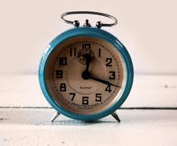
Alarm Clock
Notes:
What about AM and PM?

Slide 11
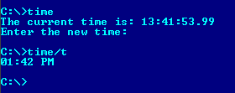
DOS TIME
Notes:
Command option for new command whether it is required or not? Cumbersome
It was good for CS but not for all general public

Slide 12
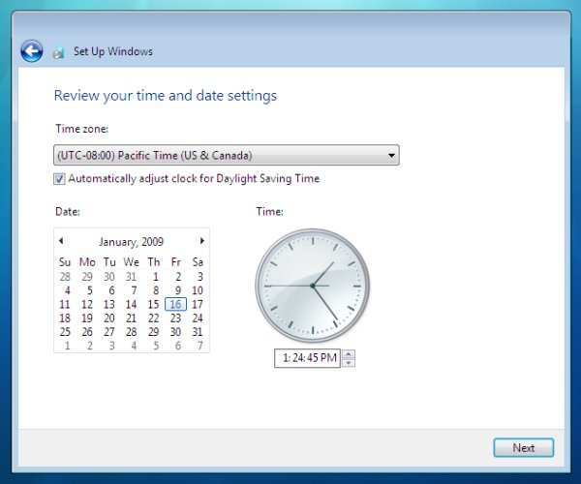
Why Study HCI – Software Perspective

Slide 13
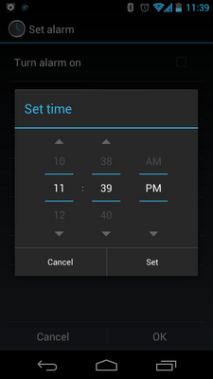
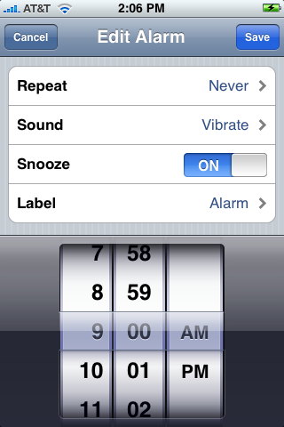
Smart Phone Clock

Slide 14
Don Norman’s Door Example
A classic book. Read it!
I will share its pdf today.
Main Point: no one reads manuals, so things should be designed so that manuals are not needed
BTW what is wrong with the kettle on the book cover?
Notes:
Design of general use thing must be special. No one read the manual so the design must be self descriptive.

Slide 15
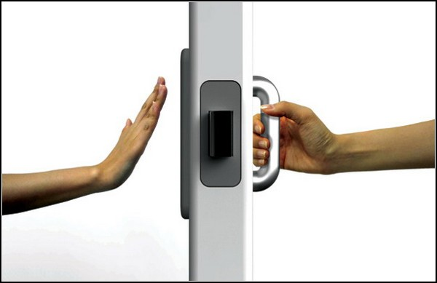
Don Norman’s Door Example
A plate naturally says “ push me” and a handle naturally says “pull me “

Slide 16
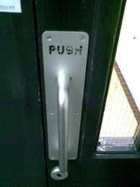
Don Norman’s Door Example
When Don Norman’s advice is not followed
Notes:
Naturally handle is for pull
Instruction less.

Slide 17
The HUMAN

Slide 18
Vision
Two stages in vision
• physical reception of stimulus
• processing and interpretation of stimulus
Notes:
Human factor. To whom you are looking stimulus…. Looking for a friend after a long time

Slide 19
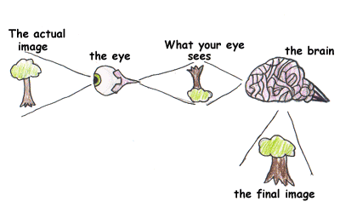
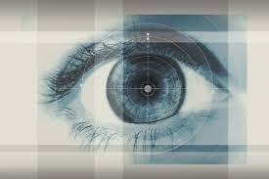
The Eye - physical reception
mechanism for receiving light and transforming it into electrical energy
light reflects from objects
images are focused upside-down on retina
retina contains rods for low light vision and cones for colour vision
ganglion cells (brain!) detect pattern and movement
Notes:
Light fall on object and once light is reflected and we can see. Brain work as mirror and video camera rod light: dark light open, sharp contract

Slide 20
Interpreting the signal
Size and depth
visual angle indicates how much of view object occupies (relates to size and distance from eye)
visual acuity is ability to perceive detail (limited)
familiar objects perceived as constant size (in spite of changes in visual angle when far away)
Notes:
Keep running and looking below the ball to get it caught. If the vision calculation is wrong the ball might drop somewhere.
You are familiar with ball and you are perceiving the old/big size when something new like plane first bird then plane then specific plane
Idea changes when the distance is reduced

Slide 21
Interpreting the signal (cont)
Brightness
subjective reaction to levels of light
affected by luminance of object
measured by just noticeable difference
Colour
made up of hue, intensity, saturation
cones sensitive to colour wavelengths
blue acuity is lowest (visibility)
8% males and 1% females colour blind
How to Design for Color Blindness ?
Notes:
3 components
Hue
Determined by the spectral wavelength
Blue (short)
Green (medium)
Red (long)
150 hues determined by eye
Intensity
Brightness of color
Saturation
Amount of whiteness in the color
7 million colors can be perceived
Light level brightness. Sharp eyes become contract luminance is the intensity of light reflected… mirror more luminance as compared to wood
Can be compared

Slide 22
Interpreting the signal (cont)
The visual system compensates for:
movement
changes in luminance.
Context is used to resolve ambiguity
Optical illusions sometimes occur due to over compensation
Notes:
Visual system adjust itself Context size, speed, height its plane and cannot be bird friend after a long time
Jin booth example
Over compensation (when you are observing more an object)

Slide 23
Optical Illusions
the Ponzo illusion
the Muller Lyer illusion
Notes:
Ponzo suggested that the human mind judges an object's size based on its background. Railway track
The Müller-Lyer illusion is an optical illusion consisting of three stylized arrows. When viewers are asked to place a mark on the figure at the midpoint, they invariably place it more towards the "tail" end.

Slide 24
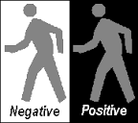
Reading
Several stages:
visual pattern perceived
decoded using internal representation of language
interpreted using knowledge of syntax, semantics, pragmatics
Reading involves saccades and fixations
Perception occurs during fixations
Word shape is important to recognition
Negative contrast improves reading from computer screen
Notes:
Saccades: eyes movement same.
When we are at fix we can perceive
calligrapghy

Slide 25
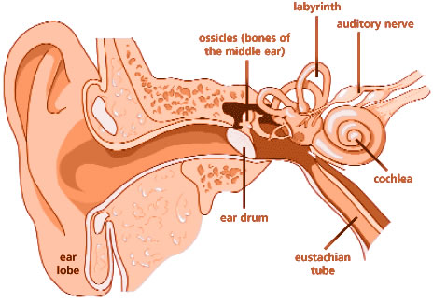
Hearing
Provides information about environment: distances, directions, objects etc.
Physical apparatus:
outer ear – protects inner and amplifies sound
middle ear – transmits sound waves as vibrations to inner ear
inner ear – chemical transmitters are released and cause impulses in auditory nerve
Sound
pitch – sound frequency
loudness – amplitude
timbre – type or quality
Notes:
Mode can be judge as well
Sound, wave and sound
Timbre quality rapping: energize, soothing music: relaxation music

Slide 26
Hearing (cont)
Humans can hear frequencies from 20Hz to 15kHz
Auditory system filters sounds
can attend to sounds over background noise.
for example, the party phenomenon.
Notes:
Hearing system: party and you get a call and recognize

Slide 27
Touch/Haptic
Provides important feedback about environment.
May be key sense for someone who is visually impaired.
Stimulus received via receptors in the skin:
Thermo-receptors – heat and cold
nociceptors – pain
mechanoreceptors – pressure (some instant, some continuous)
Some areas more sensitive than others e.g. fingers.
Kinesthesis - awareness of body position
affects comfort and performance.
Notes:
Hot and cold are sensed by thermo receptor by touching receptor: one who receive information nose is more sensitive
Guesture comfort: height: leg and low knees

Slide 28
Movement
Time taken to respond to stimulus: reaction time + movement time
Movement time dependent on age, fitness etc.
Reaction time - dependent on stimulus type:
visual ~ 200ms
auditory ~ 150 ms
pain ~ 700ms
Increasing reaction time decreases accuracy in the unskilled operator but not in the skilled operator.
Notes:
Decision on catch. Mosquito bite felt a bit late due to 700ms

Slide 29
Movement (cont)
Fitts' Law describes the time taken to hit a screen target:
Mt = a + b log₂(D/S + 1)
where: a and b are empirically determined constants
Mt is movement time
D is Distance
S is Size of target
targets as large as possible distances as small as possible
Notes:
Decision to hit the wicket from far away we take time as compared to shot distance

Slide 30
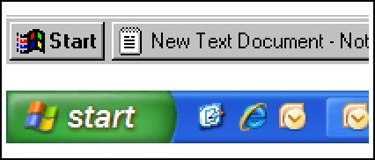
Fitts law
Fitts law is useful for web designers when deciding where to place the next button
Call to Action Buttons , links and other buttons can be strategically placed on websites/apps to increase the chance of clicking. Not only do you want to direct traffic to the right places, but users need to a have a simple and easy experience. Notice how the windows start button almost doubled in size?
Notes:
Popup windows right place with ease: start button size and position

Slide 31
Summary
Today we learnt about,
Basics of Human Computer Interaction
Alarm Clock Example
Dos time versus software application
Don Norman’s Door Example
The human
Information i/o …
visual,
auditory,
haptic,
movement

Slide 32
Video Link
https://www.youtube.com/watch?v=hLGcSLXGyv4&list=PLM8O2eH9K-Mg7UIT1yoHxo6ZNOomyRkO2

