Slide 1
Lecture
Interaction Design
Basics– Part II

Slide 2
Today’s Outline
Basic principles
Grouping, structure, order
Alignment
Use of white space

Slide 3
Basic principles of design
ask
what is the user doing?
think
what information, comparisons, order
design
form follows function
Notes:
Web page hyper text calling

Slide 4
Tools for layout
We have a number of visual tools available to help us suggest to the user appropriate ways to read and interact with a screen or device.

Slide 5
Available tools
grouping of items
order of items
decoration - fonts, boxes etc.
alignment of items
white space between items

Slide 6
Grouping and structure
If things logically belong together, then we should normally physically group them together. This may involve multiple levels of structure.
For example, in the Figure in next slide we can see a potential design for an ordering screen. Notice how the details for billing and delivery are grouped together spatially; also note how they are separated from the list of items actually ordered by a line as well as spatially.
Notes:
Similar logically

Slide 7
Grouping and structure
This reflects the following logical structure:
logically together ⇒ physically together
Billing details:
Name
Address: …
Credit card no
Delivery details:
Name
Address: …
Delivery time
Order details:
item quantity cost/item cost
size 10 screws (boxes) 7 3.71 25.97
…… … … …
Figure: Grouping of related items

Slide 8
Example:

Slide 9
Order of groups and items
think! - what is natural order
should match screen order!
use boxes, space etc.
set up tabbing right!
instructions
beware the cake recipie syndrome! … mix milk and flour, add the fruit after beating them
Notes:
Fix top, variable down side tabbing: tab

Slide 10
Decoration
We can see how the design uses boxes and a separating line to make the grouping clear. Other decorative features like font style, and text or background colors can be used to emphasize groupings.

Slide 11
Example – A microwave control panel
Decoration of different buttons in single layout

Slide 12
Decoration
use boxes to group logical items
use fonts for emphasis, headings
but not too many!!
ABCDEFGHIJKLM
NOPQRSTUVWXYZ
Notes:
Not most bold

Slide 13
Alignment - text
you read from left to right (English and European)
⇒ align left hand side
boring but
readable!
Willy Wonka and the Chocolate Factory
Winston Churchill - A Biography
Wizard of Oz
Xena - Warrior Princess
Willy Wonka and the Chocolate Factory
Winston Churchill - A Biography
Wizard of Oz
Xena - Warrior Princess
fine for special effects but hard to scan
Notes:
signature

Slide 14
Alignment - names
Usually scanning for surnames ⇒ make it easy!
✗
✓
Alan Dix
Janet Finlay
Gregory Abowd
Russell Beale
Dix , Alan
Finlay, Janet
Abowd, Gregory
Beale, Russell
✓
Alan Dix
Janet Finlay
Gregory Abowd
Russell Beale

Slide 15
Alignment - numbers
think purpose!
which is biggest?
532.56 179.3 256.317 15 73.948 1035 3.142 497.6256
Notes:
think the purpose first

Slide 16
Alignment - numbers
visually:
long number = big number
align decimal points
or right align integers
627.865 1.005763 382.583 2502.56 432.935 2.0175 652.87 56.34
Notes:
Numbers vs words alignment is different

Slide 17
Multiple columns
scanning across gaps hard: (often hard to avoid with large data base fields)
sherbert 75 toffee 120 chocolate 35 fruit gums 27 coconut dreams 85

Slide 18
Multiple columns - 2
use leaders
sherbert 75 toffee 120 chocolate 35 fruit gums 27 coconut dreams 85

Slide 19
Multiple columns - 3
or greying (vertical too)
sherbert 75 toffee 120 chocolate 35 fruit gums 27 coconut dreams 85

Slide 20
Multiple columns - 4
or even (with care!) ‘bad’ alignment
sherbert 75 toffee 120 chocolate 35 fruit gums 27 coconut dreams 85

Slide 21
White space - the counter
WHAT YOU SEE

Slide 22
White Space
In typography the space between the letters is called the counter.
In painting this is also important and artists may focus as much on the space between the foreground elements such as figures and buildings as on the elements themselves.
Notes:
Space between alphabet, word or lines

Slide 23
White space - the counter
WHAT YOU SEE
THE GAPS BETWEEN

Slide 24
White Space
Often the shape of the counter is the most important part of the composition of a painting and in calligraphy and typography the balance of a word is determined by giving an even weight to the counters.
If one ignores the ‘content’ of a screen and instead concentrates on the counter – the space between the elements – one can get an overall feel for the layout.
Notes:
Without ready say too much content

Slide 25
Space to separate
Notes:
3 element seperated

Slide 26
space to structure
Notes:
Can differerntiate

Slide 27
Space to highlight

Slide 28
White Space Animation

Slide 29
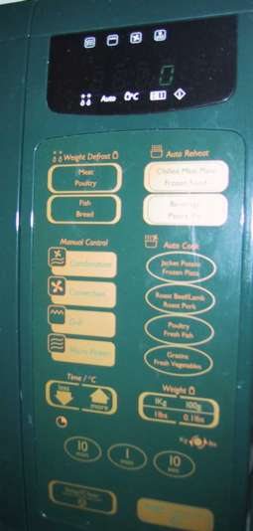
We covered so far: Physical controls
grouping of items
defrost settings
type of food
time to cook
defrost settings
type of food
time to cook

Slide 30
Physical controls
grouping of items
order of items
1) type of heating
1
2) temperature
3) time to cook
2
4) start
3
4

Slide 31
Physical controls
grouping of items
order of items
decoration
different colours for different functions
lines around related buttons (temp up/down)

Slide 32
Physical controls
grouping of items
order of items
decoration
alignment
centered text in buttons easy to scan ?

Slide 33
physical controls
grouping of items
order of items
decoration
alignment
white space
(gaps to aid grouping)
Notes:
White space between different groups to aid

Slide 34
User action and control
entering information
knowing what to do
affordances

Slide 35
Entering Information
Some of the most complicated and difficult screen layouts are found in forms-based interfaces and dialog boxes is to design for entering information.
In each case the screen consists not only of information presented to the user, but also of places for the user to enter information or select options.

Slide 36
Entering information
Name:
Alan Dix
forms, dialogue boxes
presentation + data input
similar layout issues
alignment - N.B. different label lengths
logical layout
use task analysis
groupings
natural order for entering information
top-bottom, left-right (depending on culture)
set tab order for keyboard entry
Address:
Lancaster
✓
Name:
Alan Dix
Address:
Lancaster
?
Name:
Alan Dix
Address:
Lancaster
Notes:
Task analysis confirm at down

Slide 37
Knowing what to do
Some elements of a screen are passive, simply giving you information; others are active, expecting you to fill them in, or do something to them.
It is often not even clear which elements are active, let alone what the effect is likely to be when you interact with them!

Slide 38
Knowing what to do
what is active what is passive
where do you click
where do you type
consistent style helps
e.g. web underlined links
labels and icons
standards for common actions
language – bold = current state or action

Slide 39
Affordances
These are especially difficult problems in multimedia applications where one may deliberately adopt a non-standard and avant-garde style.
How are users supposed to know where to click?
The psychological idea of affordance says that things may suggest by their shape and other attributes what you can do to them.
Notes:
Shape or attitude may sugguest action

Slide 40
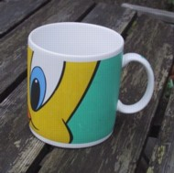
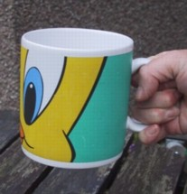
Affordances
psychological term
for physical objects
shape and size suggest actions
pick up, twist, throw
also cultural – buttons ‘afford’ pushing
for screen objects
button–like object ‘affords’ mouse click
physical-like objects suggest use
culture of computer use
icons ‘afford’ clicking
or even double clicking … not like real buttons!
mug handle
‘affords’ grasping
Notes:
Buttons or knob\
Culture: every body know click or double clicking

Slide 41
Appropriate appearance
presenting information
aesthetics and utility
colour and 3D
localisation & internationalisation

Slide 42
Presenting information
purpose matters
sort order (which column, numeric alphabetic)
text vs. diagram
scatter graph vs. histogram
use paper presentation principles!
but add interactivity
softens design choices
e.g. re-ordering columns
‘dancing histograms’ (chap 21)
name
name
size
size
size
chap1
chap10
chap11
chap12
chap13
chap14
…
chap10
chap5
chap1
chap14
chap20
chap8
…
17
12
51
262
83
22
…
12
16
17
22
27
32
…

Slide 43
Aesthetics and utility
aesthetically pleasing designs
increase user satisfaction and improve productivity
beauty and utility may conflict
mixed up visual styles ⇒ easy to distinguish
clean design – little differentiation ⇒ confusing
backgrounds behind text … good to look at, but hard to read
but can work together
e.g. the design of the counter
in consumer products – key differentiator (e.g. iMac)
Notes:
Beautiful or utility

Slide 44
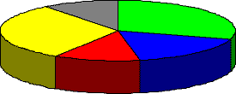
Colour and 3D
both often used very badly!
colour
older monitors limited palette
colour over used because ‘it is there’
beware colour blind!
use sparingly to reinforce other information
3D effects
good for physical information and some graphs
but if over used … e.g. text in perspective!! 3D pie charts
Notes:
What this presenting

Slide 45
Bad use of colour
over use - without very good reason (e.g. kids’ site)
colour blindness
poor use of contrast
do adjust your set!
adjust your monitor to greys only
can you still read your screen?

Slide 46
Grey

Slide 47
Cross countries and cultures
localisation & internationalisation
changing interfaces for particular cultures/languages
globalisation
try to choose symbols etc. that work everywhere
simply change language?
use ‘resource’ database instead of literal text … but changes sizes, left-right order etc.
deeper issues
cultural assumptions and values
meanings of symbols
e.g tick and cross … +ve and -ve in some cultures … but … mean the same thing (mark this) in others
Notes:
Japan o good
Left right order

Slide 48
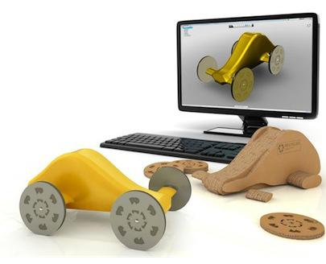
Prototyping
A prototype is an early sample, model, or release of a product built to test a concept or process or to act as a thing to be replicated or learned from. It is a term used in a variety of contexts, including semantics, design, electronics, and software programming. A prototype is designed to test and trial a new design to enhance precision by system analysts and users. Prototyping serves to provide specifications for a real, working system rather than a theoretical one. In some workflow models, creating a prototype (a process sometimes called materialization) is the step between the formalization and the evaluation of an idea.
Notes:
A prototype is an early sample, model, or release of a product built to test a concept or process or to act as a thing to be replicated or learned from. It is a term used in a variety of contexts, including semantics, design, electronics, and software programming. A prototype is designed to test and trial a new design to enhance precision by system analysts and users. Prototyping serves to provide specifications for a real, working system rather than a theoretical one.In some workflow models, creating a prototype (a process sometimes called materialization) is the step between the formalization and the evaluation of an idea.

Slide 49
Iteration and Prototyping
Because human situations are complex and designers are not infallible it is likely that our first design will not be perfect! For this reason, almost all interaction design includes some form of iteration of ideas.
This often starts early on with paper designs and storyboards being demonstrated to colleagues and potential users.

Slide 50
Iteration and Prototyping
Later in the design process one might use mockups of physical devices or tools such as Shockwave or Visual Basic to create prototype versions of software.

Slide 51
Iteration and prototyping
getting better …
and starting well...

Slide 52
Prototyping
you never get it right first time
if at first you don’t succeed …
OK?
design
prototype
evaluate
done!
re-design

Slide 53
Formative Vs Summative
Any of these prototypes, whether paper-based or running software, can then be evaluated to see whether they are acceptable and where there is room for improvement.
This sort of evaluation, intended to improve designs, is called formative evaluation.
This is in contrast to summative evaluation, which is performed at the end to verify whether the product is good enough.

Slide 54
Pitfalls of prototyping
moving little by little … but to where
Malverns or the Matterhorn?
1. need a good start point
2. need to understand what is wrong

Slide 55
Design
A really good designer might guess a good initial design based on experience and judgment. However, the complexity of interaction design problems means that this insight is hard.
Another approach, very common in graphical design, is to have several initial design ideas and drop them one by one as they are developed further.

Slide 56
Summary
We have seen that design in HCI is not just about creating devices or software, but instead is about the whole interaction between people, software and their environment.
Because of this it is good to see the product of design not just as the obvious artifacts but as the whole intervention that changes the existing situation to a new one.

