Slide 1
Human Computer Interaction
Waqas Swati
25 March 2019
1100-1400Hrs
Spring 2019 Lecture#6

Slide 2
Need Finding
Week 4 Waqas Swati

Slide 3
Lecture Plan
Need Finding
The by-the-book method
break
My personal preferences

Slide 4
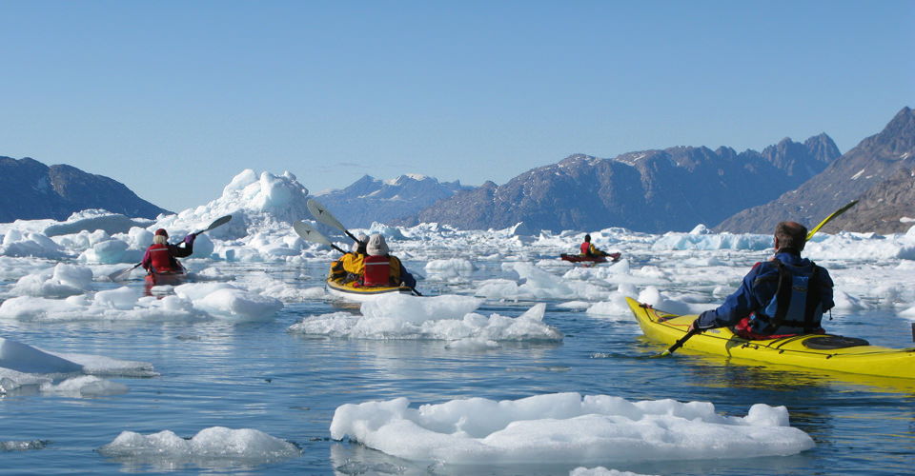
Suppose You Want to Canoe in Greenland

Slide 5
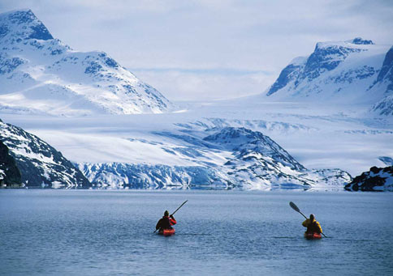

Slide 6
What would be a good way to keep track of the coast line?

Slide 7
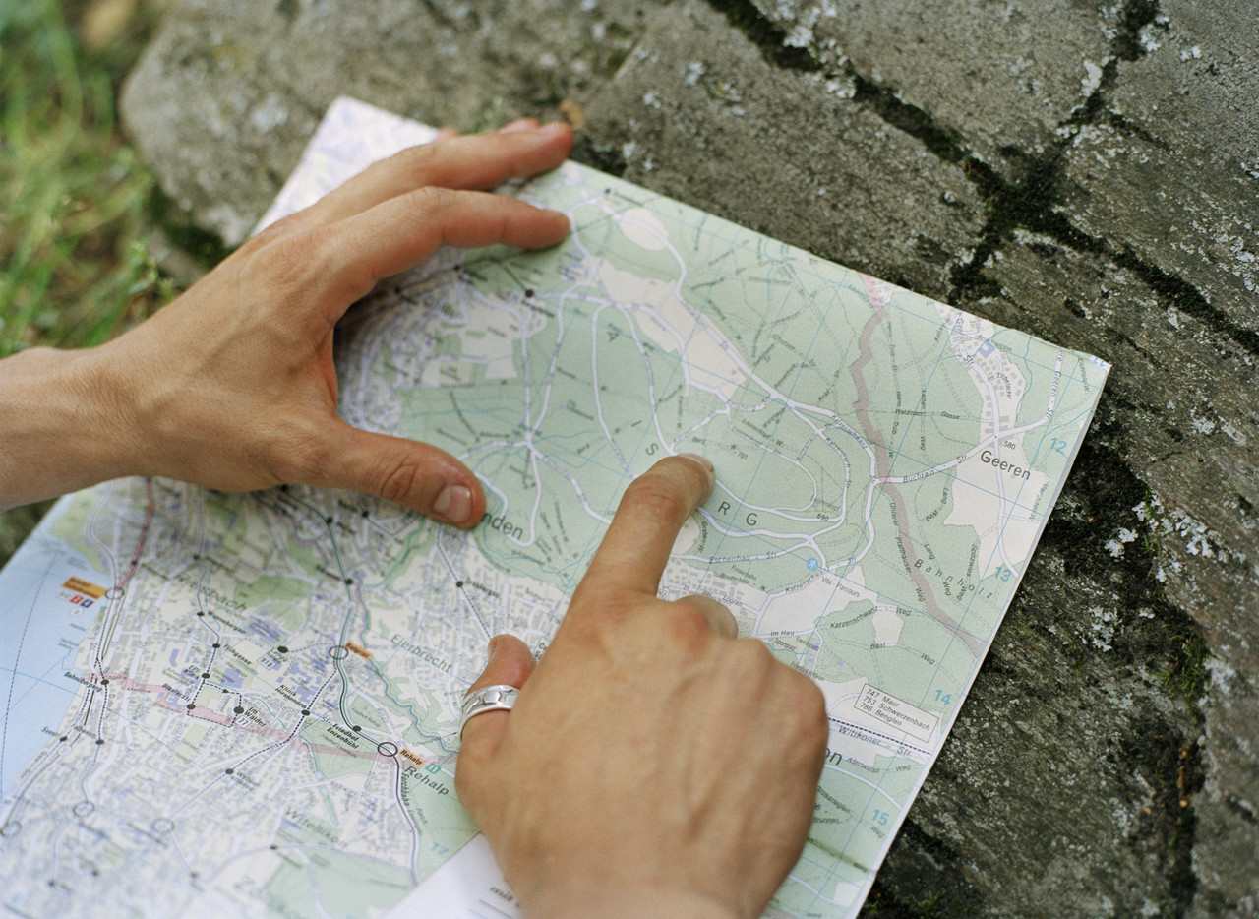
A Paper Map?

Slide 8
A Paper Map?

Slide 9
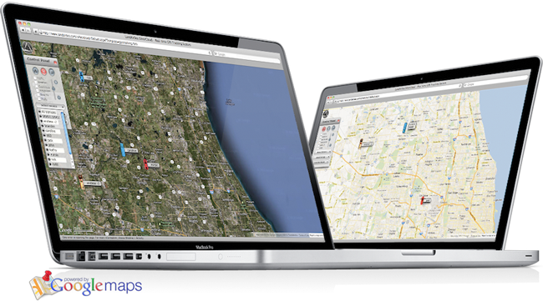
Maps Program on Laptop?

Slide 10
Maps Program on Laptop?

Slide 11
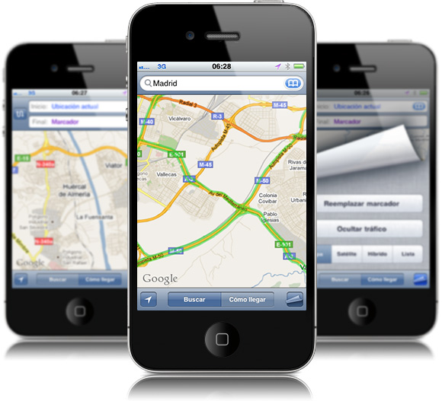
A Maps Program on Mobile?

Slide 12
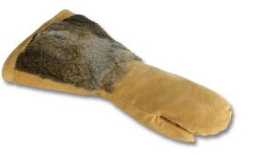
Can You Use a Mobile?

Slide 13
A Maps Program on Mobile?

Slide 14
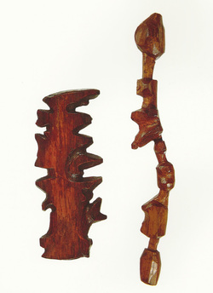
Is this a Good Solution?
You can feel it inside the mittens
No need for WiFi etc
No harm done if it gets wet
It can even float in the water
Used by Inuit’s since centuries

Slide 15
Good design takes context into account

Slide 16
Participant Observation

Slide 17
Step into Shoes of the User
You are most probably different from the user
It is not possible that you design a system according to needs of the user
You need to observe the life of the user before you can design a system that would be useful to your user

Slide 18
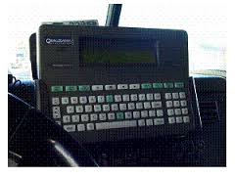
Trucker’s Example
The makers of a GPS system for truckers observed that their system is underutilized
WHY??? What do you think

Slide 19
Trucker’s Example
On closer examination
Truckers have large fingers
They wear gloves a lot
HCI experts recommend deep understanding of users

Slide 20
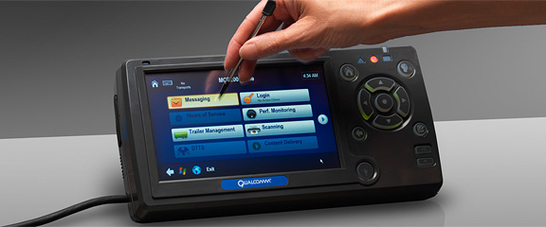
Redesigned :large screen and stylus

Slide 21
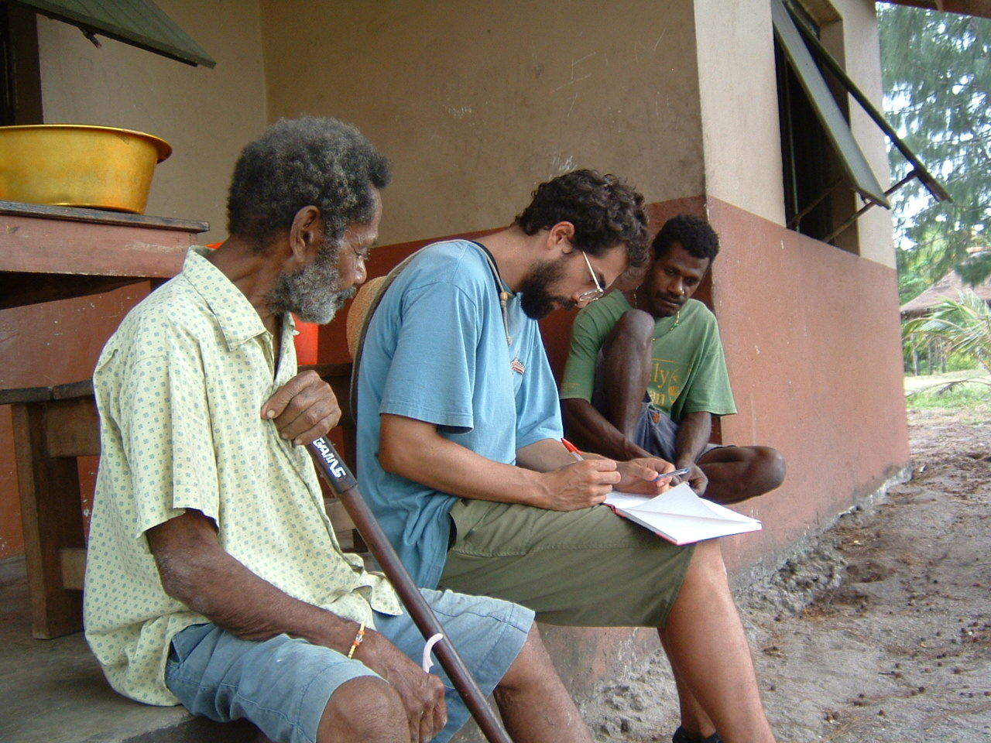
Inspiration
Ethnography
Ethno =folk
Graphy=write
Systematic study of a group of people from the point of view of the subject

Slide 22
Things to Understand
What do people do now
What are their goals and motivations
Similarities and differences among the potential users

Slide 23
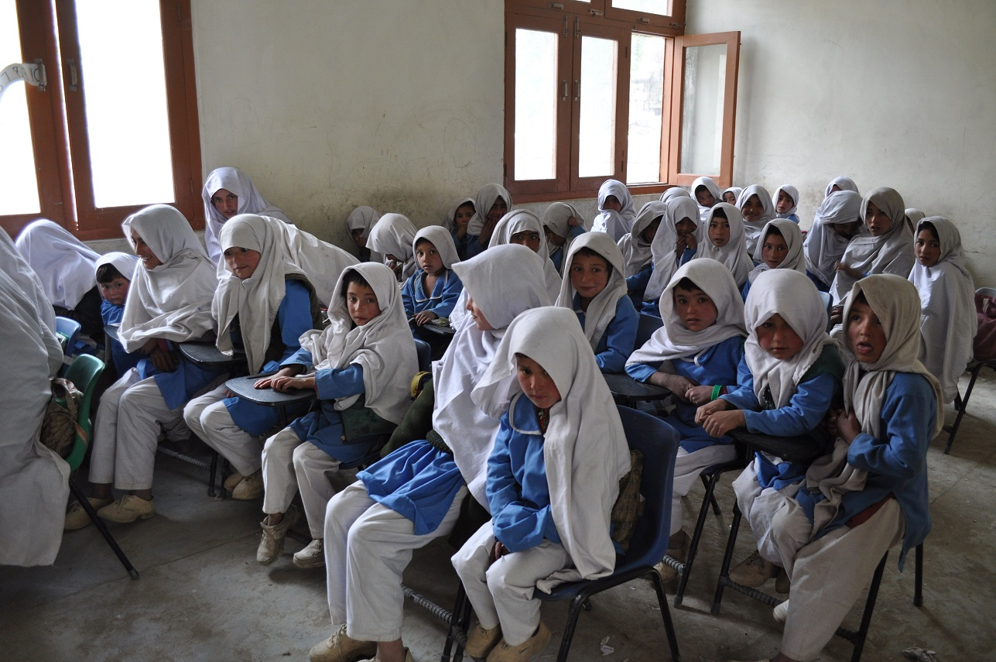
Will 1 educational software work?

Slide 24
Things to Observe
How they use their current systems
Can be computer based or not
Especially look out for the errors
They are the places the software can be improved
HCI people believe that errors are because the system is not designed well
Users are never dumb

Slide 25
Interview Potential Users
You must interview people who are potential users of your system
They can be :
Current users of a software system:
The problems they face are potential places to improve
Not use a software system
Goal: broaden the number of user
Try to find out they barriers they see and their goals
Who should you interview if you are redesigning CuOnline?
Notes:
3 types of user
1 students
2 teachers
3 Management

Slide 26
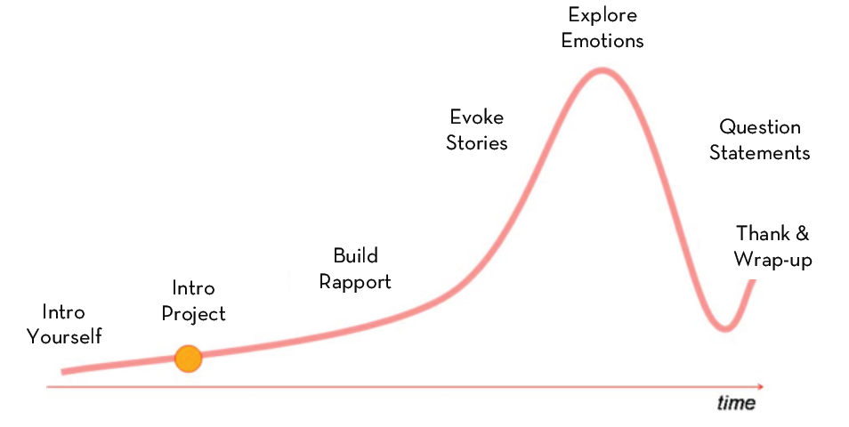
How to Spend Time During an Interview

Slide 27
Some Tips
Ask Questions neutrally
“What do you think about shopping “ is better than “don’t you think shopping is great”
Look for inconsistencies
What people do and what they say are usually different
Watch for the body Language
Don’t ask yes/no questions
You need stories, even if they are not true. They tell you about how they think about the world

Slide 28
Conclusion
Not observing your users or customers can be disaster.
This was experienced by Walmart in 2009
Asked customers “Would you like our aisles to be less cluttered”…answers were yes
They made it less cluttered and lost more than 1 billion dollar
Mistake
The asked instead of observing
They asked a “leading question”

Slide 29
An Example of Participant Observation

Slide 30
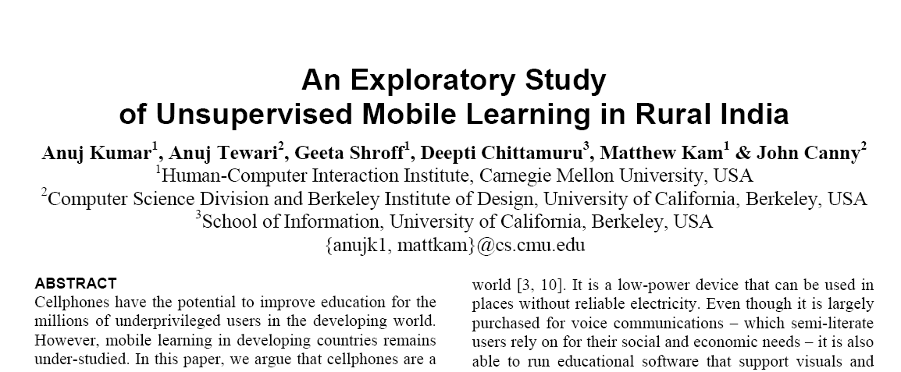
It is From a CHI Paper

Slide 31
What Was This Study About?
Mango Area in UP
Two Villages
Aim: Can Cell phone be used for learning?
Social Context
Understand lives of kids in villages
When do they get time
Understand problems

Slide 32
The Experimental Setup
Mobile phones were given to 18 children from both genders
Lower caste + Upper Caste
Phones loaded with educational games
Logs were maintained
Interviews and log data to come up with result

Slide 33
Major Segments
High Caste
Boys
Keep an eye in fields
Good time to play learning game
Girls
Not allowed to play outside in afternoon
Low Caste
Boys
Work in fields
Cannot use phone
Girls
Play outside in afternoon
Note : In order to learning to take place they need a non trivial time in which they can use the cell phone
All kids have around 1 hour before bedtime in which they can play with their cell phone

Slide 34
My Own Thoughts

Slide 35
I don’t really Interviewing
Why
I feel uncomfortable talking to new people
I feel people will try be uncomfortable as well
To find the reality I have to spend a lot of time
And still not really know the reality
I personally prefer:
My own needs or the needs of my social circle
Need discovery through data

Slide 36
The story in the Data

Slide 37
We Leave Footprints Every Where

Slide 38
Examples
ATM History
Facebook gives us our friends
Linkedin gives us our professional connections
Call History
Apps and software log usage pattern
OS logs
If such data is available they give a more true picture

Slide 39
Lets now look into some example
Most of it my mentors work ☺

Slide 40
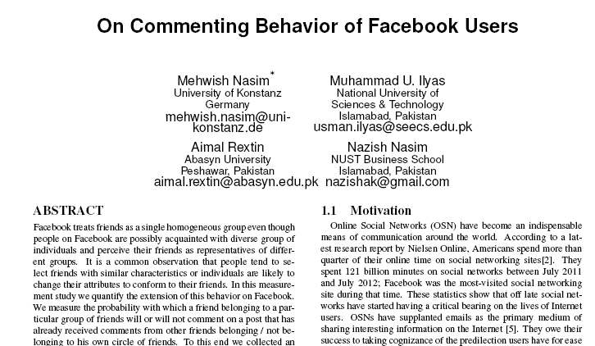
Example 1
Based on a my observation that I tend to avoid conversation in FB if I don’t know the people involved

Slide 41
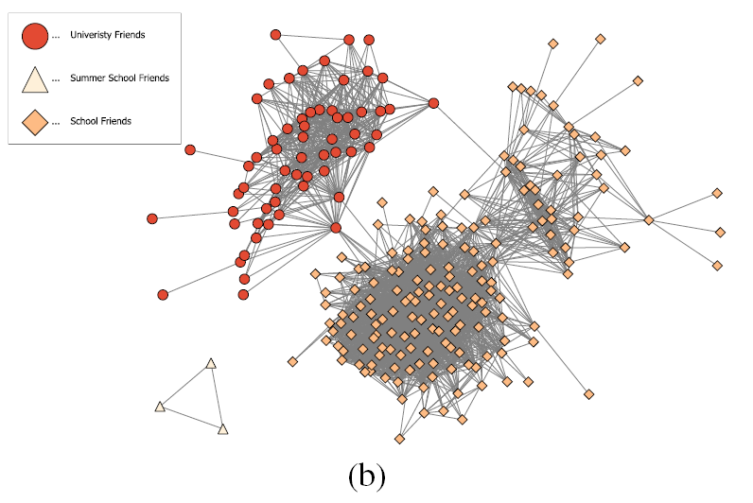
Social Network of One User

Slide 42
What did We Find?
The guess was right. People do tend to avoid conversation in which they are not friends with the people involved
They tend to jump in conversations between their own friends
Indicates the need to redesign the FB interface , at least in the Pakistani cultural context
Privacy might be better assured
Save from possible embarrassment

Slide 43
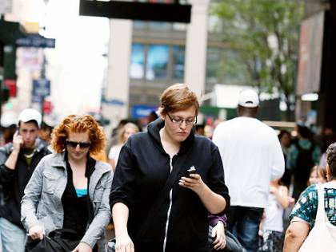
Example 2
Walk and Type
Speed reduced
Error Increases
Reason
Jerks experienced by body
Distractions : avoid bumping to someone

Slide 44
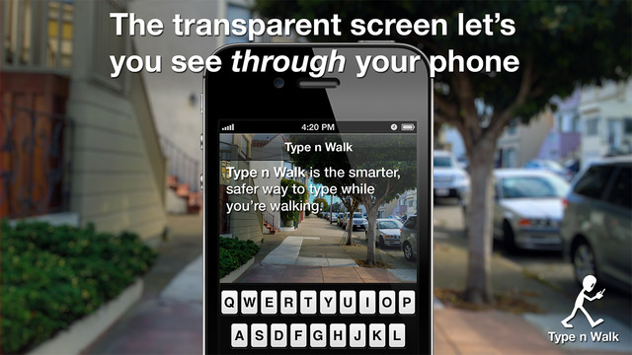
A Commercial Product

Slide 45
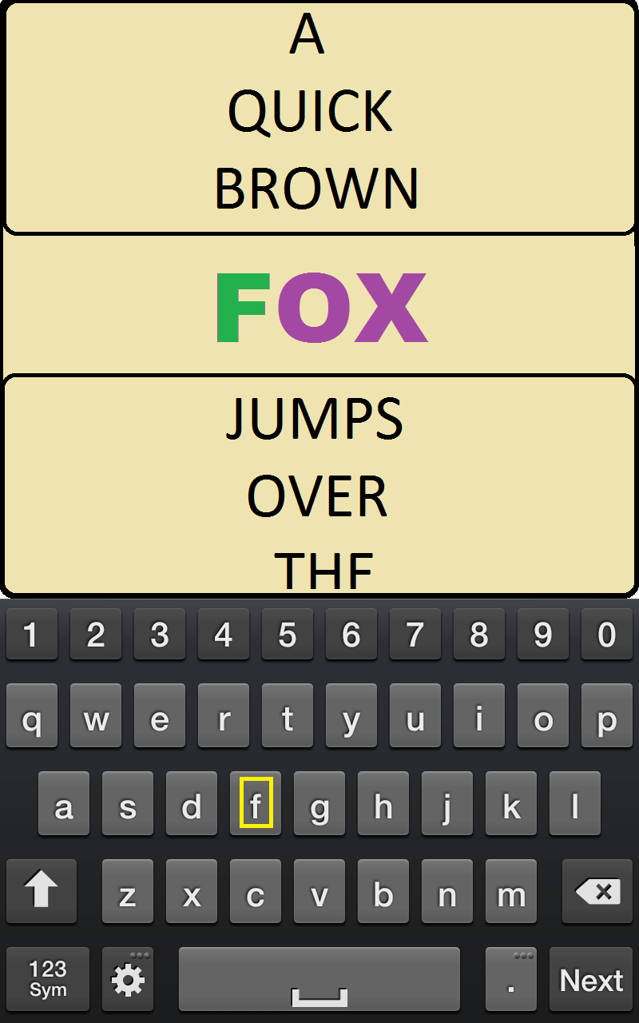
How to Measure the Speed and Error Rate

Slide 46
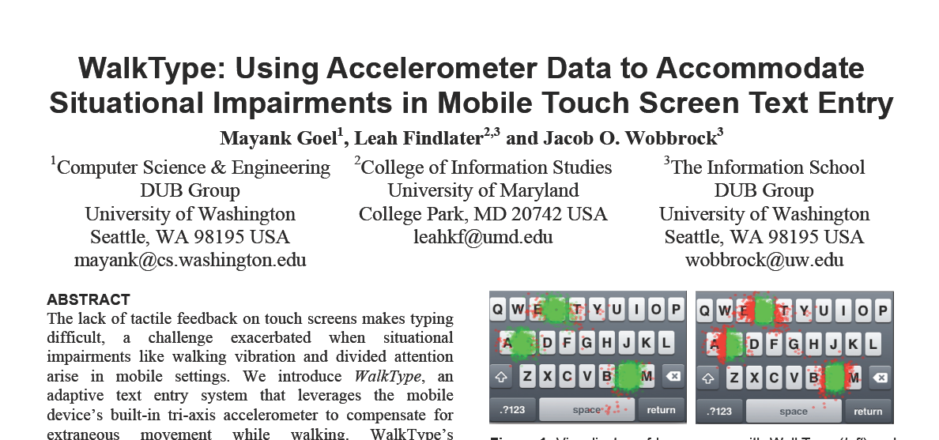

Slide 47
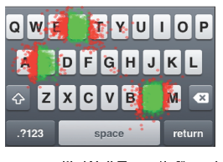
Where are the Errors?

Slide 48
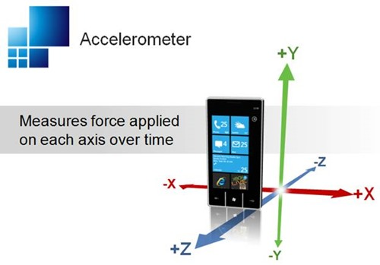
Accelerometer

Slide 49
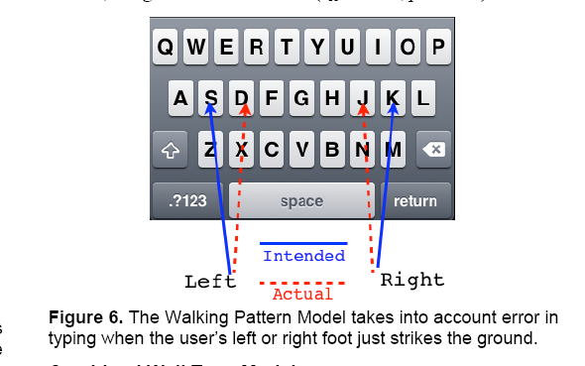
The Solution

Slide 50
Personal Intuition

Slide 51
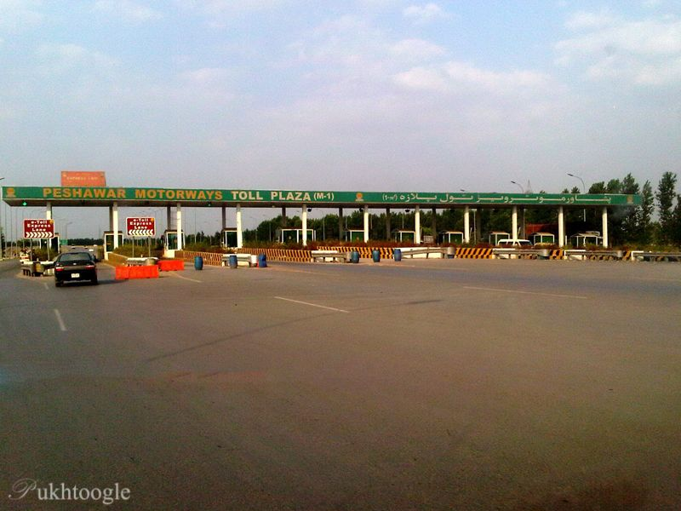
Example
Called driver 15 mins
away
Always had to search him
Didn’t want to make him a “fav” because I called him once a week
But I called him around 8:45 am every Monday for 1 year

Slide 52
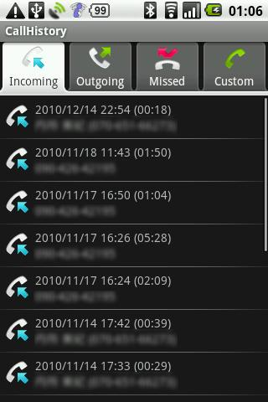
Call Log Has The Traces
Android stores your calling activity for 1 month
Built an app to capture this data.
Wanted to check the hypothesis
“Do I and other people really call different ppl at different time?”

Slide 53
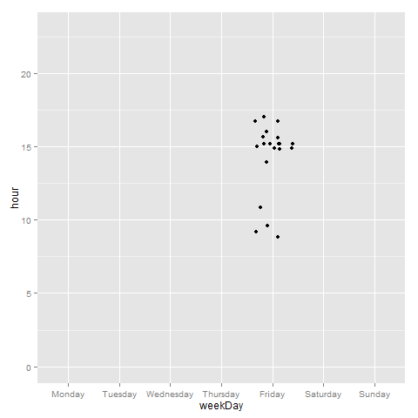
My Results

Slide 54
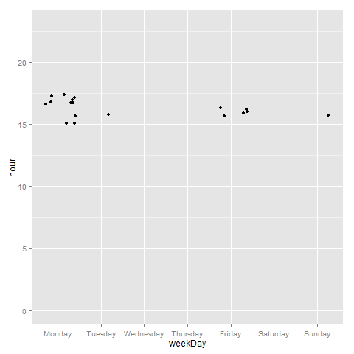

Slide 55
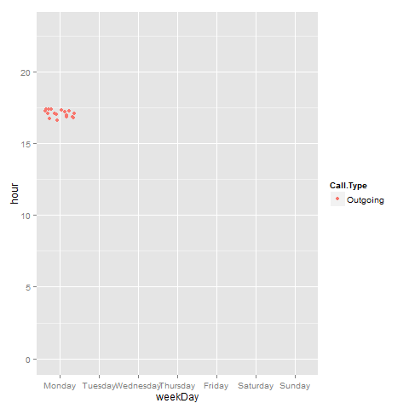

Slide 56
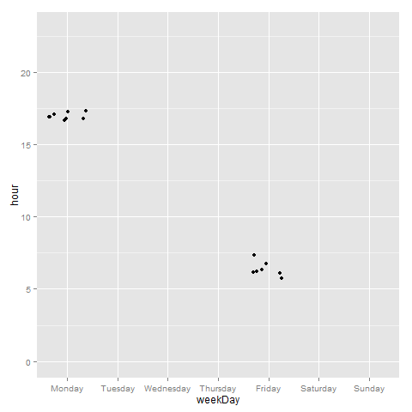

Slide 57
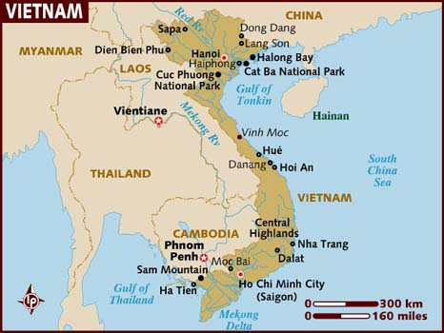
Example
I once went to Vietnam

Slide 58
My Flight
My flight was from Bangkok →Hanoi→ Nha Trang
If I had Bangkok →Ho Chi Minh City→Nha Trang then I would have saved 3 hours in one direction

Slide 59
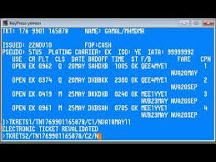
Could I have Avoided It?
With a Travel Agent.. Hmm.. Doubt it

Slide 60
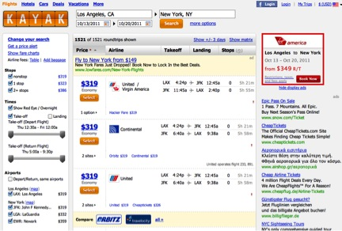
How If I Reserved Myself ?

Slide 61
THE END…!!

Slide 72
What Do I need?
A way to represent graphically all flight data
Data Visualization
Human visual system is highly advanced
Large portion of brain
Great in detecting patterns
Very quick

Slide 73
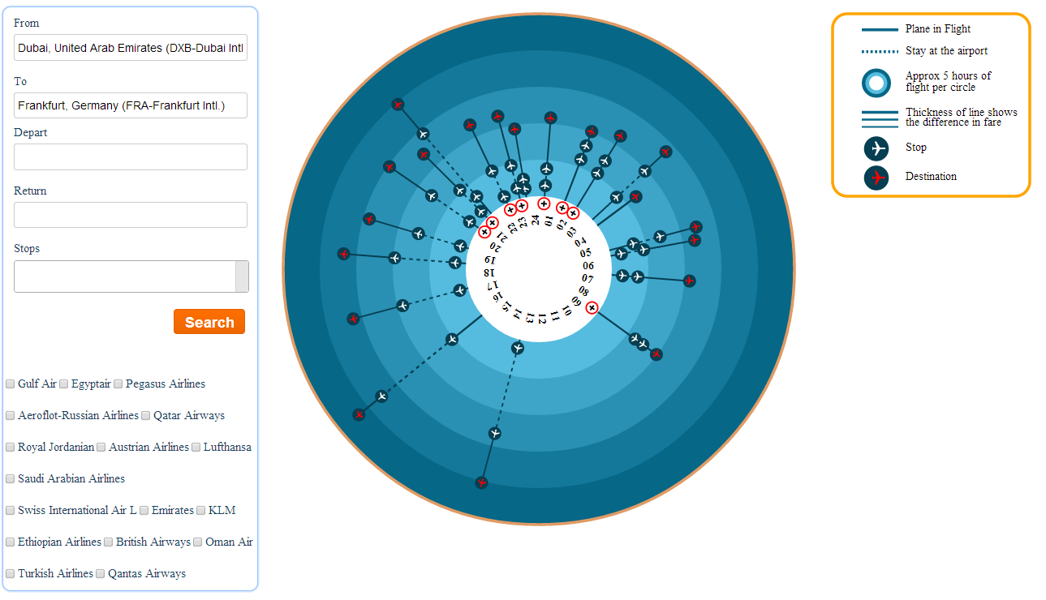
My Solution

Slide 74
Evaluation
22 people
As good as other when user wants to optimize one thing like fate
TravelGraph better when you want to optimize multiple things
Find the graph with the lowest fare and lowest transit time

