Slide 1
HUMAN COMPUTER INTERACTION
LECTURE 5
Interaction

Slide 2
Revision
Any question from previous lecture?

Slide 3
Today’s Outline
We will cover today,
  Interaction models
    translations between user and system
  ergonomics
    physical characteristics of interaction

Slide 4
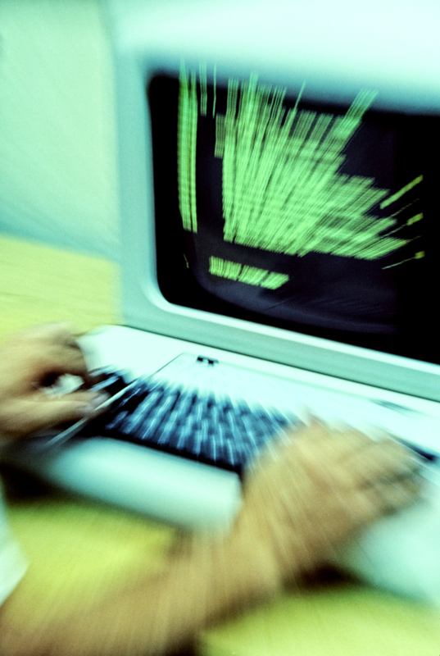
What is interaction?
communication
user  system
but is that all … ?
Notes:
2 participants user and the system

Slide 5
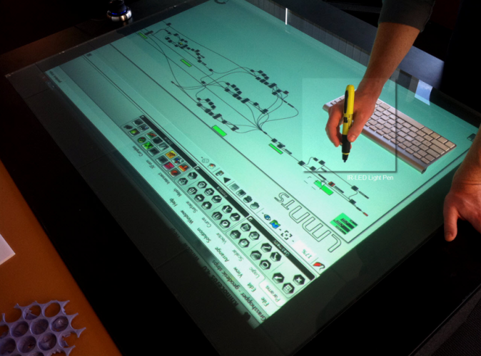
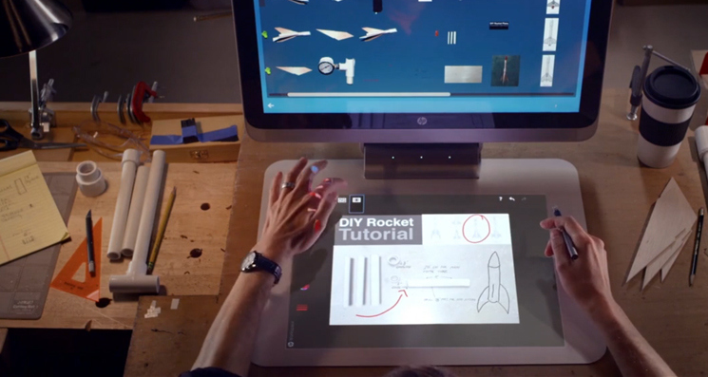
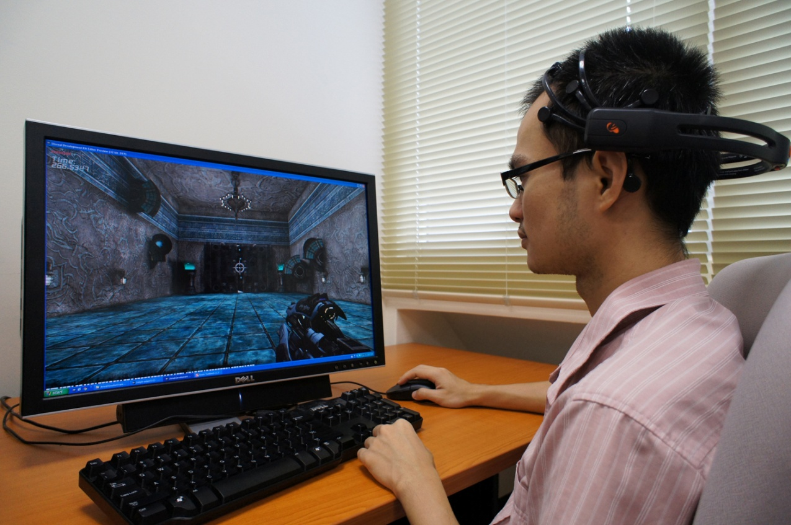
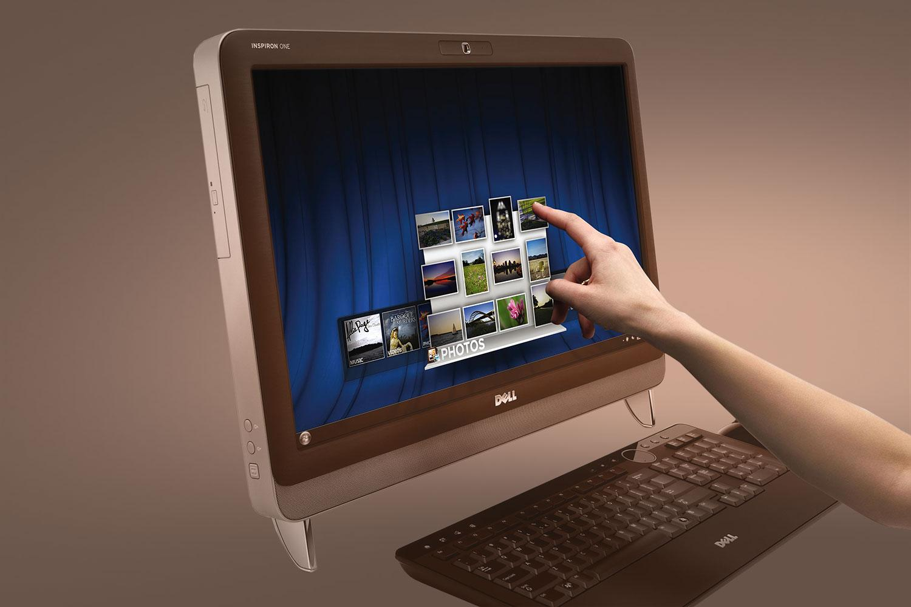
Different types of interaction

Slide 6
Models of interaction
Terms of interaction
Norman model

Slide 7
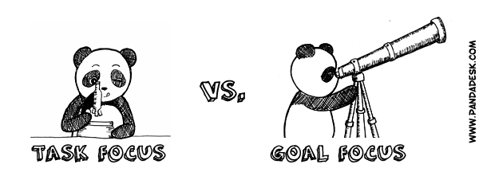
Terms of interaction
Traditionally, the purpose of an interactive system is to aid a user in accomplishing goals from some application domain.
Tasks are operations to manipulate the concept of domain.
Notes:
A domain
defines an area of expertise and knowledge in some real-world activity
Some examples of domains are graphic design, authoring and process control in a factory.

Slide 8
Some terms of interaction
Domain – the area of work under study
  e.g. graphic design
Goal – what you want to achieve
  e.g. create a solid red triangle
Task – how you go about doing it
– ultimately in terms of operations or actions
  e.g. … select fill tool, click over triangle
Notes:
Hr system
goal enteries and reports

Slide 9
Domain or Problem Domain
A problem domain is the area of expertise or application that needs to be examined to solve a problem.
A problem domain is simply looking at only the topics of an individual's interest, and excluding everything else.
  For example, when developing a system to measure good practice in medicine, carpet drawings at hospitals would not be included in the problem domain. In this example the domain refers to relevant topics solely within the delimited area of interest: medicine.
Notes:
House paint… domain is house paint
graphic design CAD, NOT FOCUS ON VIDEO

Slide 10
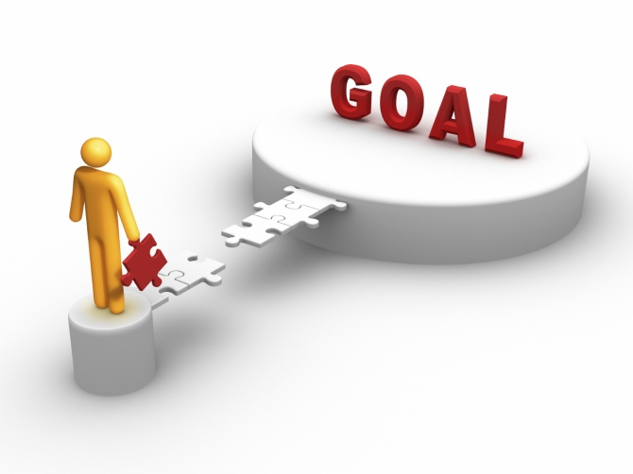
Goal
A goal is a desired result a person or a system envisions, plans and commits to achieve a personal or organizational desired end-point in some sort of assumed development.
Many people endeavor to reach goals within a finite time by setting
deadlines.
Notes:
GOAL in Hockey vs in football
hockey from d and opponent
football from anywhere any one.

Slide 11
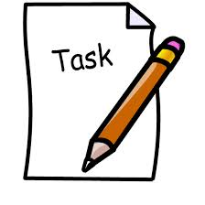
Task
A task is an activity that needs to be accomplished within a defined period of time or by a deadline to work towards work-related goals.
A task can be broken down into assignments which should also have a defined start and end date or a deadline for completion.
Notes:
Task move to opponent side, but got attack from opponent then defend

Slide 12
Donald Norman’s model
Seven stages
  user establishes the goal
  formulates intention
  specifies actions at interface
  executes action
  perceives system state
  interprets system state
  evaluates system state with respect to goal
Norman’s model concentrates on user’s view of the interface
Notes:
Focus on user perspective
Decide the goal
how we will go through
Interface related action
Execution
what system state should be
Real check system state
Evaluate the state

Slide 13

execution/evaluation loop
    user establishes the goal
    formulates intention
    specifies actions at interface
    executes action
    perceives system state
    interprets system state
    evaluates system state with respect to goal
goal
execution
evaluation
system
Notes:
You have to evaluate the execution in terms of these factors

Slide 14
execution/evaluation loop
    user establishes the goal
    formulates intention
    specifies actions at interface
    executes action
    perceives system state
    interprets system state
    evaluates system state with respect to goal
goal
execution
evaluation
system
Notes:
Establish the goal first
What do we want to do ( as a company user requirement from HR system: record leave increment pay etc ) my goal is complete system from hr

Slide 15
execution/evaluation loop
    user establishes the goal
    formulates intention
    specifies actions at interface
    executes action
    perceives system state
    interprets system state
    evaluates system state with respect to goal
goal
execution
evaluation
system
Notes:
Time for execution
Formulating the intention
different record for mgt leave salary etc
personal data is for hr, SALARY for account dept
Hr hr interface, management mgt interface
add delete

Slide 16
execution/evaluation loop
    user establishes the goal
    formulates intention
    specifies actions at interface
    executes action
    perceives system state
    interprets system state
    evaluates system state with respect to goal
goal
execution
evaluation
system
Notes:
Checked that all record entered?
If yes, test, deploy, compare with manual…. If working fine, generating reports etc evaluate outstanding
if not check the goal and intention again

Slide 17
Using Norman’s model
Some systems are harder to use than others
Gulf of Execution
  user’s formulation of actions
  ≠ actions allowed by the system
Gulf of Evaluation
  user’s expectation of changed system state
  ≠ actual presentation of this state
Notes:
user expectation is not up-to the mark
EXE: system not allowing some actions (accounts to account, hr to hr)
EVA: perceive at your own
Little water definition
"The basic idea is simple. To get something done, you have to start with some notion of what is wanted—the goal that is to be achieved. Then, you have to do something to the world, that is, take action to move yourself or manipulate someone or something. Finally, you check to see that your goal was made. So there are four different things to consider: the goal, what is done to the world, the world itself, and the check of the world. The action itself has two major aspects: doing something and checking. Call these execution and evaluation." [Norman, p. -46.]

Slide 18
What is Ergonomics?
“The scientific discipline concerned with understanding of interactions among humans and other elements of a system, and the profession that applies theory, principles, methods and data to design in order to optimize human well-being and overall system performance”.
Ergonomics means
“fitting the job to the worker”
From the Greek
Ergo = Work
Nomos = Laws
Source : International Ergonomics Association (IEA) in 2000
Notes:
Focus on human interacting with the system(computer, paint) for human well being to improve performance
job must be according need of user, worker
construction: helmet, torch, safety for well being

Slide 19
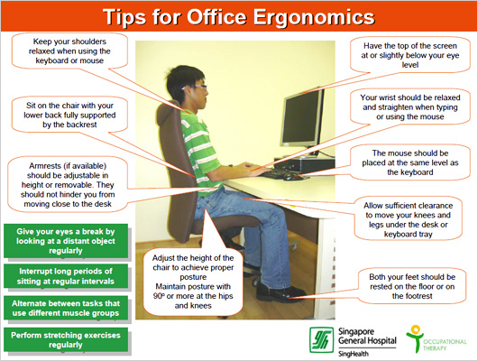

Slide 20
Common interaction styles
command line interface
menus
natural language
question/answer and query dialogue
form-fills and spreadsheets
WIMP
point and click
three–dimensional interfaces

Slide 21
Command line interface
Way of expressing instructions to the computer directly
  function keys, single characters, short abbreviations, whole words, or a combination
suitable for repetitive tasks
better for expert users than novices
offers direct access to system functionality
command names/abbreviations should be meaningful!
Notes:
Press a command key ctrl c and ctrl v

Slide 22
Menus
Set of options displayed on the screen
Options visible
  less recall - easier to use
  rely on recognition so names should be meaningful
Notes:
Less recognition over recall
selection

Slide 23
Natural language
Familiar to user
speech recognition or typed natural language
Problems
  vague
  ambiguous
  hard to do well!
Notes:
Live or life

Slide 24
Query interfaces
Question/answer interfaces
  user led through interaction via series of questions
  suitable for novice users but restricted functionality
  often used in information systems
Query languages (e.g. SQL)
  used to retrieve information from database
  requires understanding of database structure and language syntax, hence requires some expertise

Slide 25
Form-fills
Primarily for data entry or data retrieval
Screen like paper form.
Data put in relevant place
Requires
  good design
  obvious correction
  facilities

Slide 26
Spreadsheets
first spreadsheet VISICALC, followed by Lotus 1-2-3
MS Excel most common today
sophisticated variation of form-filling.
  grid of cells contain a value or a formula
  formula can involve values of other cells
  e.g. sum of all cells in this column
  user can enter and alter data spreadsheet maintains consistency

Slide 27
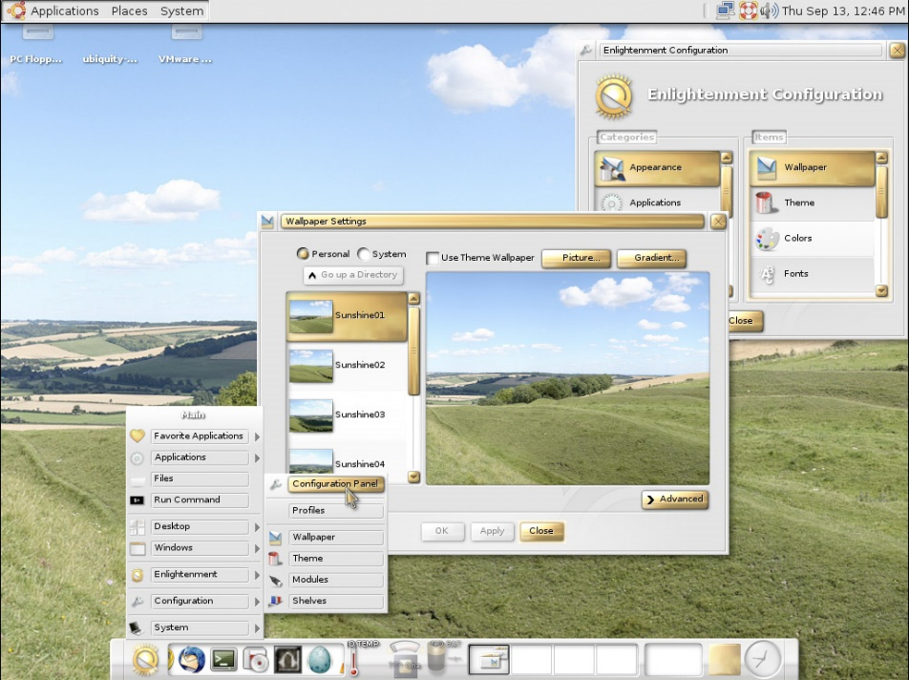
WIMP Interface
Windows
Icons
Menus
Pointers
… or windows, icons, mice, and pull-down menus!
default style for majority of interactive computer systems, especially PCs and desktop machines

Slide 28
Point and click interfaces
used in ..
  multimedia
  web browsers
  hypertext
just click something!
  icons, text links or location on map
minimal typing
Notes:
Click on next button

Slide 29
Elements of the wimp interface
windows, icons, menus, pointers
+++
buttons, toolbars,
palettes, dialog boxes

Slide 30
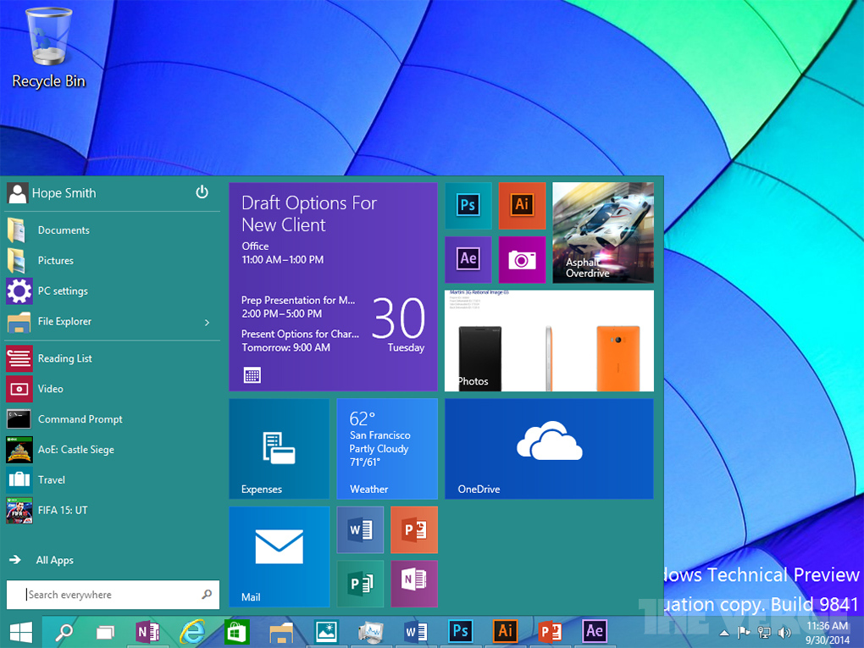
Windows
Areas of the screen that behave as if they were independent
  can contain text or graphics
  can be moved or resized
  can overlap and obscure each other, or can be laid out next to one another (tiled)

Slide 31
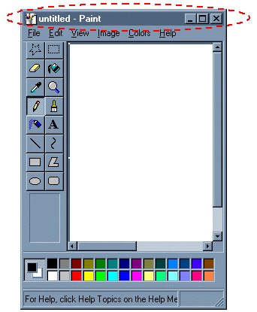
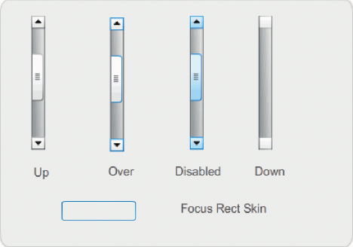
Windows
scrollbars
  allow the user to move the contents of the window up and down or from side to side
title bars
  describe the name of the window

Slide 32
Icons
small picture or image
represents some object in the interface
  often a window or action
windows can be closed down (iconised)
  small representation for many accessible windows
icons can be many and various
  highly stylized
  realistic representations.

Slide 33
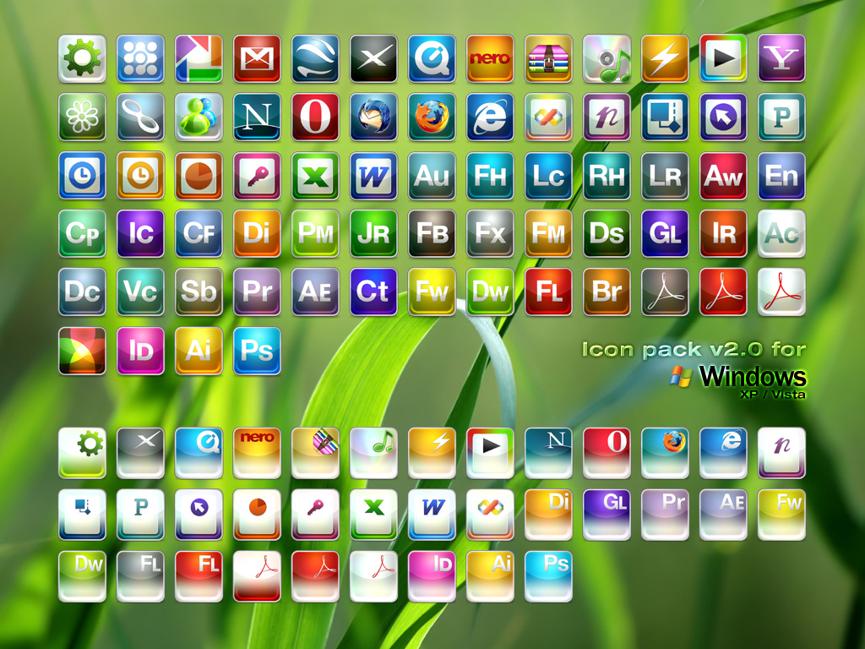
icons

Slide 34
Pointers
important component
  WIMP style relies on pointing and selecting things
uses mouse, trackpad, joystick, trackball, cursor keys or keyboard shortcuts
wide variety of graphical images

Slide 35
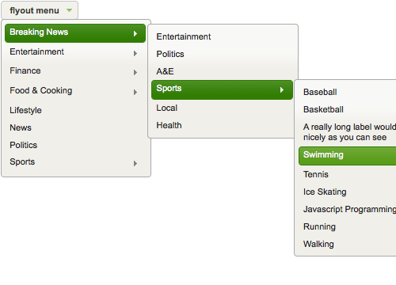
Menus
Choice of operations or services offered on the screen
Required option selected with pointer
problem – take a lot of screen space
solution – pop-up: menu appears when needed

Slide 36
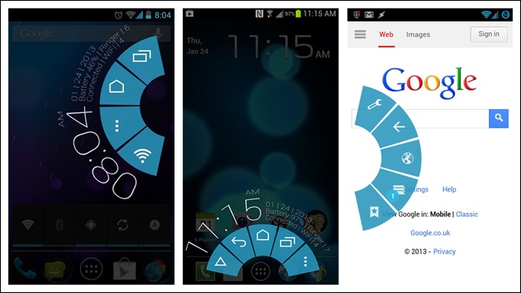
Kinds of Menus
Menu Bar at top of screen (normally), menu drags down
  drop-down menu - mouse click reveals menu
  fall-down menus - mouse just moves over bar!
Contextual menu appears where you are
  pop-up menus - actions for selected object
  pie menus - arranged in a circle
    easier to select item (larger target area)
    quicker (same distance to any option)
    … but not widely used!

Slide 37
Menus design issues
which kind to use
what to include in menus at all
words to use (action or description)
how to group items
choice of keyboard accelerators
Notes:
File f or find f

Slide 38
Buttons
individual and isolated regions within a display that can be selected to invoke an action
Special kinds
  radio buttons
  – set of mutually exclusive choices
  check boxes
  – set of non-exclusive choices

Slide 39
Summary
Today we have learnt,
  Interaction models
    translations between user and system
  ergonomics
    physical characteristics of interaction

