Slide 1
HUMAN COMPUTER INTERACTION
LECTURE 4
Computer

Slide 2
Quiz # 1
Mention the steps involved in perceptual process.
Differentiate between perception and recognition in perceptual process.

Slide 3
chapter 2
the computer
Notes:
m

Slide 4
The Computer
a computer system is made up of various elements
each of these elements affects the interaction
  input devices – text entry and pointing
  output devices – screen (small&large), digital paper
  virtual reality – special interaction and display devices
  physical interaction – e.g. sound, haptic, bio-sensing
  paper – as output (print) and input (scan)
  memory – RAM & permanent media, capacity & access
  processing – speed of processing, networks
Notes:
Haptics is any form of interaction involving touch
The measurement of physiological activity or the detection of organisms.

Slide 5

Interacting with computers
to understand human–computer interaction
… need to understand computers!
what goes in and out
devices, paper,
sensors, etc.
what can it do?
memory, processing,
networks

Slide 6
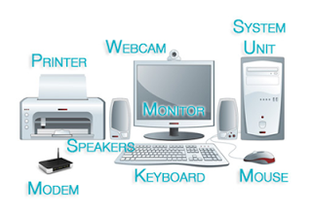
A ‘typical’ computer system
?
screen, or monitor, on which there are windows
keyboard
mouse/trackpad
variations
  desktop
  laptop
  PDA
the devices dictate the styles of interaction that the system supports
If we use different devices, then the interface will support a different style of interaction

Slide 7

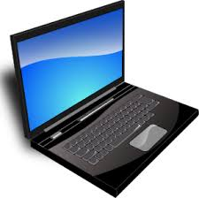
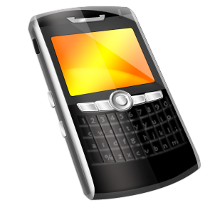
How many …
computers in your house?
  hands up, …
  … none, 1, 2 , 3, more!!
computers in your pockets?
are you thinking …
… PC, laptop, PDA ??

Slide 8
How many computers …
in your house?
  PC
  TV, VCR, DVD, HiFi, cable/satellite TV
  microwave, cooker, washing machine
  central heating
  security system
  can you think of more?
in your pockets?
  PDA
  phone, camera
  smart card, card with magnetic strip?
  electronic car key
  USB memory
  try your pockets and bags

Slide 9
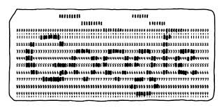
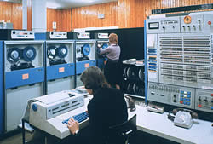
Interactivity?
Long ago in a galaxy far away … batch processing
  punched card stacks or large data files prepared
  long wait ….
  line printer output
  … and if it is not right …
Now most computing is interactive
  rapid feedback
  the user in control (most of the time)
  doing rather than thinking …
Is faster always better?

Slide 10
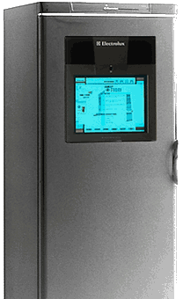
Richer interaction
sensors
and devices
everywhere

Slide 11
text entry devices
keyboards (QWERTY et al.)
chord keyboards, phone pads
handwriting, speech

Slide 12
Keyboards
Most common text input device
Allows rapid entry of text by experienced users
Keypress closes connection, causing a character code to be sent
Usually connected by cable, but can be wireless

Slide 13
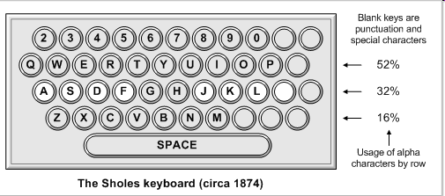
layout – QWERTY
Standardised layout
but …
  non-alphanumeric keys are placed differently
  accented symbols needed for different scripts
  minor differences between UK and USA keyboards
QWERTY arrangement not optimal for typing
– layout to prevent typewriters jamming!
Alternative designs allow faster typing but large social base of QWERTY typists produces reluctance to change.
Notes:
$ or pound at 4
not that good but typewriter used to still by nearby
almost used 1874 how to change

Slide 14
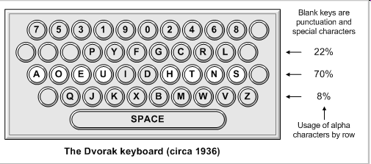
alternative keyboard layouts
Alphabetic
  keys arranged in alphabetic order
  not faster for trained typists
  not faster for beginners either!
Dvorak
  common letters under dominant fingers
  biased towards right hand
  common combinations of letters alternate between hands
  10-15% improvement in speed and reduction in fatigue
  But - large social base of QWERTY typists produce market pressures not to change
Notes:
1036
common letter on dominant fingers
vowels arranged
right hand focus

Slide 15
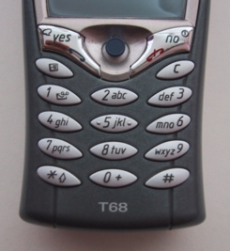
phone pad and T9 entry
use numeric keys with
multiple presses
  2 – a b c 6 - m n o
  3 - d e f 7 - p q r s
  4 - g h i 8 - t u v
  5 - j k l 9 - w x y z
hello = 4433555[pause]555666
surprisingly fast!
T9 predictive entry
  type as if single key for each letter
  use dictionary to ‘guess’ the right word
  hello = 43556 …
  but 26 -> menu ‘am’ or ‘an’

Slide 16
Handwriting recognition
Text can be input into the computer, using a pen and a digesting tablet
  natural interaction
Technical problems:
  capturing all useful information - stroke path, pressure, etc. in a natural manner
  segmenting joined up writing into individual letters
  interpreting individual letters
  coping with different styles of handwriting
Used in PDAs, and tablet computers …
… leave the keyboard on the desk!
Notes:
Samll c and e

Slide 17
Speech recognition
Improving rapidly
Most successful when:
  single user – initial training and learns peculiarities
  limited vocabulary systems
Problems with
  external noise interfering
  imprecision of pronunciation
  large vocabularies
  different speakers
Notes:
Call home

Slide 18
Numeric keypads
for entering numbers quickly:
  calculator, PC keyboard
for telephones
not the same!!
ATM like phone
1
2
3
7
8
9
4
5
6
4
5
6
7
8
9
1
2
3
*
0
#
0
.
=
telephone
calculator

Slide 19
positioning, pointing and drawing
mouse, touchpad
trackballs, joysticks etc.
touch screens, tablets
eyegaze, cursors

Slide 20
the Mouse
Handheld pointing device
  very common
  easy to use
Two characteristics
  planar movement
  buttons
    (usually from 1 to 3 buttons on top, used for making a selection, indicating an option, or to initiate drawing etc.)

Slide 21

the mouse (ctd)
Mouse located on desktop
  requires physical space
  no arm fatigue
Relative movement only is detectable.
Movement of mouse moves screen cursor
Screen cursor oriented in (x, y) plane,
mouse movement in (x, z) plane …
… an indirect manipulation device.
  device itself doesn’t obscure screen, is accurate and fast.
  hand-eye coordination problems for novice users
Notes:
Natural access
relative movement with surface not air
don’t obsure cover screen idle

Slide 22
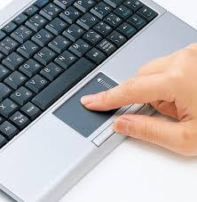
Touchpad
small touch sensitive tablets
‘stroke’ to move mouse pointer
used mainly in laptop computers
good ‘acceleration’ settings important
  fast stroke
    lots of pixels per inch moved
    initial movement to the target
  slow stroke
    less pixels per inch
    for accurate positioning

Slide 23
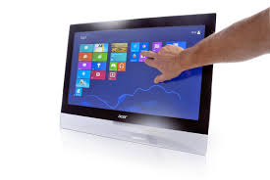
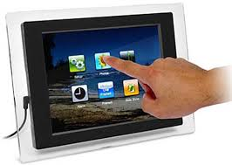
Touch-sensitive screen
Detect the presence of finger or stylus on the screen.
  works by interrupting matrix of light beams, capacitance changes or ultrasonic reflections
  direct pointing device
Advantages:
  fast, and requires no specialised pointer
  good for menu selection
  suitable for use in hostile environment: clean and safe from damage.
Disadvantages:
  finger can mark screen
  imprecise (finger is a fairly blunt instrument!)
    difficult to select small regions or perform accurate drawing
  lifting arm can be tiring
Notes:
Can cover
finger thickness

Slide 24
Cursor keys
Four keys (up, down, left, right) on keyboard.
Very, very cheap, but slow.
Useful for not much more than basic motion for text-editing tasks.
No standardised layout, but inverted “T”, most common

Slide 25
display devices
bitmap screens (CRT & LCD)
large & situated displays
digital paper
Notes:
output

Slide 26
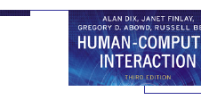


bitmap displays
screen is vast number of coloured dots
Notes:
Combination of small color dots (bits)

Slide 27
resolution and colour depth
Resolution … used (inconsistently) for
  number of pixels on screen (width x height)
    e.g. SVGA 1024 x 768, PDA perhaps 240x400
  density of pixels (in pixels or dots per inch - dpi)
    typically between 72 and 96 dpi
Aspect ratio
  ration between width and height
  4:3 for most screens, 16:9 for wide-screen TV
Colour depth:
  how many different colours for each pixel?
  black/white or greys only
  256 from a pallete
  8 bits each for red/green/blue = millions of colours
Notes:
More dots per inch pleasant display

Slide 28
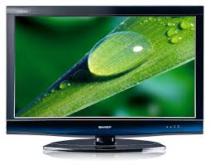
Liquid crystal displays
Smaller, lighter, and … no radiation problems.
Found on PDAs, portables and notebooks,
… and increasingly on desktop and even for home TV
also used in dedicted displays:
digital watches, mobile phones, HiFi controls
How it works …
  Top plate transparent and polarised, bottom plate reflecting.
  Light passes through top plate and crystal, and reflects back to eye.
  Voltage applied to crystal changes polarisation and hence colour
  N.B. light reflected not emitted => less eye strain

