Slide 1
Ground Improvement Techniques

Slide 2
SOIL STABILIZATION
The improvement process under the situation when the influence zone is limited to less than 1m (roads etc.) is called surface stabilization.
Geo-Technical process of improving the engineering properties of the soil (density, shear strength, C&O factors are improved while compressibility, settlement and permeability reduced) and making it more stable and durable is called ground improvement.

Slide 3
Present Day Scenario
Best buildable lands not available for construction
Available sites are having low strength because :
Filled up sites,
Low lying water logged,
Waste lands,
Creek lands with deep deposits of soft saturated marine clays
Another problem: Design loads are high and the site is situated in seismic zones

Slide 4
What are the options?
Traditional foundation techniques sometimes costlier than the super structure and in many situations can’t be built
when a poor ground exists at the project site, designer faces following questions:
Should the poor ground be removed and replaced with a
more suitable material?
Should the weak ground be bypassed laterally by
changing the project’s location or vertically by the use of
deep foundations? or
Should the design of the facility (height, configuration,
etc) be changed to reflect the ground’s limitations?

Slide 5
Development of ground improvement, gives the designer/bulder has a fourth option
To “fix” the poor ground and make it suitable for the project’s needs
Now the designer/builder faces new questions:
Should the problematic ground at the project site be
fixed instead of bypassed?
What are the critical issues that influence the successful
application of a specific fixing tool? And
Which fixing tool to be used from comprehensive
and diversified set currently available in the tool box?

Slide 6
What are the major functions of Ground improvement in soil ?
To increase the bearing capacity
To control deformations and accelerate consolidation
To provide lateral stability
To form seepage cut-off and environmental control
To increase resistance to liquefaction
Above functions can be accomplished :
by modifying the ground’s character - with or without the addition of foreign material

Slide 7
PRE-LOADING
In this method preloading of 1.2 to 1.3 times of designed load is applied in advance to allow desired settlement and accelerate consolidation.
Specifically for alluvial soils having high moisture content, high compressibility and low shearing strength by lowering water table by any means.
Process can be accelerated by introducing sand piles in the periphery.
Best suited for air fields, storage tanks, flood control structures etc.
Undesired initial investment, disposal of use of preloaded soil, unexpected time delay may be considered.

Slide 8
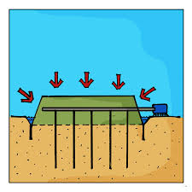
Vacuum Preloading
The basic idea of vacuum preloading method is applying a vacuum suction into an isolated soil mass to reduce the atmosphere pressure and pore water pressure in the soil, resulting soil consolidation and effective stress enhance without change the total stress.

Slide 9
Vacuum Preloading
Vacuum preloading (consolidation) method was initially proposed by Kjellman at 1952 and was worked out by the Royal Swedish Geotechnical Institute as a method for improving fine grain soil. This method utilises atmosphere pressure as a temporary surcharge for improving fine grain soft soil.

Slide 10
Vacuum Preloading
The basic idea of vacuum preloading method is applying a vacuum suction into an isolated soil mass to reduce the atmosphere pressure and pore water pressure in the soil, resulting soil consolidation and effective stress enhance without change the total stress.
Basically, whole vacuum preloading system consists of drainage system, isolation system and vacuum pumps. Once generated in vacuum pumps, vacuum suction rapidly spreads into soils along drainage system, reducing atmosphere and pore water pressure and forming pressure difference between vertical drains and pore water in soils. This pressure difference cause the pore water flows toward vertical drain which means soil consolidation happens. Vacuum suction keeps taking out water and air and accelerating soil consolidation.

Slide 11
Vacuum Preloading
Drainage system is an interconnected network of PVD, horizontal filter pipes and sand layer, forming a complete path for spreading of vacuum suction and water flow.
Isolation system is used to cutoff leakage of water & air below it. It consists of geomembrane, the soft clay itself and cutoff wall if necessary.
In the lateral direction, vacuum suction exerts an inward force into the subsoil which is totally different with surcharge preloading where an outward force is exerted. As a result, in most cases, the sliding failure mechanism could be partly or totally eliminated when applying vacuum preloading method. This is a distinguished advantage when conducting ground improvement on very soft ground or beside existing buildings or infrastructures.

Slide 12
Electrical Method
 Used to densify the in situ cohesive soils.
 Method is called electro osmosis.
 Simply placing electrodes & passing direct current between them.
 Current induces flow of water from anode to cathode.
 Anode is metal rod & cathode is perforated pipe.

Slide 13
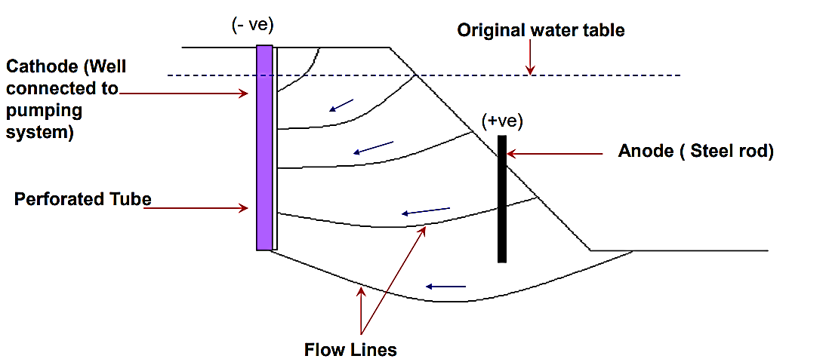
Electro Osmotic Stabilization of soils

Slide 14
Electrical Method
 The flow rate to a cathode well point can be estimated using modification of Darcy's law: q = Ke ieA
 Where, q= flow rate, m3 /s, Ke = electro osmotic coefficient of permeability based on voltage, 1 x 10-9 to 7 x 10-9 m/s per V/m, ie = electrical potential gradient, V/m, A = cross-sectional area, m2 .
 The consumption of power varies from 1 to 10 kv per m3 of stabilized soil.

Slide 15
Deep Mixing Method
The deep mixing method involves the stabilization of soils at large depth. It is an in situ ground modification technology in which a wet or dry binder is injected into the ground and blended with in situ soft soils (clay, peat or organic soils) by mechanical or rotary mixing tool. The aim is to produce the stabilized soil mass which may interact with natural soil and not, to produce too stiffly stabilized soil mass like a rigid pile which may independently carry out the design load.
Depending on applications, the following patterns may be produced, single patterns, block patterns, panel pattern or stabilized grid pattern.

Slide 16
Deep Mixing Method
The increased strength and stiffness of stabilized soil should not, therefore, prevent
an effective interaction and load distribution between the stabilized soil and natural soil
(EuroSoilStab, 2002). Thus the design load should be distributed and carried out partly
by natural soil and partly by stabilized soil mass (column).

Slide 17
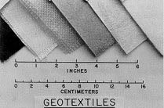
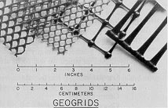
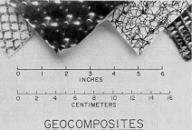
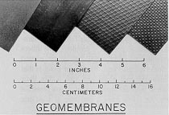
Reinforcement
Soil is stronger in compression than in tension
To improve strength in tension, geosynthetics placed in soil for soil reinforcement

Slide 18
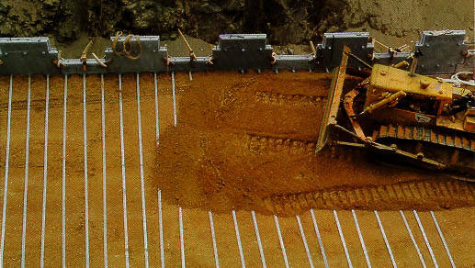
Reinforced earthwall construction

Slide 19
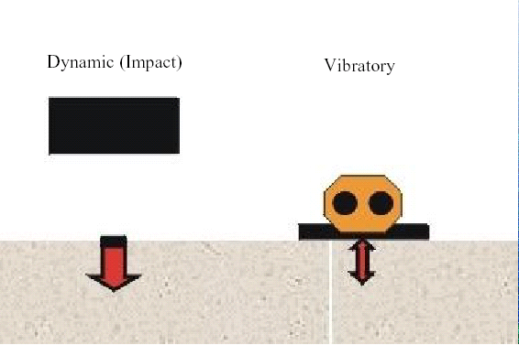
Dynamic vs. Vibratory

Slide 20
Vibratory probe compaction
Long probe mounted onto a vibratory pile driver compacts the soil around the probe; penetrations spaced in a grid pattern similar to vertical drains

Slide 21
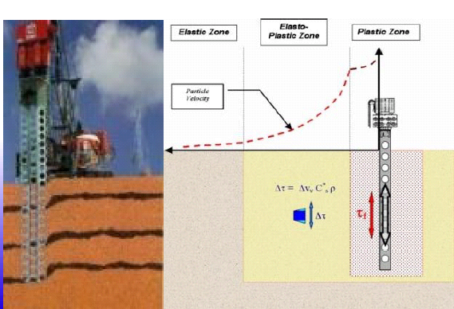
Vibratory probe compaction

Slide 22
Vibroflotation
Probe incldes the vibrator mechanism and water jets
Probe is lowuered into the ground using a crane
Vibratory eccentric force induces densification and water jets assist in insertion and extraction
Vibratory probe compaction is effective if silt content is less than 12-15% and clay is less than 3%
Probes inserted in grid pattern at a spacing of 1.5 to 3 m

Slide 23
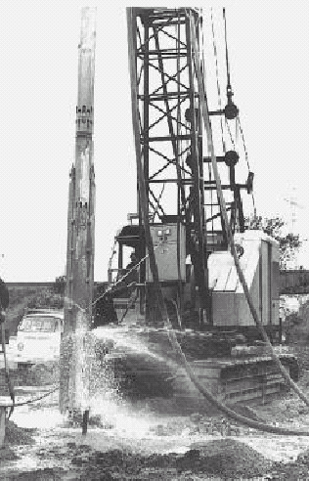
Vibroflotation
Ground Type
Relative Effectiveness
Sands
Excellent
Silty Sands
Marginal to Good
Silts
Poor
Clays
Not applicable
Mine Spoils
Good (if granular)
Dumped Fill
Depends upon nature of fill
Garbage
Not Applicable

Slide 24
Vertical Drains
Vertical drains are installed under a surcharge load to accelerate the drainage of impervious soils and thus speed up consolidation
These drains provide a shorter path for the water to flow through to get away from the soil
Time to drain clay layers can be reduced from years to a couple of months

Slide 25
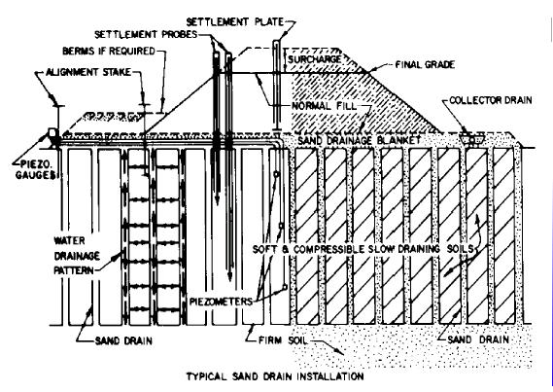
Vertical Drains

Slide 26
Thermal Method: Heating
Rarely used method
 Used to stabilize saturated clays by heat
 Russian technology
 At 100° c drying increases the strength of clays.
 A permanent change in structure of clay is possible at a temperature of 500°c, and at 1000°c there will be fusion of clay particles transforming clay into solid substance like brick.

Slide 27
Thermal Method: Ground Freezing
Useful in soils which is having pore water content is more.
 Series of refrigerant pipes are spreaded.
 Pore water starts converting into ice.
 The freezed soil is having high strength & low permeability.
 Possible to stabilize wide range of type of soils.

Slide 28
Thermal Method: Ground Freezing
Freezing technique has been successfully used in
- sinking tunnel shaft
- advancing tunnels in running ground
- providing lateral restraint for excavations.

Slide 29
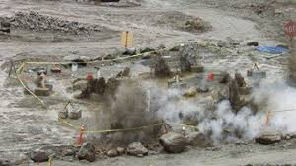
Blasting method
Blasting is the use of buried explosives to cause the densification of loose cohesion less ground. The principal is that the blasting of explosives in a predetermined pattern causes liquefaction, followed by the expulsion of pore water and subsequent densification of the ground. Blast densification is being utilized for more than 80 years to densify loose, saturated sand deposits.

Slide 30
Blasting method
The aim of this ground-improvement technique is to densify and improve the engineering characteristics of loose sand deposits and thus prevent or minimize the effects of liquefaction during an earthquake. The liquefaction of loose, saturated sands due to seismically induced ground motions continues to be the major source of damage to facilities and loss of human lives after severe earthquake events.

Slide 31
Procedure of the blasting for ground improvement
Series of boreholes are drilled and Pipe of 7.5 to 10 cm is driven to the required depth
The detonator and the dynamic sticks are both enclosed in a water proof bundle and is lowered through casings
Casing is withdrawn and a wad of paper or wood is placed against the charge of Explosive (To protect it from misfire)
Boreholes are backfilled with sand to obtain full force of blast
The charge is fired in definite pattern

Slide 32
Blasting method
Blasting is more effective in loose sands that contain less than 20% silt and less than 5% clay. In case of partial saturated soil, the capillary action obstructs the densification tendency by preventing soil particles to come close. So this method is not useful for partial saturated soils. When deeper deposits are in question, the blasting is done in stages. Repeated shots are more effective than a single larger one.

Slide 33
Thank You!

