Slide 1
ENGINEERING GEOLOGY
IQRA NATIONAL UNIVERSITY
Lecture 01
INTRODUCTION TO ENGINEERING GEOLOGY
PREPARED BY ENGR. IMTIAZ KHAN LECTURER CED ,INU PESH

Slide 2
INTRODUCTION TO GEOLOGY
Geo means “EARTH”.
Logy means “STUDY OF”.
Geology literally means "study of the Earth.“

Slide 3
TYPES OF GEOLOGY
Physical geology:
Examines the materials and processes of the Earth.
Historical geology:
Examines the origin and evolution of our planet through time.

Slide 4
MAIN BRANCHES OF GEOLOGY
BRANCHES | DETAIL
Physical Geology | Different physical features of the earth. (mountain , rivers, volcanoes)
Mineralogy | Study of minerals. (MARBLES , DIAMOND ETC)
Petrology | Study of rocks. (properties , composition etc)
Structural Geology | Structural study of earth. (three dimensional study of rocks etc)
Historical Geology | Historical study of the earth.
Paleontology | Study of fossils. ( animals , plants)
Economic Geology | Earth materials that can be used for economic or industry purpose.

Slide 5
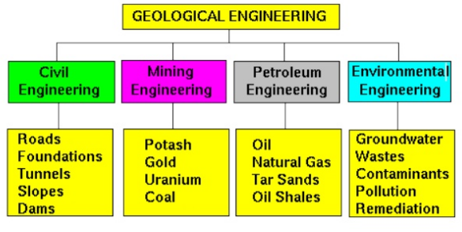
SCOPE OF GEOLOGY
Geology provides necessary information about the site of construction material used in the construction of building , dams ,bridges, roads, tunnels etc.
Geology information is most important in the designing phase of the engineering structures.

Slide 6
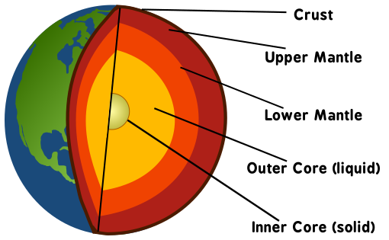
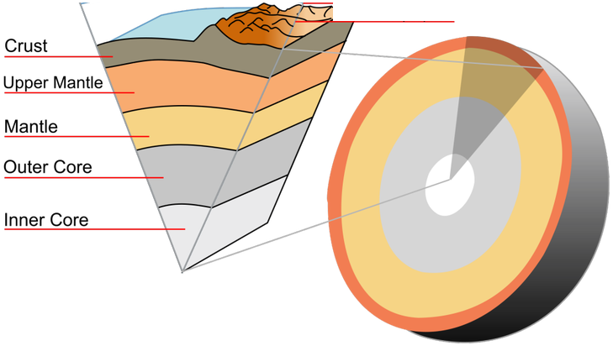
ANATOMY OF THE EARTH

Slide 7
INTER CORE
Thought to be as hot as the surface of the sun!
Solid layer
Composition of iron and Nickel
Inner core: (1216 km)

Slide 8
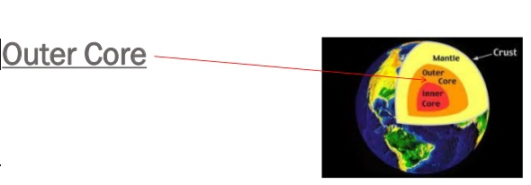
OUTER CORE
Hot but not as hot as inner core.
Liquid layer.
Composed of iron and nickel.
Outer core : (2270 km)

Slide 9
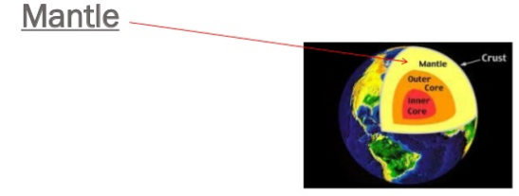
MANTLE
Still hot! (but not as hot as core).
Largest layer
Composed of various material (iron (Fe), magnesium (Mg), aluminum (Al), silicon (Si), and oxygen (O) silicate compounds)
Solid and liquid (mantle is solid but can deform slowly in a plastic manner)
Upper mantle (650 km)
Lower mantle (2235 km)

Slide 10
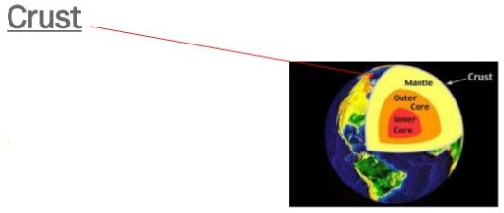
CRUST
Top most layer (crust is rocky and brittle).
Composed of (least dense).
calcium (Ca) and sodium (Na) aluminum-silicate minerals.
Continental crust (25-40 km).
Oceanic crust (~6 km).

Slide 11
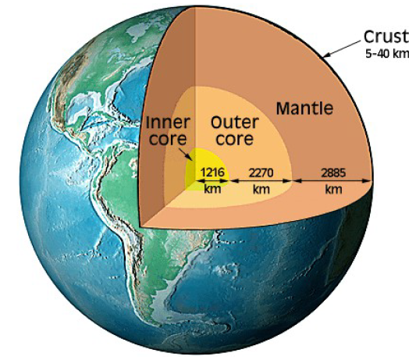
0RIGN OF THE EARTH

Slide 12
How earth came into being ?
Most common Theories
1. Nebular Hypothesis
2. Planetesimal Hypothesis
3. Gaseous Tidal Hypothesis
4. Binary Star Hypothesis

Slide 13
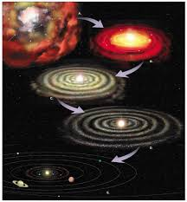
NEBULAR HYPOTHESIS
German philosopher, Kant and French mathematician, Laplace.
Earth, planets and sun originated from Nebula.
Nebula was large cloud of gas and dust. It rotates slowly.
Gradually it cooled and contracted and its speed increased.
A gaseous ring was separated from nebula.
Later the ring cooled and took form of a planet.
On repetition of the process all other planets came into being.
The central region, nebula became sun.

Slide 14
NEBULAR HYPOTHESIS
Criticism
Where nebula came from ?
Why only 9 rings
Nebula –gaseous form (gass cold – liquid – solid)
L= m&(r)2
(2% rotation 99.9% mass) (planets 0.1% mass 98% rotation)

Slide 15
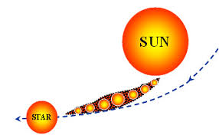
PLANETESIMAL HYPOTHESIS
Chamberlin and Moulton proposed the theory in 1904.
The sun existed before the formation of planets.
A star came close to the sun.
Because of the gravitation pull of the star, small gaseous bodies were separated from the sun.
These bodies on cooling became small planets.
During rotation the small planets collided and form planets.

Slide 16
PLANETESIMAL HYPOTHESIS
Criticism
Why only 9 planets?
Infinite universe -how collision takes place.
L= m&(r)2
(2% rotation 99.9% mass) (planets 0.1% mass 98% rotation)
Cigar shape

Slide 17
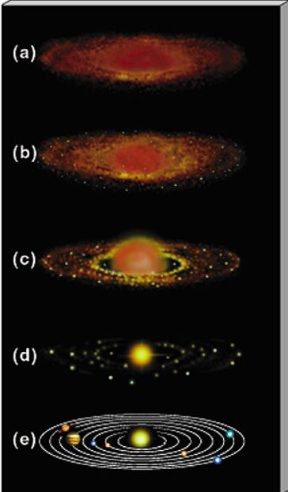
GASEOUS TIDAL HYPOTHESIS
Jeans and Jeffrey proposed the theory in 1925
Large star came near the sun. Due to gravitational pull a gaseous tide was raised on the surface of the sun.
As the star came nearer, the tide increased in size.
Gaseous tide detached when star move away.
The shape of the tide was like spindle.
It broke into pieces-forming nine planets of the solar system.

Slide 18
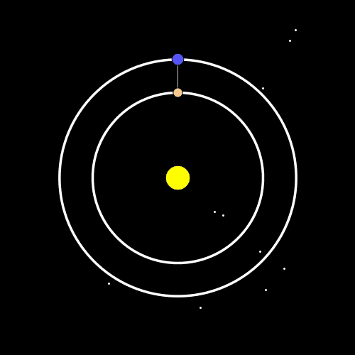
BINARY STAR HYPOTHESIS
Lyttleton , 1938.
Before formation of planet , Sun has a companion Star.
Another star came closer and dragged the companion start away Gaseous filament, from the companion star and remained closer to sun.
The planets were formed from this gaseous filament by same process discussed in Gaseous tidal hypothesis.

Slide 19
END OF THE LECTURE

