Slide 1
Fourier Series

Slide 2
Fourier series:
Fourier series are infinite series designed to
represent general periodic functions in terms
Of sines and cosines.

Slide 3
Periodic function:
A function $f(x)$is called periodic function if
$f(x)$is define for all real $x$, except possibly at
Some points, and if there is some positive no
p, called a period of $f(x).$
s.t $f(x+p) = f(x)$

Slide 4
Period:
The period is defined as the length of a functions
cycle. Trigonometric functions are cyclic and when
you graph them, you will seethe up’s and downs
of the graph and You will see these up’s and
downs keep repeating at regular domain.

Slide 5
Formulas of Fourier series
F(x) = $a_{0}+ \sum_{n=1}^{∝}{a_{n}\cos\left(nx\frac{π}{L}\right)+\sum_{n=1}^{∝}{\begin{aligned}b_{n}\sin\left(nx\frac{π}{L}\right) \\ \end{aligned}}}$
L is half of the period of the function
But when function has period -$π to π$
F(x) = $a_{0}+ \sum_{n=1}^{∝}{a_{n}\cos\left(nx\right)+\sum_{n=1}^{∝}{\begin{aligned}b_{n}\sin\left(nx\right) \\ \end{aligned}}}$
0r even this one, where $a_{0}$ is rolled into 1st sum
F(x) = $\sum_{n=0}^{∝}{a_{n}\cos\left(nx\right)+\sum_{n=1}^{∝}{\begin{aligned}b_{n}\sin\left(nx\right) \\ \end{aligned}}}$
Where $a_{0}, a_{1},…and b_{0}, b_{1},…$ are coefficient of series.

Slide 6
F(x) = $a_{0}+ \sum_{n=1}^{∝}{a_{n}\cos\left(nx\right)+\sum_{n=1}^{∝}{b_{n}sin⁡(nx)}}$
Here
$a_{0}$ = $\frac{1}{2π}\int_{−π}^{π}{f\left(x\right)dx}$
$a_{n}= \frac{1}{π}\int_{−π}^{π}{f\left(x\right)cosnxdx}$ ; n = 1, 2, 3…
$b_{n}= \frac{1}{π}\int_{−π}^{π}{f\left(x\right)sinnxdx}$ ; n = 1, 2, 3…

Slide 7
Question: Find the Fourier Series of the given function.

Slide 8
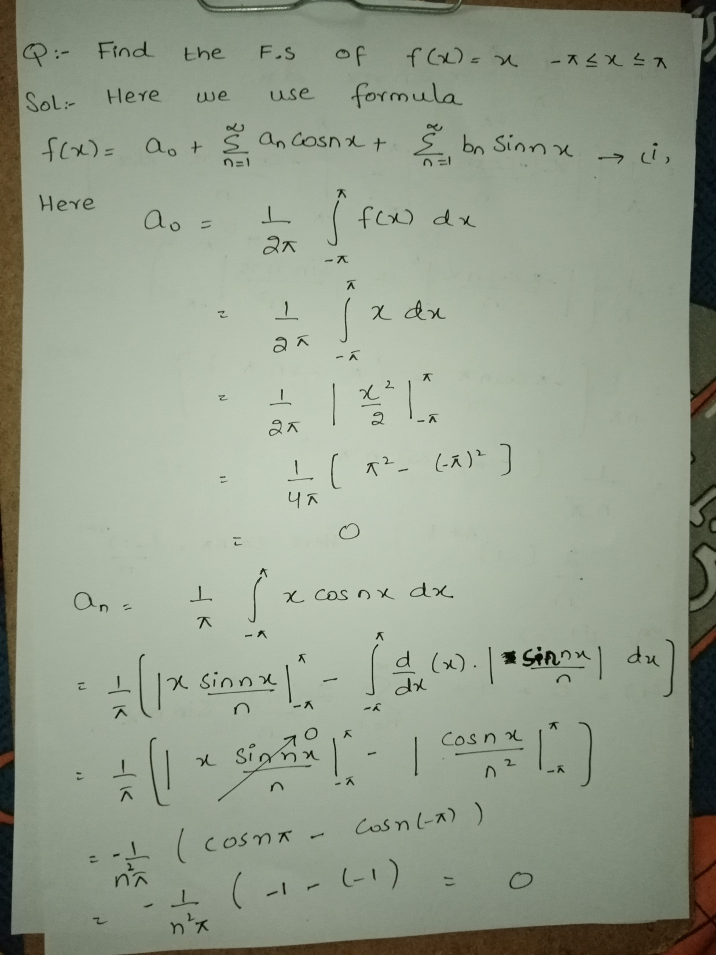

Slide 9
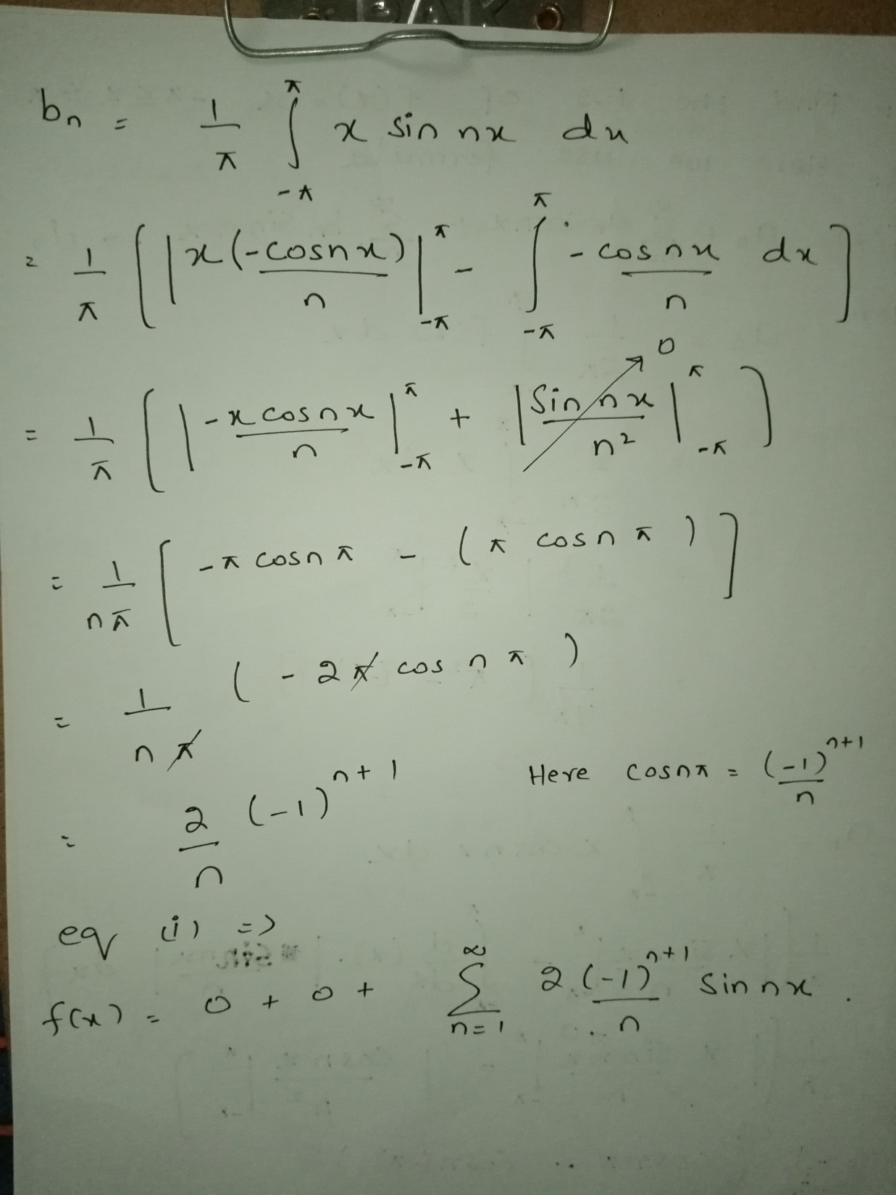

Slide 10
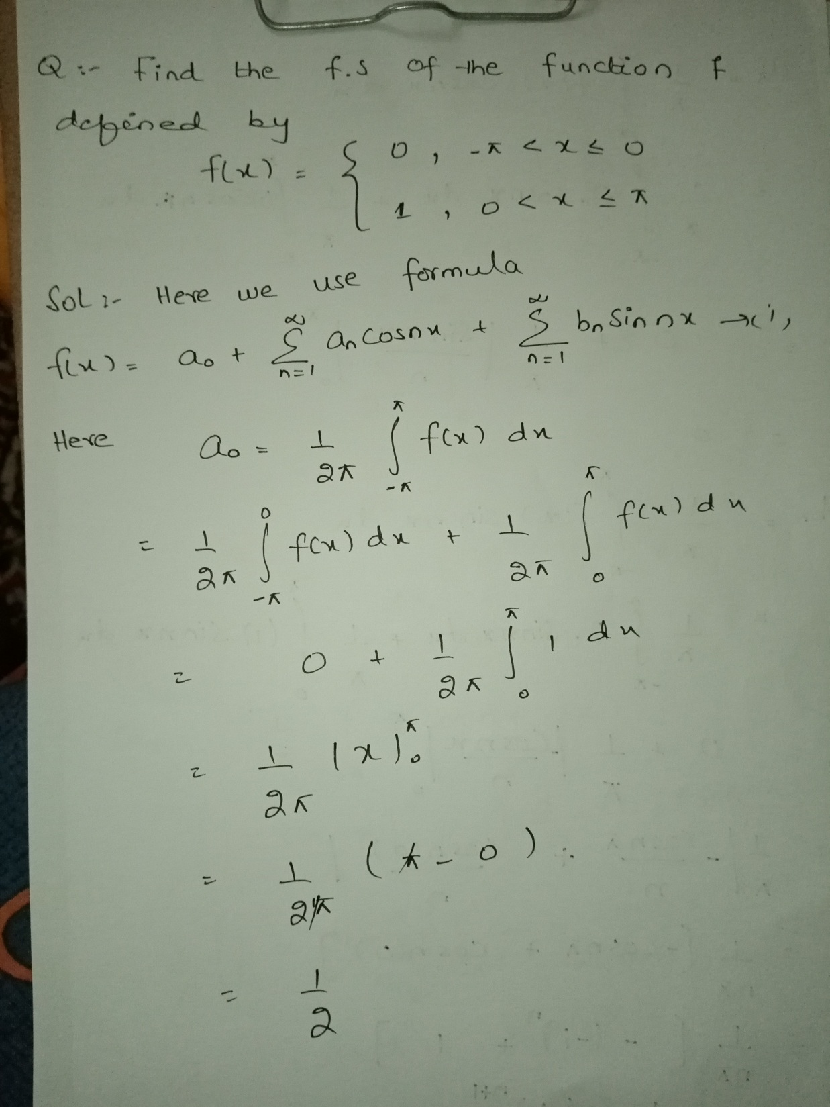

Slide 11
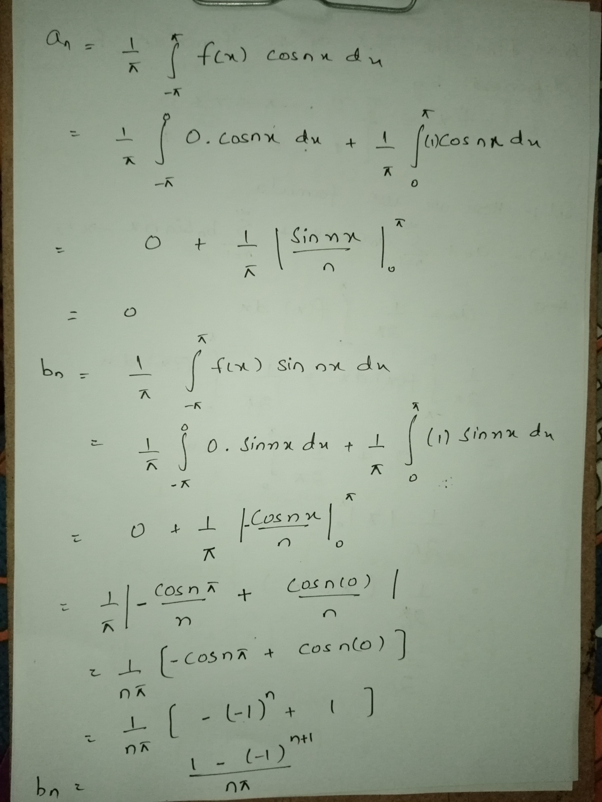

Slide 12
Application of Fourier Series in Engineering.
STUDENTS TASK

