Slide 1
Formal Method in Software Engineering
Lecture#6 Chapter 7: Advanced Topics in Logic
Waqas Swati
1st May 2019
1100-1400Hrs

Slide 2
Outline
Chapter 7
Advanced Topics in Logic
Fuzzy Logic
Definition
Importance and Usage
Practical Example
Temporal Logic
Definition
Importance and Usage
Practical Example

Slide 3
Your take on….?

Slide 4
Your take on….?

Slide 6
Fuzzy Logic
Fuzzy logic is a branch of many-valued logic that allows inferences to be made when dealing with vagueness, and it can handle problems with imprecise or incomplete data.
Its value expresses the extent to which the statement is true, with a value of 1 expressing absolute truth, and a value of 0 expressing absolute falsity.
Notes:
Interpretation
Imbiguity

Slide 7
Fuzzy Logic vs Propositional Logic
It differs from classical two-valued propositional logic, in that it is based on degrees of truth, rather than on the standard binary truth-values of “true or false” (1 or 0) of propositional logic.
That is, while statements made in propositional logic are either true or false (1 or 0), the truth-value of a statement made in fuzzy logic is a value between 0 and 1.

Slide 8
Example
Consider the statement “John is tall”.
If John is 6 ft, 4 in.,
then we would say that this is a true statement (with a truth-value of 1) since John is well above average height.
However, if John is 5 feet, 9 in. tall (around average height), then this statement has a degree of truth, and this could be indicated by a fuzzy truth-valued of 0.6.

Slide 9
Example (Cont’d)
Today is sunny day.
the statement that today is sunny may be assigned a truth-value of 1 if there are no clouds. Similarly, 0.8 if there are a small number of clouds and 0 if it is raining all day.

Slide 10
Compound Proposition
Propositions in fuzzy logic may be combined together to form compound propositions.
Suppose X and Y are propositions in fuzzy logic, then compound propositions may be formed from the conjunction, disjunction and implication operators.

Slide 11
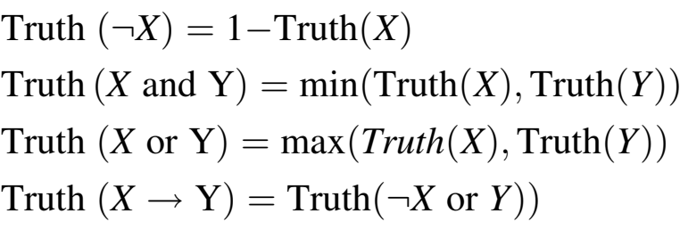
Compound Proposition (Cont’d)
The usual definition in fuzzy logic of the truth-values of the compound propositions formed from X and Y is given by:

Slide 12
Time to watch a video on Fuzzy Logic

Slide 13
Usage
Under these definitions, fuzzy logic is an extension of classical two-valued logic, which preserves the usual meaning of the logical connectives of propositional logic when the fuzzy values are just {0,1}.
Fuzzy logic has been very useful in expert system and Artificial Intelligence applications.
The first fuzzy logic controller was developed in England in the mid-1970s.
It has been applied to the aerospace and automotive sectors, and also to the medical, robotics and transport sectors.

Slide 14
Temporal Logic

Slide 15
Reading Assignment
Go through chapter 7 of “Concise Guide to Formal Methods”

