Slide 1
Formal Method in Software Engineering
Lecture#4
Waqas Swati
13th March 2019
1100-1400Hrs

Slide 2
Outline
Chapter 4
Sets, Relations and Functions
Set Theory
Types, Operations, Computer representation of sets
Relation
Domain, Range, Application of relations
Function
Domain, Range, Co-Domain, Types of Function

Slide 3
Set Theory
In mathematics, a set is a collection of distinct objects, considered as an object in its own right.
Sets may be defined by using a predicate to constrain set membership.
S = {n : ℕ : n ≤ 10 ^ n mod 2 = 0} ={2, 4, 6, 8, 10}
∈ ∉ : or | ∅ ∪ ∩ | Belongs to Does not belongs to Such that Null set or empty set Union of two sets Intersection of two sets
Notes:
For example, the items you wear: hat, shirt, jacket, pants, and so on.
I'm sure you could come up with at least a hundred.
This is known as a set.
Or another example is types of fingers.
This set includes index, middle, ring, and pinky.
The first set {socks, shoes, watches, shirts, ...} we call an infinite set,
the second set {index, middle, ring, pinky} we call a finite set.
Set of even numbers: {..., -4, -2, 0, 2, 4, ...} Set of odd numbers: {..., -3, -1, 1, 3, ...} Set of prime numbers: {2, 3, 5, 7, 11, 13, 17, ...} Positive multiples of 3 that are less than 10: {3, 6, 9}

Slide 4
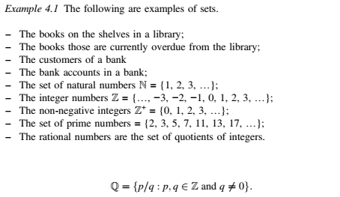
Set Theory (Con’t)
Fundamental building block.
Collection of well-defined objects.
Same kind
Distinct
No repetition
No Order
Venn Diagram
Set operations (Union, Intersection, Difference)

Slide 5
Set Theory (Con’t)
Empty Set or Null Set:
A set which does not contain any element is called an empty set, or the null set or the void set and it is denoted by ∅ and is read as phi.
In roster form, ∅ is denoted by {}.
An empty set is a finite set, since the number of elements in an empty set is finite, i.e., 0.
S={}

Slide 6
Set Theory (Con’t)
Set Cardinality
The cardinality of a set is a measure of a set's size, meaning the number of elements in the set.
For instance, the set has a cardinality of for the three elements that are in it.
A = {1, 2, 3, 4}, A = I4I
Notes:
Z= -1,1

Slide 7
Set Theory (Con’t)
Subset
If A and B are two sets, and every element of set A is also an element of set B, then A is called a subset of B and we write it as A ⊆ B or B ⊇ A
The symbol ⊂ stands for ‘is a subset of’ or ‘is contained in’ • Every set is a subset of itself, i.e., A ⊂ A, B ⊂ B. • Empty set is a subset of every set.
For example, Let A = {2, 4, 6} and B = {6, 4, 8, 2} Here A is a subset of B. What about B⊆A??

Slide 8
Set Theory (Con’t)
Proper Set
If A and B are two sets, then A is called the proper subset of B if A ⊆ B but B ⊇ A i.e., A ≠ B. The symbol ‘⊂’ is used to denote proper subset. Symbolically, we write A ⊂ B. For example;
A = {1, 2, 3, 4}, Here n(A) = 4
B = {1, 2, 3, 4, 5}, Here n(B) = 5
We observe that, all the elements of A are present in B but the element ‘5’ of B is not present in A.
So, we say that A is a proper subset of B. Symbolically, we write it as A ⊂ B.
No set is a proper subset of itself???

Slide 9
Set Theory (Con’t)
Power Set
The collection of all subsets of set A is called the power set of A. It is denoted by P(A). In P(A), every element is a set. For example;
If A = {p, q} then all the subsets of A will be: P(A) = {∅, {p}, {q}, {p, q}} Number of elements of P(A) = n[P(A)] = 4
In general, n[P(A)] = 2^m where m is the number of elements in set A.
Notes:
Example: The shop has banana, chocolate and lemon ice cream.
Nothing at all: {}
Or maybe just banana: {banana}. Or just {chocolate} or just {lemon}
Or two together: {banana,chocolate} or {banana,lemon} or {chocolate,lemon}
Or all three! {banana, chocolate,lemon}

Slide 10
Set Theory (Con’t)
Set Theoretical Operations (Union, Intersection and Set Difference Operation)
Set Union ‘∪’.
Union of two given sets is the smallest set which contains all the elements of both the sets.
To find the union of two given sets A and B is a set which consists of all the elements of A and all the elements of B such that no element is repeated.
Let set A = {2, 4, 5, 6}, set B = {4, 6, 7, 8}
Taking every element of both the sets A and B, without repeating any element, we get a new set = {2, 4, 5, 6, 7, 8}
Therefore, A ∪ B = {x : x ∈ A or x ∈ B}
Notes:
1. If A = {1, 3, 7, 5} and B = {3, 7, 8, 9}. Find union of two set A and B.
Solution: A ∪ B = {1, 3, 5, 7, 8, 9} No element is repeated in the union of two sets. The common elements 3, 7 are taken only once.
2. Let X = {a, e, i, o, u} and Y = {ф}. Find union of two given sets X and Y.
Solution: X ∪ Y = {a, e, i, o, u} Therefore, union of any set with an empty set is the set itself.

Slide 11
Set Theory (Con’t)
Set Theoretical Operations (Union, Intersection and Set Difference Operation)
Set Intersection ‘∩‘.
Intersection of two given sets is the largest set which contains all the elements that are common to both the sets.
To find the intersection of two given sets A and B is a set which consists of all the elements which are common to both A and B.
Let set A = {2, 3, 4, 5, 6} and set B = {3, 5, 7, 9}
In this two sets, the elements 3 and 5 are common. The set containing these common elements i.e., A ∩ B = {3, 5} is the intersection of set A and B.
A ∩ B = {x : x ∈ A and x ∈ B}

Slide 12
Set Theory (Con’t)
Set Theoretical Operations (Union, Intersection and Set Difference Operation)
Set Difference ‘\ or -’
If A and B are two sets, then their difference is given by A - B or B - A.
If A = {2, 3, 4} and B = {4, 5, 6}
A - B means elements of A which are not the elements of B. i.e., in the above example A - B = {2, 3}
In general, B - A = {x : x ∈ B, and x ∉ A}

Slide 13
Set Theory (Con’t)
Computer Representation of Sets
How set is stored and manipulated in computer?
M={1,2,5,8}
M={1,2,3,4,5,6,7,8,9,10}
One-To-One Correspondence
{1,1,0,0,1,0,0,1,0,0}

Slide 14
Relations
The concept of relation in math refers to an association of two objects or two variables based some property possessed by them.
Rachel is the daughter of Noah.
This statement shows the relation between two persons.
The relation (R) being ‘is daughter of’.
Notes:
Relationship between set of values
X and Y values (X Domain, Y Range)
Ordered Pair= {(4,6),(8,9),(1,6),(3,0),(6,3),(1,1),(4,5)}
Domain={4,8,1,3,6}
Range={6,9,6,0,3,1,5} Don’t repeat the values
(3,2,)(2,4)(0,5)(2,6)(3,8)

Slide 15
Relations (Con’t)
Let A and B denote the set animals and their young ones.
Clearly, A = {cat, dog, cow, goat}
B = {kitten, puppy, calf, kid}
The relation (R) being ‘is young one of ‘.
Then the fact that,
Kitten is the young one of a cat.
Thus, kitten is related to cat.
Puppy is the young one of a dog.
Thus, puppy is related to dog.
Calf is the young one of a cow.
Thus, calf is related to cow.
Kid is the young one of a goat.
Thus, kid is related to goat.
This fact can also be written as set R or ordered pairs.
R = {(kitten, cat), (puppy, dog), (calf, cow), (kid, goat)}
Clearly, R ⊆ B × A
Thus, if A and B are two non-empty sets, then the relation R from A to B is a subset of A×B, i.e., R ⊆ A × B.
If (a, b) ∈ R, then we write a R b and is read as a is related to b.
If A and B are two non-empty sets, then the relation R from A to B is a subset of A x B, i.e., R ⊆ A x B.
If (a, b) ∈ R, then we write a R b and is read as 'a' related to 'b'.

Slide 16
Relations (Con’t)
Domain and Range of Relation
The set of all first components of the ordered pairs belonging to R is called the domain of R. Thus, Dom(R) = {a ∈ A: (a, b) ∈ R for some b ∈ B}.
The set of all second components of the ordered pairs belonging to R is called the range of R.
Thus, range of R = {b ∈ B: (a, b) ∈R for some a ∈ A}.
Therefore, Domain (R) = {a : (a, b) ∈ R} and Range (R) s= {b : (a, b) ∈ R}

Slide 17
Relations (Con’t)
In the given ordered pair (4, 6); (8, 4); (4, 4); (9, 11); (6, 3); (3, 0); (2, 3) find the following relations. Also, find the domain and range.
(a) Is two less than
(b) Is less than
(c) Is greater than
(d) Is equal to
Notes:
(a) R₁ is the set of all ordered pairs whose 1ˢᵗ component is two less than the 2ⁿᵈ component.
Therefore, R₁ = {(4, 6); (9, 11)}
Also, Domain (R₁) = Set of all first components of R₁ = {4, 9} and Range (R₂) = Set of all second components of R₂ = {6, 11}
(b) R₂ is the set of all ordered pairs whose 1ˢᵗ component is less than the second component.
Therefore, R₂ = {(4, 6); (9, 11); (2, 3)}.
Also, Domain (R₂) = {4, 9, 2} and Range (R₂) = {6, 11, 3}
(c) R₃ is the set of all ordered pairs whose 1ˢᵗ component is greater than the second component.
Therefore, R₃ = {(8, 4); (6, 3); (3, 0)}
Also, Domain (R₃) = {8, 6, 3} and Range (R₃) = {4, 3, 0}
(d) R₄ is the set of all ordered pairs whose 1ˢᵗ component is equal to the second component.
Therefore, R₄ = {(3, 3)}
Also, Domain (R) = {3} and Range (R) = {3}

Slide 18
Relations (Con’t)
Application of Relations
RDBMS
Library Book Example
Any other example??

Slide 19
Functions
A function relates an input to an output.
It is like a machine that has an output and an output. Where output is some-how related to input.
"f(x) = ... " is the classic way of writing a function. And there are other ways, as you will see!
Notes:
Roughly speaking, a function, f, is a rule or mechanism, which takes input values in some input domain, say X, and produces output values in some output domain, say Y , in such a way that to each input x ∈ X corresponds a unique output value y ∈ Y , denoted f(x)

Slide 20
Functions (Cont’d)
Notes:
f(x) = x² shows us that function "f" takes "x" and squares it.

Slide 21
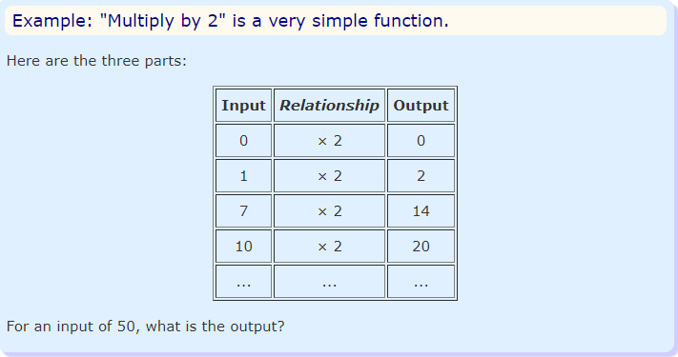
Functions (Cont’d)

Slide 22
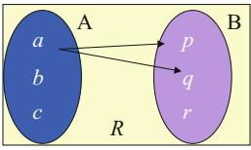
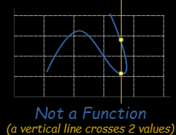
Functions (Cont’d)
Difference between Function and Relation??
A function is a relation but not every relation is a function. For example, the relation in the diagram below is not a function since there are two arrows from the element a Є A.

Slide 23
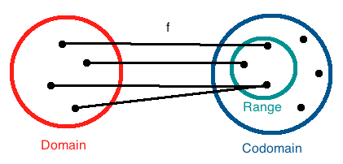
Functions (Cont’d)
Domain, Range and Co-Domain

Slide 24
Functions (Cont’d)
Types of Function
Total Function
A function which is defined for all inputs of the right type, that is, for all of a domain.
Square (x²) is a total function. Reciprocal (1/x) is not, since 0 is a real number, but has no reciprocal.
Partial Function
A function which is not defined for some inputs of the right type, that is, for some of a domain.
For instance, division is a partial function since division by 0 is undefined (on the Reals).
Notes:
Partial function data base mapping. Each domain is mapped with maximum 1 of range. UN>>PW||||||MAN>>DOB

Slide 25
Functions (Cont’d)
A function is injective (a.k.a “one-to-one”) if each element of the codomain is mapped to by at most one element of the domain.
A function is surjective (a.k.a “onto”) if each element of the codomain is mapped to by at least one element of the domain. (That is, the image and the codomain of the function are equal.)
A function is bijective (a.k.a “one-to-one & onto,” “one-to-one correspondence”) if each element of the codomain is mapped to by exactly one element of the domain.

Slide 26
Functions (Cont’d)

Slide 27
Reading Assignment
Go through chapter 4 of “Concise Guide to Formal Methods”
https://staff.washington.edu/jon/z/glossary.html
https://www.math-only-math.com
https://www.mathsisfun.com/sets/index.html

Slide 28
Assignment # 1
Application of Functions in functional programming.
Computer typed single page is enough.
Do check plagiarism and submit the similarity report (Similarity level=15%max).
You may consult books or Internet.
Use the front page provided on SIC.
Make sure to write in your own words.
Plagiarized submission will lead to zero marks.
Deadline Next Class

