Slide 1
Formal Method in Software Engineering
Lecture#3
Waqas Swati
6th March 2019
1100-1400Hrs

Slide 2
Outline
Chapter 3
Overview of Formal Methods
Introduction
Criticism on Formal Methods
Why should we use Formal Methods?
Industrial tools for Formal Methods.
Approaches to Formal Methods
Model Oriented Approach
Axiomatic Approach
Mathematics in Software Engineering
Z Specification Language
Usability of Formal Methods

Slide 3
Introduction to Formal Methods
The term “formal methods” refers to various mathematical techniques used for the formal specification and development of software.
They consist of a formal specification language and employ a collection of tools to support the syntax checking of the specification, as well as the proof of properties of the specification.
The formal specification thus becomes the key reference point for the different parties involved in the construction of the system.
It may be used as the reference point for the requirements; program implementation; testing and program documentation.
Notes:
The use of mathematical notation avoids speculation about the meaning of phrases in an imprecisely worded natural language description of a system.
Natural language is inherently ambiguous, whereas mathematics employs a precise rigorous notation.

Slide 4
Introduction to Formal Methods (Cont’d)
The specification is written in a mathematical language, and the implementation may be derived from the specification via stepwise refinement.
The refinement step makes the specification more concrete and closer to the actual implementation.
Notes:
S= Initial Specification
Mo Initial Model
Mn Eventual Implementation

Slide 5
Introduction to Formal Methods (Cont’d)
Requirements are the foundation of the system to be built.
Requirement ∝ Product
The objective of requirements validation is to ensure that the requirements reflect what is actually required by the customer.
Formal methods may be employed to model the requirements, and the model exploration yields further desirable or undesirable properties.
Notes:
, and irrespective of the best design and development practices, the product will be incorrect if the requirements are incorrect.
The use of formal methods generally leads to more robust software and increased confidence in its correctness.

Slide 6
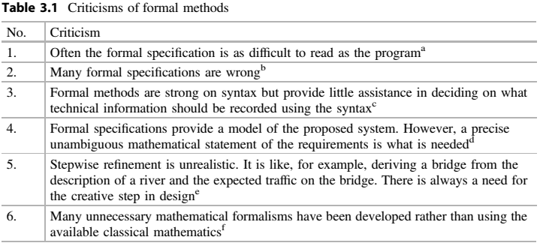
Criticism of Formal Methods
But informal offer no guarantee of correct understanding because of ambiguity.
The validation of specification can be carried out by using mathematical proof.
VDM offers this (Specification + Development).
Models allow properties of requirements to be studied prior to implementation.
Its time consuming but tool support make it easier.
Easy to learn, their results are good and useful.

Slide 7
Why should we use Formal Methods
There is a strong motivation to use best practice in software engineering in order to produce software adhering to high-quality standards.
Quality problems with software may cause minor irritations or major damage to a customer’s business including loss of life.
Formal methods are a leading-edge technology that may be of benefit to companies in reducing the occurrence of defects in software products.

Slide 8
Why should we use Formal Methods (Cont’d)
It is quite possible that a Software Company is sued for the defective software if it has injured a third party.
Cost Effective.
9% cost saving is attributed to the use of formal methods during the CICS project.
The T800 project attributes a 12-month reduction in testing time to the use of formal methods.
The use of Formal Methods in MANDATORY.
MOD UK from 1990.
Safety Critical Systems.
Notes:
Customer Information Control System by IBM
Terminator Robot

Slide 9
Industrial Tools for Formal Methods
Initially criticized for not being of industrial strength.
CZT.
B-Toolkit.
IFAD Toolbox.

Slide 10
Approaches to Formal Methods
Model Oriented Approach
Axiomatic Approach
Mathematically based modeling.
Model is simplification of real world.
Model explain the behavior and predict future.
Modeling here is based set theory, sequences, functions and relations.
VDM
Z
Focus on properties of proposed system.
Required properties & behavior are stated in mathematical notation, requires no modeling.
Example of Stack
Stack Operators [PUSHing, POPing]
Model Oriented Approach
This approach explicitly construct a model of stack, the operations are defined in terms of effect they have on model.
Axiomatic Approach
The properties of push and pop in element are explicitly defined.

Slide 11
Mathematics in Software Engineering
Debate is still on-going.
What about you… ??
Prefer inspection and testing
Time to market will be effected
Important of high quality product
No emphasis on quality= loss in reputation

Slide 12
Z- Specification
Founded on Zermelo set theory at Oxford University in the early 1980s.
It is used for the formal specification of software and is a model-oriented approach.
An explicit model of the state of an abstract machine is given, and the operations are defined in terms of the effect on the state.
Consists essentially of boxes (or schemas), and these are used to describe operations and states.
The Z specification language was published as an ISO standard (ISO/IEC 13568:2002) in 2002.
The schema calculus is a powerful means of decomposing a specification into smaller pieces or schemas.
Mathematical data types are used to model the data in a system, and these data types obey mathematical laws.

Slide 13
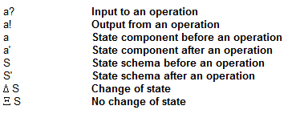
Z- Specification (Cont’d)
Operations are defined in a pre/post-condition style.
Symbol | Semantic

Slide 14
Reading Assignment
Go through chapter 3 of “Concise Guide to Formal Methods”
https://staff.washington.edu/jon/z/glossary.html

